Slide 1
Introduction to UML-B, UML-B Class Diagrams, UML-B Context Diagrams

Slide 2
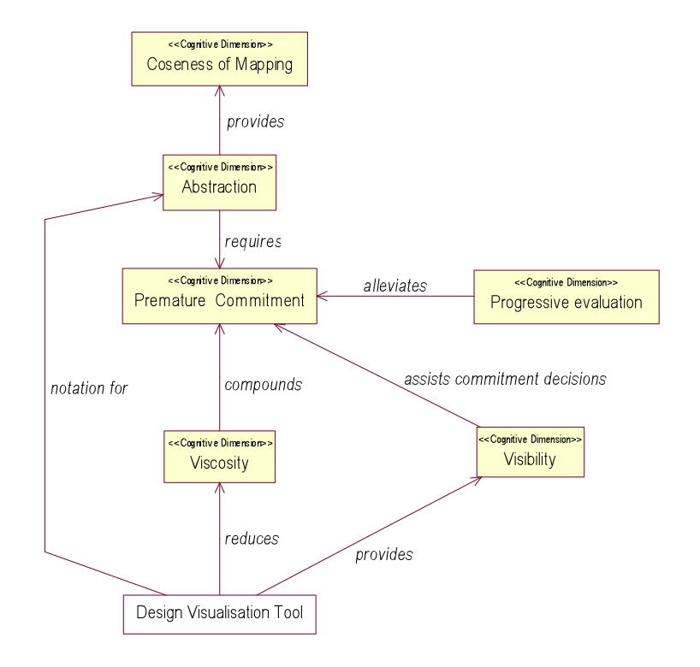
Cognitive Dimensions of Formal Notations
An analysis of the cognitive dimensions of a formal notation
and the effect of a visualisation tool
Cognitive Dimensions of Notations
(Thomas Green)
“provide a common vocabulary for discussing many factors in notation,
UI or programming language design”

Slide 3
Motivation
Provide a more approachable interface for newcomers to Event-B
Provide diagrams to help visualise models
Provide extra features to Event-B
N.b. not trying to formalise UML

Slide 4
What is UML-B?
A Graphical front-end for Event-B
Plug-in for Rodin
Not UML …
Has its own meta-model (abstract syntax)
Semantics inherited from translation to Event-B
… but it has some similarities with UML
Project Diagrams (something like package diagrams)
Class Diagrams
State Machine Diagrams
Translator generates Event-B automatically

Slide 5
What are the benefits?
Visualisation
Helps understanding
communication
Faster modelling (allows you to experiment)
One drawing node = several lines of B
Extra information inferred from position of elements
(e.g. if contained in a class or statemachine)
Experiment with different abstractions
Provides structuring constructs
Class
Event-B has no lifting mechanism
Hierarchical state-machines
Event-B has no event sequencing mechanism
finding useful abstractions is hard

Slide 6

Getting Started
Install UML-B using the Rodin update site
Help – Install, select the main Rodin update site, wait for it to retrieve the categories, select UML-B Modelling Environment under Modelling Extensions.
UML-B Perspective
UML-B New Project Wizard
Opens a project diagram for you
Add machines and contexts
Double click on a machine to open a class diagram
or on a context to open a context diagram
UML-B Menu
Enable automatic translation on every save
Disabled by default (Recommend leaving disabled for larger models)
UML-B toolbar button
Save and translate
Look for this icon

Slide 7
Class-oriented problems
In Event-B models, often find a pattern
Set I (or could be constant or variable)
Variables v ∈ I → T
Events e (i,..) =
when i ∈ I, …
then v(i) := x
I is a set of instances of a class
v is a set of values, one for each instance (a class attribute)
e is a ‘family’ of identical events to assign values to v (a class event)
I.e. trying to represent class-oriented problems

Slide 8
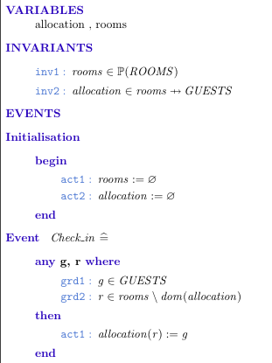
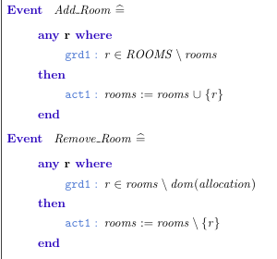
An Event-B model of a class-oriented problem
class
attribute (or association)
constructor
class event
destructor

Slide 9
Example - modelling with UML-B
In a university degree programme,
students are registered on degree courses.
Students must be enrolled to be registered in a course.
Courses can be removed from the degree programme.
There is no need to consider multiple degree programmes –
just assume we are modelling a single degree programme.

Slide 10
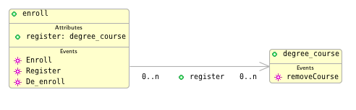
Example - modelling with UML-B
In a university degree programme,
students are registered on degree courses.
Students must be enrolled to be registered in a course.
Courses can be removed from the degree programme.

Slide 11
Example - modelling with UML-B
In a university degree programme,
students are registered on degree courses.
Students must be enrolled to be registered in a course.
Courses can be removed from the degree programme.
parameter: c ∈ degree_course
constructor
guard: self ↦ c ∉ register
action: register ≔ register ∪ {self ↦ c}
guard: register[{self}] = ∅
guard: register ▷ {self} = ∅

Slide 12
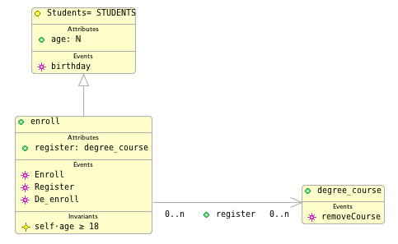
Adding an Invariant
Enrolled students must be 18.
guard: self⋅age ≥ 18
Translation: ∀self·((self∈enroll)⇒(age(self) ≥ 18))

Slide 13
UML-B Class Diagrams – Translation rules (part)
UML-B | Event-B
Class (variable instances) Class (fixed instances) Class (variable inst and has super class) Class (fixed inst and has super class) | Variable ⊆ Set Set Variable ⊆ SuperClass Constant ⊆ SuperClass
Attribute (card 0..n - 1..1) Attribute (card 0..n - 0..1) Attribute (card 0..n - 0..n) Etc. (try other cardinalities in UML-B) | Variable ∈ Class → Type Variable ∈ Class ⇸ Type Variable ∈ Class ↔ Type Etc.
Associations | As Attribute but Type is another class
Class Event | Event(self) WHEN self ∈ Class …
Class Constructor | Event(self) WHEN self ∈ SET\Class …
Class Invariant | ∀self·((self∈Class)⇒ Class invariant

Slide 14
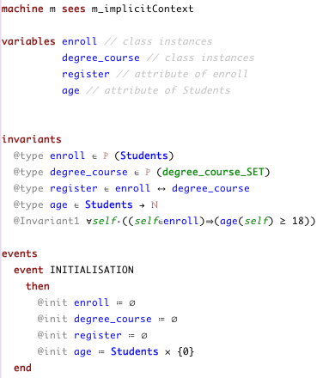
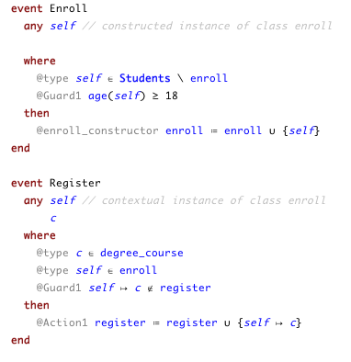
Example – Event-B produced by UML-B

Slide 15
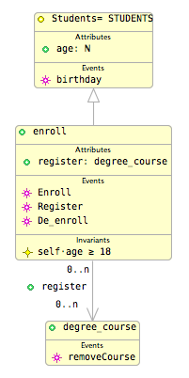
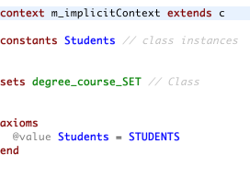
The ‘Implicit’ Context
Each class diagram creates an implicit context
Contains the ‘basis’ of things on the class diagram
e.g. a carrier set for the type of class instances

Slide 16
Context Diagrams
How can we model constants that belong to a class?
in Event-B our machine would see a Context
with sets, constants, axioms
UML-B takes a similar approach
Class Diagram (Machine) sees Context Diagram
Similar to a Class Diagram but translates to sets, constants and axioms
ClassType instead of Class
Constant Attributes/Associations represent constants
Axioms instead of Invariants
No Events

Slide 17
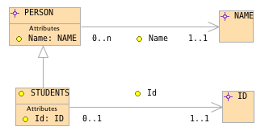
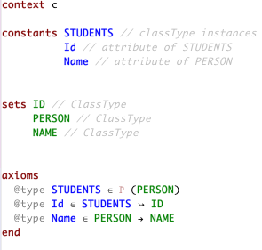
A Context Diagram and its translation

Slide 18
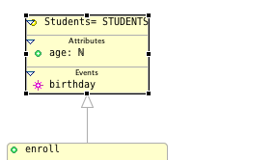
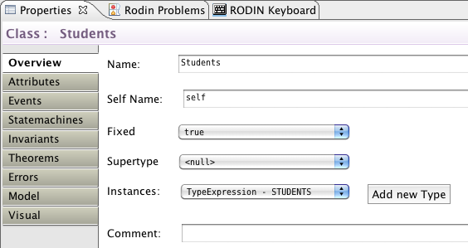
Linking a Class to a ClassType
1. select class
2. click button and enter
name of ClassType
3. select ClassType in
Instances combo

Slide 19

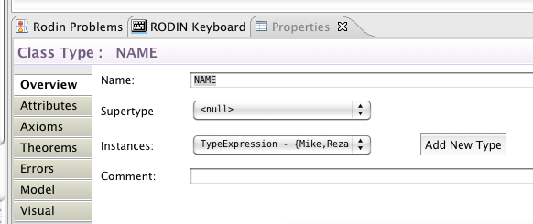
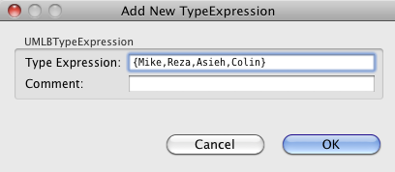
Enumerated Types
For real enumerated types e.g.
signal = {red, amber, green}
also, for restricting types to an example for model checking
4
1
3
2

Slide 20
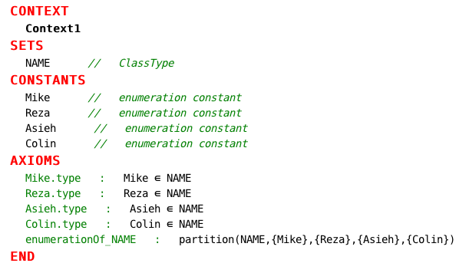
Enumerated Types

Slide 21
Summary
Project (package) diagrams show the machines and contexts and their relationships
Class diagrams for class-oriented modelling
automatically generates class structures in Event-B
Attribute and association cardinalities
Options for class instances
variable (constructors and destructors)
fixed
Automatically generates an ‘implicit context’
Context diagrams for class oriented modelling of sets, constants and enumerated types

