Slide 1


“Instantiating and Composing Event-B Specifications – Case-Study Experience”
Ali Gondal
Michael Poppleton, Michael Butler
School of Electronics & Computer Science
University of Southampton, UK

Slide 2
Outline
Motivation
Event-B (de)composition landscape
Towards feature-based modelling in Event-B
Production cell case-study
ATM case study
Future work

Slide 3
Motivation
How to develop/exploit reuse with Event-B ?
Develop “feature-oriented” working from FOSD community
Towards flexible, domain-specific modelling refinement & composition -> product developments
Towards formal modelling & verification of SPLs (Software Product Lines)
Experimenting with decomposition and composition (sh-event and sh-variable), and generic instantiation to this end …

Slide 4
“Feature” – some definitions:
Bosch et al “A logical unit of behaviour specied by a set of functional and non-functional requirements.”
Chen et al “a product characteristic from user or customer views, which essentially consists of a cohesive set of individual requirements”
Batory “elaboration or augmentation of an entity(s) that introduces a new service, capability or relationship”
Batory et al “an increment in product functionality”

Slide 5
BIG methodological issue:
Refinement is top-down
and hierarchic
Feature-orientation is bottom-out, generative
and anarchic (?)

Slide 6
Publications
Poppleton, M.: Towards feature-oriented specification and development with Event-B, REFSQ 2007 (LNCS)
Poppleton, M.: The composition of Event-B models, ABZ2008 (LNCS)
Poppleton, M, Fischer, B, Franklin, C, Gondal, A, Snook, C, Sorge, J: Towards Reuse with “Feature-Oriented Event-B”, MCGPLE 2008
Gondal, A, Poppleton, M, Snook, C: Feature Composition - towards product lines of Event-B models, MDPLE 2009
Gondal, A, Poppleton, M, Butler, M, Snook, C: Formal Software Product Line Modelling Using Event-B, SETP 2010
Gondal, A, Poppleton, M, Butler, M: Composing Event-B Specifations - Case-Study Experience, SC11 (LNCS in press)

Slide 7
Decomposition Techniques
Shared variable decomposition (SVD)*
Problem decomposition at higher abstraction level
Asynchronous shared-memory communication
Shared event decomposition (SED)*
Solution decomposition at lower abstraction level
Architectural decomposition
Synchronous message passing
* Tool support available

Slide 8
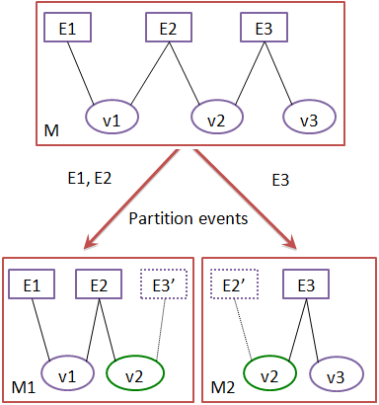
Shared-variable decomposition

Slide 9
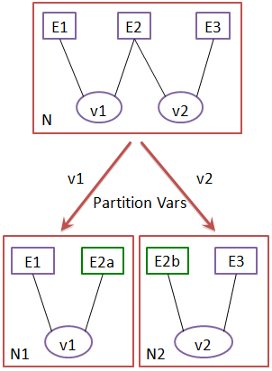
Shared-Event decomposition

Slide 10
Composition
Shared variable composition (SVC)
Shared event composition (SEC)*
Fusion Composition
Motivation: assemble and configure features in a SPL domain
Conjunction of models with possibly shared variables; extends SEC
Distinct from SVC: allows fusion of events
Proposed in [2], to be investigated
Feature Composition [4, 5]*
Unconstrained model composition via syntactic cut & paste
* Tool support available
Notes:
- Shared-event decomposition is about splitting a model into component
parts, where variables are partitioned across components, and any event
e(v,w) where v,w are in different components M1, M2, is split into
synchronously-communicating parts e1 and e2.
e1 and e2 thus communicate value between v and w
- Fusion is a composition of models, defined for common variables. The
fusion e of two events e1 and e2 is constructed by conjoining the guards
and concatenating the actions. This does require there to be sufficient
nondeterminism in e1 and e2, and common transitions, in order for e to be
feasible.
- The point is about composition of "features" i.e. distinct viewpoints of
behaviour on common (or overlapping) frames

Slide 11
Feature Modelling
Feature in Event-B:
For now: machine or refinement with zero or more contexts
Ideally: partial or complete development tree
For now: treat refinements as separate, related features
Notes:
- This is about units for feature composition. For the plugin its a single
model or refinement, including seen contexts (which are simply
concatenated)
- Ideally we would regard a whole development as a feature unit for
composition (but are a long way from that today)

Slide 12
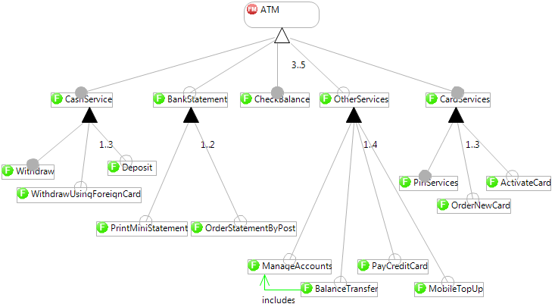
Feature Modelling Example

Slide 13
Feature modelling and configuration tools*
Build a feature model for a product line (PL)
e.g. Automobile, Mobile Phones, ATM etc.
syntax checking of feature model
Configure the model to build a specific product
Select desired features from the feature model
Link in underlying Event-B “features”
Identify any conflicts and constraints
Resolve, compose these Event-B features to build the product instance
* Under development, based on existing Feature composition plugin
http://wiki.event-b.org/index.php/Feature_Modelling_Tool

Slide 14
Feature modelling Process
Configure fm
Construct & validate fm
product instance
Resolve conflicts & compose features

Slide 15
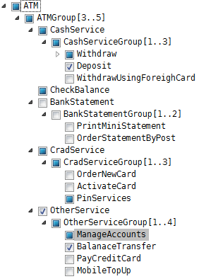
Feature Model Configuration
Notes:
TODO: Add fig for ATM configuration example

Slide 16
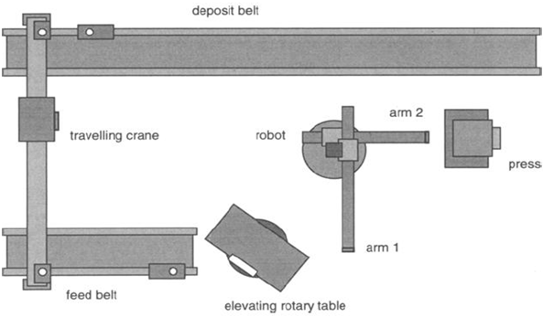
Production Cell (PC) Example

Slide 17
Production Cell (PC) Example
Modelled in two ways:
Component-based PC (top-down)
Modelled each physical component of PC
Feed belt, Table, Robot, Press, Deposit Belt, Crane
Controller-based PC (middle-out)
Modeled various controllers of the plant
Loader, Movement, Rotation, Magnet controller
i.e. two orthogonal feature-structured views

Slide 18
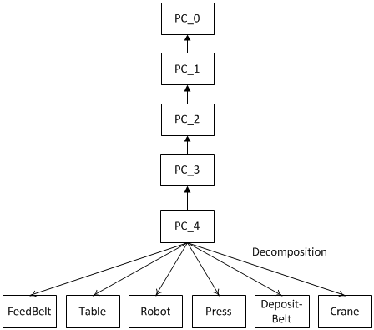
Physical component-based PC

Slide 19
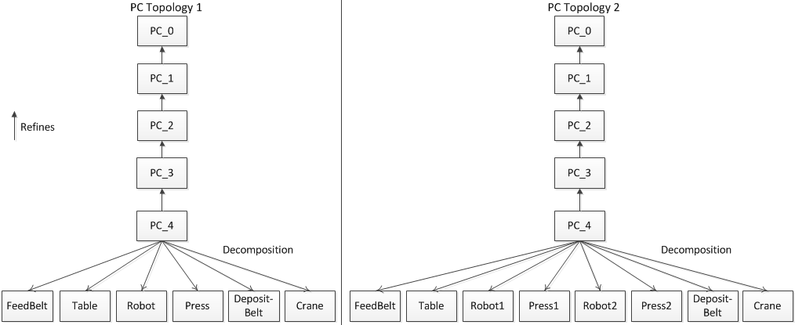
- PC Topology 2 is a result of instantiation and refactoring of PC Topology 1
- All POs of Topology 2 were discharged in the same way as Topology 1

Slide 20
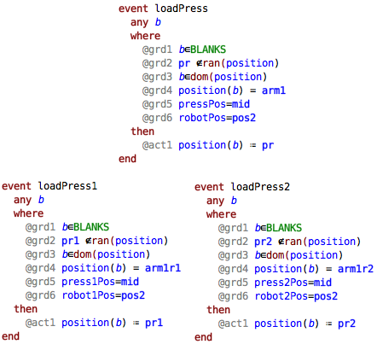
PC – topology, event instantiation
Notes:
- Its not entirely trivial: topology 2 is the addition of a second
robot/press pair to the production cell.
Slide2 22-23 show the difference
in terms of events communicating between processing elements:
second robot/press pair is interspersed between first robot/press pair and
deposit belt.
Thus slide 20 is duplication of a press event, slide 21 the refactoring

Slide 21
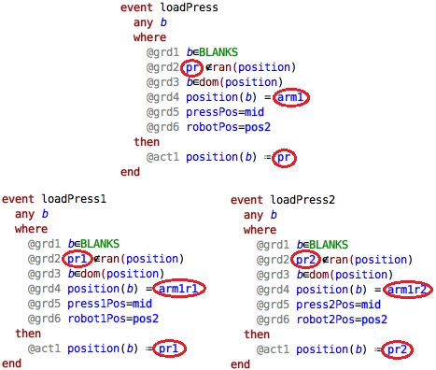
PC – topology, event instantiation

Slide 22
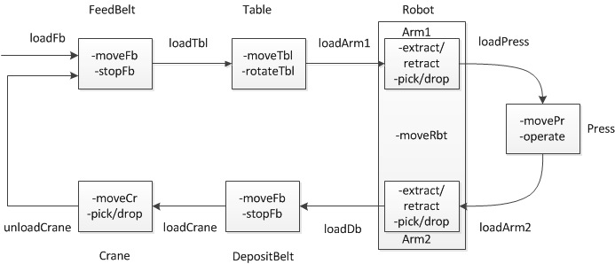
PC – topology 1, events: graphic view

Slide 23
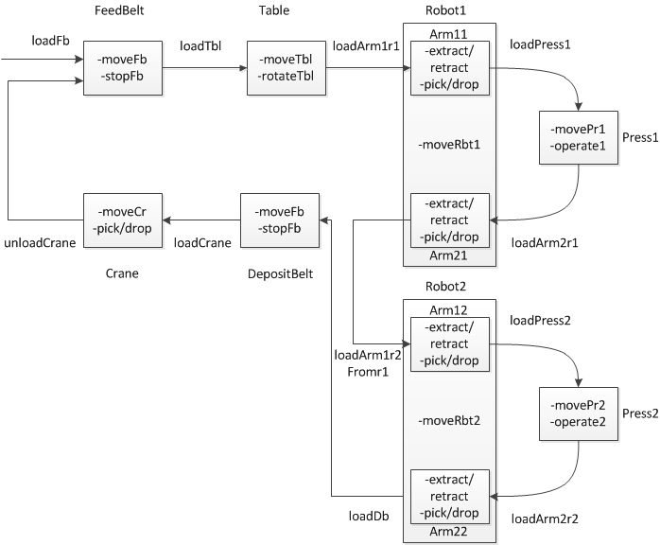
PC – topology 2, events: graphic view

Slide 24
PC – topology 1, events: input to generic instantiation

Slide 25
PC – topology 1, events: generic instantiation as toplogy 2

Slide 26
Component-based PC: genericity
What we did:
Structured-copy & refactor of events, change topology by refactoring cpt names & attributes
What we could do:
Start from other abstractions
Make domain-specific tooling
Consider a larger-variability PL: consider defining topology in context, elaborate data structures in model to instantiate from context, e.g.

Slide 27
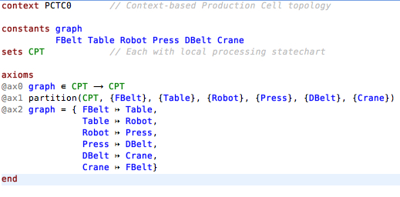
Context-based Production Cell topology
Recall Bosch mini-pilot: switch/pushbutton/n-way switch
Towards a metamodel for a domain-specific product line ?

Slide 28
 | PC Topology 1 | PC Topology 2
Ref. level | Auto | Manual | Reviewed | Total | Total | Auto | Manual | Reviewed
PC-0 | 3 | - | - | 3 | 6 | 6 | - | -
PC-1 | 36 | 1 | - | 37 | 56 | 55 | 1 | -
PC-2 | 22 | 4 | - | 26 | 26 | 16 | 10 | -
PC-3 | 41 | 4 | - | 45 | 59 | 55 | 4 | -
PC-4 | 10 | - | - | 10 | 8 | 8 | - | -
PC-5 | 84 | - | - | 84 | 190 | 188 | 2 | -
PC-6 | 20 | - | - | 20 | 40 | 40 | - | -
PC-7 | 188 | - | 8 | 196 | 432 | 401 | 11 | 20
Total | 404 | 9 | 8 | 421 | 817 | 769 | 28 | 20

Slide 29
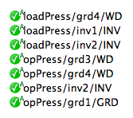
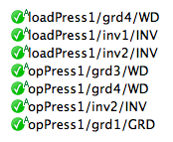
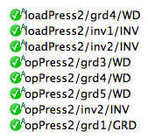
Topology-1
Only renames Press to Press1
Renames Press to Press2*
Topology-2
* 1 extra PO as a result of additional guard in the model to ensure that opPress2 happens after opPress1.
Notes:
- The point is PO/proof reuse. Effectively all load/opPress1,
load/opPress2 POs in top'y 2 are just refactors of the corresponding top'y
1 PO's. With addition of a new PO on opPress2 to do with event sequencing.
There's no auto-support today for such proof reuse but there could be ...

Slide 30
Topology-1
Only renames Press to Press1
Renames Press to Press2*
Topology-2
* 1 extra PO as a result of additional guard in the model to ensure that opPress2 happens after opPress1.
Notes:
- The point is PO/proof reuse. Effectively all load/opPress1,
load/opPress2 POs in top'y 2 are just refactors of the corresponding top'y
1 PO's. With addition of a new PO on opPress2 to do with event sequencing.
There's no auto-support today for such proof reuse but there could be ...

Slide 31
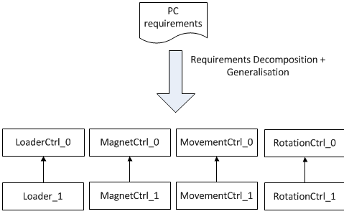
Controller-based PC
Notes:
- Earlier slides discuss a physical component-based decomposition of the
prod cell. Also a 2nd topology of said components.
Now, These slides decompose in a different way: functionally. 4 different
"controllers" for each component: loader/magnet/movement/rotation.

Slide 32
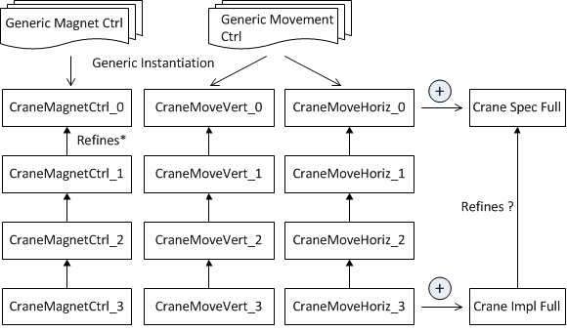
Crane Instantiation using generic PC controllers
Notes:
Each of
these (s32) has a generic development, which must be instantiated for a
specific component. Thus crane = magnetCtl + vertMoveCtl + horizMoveCtl.
Then the models (at each refinement level) are manually composed to give a
crane development, which must be fully proved. Preservation of
refinement/proof reuse much more problematic in this scenario

Slide 33
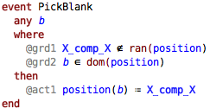
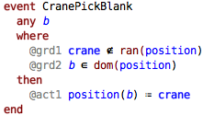
Event specialization Example
Notes:
X_Š_X syntax to denote generic identifiers for instantiation

Slide 34
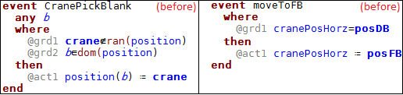
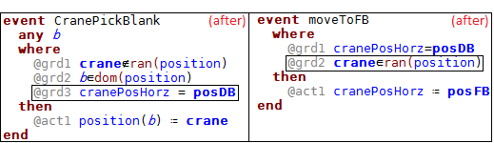
Guard Strengthening Example
Notes:
guard strengthening is one of the manipulations required in doing
the manual compostion

Slide 35
ATM Case-study

Slide 36
ATM Case-study
Modelled two ATM features
Cash Deposit
Balance Transfer
Glossary:
SVD – Shared-Variable Decomposition
SED – Shared-Event Decomposition
SVC – Shared-Variable Composition
SEC – Shared-Event Composition

Slide 37
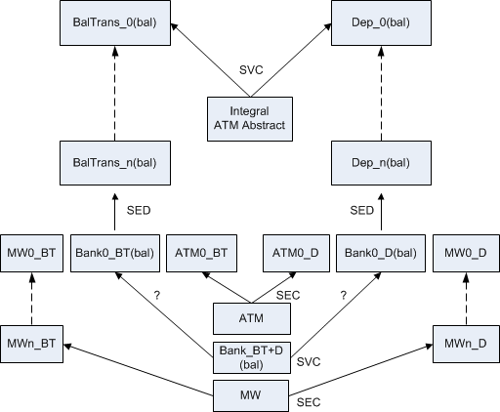
(De)Compose for external events
Started with separate feature refinements
Architectural Decomp
Architectural Composition
Notes:
integral ATM model is SVD-decomposed into features
Such feautures are refined then each decomposed SED into architectural
subcomponents - here its balanceTransfer and deposit - for bank code,
middleware code, ATM code
Then the subcomponents are architecturally recomposed - bank/mw/ATM bits

Slide 38
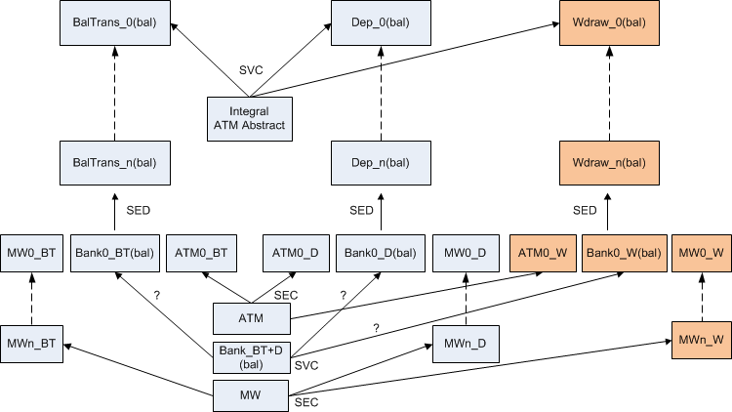
Notes:
how you make a new feature in such a framework: invent it
(Wdraw_0) such that its an abstraction of updated integral ATM abstract
model.
Obviously such update to integral model to minimally disrupt the
existing (blue) picture, ideally just adding new external events.
Then proceed down with pink refinements etc
? denotes compositions yet to be proved correct by construction - but from
practice they look OK

Slide 39
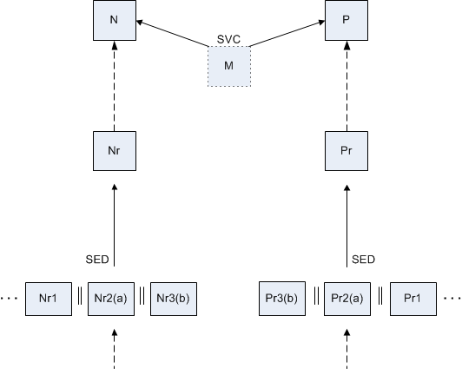
Notes:
- s39-41 generalises this story

Slide 40
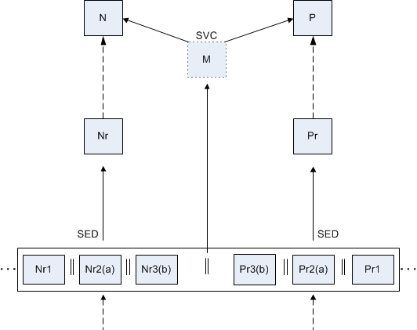

Slide 41
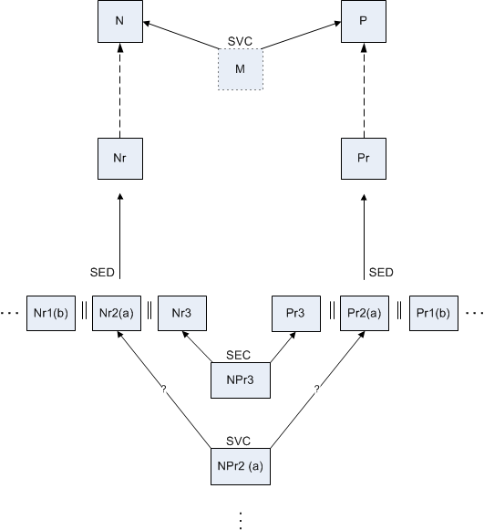

Slide 42
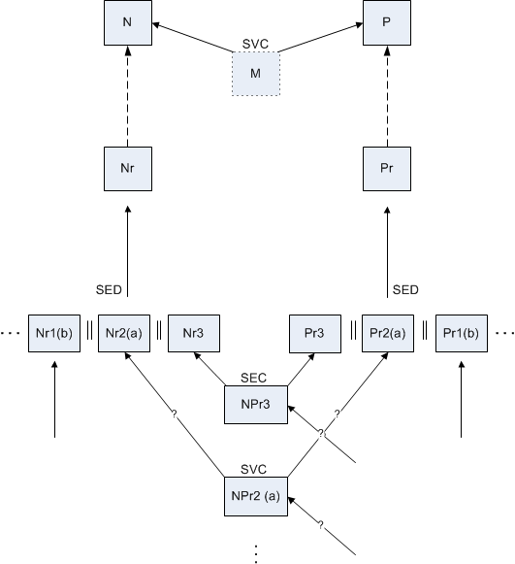
Notes:
- s42 talks about more refinement/development at the bottom of the picture

Slide 43
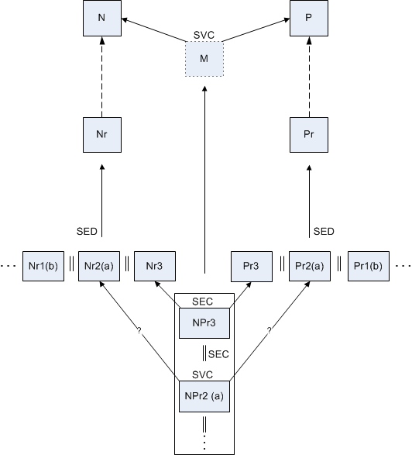

Slide 44
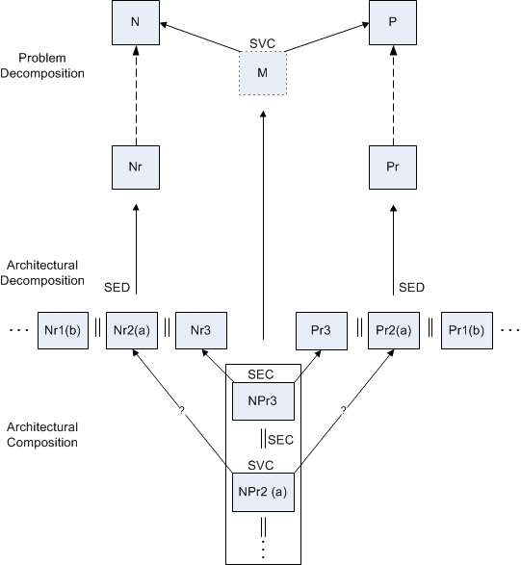

Slide 45
Conclusion
In two case studies we
Explored the question: How close can we get to feature-based modeling with standard Event-B techniques ?
Mixed two styles of (de)composition, thus preserving refinement
Explored generic instantiation (via Feature composition tool)
Generated lots more method and tool requirements!

Slide 46
Future Work
Theory: explore mixed working with SVD, SED, SVC, SEC, Fusion - globally and locally – prove refinement preservation
Case studies: explore mixed working with SVD, SED, SVC, SEC, Fusion - globally and locally
Case studies: explore generic instantiation & composition patterns and associated PO transformations in search of proof reuse
Tool support for all this!
Guidelines for feature-based modelling in Event-B

Slide 47
Questions?

