Slide 1
Text & Sentiment Analysis
DataViz: Final Project, Dana Westley

Slide 2
Research Questions
How do people talk about social issues?
What other major topics do people mention when posting about social issues?
How has the sentiment of people tweeting about these issues changed in the first 30 days of Trump’s presidency?

Slide 3

Project – Twitter Mining
Pull 1,000 tweets mentioning search terms related to each issue daily, 9,000 tweets a day
~90,000 Tweets per Social Issue
Social Issues & Search Terms
Racism
“Racism” “Racial+Justice” “Race+America”
Religious Freedom
“Religious+Freedom” “Freedom+Religion”“War+Religion”
Women’s/Gender Issues
“Womens+Rights” “Gender+Rights” “Gender+Equality”

Slide 4
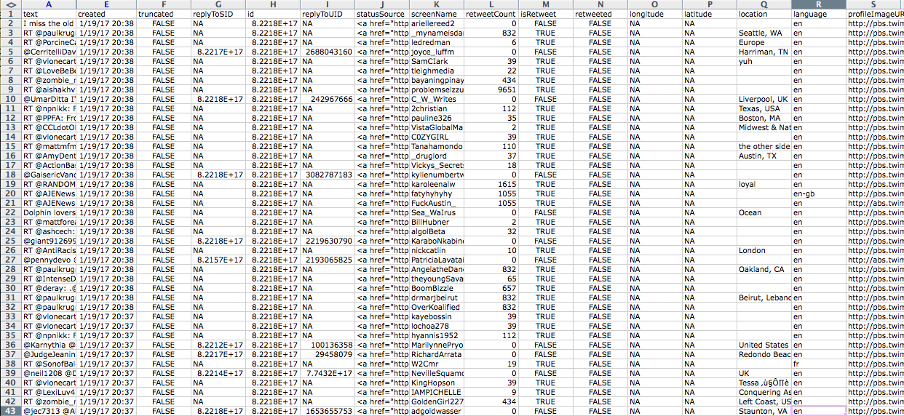
What the Data Looks Like

Slide 5

Analyses
Part 1: Content Analysis
Used tidytext to tokenize by words and create a count
Common themes across mentions of topics of interest
Ex: Trump was in the top 3-4 most common words for ALL issues (after removing highly common stop words like “rt” and “https”)

Slide 6

Analyses
Part 2: Sentiment Analysis
Most common positive/negative terms used
Using tidytext again, joined Bing word database with positive/negative lexicons to my own data
Are there common terms in tweets about these positive/negative?
Answer: Depends on the issue….. (ex: “racist” for race and not others)

Slide 7


Analyses
Part 3: Change Over Time
Aggregate data to find mean, melt using reshape2
Are people’s tweets about these positive/negative?
Answer: Depends on the issue (again!)
Tweets about race had a higher average negative daily word count than either religion or gender, which both had higher positive daily word counts overall

