Slide 1
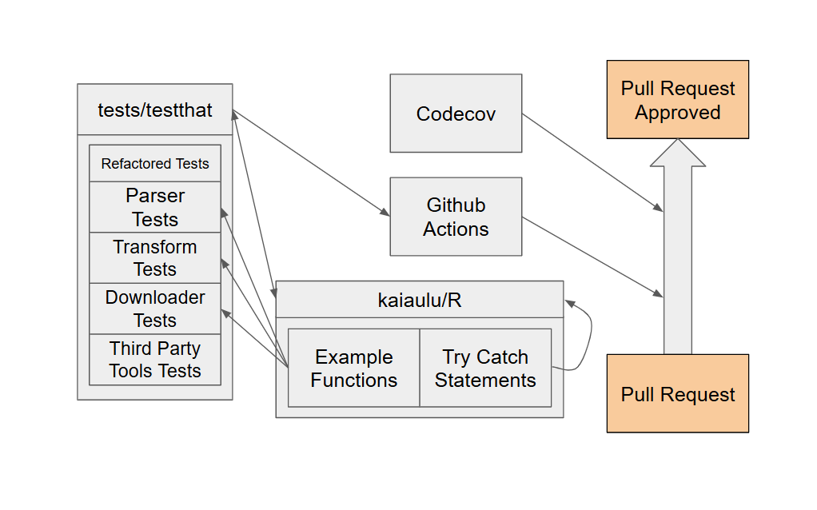

Slide 2
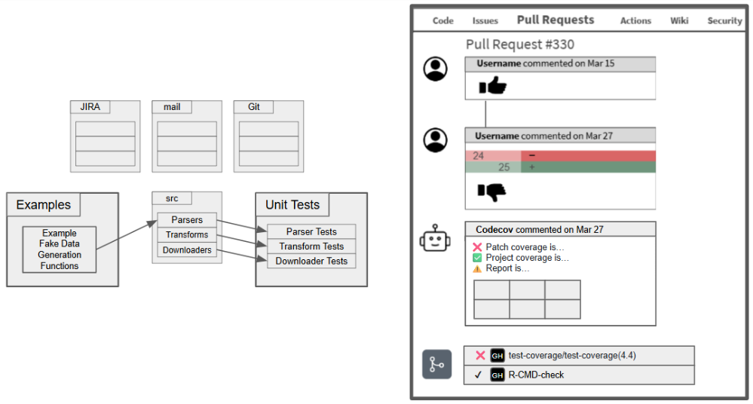

Slide 3
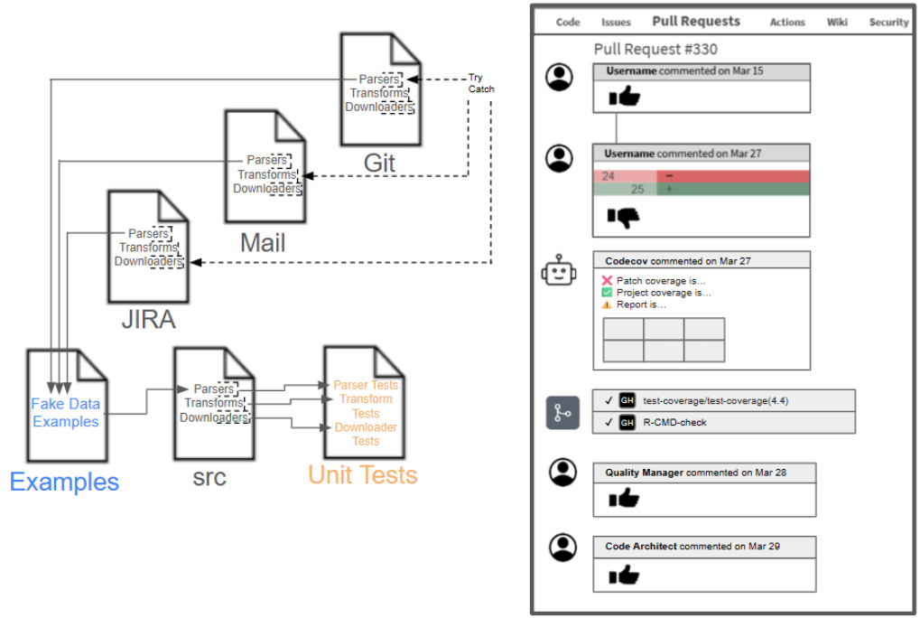

Slide 4
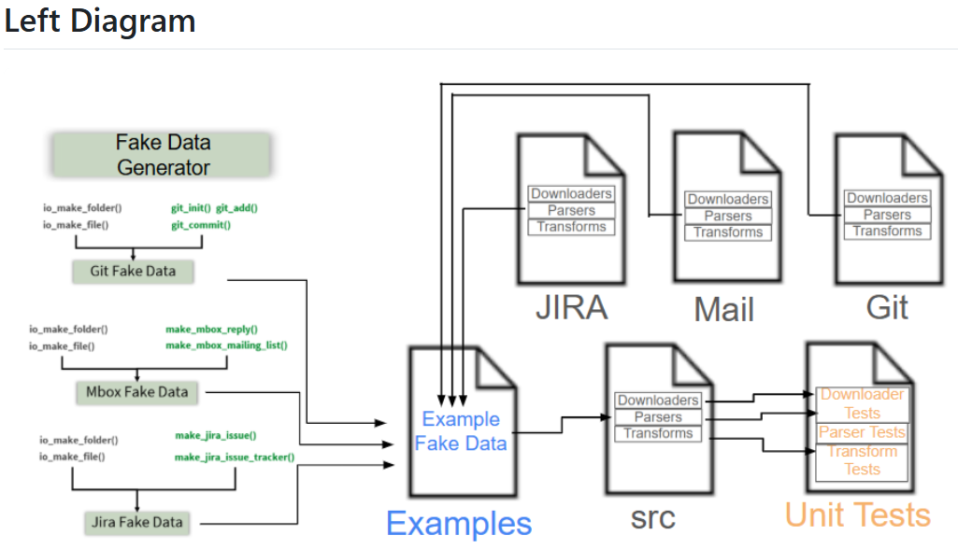
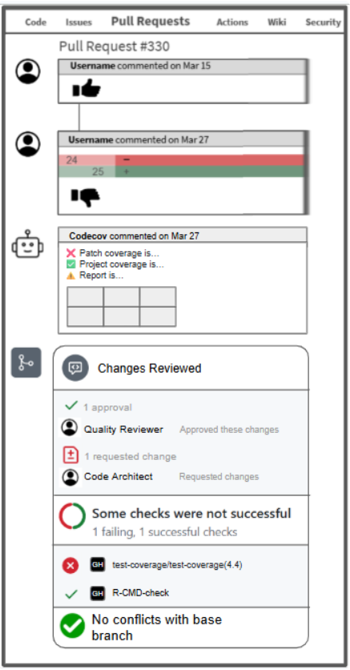
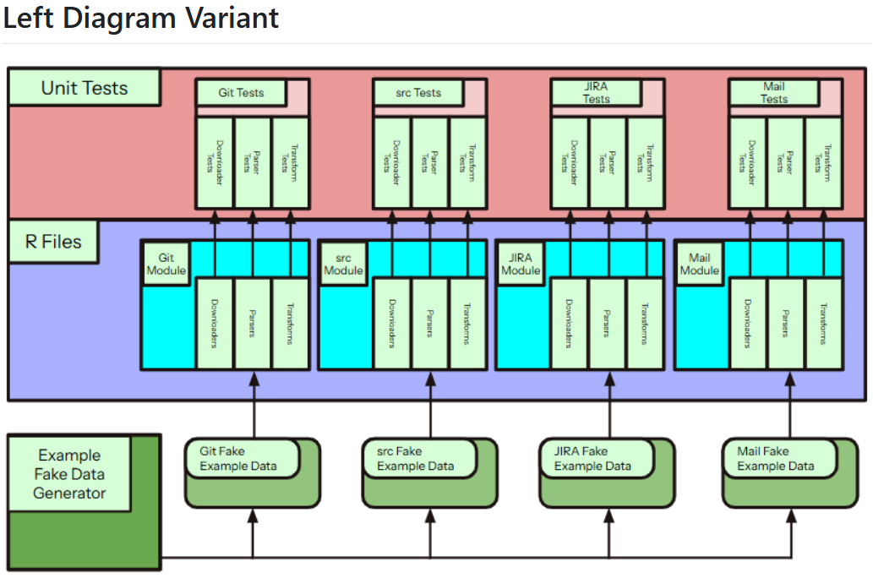

Slide 5


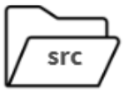
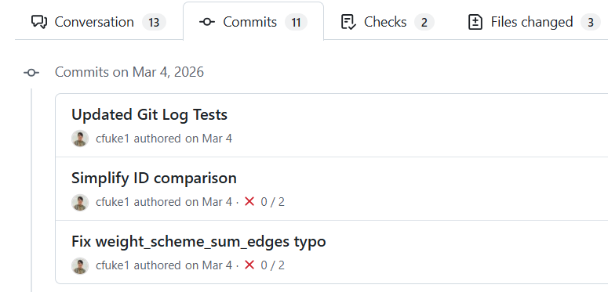
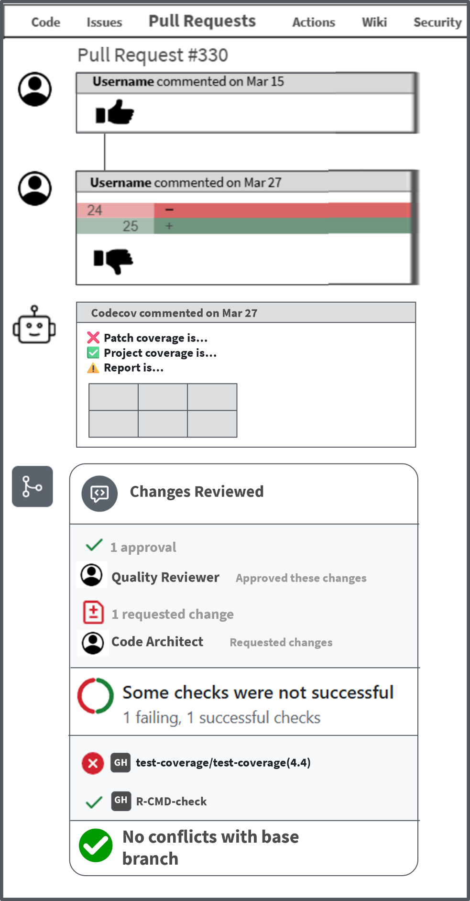





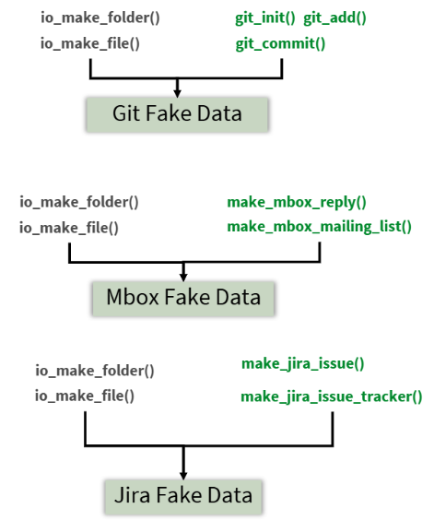

Unit Tests : : CHEAT SHEET
About
Code Quality
GitHub Actions
GH
Tests
test-coverage/test-coverage(4.4)
GitHub Actions
Commits
Commits on Mar 8, 2026
Create new transform tests
Commit # 1cd3f7c
Commit # e637da5
Commit # 18f1d2d
Username authored on Mar 8
…
Add new Example function
GH
Username authored on Mar 8
Fix edge case in parser
Username authored on Mar 8
Fake Data Generator
Unit Tests
Fake Data Generator
JIRA.R
Mail.R
Git.R
Example Fake Data
Downloader Tests
Parser Tests
Transform Tests
Examples
src.R
Tests
Kaiāulu
CC BY SA Ruben Jacobo, Waylon Ho, Carlos Paradis • Kaiaulu package version 0.0.0.9600 (in development) • Updated: 2023-12

Slide 6

Unit Tests : : CHEAT SHEET
About
Code Quality
Unit Tests
GH
Fake Data Generator
Git.R
…
Mail.R
src.R
Downloaders
function()
…
Parsers
function() …
function() …
function() …
Fake Data Generator
JIRA.R
JIRA.R
testthat
Example Fake Data
Tests/**
Example.R
Kaiāulu
CC BY SA Ruben Jacobo, Waylon Ho, Carlos Paradis • Kaiaulu package version 0.0.0.9600 (in development) • Updated: 2023-12

Slide 7





Fake Data Generator : : CHEAT SHEET
About
Fake Examples
The fake data generators provide API to create minimal reproducible examples (MRE) capturing unusual project data to unit test Kaiaulu data parsers. They can also be used to compare equivalent analyses to other tools, and different versions of the same tool.
Pull Requests
Code Issues Pull Requests Actions Wiki Security
Pull Request #330
Username commented on Mar 15
Unit Tests
…
Downloaders
function() …
function() …
function() …
Codecov commented on Mar 27
Parsers
❌ Patch coverage is…
✅ Project coverage is…
⚠️ Report is…
Downloaders
function() …
function() …
function() …
Downloaders
function() …
function() …
function() …
Transforms
function() …
function() …
function() …
Parsers
function() …
function() …
function() …
Parsers
function() …
function() …
function() …
Mail.R
function() …
function() …
function() …
Transforms
Fake Data Generator
Transforms
function() …
function() …
function() …
function() …
function() …
function() …
JIRA.R
Fake Data Generator
src.R
Fake Data Generator
Changes Reviewed
Downloaders
function() …
function() …
function() …
1 approval
Parsers
Quality Reviewer Approved these changes
function() …
function() …
function() …
1 requested change
Transforms
function() …
function() …
function() …
Code Architect Requested changes
Git.R
Fake Data Generator
Example Fake Data
GH
testthat
test-coverage/test-coverage(4.4)
GH
Example.R
Tests/**
R-CMD-check
No conflicts with base branch
Kaiāulu
CC BY SA Ruben Jacobo, Waylon Ho, Carlos Paradis • Kaiaulu package version 0.0.0.9600 (in development) • Updated: 2023-12

Slide 8
Unit Tests : : CHEAT SHEET
About
Code Quality
Kaiaulu has multiple measures in place to ensure that its codebase remains stable. These include
Unit Tests
Codecov
GitHub Actions
Example Functions
Internal Try Catch Statements
Codecov is the first tool in a Pull Request that is responsible for code quality. It scans the coverage files generated from the ‘covr’ R package, which displays what percentage of the codebase has been tested for, by scanning the output from testthat. Based on how it is configured, Codecov can automatically deny Pull Requests from merging if the coverage is too little.
Manual review by a designated Quality Reviewer catches code that is dependent on the writer’s personal setup. The Quality Reviewer is responsible for running committed code on their own machine and verifying that it is running as intended.
Manual review by a designated Code Architect catches consistency issues between what is in the committed code, and the code that already exists in the files.
All unit tests in Kaiaulu are ran for every commit in a Pull Request by using GitHub Actions. GitHub Actions creates a simulated test environment by downloading all required third party tools and running all the tests in the testthat folder. If any test were to fail, GitHub Actions will state which one it was as well as its error output, and the Pull Request would be unable to be merged to the master branch. This ensures that no error-causing code can be merged to the master branch, causing future issues.
Fake Data Examples
In order to create easily reproducible tests, Kaiaulu’s R function files contain Fake Data Generation functions. These functions can create fake data, which is utilized in Example.R. This file contains functions which use the fake data functions to easily reproduce raw data that creates odd behavior in Kaiaulu. This, in turn, allows the data to be called by the unit tests, and ensures that users will not have to deal with that same erroneous case ever again.
Code Issues Pull Requests Actions Wiki Security
Pull Request #330
Username commented on Mar 15
R/**
…
Downloaders
Codecov commented on Mar 27
Unit Tests & Try Catch
function() …
function() …
function() …
❌ Patch coverage is…
✅ Project coverage is…
⚠️ Report is…
Parsers
Kaiaulu’s native R code takes the form of three types of functions:
Downloaders download raw data from a website
Parsers change the downloaded data into parsed R tables
Transforms change the parsed data into parsed node and edge lists, and then present the data in the form of a graph specified by the user
Each of these functions need to be tested for in different ways:
Downloaders require a fake URL to be generated in order to be tested for
Parsers require fake data, and due to being the functions most prone to receiving odd raw data from users, need to be thoroughly tested for in order to ensure their stability
Transforms also require fake data, but the relationships between the nodes and edge tables should be tested for the most
The Try Catch statements in Kaiaulu ensure that functions don’t return confusing errors to users that don’t make sense. They are primarily used in command line wrapper functions. That way, instead of being returned an unfamiliar error in the form of an R warning, the function explicitly states to the user what they did wrong.
Downloaders
function() …
function() …
function() …
Downloaders
function() …
function() …
function() …
Transforms
function() …
function() …
function() …
Parsers
function() …
function() …
function() …
Parsers
function() …
function() …
function() …
Mail.R
function() …
function() …
function() …
Transforms
Fake Data Generator
Transforms
function() …
function() …
function() …
function() …
function() …
function() …
Changes Reviewed
JIRA.R
Fake Data Generator
src.R
Fake Data Generator
Downloaders
1 approval
function() …
function() …
function() …
Quality Reviewer Approved these changes
Parsers
function() …
function() …
function() …
1 requested change
Transforms
Code Architect Requested changes
function() …
function() …
function() …
Git.R
Fake Data Generator
Example Fake Data
GH
testthat
test-coverage/test-coverage(4.4)
GH
R-CMD-check
Example.R
Tests/**
No conflicts with base branch
Kaiāulu
CC BY SA Ian Jaymes Iwata, Anthony Lau, Sean Sunoo, Carlos Paradis • Kaiāulu package version 0.0.0.9700 (in development) • Updated: 2024-04

Slide 9



Unit Tests : : CHEAT SHEET
About
Try Catch + Code Quality
Pull Request
PR
Kaiaulu has multiple measures in place to ensure that its codebase remains stable. These include
Unit Tests
Codecov
GitHub Actions
Example Functions
Internal Try Catch Statements
GitHub Actions
Quality Manager
Code Architect
Parsers
Codecov
GH
Downloaders
function()
try
…
…
…
…
…
catch
function()
…
function() …
function() …
function() …
Parsers
Return error + comprehensible explanation
function() …
function() …
function() …
PR
PR
✅
PR
Transforms
Pull Request
Approved
function() …
function() …
function() …
New Commit
Pull Request
Denied
Fake Data Examples
Fake Data Generator
Mail.R
Code Issues Pull Requests Actions Wiki Security
In order to create easily reproducible tests, Kaiaulu’s R function files contain Fake Data Generation functions. These functions can create fake data, which is utilized in Example.R. This file contains functions which use the fake data functions to easily reproduce raw data that creates odd behavior in Kaiaulu. This, in turn, allows the data to be called by the unit tests, and ensures that users will not have to deal with that same erroneous case ever again.
Pull Request #330
Username commented on Mar 15
R/**
Downloaders
…
function() …
function() …
function() …
Parsers
function() …
function() …
function() …
Codecov commented on Mar 27
Transforms
❌ Patch coverage is…
✅ Project coverage is…
⚠️ Report is…
function() …
function() …
function() …
Downloaders
Mail.R
function() …
function() …
function() …
Fake Data Generator
Downloaders
Unit Tests
Parsers
function() …
function() …
function() …
function() …
function() …
function() …
Parsers
Transforms
function() …
function() …
function() …
function() …
function() …
function() …
Transforms
Kaiaulu’s native R code takes the form of three types of functions:
Downloaders download raw data from a website
Parsers change the downloaded data into parsed R tables
Transforms change the parsed data into parsed node and edge lists, and then present the data in the form of a graph specified by the user
Each of these functions need to be tested for in different ways:
Downloaders require a fake URL to be generated in order to be tested for
Parsers require fake data, and are prone to receiving odd raw data from users, so they need to be thoroughly tested for in order to ensure their stability
Transforms also require fake data, but the relationships between the nodes and edge tables should be tested for the most
JIRA.R
function() …
function() …
function() …
Changes Reviewed
Fake Data Generator
src.R
Fake Data Generator
Downloaders
1 approval
function() …
function() …
function() …
Quality Reviewer Approved these changes
Parsers
function() …
function() …
function() …
1 requested change
Transforms
Code Architect Requested changes
function() …
function() …
function() …
Git.R
Fake Data Generator
Example Fake Data
GH
testthat
test-coverage/test-coverage(4.4)
GH
R-CMD-check
Example.R
Tests/**
No conflicts with base branch
Kaiāulu
CC BY SA Ian Jaymes Iwata, Anthony Lau, Sean Sunoo, Carlos Paradis • Kaiāulu package version 0.0.0.9700 (in development) • Updated: 2024-04

Slide 10
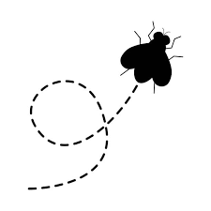
Unit Tests : : CHEAT SHEET
Pull Request
PR
About
Try Catch + Code Quality
Kaiaulu has multiple measures in place to ensure that its codebase remains maintainable. These include:
Unit Tests
Codecov
GitHub Actions
Example Functions
Internal Try Catch Statements
GitHub Actions
Quality Manager
Code Architect
Codecov
GH
Downloaders
function() …
function() …
function() …
Parsers
function() …
function() …
function() …
PR
✅
PR
Transforms
Pull Request
Approved
function() …
function() …
function() …
New Commit
Pull Request
Denied
Example Module
Fake Data Generator
Mail.R
Code Issues Pull Requests Actions Wiki Security
In order to create easily reproducible tests, Kaiaulu’s R function files contain Fake Data Generation functions. These functions can create fake data, which is utilized in Example.R. This file contains functions which use the fake data functions to easily reproduce raw data that creates odd behavior in Kaiaulu. This allows the data to be called by the unit tests, which ensure that users will not have to deal with that same erroneous case ever again.
Pull Request #330
Username commented on Mar 15
R/**
Downloaders
…
function() …
function() …
function() …
Parsers
function() …
function() …
function() …
Codecov commented on Mar 27
Transforms
❌ Patch coverage is…
✅ Project coverage is…
⚠️ Report is…
function() …
function() …
function() …
Downloaders
Mail.R
function() …
function() …
function() …
Fake Data Generator
Downloaders
Unit Tests
Parsers
function() …
function() …
function() …
function() …
function() …
function() …
Parsers
Transforms
function() …
function() …
function() …
function() …
function() …
function() …
Transforms
Kaiaulu’s native R code takes the form of three main types of functions:
Downloaders download raw data from a website
Parsers change the downloaded raw data into parsed R tables
Transforms change the parsed data into parsed node and edge lists, and then present the data in the form of a graph specified by the user
Each of these functions need to be tested for in different ways:
Downloaders require a fake URL to be generated in order to be tested for
Parsers require fake data, and are prone to receiving odd raw data from users, so they need to be thoroughly tested for in order to ensure their stability
Transforms also require fake data, but the relationships between the nodes and edge tables should be tested for the most
JIRA.R
function() …
function() …
function() …
Changes Reviewed
Fake Data Generator
src.R
Fake Data Generator
Downloaders
1 approval
function() …
function() …
function() …
Quality Reviewer Approved these changes
Parsers
function() …
function() …
function() …
1 requested change
Transforms
Code Architect Requested changes
function() …
function() …
function() …
Git.R
Fake Data Generator
Example Fake Data
GH
testthat
test-coverage/test-coverage(4.4)
GH
R-CMD-check
Example.R
Tests/**
No conflicts with base branch
Kaiāulu
CC BY SA Ian Jaymes Iwata, Anthony Lau, Sean Sunoo, Carlos Paradis • Kaiāulu package version 0.0.0.9700 (in development) • Updated: 2024-04

Slide 11
Unit Tests : : CHEAT SHEET
About
Failing Gracefully: Try Catch
Kaiaulu has multiple measures in place to ensure that its codebase remains maintainable. These include: Unit Tests
Codecov
GitHub Actions
Example Functions
Internal Try Catch Statements
Pull Request Work Flow
Anchor: In practice, the process happens in the Pull Request.
- Explain the full code review pipel
Incorrect Git Log
Path specified
Example Module
Kaiaulu’s native R code takes the form of three main types of functions:
Downloaders download raw data from a website
Parsers change the downloaded raw data into parsed R tables
Transforms change the parsed data into parsed node and edge lists, and then present the data in the form of a graph specified by the user
Each of these functions need to be tested for in different ways:
Downloaders require a fake URL to be generated in order to be tested for
the nodes and edge tables should be tested for the most
In order to create easily reproducible tests, Kaiaulu’s R function files contain Fake Data Generation functions. These functions can create fake data, which is utilized in Example.R. This file contains functions which use the fake data functions to easily reproduce raw data that creates odd behavior in Kaiaulu. This allows the data to be called by the unit tests, which ensure that users will not have to deal with that same erroneous case ever again.
Code Issues Pull Requests Actions Wiki Security
Pull Request #330
Username commented on Mar 15
…
Codecov commented on Mar 27
❌ Patch coverage is…
✅ Project coverage is…
⚠️ Report is…
Unit Tests
Anchor: Kaiaulu has many modules but under the hood, they are downloaders, parsers, and transforms and hey can be tested in the same manner.
Code Review Work Flow
Changes Reviewed
In order to create easily reproducible tests, Kaiaulu’s R function files contain Fake Data Generation functions. These functions can create fake data, which is utilized in Example.R. This file conta
1 approval
Downloaders
Mail.R
function() …
function() …
function() …
Quality Reviewer Approved these changes
Git.R
Parsers
1 requested change
function() …
function() …
function() …
Code Architect Requested changes
Transforms
JIRA.R
function() …
function() …
function() …
Pull Request Created + Commit Pushed
.
.
.
Fake Data Generator
Git.R
GitHub Actions
Quality Manager
Code Architect
src.R
Codecov
GH
Example Fake Data
GH
test-coverage/test-coverage(4.4)
testthat
GH
R-CMD-check
Example.R
Tests/**
❌
✅
No conflicts with base branch
New Commit
Pull Request
Denied
Pull Request
Approved
Anchor: Fake Data Generator is used to construct example, and they example are used to test the parsers
Kaiāulu
CC BY SA Ian Jaymes Iwata, Anthony Lau, Sean Sunoo, Carlos Paradis • Kaiāulu package version 0.0.0.9700 (in development) • Updated: 2024-04

Slide 12
Unit Tests : : CHEAT SHEET
About
Failing Gracefully: Try Catch
Kaiaulu has multiple measures in place to ensure that its codebase remains maintainable. Unit tests catch if changes to the code or third-party tools breaks functionality as well as clarify setup issues for users. Example functions create fake data for the unit tests to be tested with. Internal try catch statements let functions fail gracefully. Codecov makes use of a bot that can automatically deny Pull Requests if tested code coverage requirements are not met. GitHub Actions run the unit tests as well as other checks for every commit to a Pull Request and will deny it from merging if any tests fail.
Pull Request Workflow
In practice, the process happens in the Pull Request. If necessary, the Codecov bot comment on the request and report its patch and project coverage, as well as deny the PR if it deems them too low. The users assigned to the project’s Quality Reviewer and Code Architect can then either approve or request changes to the commit files. Github Actions is run immediately upon a commit but appears at the bottom of the Pull Request itself, and can inform the user specifically of which tests failed when running the commit code.
Incorrect Git Log
Path specified
Try catch statements inside the code allow errors that propagate through files to be caught gracefully. Without them, an error that began in one file could travel through multiple others through function calls before finally being thrown in a completely unrelated file. In the context of Kaiaulu, this could occur if there was an uncaught error in a parser function, which moved to a transform function, which eventually threw an error in an .Rmd file the user was trying to run. Without a try catch statement, the user may think their error came from the .Rmd file itself.
Example Module
Code Issues Pull Requests Actions Wiki Security
In order to create easily reproducible tests, Kaiaulu’s R function files contain Fake Data Generation functions. These functions can create fake data, which is utilized in Example.R. This file contains functions which use the fake data functions to easily reproduce raw data that creates odd behavior in Kaiaulu. This allows the data to be called by the unit tests, which ensure that users will not have to deal with that same erroneous case ever again.
Pull Request #330
Username commented on Mar 15
…
Codecov commented on Mar 27
Code Review Workflow
❌ Patch coverage is…
✅ Project coverage is…
⚠️ Report is…
Unit Tests
Any new code to be merged into Kaiaulu must follow a process with many checks. Codecov executes immediately when a commit is pushed to a Pull Request, and it immediately deny it based on code test coverage. Github Actions works the same way and can deny the commit if any tests from the testthat folder fail. The Quality Reviewer is a user role that runs the committed code on their own machine, ensuring that code is not reliant on the hosts’ personal setup. Lastly, the Code Architect is another user role that checks to see that the committed code matches the conventions of other similar files in Kaiaulu.
Kaiaulu has many modules but under the hood, they are downloaders, parsers, and transforms and they can be tested in the same repeatable manner.
Changes Reviewed
Downloaders
1 approval
Mail.R
function() …
function() …
function() …
Quality Reviewer Approved these changes
Git.R
Parsers
1 requested change
function() …
function() …
function() …
Code Architect Requested changes
Transforms
JIRA.R
function() …
function() …
function() …
Pull Request Created + Commit Pushed
.
.
.
Fake Data Generator
Git.R
GitHub Actions
Quality Reviewer
Code Architect
src.R
Codecov
GH
Example Fake Data
GH
test-coverage/test-coverage(4.4)
testthat
GH
R-CMD-check
Example.R
Tests/**
❌
✅
No conflicts with base branch
New Commit
Pull Request
Denied
Pull Request
Approved
The Fake Data Generator is used to construct example, and the examples are used to test the parsers, which take raw data.
Kaiāulu
CC BY SA Ian Jaymes Iwata, Anthony Lau, Sean Sunoo, Carlos Paradis • Kaiāulu package version 0.0.0.9700 (in development) • Updated: 2024-04

Slide 13

Unit Tests : : CHEAT SHEET
About
Kaiaulu has multiple measures in place to ensure that its codebase remains maintainable.
Try catch statements and tests let functions fail gracefully and ensure functions work as intended.
Codecov and GitHub Actions run the unit tests as well as other checks for every commit to a Pull Request and will deny it from merging if any tests fail.
Examples
Kaiaulu’s Example.R is used to create fake examples. This allows the data to be called by the unit tests, which ensure that users will not have to deal with that same erroneous case ever again.
Pull Request Workflow
In practice, the workflow process happens in the Pull Request. Codecov has a bot comment on the request and report its patch and project coverage, as well as deny the PR if it deems them too low.
The users assigned to the project’s Quality Reviewer and Code Architect can then either approve or request changes to the commit files.
GitHub Actions can inform the user specifically of which tests failed when running the commit code.
Fake Data Generator
Failing Gracefully: Try Catch
Fake Data Generation functions are at the bottom of each R file. These functions are called in Example.R to create the fake data necessary for testing their respective file functions.
Try catch statements allow errors that propagate through files to be caught gracefully.
Tests
Code Issues Pull Requests Actions Wiki Security
Tests for Kaiaulu are made using R’s testthat framework. Since Kaiaulu is built upon many functions that have the same type of functionality, tests can be written in a repeatable fashion.
Pull Request #330
Incorrect Git Log
Path specified
Username commented on Mar 15
A common example in Kaiaulu is an invalid Git Log Path specified in a parser, which moves to a transform, and eventually throws an error in an .Rmd file.
…
Code Review Workflow
Codecov commented on Mar 27
Test Framework
The Kaiaulu code review workflow follows a multiple step process.
Codecov will deny a commit based on code test coverage.
GitHub Actions will deny a commit if any tests from the testthat folder fail.
The Quality Reviewer is a user role that runs the committed code on their own machine, ensuring that code is not reliant on the hosts’ personal setup.
Lastly, the Code Architect is another user role that checks to see that the committed code matches the conventions of other similar files in Kaiaulu.
❌ Patch coverage is…
✅ Project coverage is…
⚠️ Report is…
GH
Changes Reviewed
Downloaders
Mail.R
function() …
function() …
function() …
1 approval
Git.R
Parsers
Quality Reviewer Approved these changes
function() …
function() …
function() …
Transforms
1 requested change
JIRA.R
function() …
function() …
function() …
Code Architect Requested changes
.
.
.
Fake Data Generator
Git.R
Pull Request Created + Commit Pushed
Some checks were not successful
src.R
Example Fake Data
GitHub Actions
Quality Reviewer
Code Architect
1 failing, 1 successful checks
testthat
Codecov
GH
GH
test-coverage/test-coverage(4.4)
Example.R
GH
Tests/**
R-CMD-check
✅
No conflicts with base branch
The Fake Data Generator is used to construct examples, and the examples are used to test the parsers, which take raw data.
❌
Pull Request
Approved
New Commit
Pull Request
Denied
Kaiāulu
CC BY SA Ian Jaymes Iwata, Anthony Lau, Sean Sunoo, Carlos Paradis • Kaiāulu package version 0.0.0.9700 (in development) • Updated: 2024-04

Slide 14
Unit Tests : : CHEAT SHEET
About
Code Review Workflow
Kaiaulu has multiple measures in place to ensure that its codebase remains maintainable.
Try catch statements and tests let functions fail gracefully and ensure functions work as intended.
Codecov and GitHub Actions run the unit tests as well as other checks for every commit to a Pull Request and will deny it from merging if any tests fail.
The Kaiaulu code review workflow follows a multiple step process.
Codecov will deny a commit based on code test coverage.
GitHub Actions will deny a commit if any tests from the testthat folder fail.
The Quality Reviewer is a user role that runs the committed code on their own machine, ensuring that code is not reliant on the hosts’ personal setup.
Lastly, the Code Architect is another user role that checks to see that the committed code matches the conventions of other similar files in Kaiaulu.
Pull Request Workflow
In practice, the workflow process happens in the Pull Request. Codecov has a bot comment on the request and report its patch and project coverage, as well as deny the PR if it deems them too low.
The users assigned to the project’s Quality Reviewer and Code Architect can then either approve or request changes to the commit files.
GitHub Actions can inform the user specifically of which tests failed when running the commit code.
Failing Gracefully: Try Catch
Try catch statements allow errors that propagate through files to be caught gracefully.
Pull Request Created + Commit Pushed
Code Issues Pull Requests Actions Wiki Security
Pull Request #330
Incorrect Git Log
Path specified
GitHub Actions
Quality Reviewer
Code Architect
Username commented on Mar 15
A common example in Kaiaulu is an invalid Git Log Path specified in a parser, which moves to a transform, and eventually throws an error in an .Rmd file.
GH
…
Codecov
Codecov commented on Mar 27
Test Framework
❌ Patch coverage is…
✅ Project coverage is…
⚠️ Report is…
GH
❌
✅
New Commit
Pull Request
Denied
Pull Request
Approved
Changes Reviewed
Downloaders
Mail.R
function() …
function() …
function() …
Examples
1 approval
Git.R
Parsers
Quality Reviewer Approved these changes
function() …
function() …
function() …
Kaiaulu’s Example.R is used to create fake examples. This allows the data to be called by the unit tests, which ensure that users will not have to deal with that same erroneous case ever again.
Transforms
1 requested change
JIRA.R
function() …
function() …
function() …
Code Architect Requested changes
.
.
.
Fake Data Generator
Git.R
Fake Data Generator
Fake Data Generation functions are at the bottom of each R file. These functions are called in Example.R to create the fake data necessary for testing their respective file functions.
Some checks were not successful
src.R
Example Fake Data
1 failing, 1 successful checks
testthat
GH
Tests
test-coverage/test-coverage(4.4)
Example.R
GH
Tests/**
Tests for Kaiaulu are made using R’s testthat framework. Since Kaiaulu is built upon many functions that have the same type of functionality, tests can be written in a repeatable fashion.
R-CMD-check
No conflicts with base branch
The Fake Data Generator is used to construct examples, and the examples are used to test the parsers, which take raw data.
Kaiāulu
CC BY SA Ian Jaymes Iwata, Anthony Lau, Sean Sunoo, Carlos Paradis • Kaiāulu package version 0.0.0.9700 (in development) • Updated: 2024-04

Slide 15
Unit Tests : : CHEAT SHEET
About
Examples
Pull Request Workflow
Kaiaulu has multiple measures in place to ensure that its codebase remains maintainable.
Try catch statements and tests let functions fail gracefully and ensure functions work as intended.
Codecov and GitHub Actions run the tests as well as other checks for every commit to a Pull Request and will a merge if any tests fail or code coverage conditions are not met.
Kaiaulu’s Example.R is used to create fake data examples. These mimic real raw data cases.
In practice, the workflow process happens in the Pull Request. Codecov has a bot comment on the request and report its patch and project coverage, as well as deny the PR if it deems them too low.
The users assigned to the project’s Quality Reviewer and Code Architect can then either approve or request changes to the commit files.
GitHub Actions can inform the user specifically of which tests failed when running the commit code.
Fake Data Generator
Fake Data Generation functions are at the bottom of each R file. They are called in Example.R to create the fake data cases.
Tests
Failing Gracefully: Try Catch
Tests for Kaiaulu are made using R’s testthat framework. Fake examples are used for parser tests, which parse fake data.
Try catch statements allow errors that propagate through files to be caught gracefully.
Code Review Workflow
Code Issues Pull Requests Actions Wiki Security
The Kaiaulu code review workflow follows a multiple step process.
Pull Request #330
Username commented on Mar 15
Incorrect Git Log
Path specified
Pull Request Created + Commit Pushed
…
A common example in Kaiaulu is an invalid Git Log Path specified in a parser, which moves to a transform, and eventually throws an error in an .Rmd file.
Codecov commented on Mar 27
GitHub Actions
Quality Reviewer
Code Architect
❌ Patch coverage is…
✅ Project coverage is…
⚠️ Report is…
Codecov
GH
Test Framework
GH
Changes Reviewed
test-coverage/test-coverage(4.4)
Downloaders
✅
Mail.R
function() …
function() …
function() …
New Commit
Pull Request Denied
Pull Request Approved
1 approval
Git.R
Parsers
Quality Reviewer Approved these changes
function() …
function() …
function() …
Codecov
1 requested change
Transforms
Codecov will deny a commit based on code test coverage.
JIRA.R
function() …
function() …
function() …
Code Architect Requested changes
.
.
.
Fake Data Generator
GitHub Actions
Git.R
GitHub Actions will deny a commit if any tests from the testthat folder fail.
Some checks were not successful
src.R
1 failing, 1 successful checks
Example Fake Data
Quality Reviewer
GH
testthat
The Quality Reviewer is a user role that runs the committed code on their own machine, ensuring that code is not reliant on the hosts’ personal setup.
test-coverage/test-coverage(4.4)
GH
Example.R
Tests/**
R-CMD-check
Code Architect
No conflicts with base branch
The Fake Data Generator is used to construct examples, and the examples are used to test the parsers, which take raw data.
The Code Architect is a user role that checks to see that the committed code matches the conventions of other similar files in Kaiaulu.
Kaiāulu
CC BY SA Colby Fuke, Carlos Paradis • Kaiāulu package version 0.0.0.9700 (in development) • Updated: 2026-04

Slide 16
Unit Tests : : CHEAT SHEET
About
Fake Data Generator
Pull Request Workflow
Kaiaulu has multiple measures in place to ensure that its codebase remains maintainable.
Try-catch statements and tests let functions fail gracefully and ensure functions work as intended.
Codecov and GitHub Actions run tests and other checks for every commit in a Pull Request, checking whether any tests fail, docs are missing, or other conditions are not met.
Fake Data Generation functions are at the bottom of each R/ file. They are called in Example.R to create the fake data cases.
In practice, the Code Review Workflow happens in the Pull Request. Codecov is represented by a bot comment on the pull request.
GitHub Actions (R-CMD-Check, test-coverage) respectively assess whether the docs are presented for the added API and whether the tests pass.
The Quality Reviewer and Code Architect then perform full code review.
Examples
Kaiaulu’s Example.R is used to create fake data examples. These mimic real raw data unexpected cases.
Tests
Failing Gracefully: Try Catch
Tests for Kaiaulu are made using R’s testthat framework. Fake examples are used for parser tests, which parse fake data.
Try catch statements allow errors that propagate through files to be caught gracefully.
Code Review Workflow
Code Issues Pull Requests Actions Wiki Security
The Kaiaulu code review workflow follows a multiple step process.
Pull Request #330
Username commented on Mar 15
Incorrect Git Log
Path specified
Pull Request Created + Commit Pushed
…
A common example in Kaiaulu is an invalid Git Log Path specified in a parser, which eventually throws an error in an .Rmd file.
Codecov commented on Mar 27
GitHub Actions
Quality Reviewer
Code Architect
❌ Patch coverage is…
✅ Project coverage is…
⚠️ Report is…
Codecov
GH
Test Framework
GH
Changes Reviewed
test-coverage/test-coverage(4.4)
Downloaders
✅
Mail.R
function() …
function() …
function() …
New Commit
Pull Request Denied
Pull Request Approved
1 approval
Git.R
Parsers
Quality Reviewer Approved these changes
function() …
function() …
function() …
Codecov
1 requested change
Transforms
Codecov will deny a commit based on code test coverage.
JIRA.R
function() …
function() …
function() …
Code Architect Requested changes
.
.
.
Fake Data Generator
GitHub Actions
Git.R
GitHub Actions will deny a commit if any tests from the tests folder fail.
Some checks were not successful
src.R
1 failing, 1 successful checks
Example Fake Data
Quality Reviewer
GH
testthat
The Quality Reviewer is a developer role that runs the committed code on their own machine, ensuring that users can replicate the capability or analysis.
test-coverage/test-coverage(4.4)
GH
Example.R
Tests/**
R-CMD-check
Code Architect
No conflicts with base branch
The Fake Data Generator is used to construct examples, and those examples are used to test parsers for raw data.
The Code Architect is a user role that assesses if the committed code matches the conventions of other similar files in Kaiaulu, such as function signatures, code location, and nomenclature.
Kaiāulu
CC BY SA Colby Fuke, Carlos Paradis • Kaiāulu package version 0.0.0.9700 (in development) • Updated: 2026-04

Slide 17
Unit Tests : : CHEAT SHEET
About
Fake Data Generator
Pull Request Workflow
Kaiaulu has multiple measures in place to ensure that its codebase remains maintainable.
Try-catch statements and tests let functions fail gracefully and ensure functions work as intended.
Codecov and GitHub Actions run tests and other checks for every commit in a Pull Request, checking whether any tests fail, docs are missing, or other conditions are not met.
Fake Data Generation functions are at the bottom of each R/ file. They are called in Example.R to create the fake data cases.
In practice, the Code Review Workflow happens in the Pull Request. Codecov is represented by a bot comment on the pull request.
GitHub Actions (R-CMD-Check, test-coverage) respectively assess whether the docs are presented for the added API and whether the tests pass.
The Quality Reviewer and Code Architect then perform full code review.
Examples
Kaiaulu’s Example.R is used to create fake data examples. These mimic real raw data unexpected cases.
Tests
Failing Gracefully: Try Catch
Tests for Kaiaulu are made using R’s testthat framework. Fake examples are used for parser tests, which parse fake data.
Try catch statements allow errors that propagate through files to be caught gracefully.
Code Review Workflow
Code Issues Pull Requests Actions Wiki Security
The Kaiaulu code review workflow follows a multiple step process.
Pull Request #330
Username commented on Mar 15
Incorrect Git Log
Path specified
Pull Request Created + Commit Pushed
…
A common example in Kaiaulu is an invalid Git Log Path specified in a parser, which eventually throws an error in an .Rmd file.
Codecov commented on Mar 27
GitHub Actions
Quality Reviewer
Code Architect
❌ Patch coverage is…
✅ Project coverage is…
⚠️ Report is…
Codecov
GH
Test Framework
GH
Changes Reviewed
test-coverage/test-coverage(4.4)
Downloaders
✅
Mail.R
function() …
function() …
function() …
New Commit
Pull Request Denied
Pull Request Approved
1 approval
Git.R
Parsers
Quality Reviewer Approved these changes
function() …
function() …
function() …
Codecov
1 requested change
Transforms
Codecov will deny a commit based on code test coverage.
JIRA.R
function() …
function() …
function() …
Code Architect Requested changes
.
.
.
Fake Data Generator
GitHub Actions
Git.R
GitHub Actions will deny a commit if any tests from the tests folder fail.
Some checks were not successful
src.R
1 failing, 1 successful checks
Example Fake Data
Quality Reviewer
GH
testthat
The Quality Reviewer is a developer role that runs the committed code on their own machine, ensuring that users can replicate the capability or analysis.
test-coverage/test-coverage(4.4)
GH
Example.R
Tests/**
R-CMD-check
Code Architect
No conflicts with base branch
The Fake Data Generator is used to construct examples, and those examples are used to test parsers for raw data.
The Code Architect is a user role that assesses if the committed code matches the conventions of other similar files in Kaiaulu, such as function signatures, code location, and nomenclature.
Kaiāulu
CC BY SA Colby Fuke, Carlos Paradis • Kaiāulu package version 0.0.0.9700 (in development) • Updated: 2026-04

