Slide 1
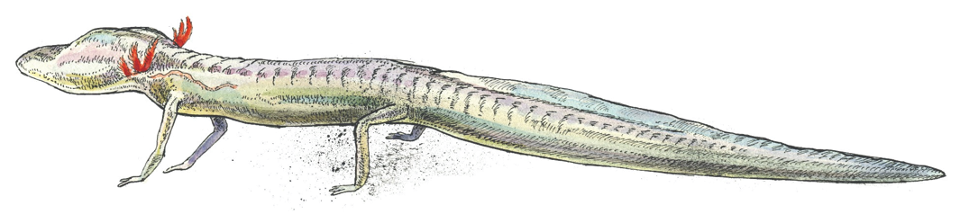
EAHCP Science Committee Meeting
Program Announcements
Fall Committee Meeting
2026-09-16

Slide 2






EAHCP Conservation Measures
Habitat Protection
Flow Protection
Supporting Measures

Slide 3
NEXT STEPS
Looking forward: protect the next implementation cycle
Organize the close around near-term commitments—not a generic summary.
NOW
NEXT CYCLE
LONGER TERM
Before the next operational milestone
Before the next committee meeting
Program learning agenda
Confirm current status
Close immediate data gaps
Document decisions
Complete targeted analyses
Refine presentation of triggers
Track agreed actions
Improve integration across measures
Evaluate performance over time
Identify adaptive changes
CLOSE WITH OWNERSHIP · Who will do what, by when, and what evidence will show completion?
LOOKING FORWARD
11

Slide 4
Edwards Aquifer Springflow
Protection Programs
EAHCP SCIENCE COMMITTEE MEETING
Sep 16, 2026· Star Park San Marcos, Tx · Chad Furl PhD PE

Slide 5
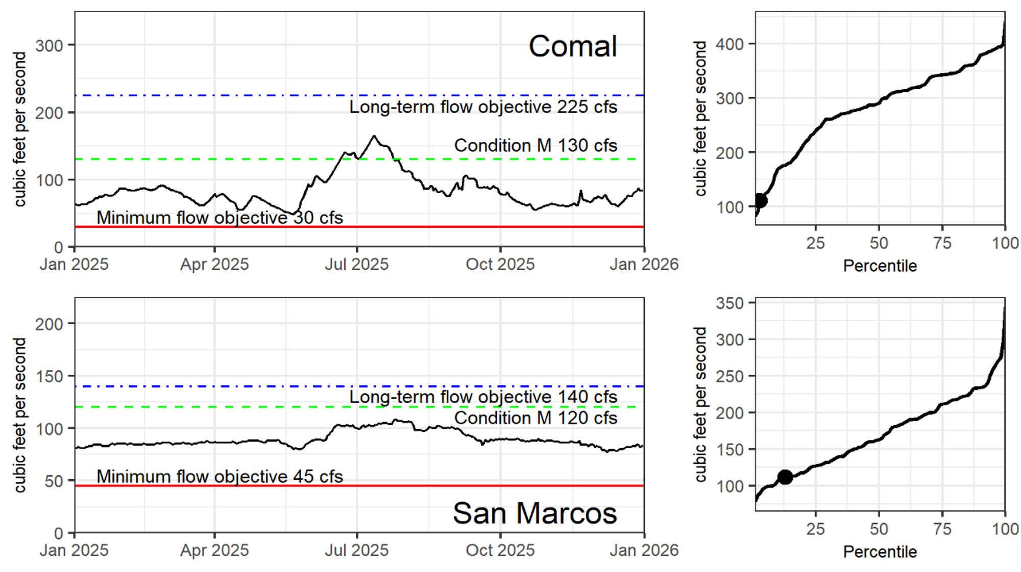
Edwards Aquifer Springflow Protection Programs
SPRINGFLOW
2025 Conditions
ANNUAL AVERAGE
Comal Springs – 83.6 cfs
San Marcos Springs – 89.4
DAILY MINIMUMS
Comal Springs – 48 cfs
San Marcos Springs – 77 cfs
LONGTERM AVERAGE
Comal Springs – 280 cfs
San Marcos Springs – 170 cfs
SPRINGFLOW RECORD
Comal – USGS 08168710
San Marcos – USGS 08170000
EA SPRINGFLOW PROTECTION
05

Slide 6
Edwards Aquifer Springflow Protection Programs
Edwards Aquifer Authority Permitting and Critical Period Management combined with EAHCP specific springflow protection actions.
EAA
EAHCP
EAA Permitting + CPM
EAHCP Springflow Protection
Established through the EAA Act.
Pumping limitations established through the issuance of groundwater withdrawal permits.
Curtailment of groundwater withdrawal established through hydrological indices.
Established by the acceptance of the HCP and issuance of ITP.
Define multiple activities to reduce groundwater pumping.
Curtailment of groundwater withdrawal established through hydrological indices.
EA SPRINGFLOW PROTECTION
1

Slide 7
01
Edwards Aquifer Authority Permitting
EA SPRINGFLOW PROTECTION
03

Slide 8
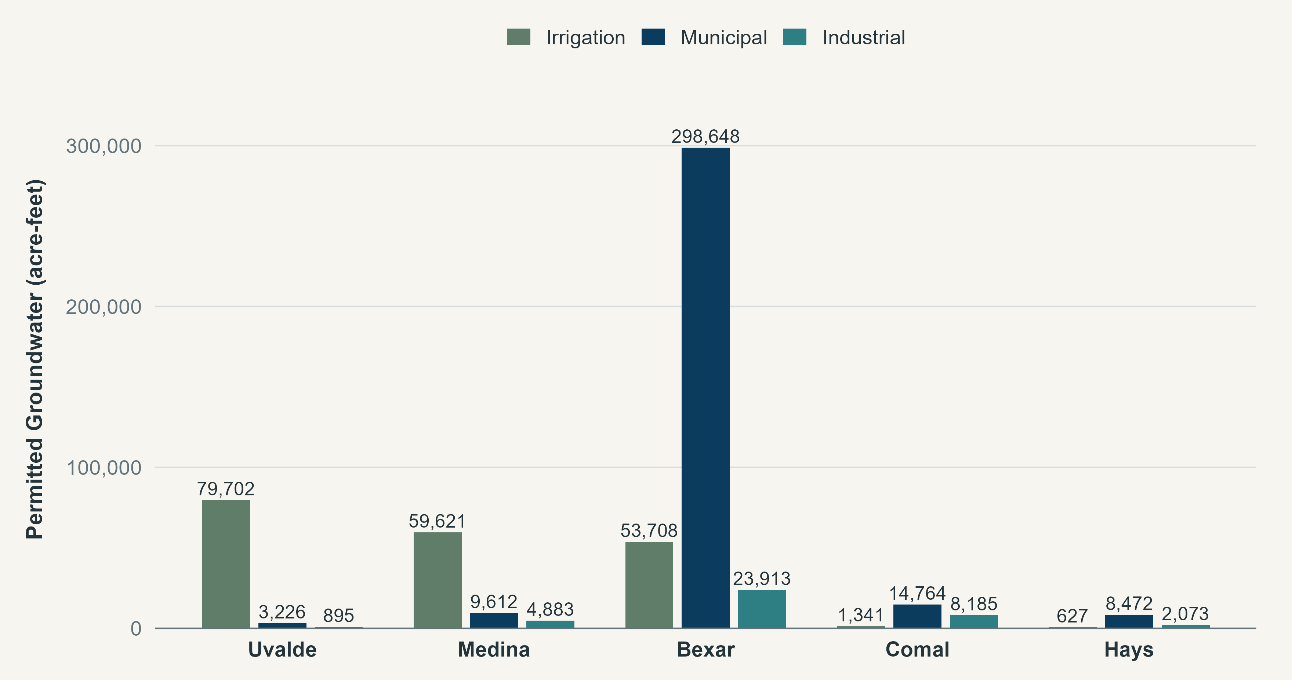
Edwards Aquifer Groundwater Withdrawal Permits
EA PERMITTING
Applications for Initial Regular Permits and Declaration of Historical Use (1973-1993) were completed by Dec1996.
GW classified as Municipal, Industrial, Irrigation (Base and Unrestricted)
First permit issued in 2001 for irrigation use; 881 permits in total approved from 2001-2006.
In 2007, SB3 sets the region’s pumping cap at 572,000 acre-feet per year in acknowledgement of historical use.
Water can only be attained by leasing or purchasing from a permit holder who has water rights.
Permitted EA groundwater by County and Use type. Permits issued in Atascosa and Guadalupe counties not shown.
EA SPRINGFLOW PROTECTION
2

Slide 9
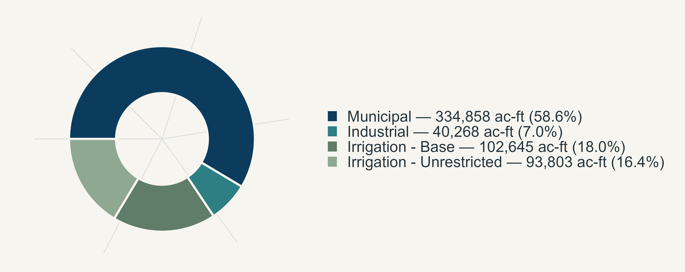
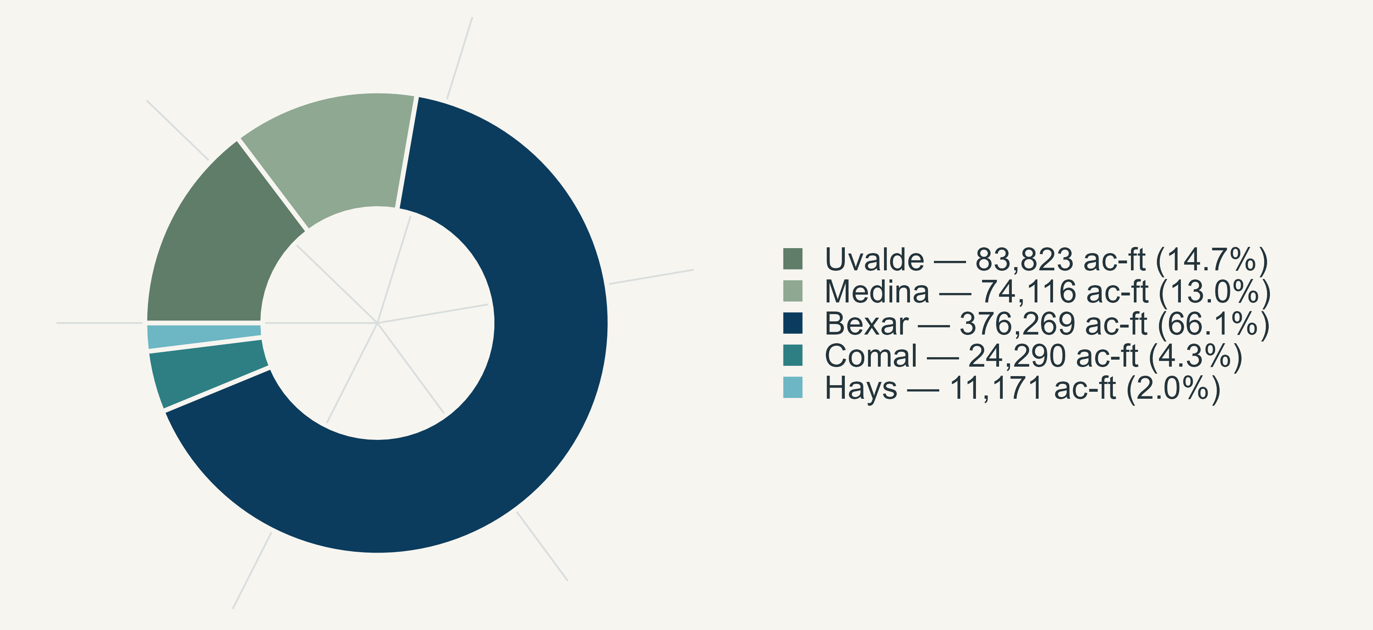
Edwards Aquifer Groundwater Withdrawal Permits
EA PERMITTING
Permitted Pumping Cap
572,000 acre-feet per year
Prior to any curtailments
EXEMPT PUMPING
Domestic and Livestock
Federal
Limited Production
~ 21,000 acre-feet in 2024
EA SPRINGFLOW PROTECTION
05

Slide 10
02
Edwards Aquifer Authority Critical Period Management
EA SPRINGFLOW PROTECTION
03

Slide 11
Edwards Aquifer Critical Period Management
Critical Period Management stages are applied separately for the Uvalde Pool (Uvalde County) and San Antonio Pool (all other counties)
CPM plan is divided into 5 stages of escalating reduced pumping requirements, each triggered by declining aquifer levels or springflow discharge rates calculated as 10-day averages.
Pumping reductions are prorated by the number of days each critical-period stage is in effect.
Stages 1-4 have been in effect since 1998 and Stage 5 in effect 2013.
SAN ANTONIO POOL
UVALDE POOL
EA SPRINGFLOW PROTECTION
1

Slide 12
MAP + EVIDENCE
MAP OF J-17, 27, SAN MARCOS, AND COMAL SPRINGS
Use this layout for wells, service areas, springs, reaches, refugia, or implementation geography.
WHAT THE MAP SHOWS
1
Location-specific finding
One sentence interpreting the first feature or spatial pattern.
2
Implementation connection
One sentence connecting geography to program operations or risk.
3
Point requiring attention
Use coral only for an exception, threshold, or discussion item.
MAP / GIS FIGURE
Replace this placeholder with an exported map. Preserve generous margins and keep legends compact.
SPATIAL EVIDENCE
07

Slide 13
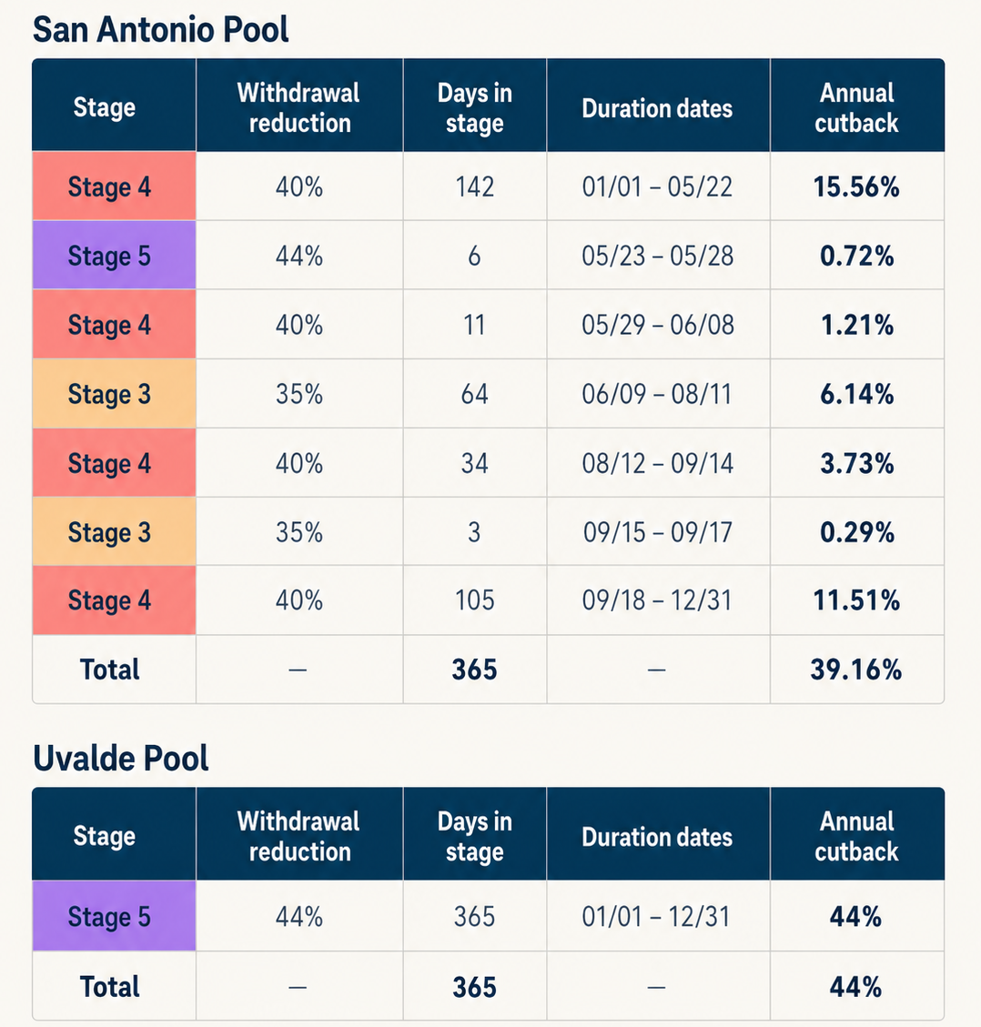
Edwards Aquifer Critical
Period Management
CPM
2025 Critical Period Stages and Annual Pumping Reductions
Pumping reductions are prorated by the number of days each critical-period stage is in effect.
SAN ANTONIO POOL 39.2% reduction
UVALDE POOL 44% reduction
HYDROLOGIC UPDATE
05

Slide 14
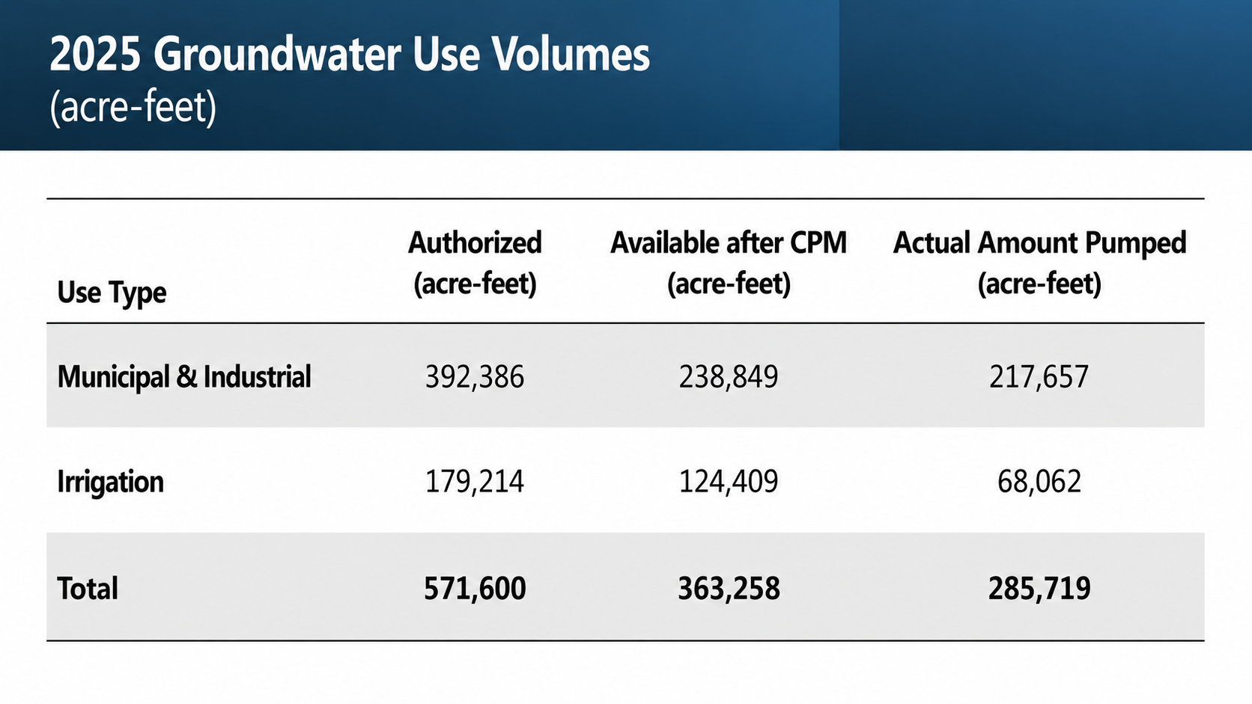
Edwards Aquifer Critical
Period Management
CPM
2025 Critical Period Stages and Annual Pumping Reductions
Pumping reductions are prorated by the number of days each critical-period stage is in effect.
SAN ANTONIO POOL 39.2% reduction
UVALDE POOL 44% reduction
HYDROLOGIC UPDATE
05

Slide 15
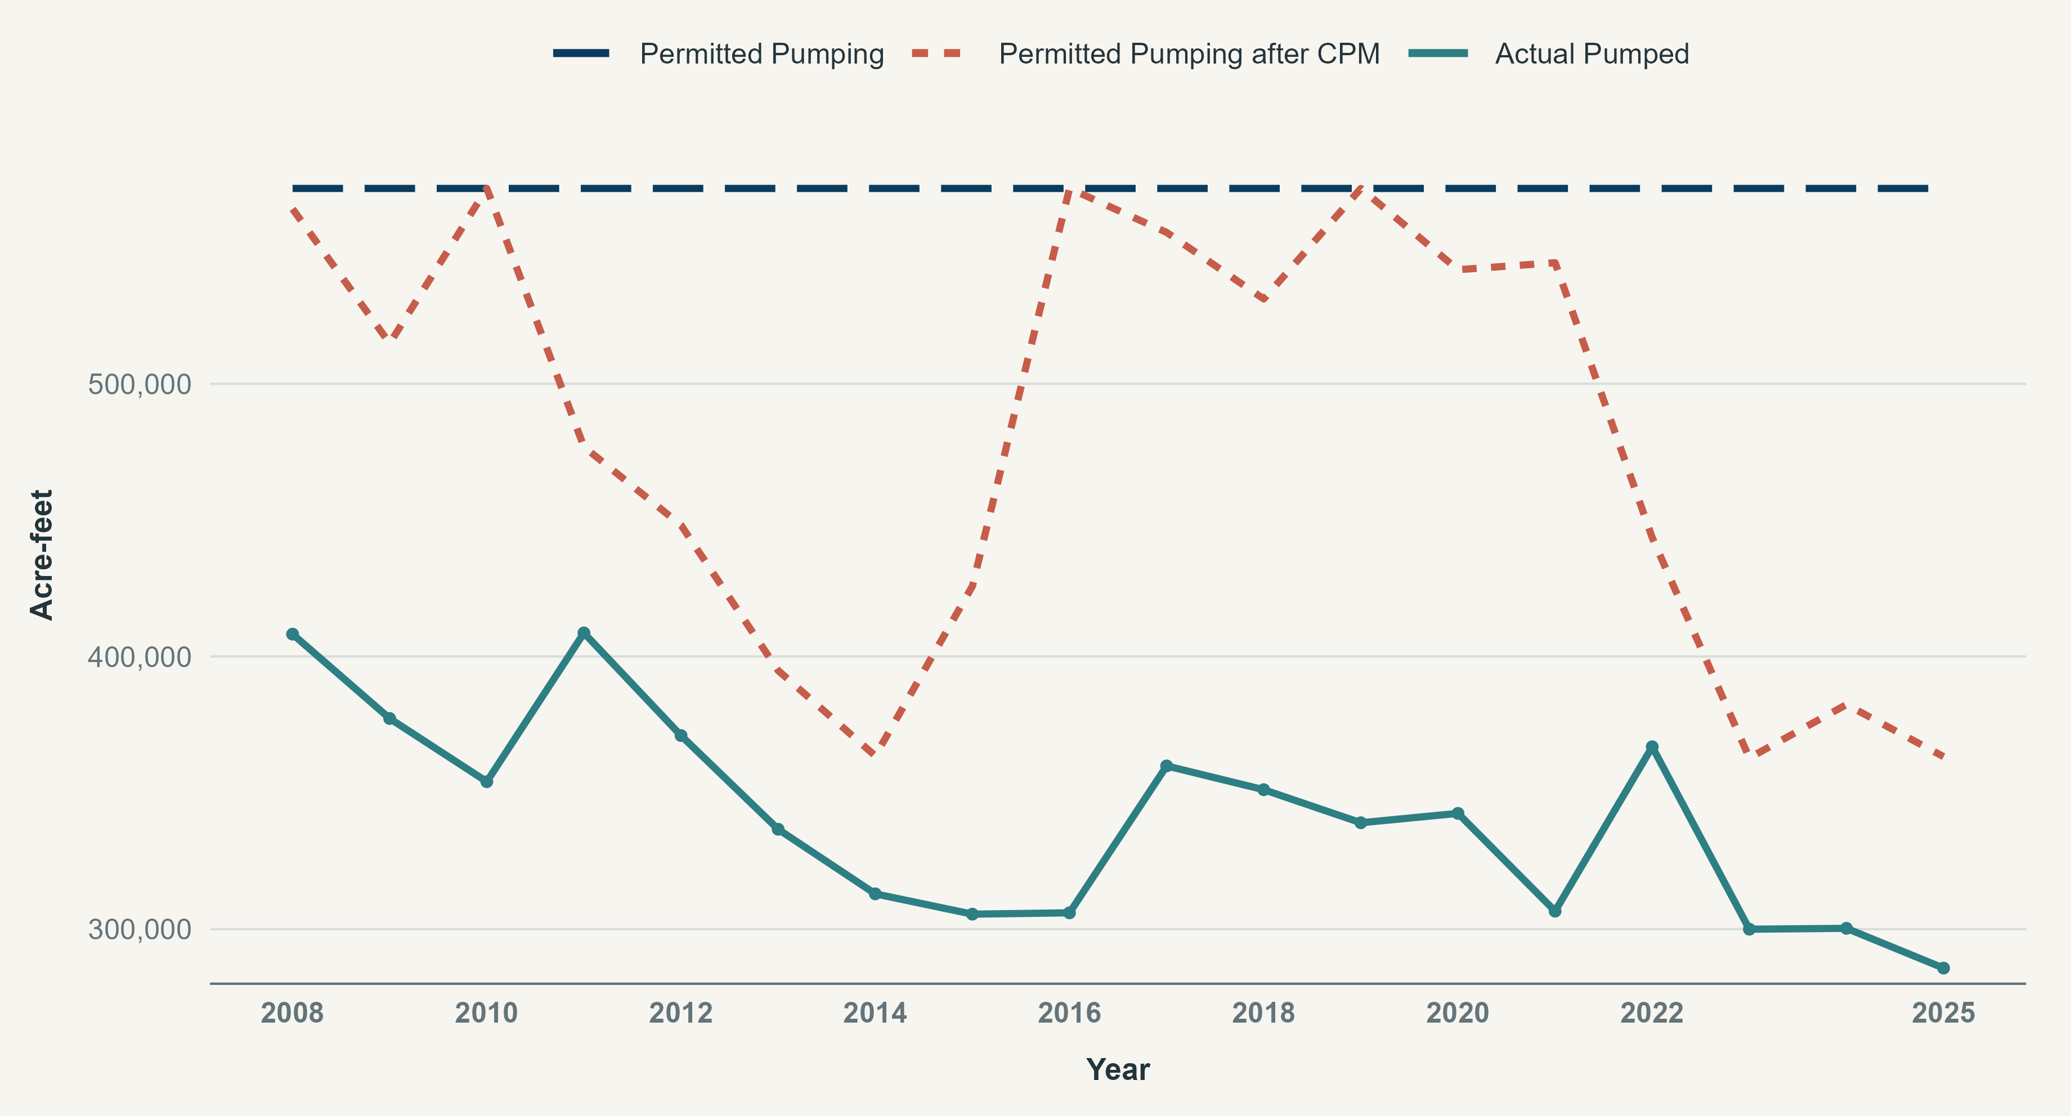
Edwards Aquifer Critical Period Management
CONNECTED FUNCTIONS
Hydrologic monitoring, implementation actions, and biological outcomes should read as one connected story.
TAKEAWAY · Explain what changed, why it matters, and what the program is doing about it.
SPRINGFLOW PROTECTION
04

Slide 16
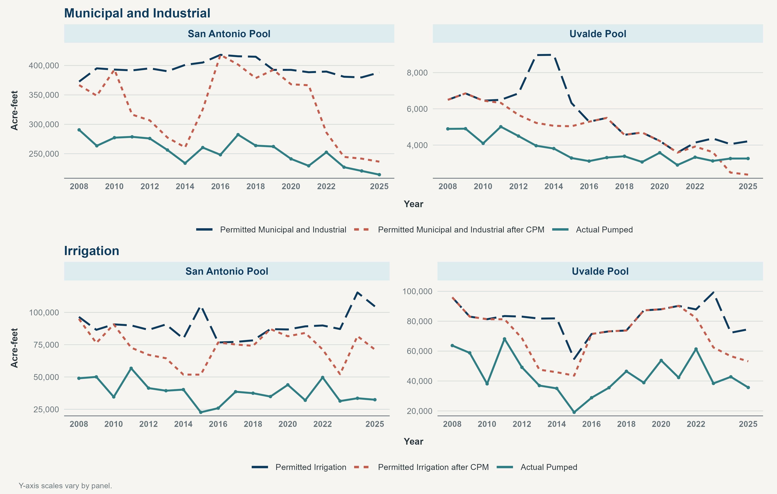
Edwards Aquifer Critical Period Management
CONNECTED FUNCTIONS
Hydrologic monitoring, implementation actions, and biological outcomes should read as one connected story.
TAKEAWAY · Explain what changed, why it matters, and what the program is doing about it.
SPRINGFLOW PROTECTION
04

Slide 17
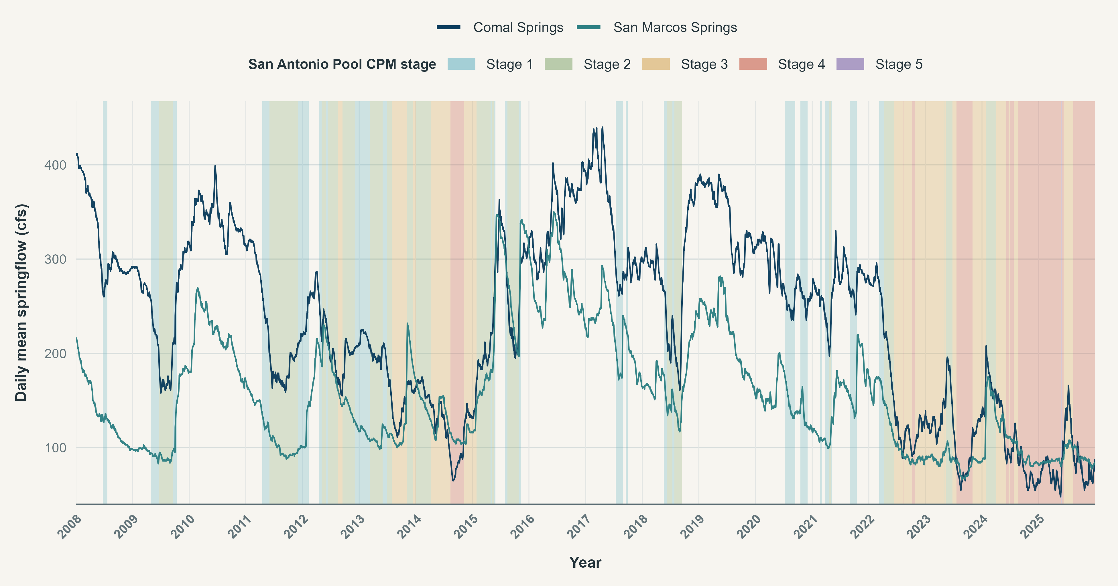
Edwards Aquifer Critical Period Management
CONNECTED FUNCTIONS
CPM by the numbers
TAKEAWAY · Explain what changed, why it matters, and what the program is doing about it.
SPRINGFLOW PROTECTION
04

Slide 18
03
EAHCP Springflow Protection Measures
EA SPRINGFLOW PROTECTION
03

Slide 19
EAHCP Springflow Protection Measures
In 2007, the Texas Legislature directed the EAA and other Permittees to participate in the Edwards Aquifer Recovery and Implementation Program to develop a plan for managing the Edwards that would protect the Covered Species.
SB3 Article 1.14 (h)
“… the authority, through a program, shall implement and enforce water management practices, procedures and methods to ensure that, not later than December 31, 2012, the continuous minimum springflows of the Comal Springs and the San Marcos Springs are maintained…to the extent required by federal law…”
This was partly a response to SB3 and raising the pumping cap to 572k af-yr
Why was this required?
The EARIP was part of a negotiation at the Texas Legislature to raise the pumping cap to 572k ac-ft
SPATIAL EVIDENCE
07

Slide 20
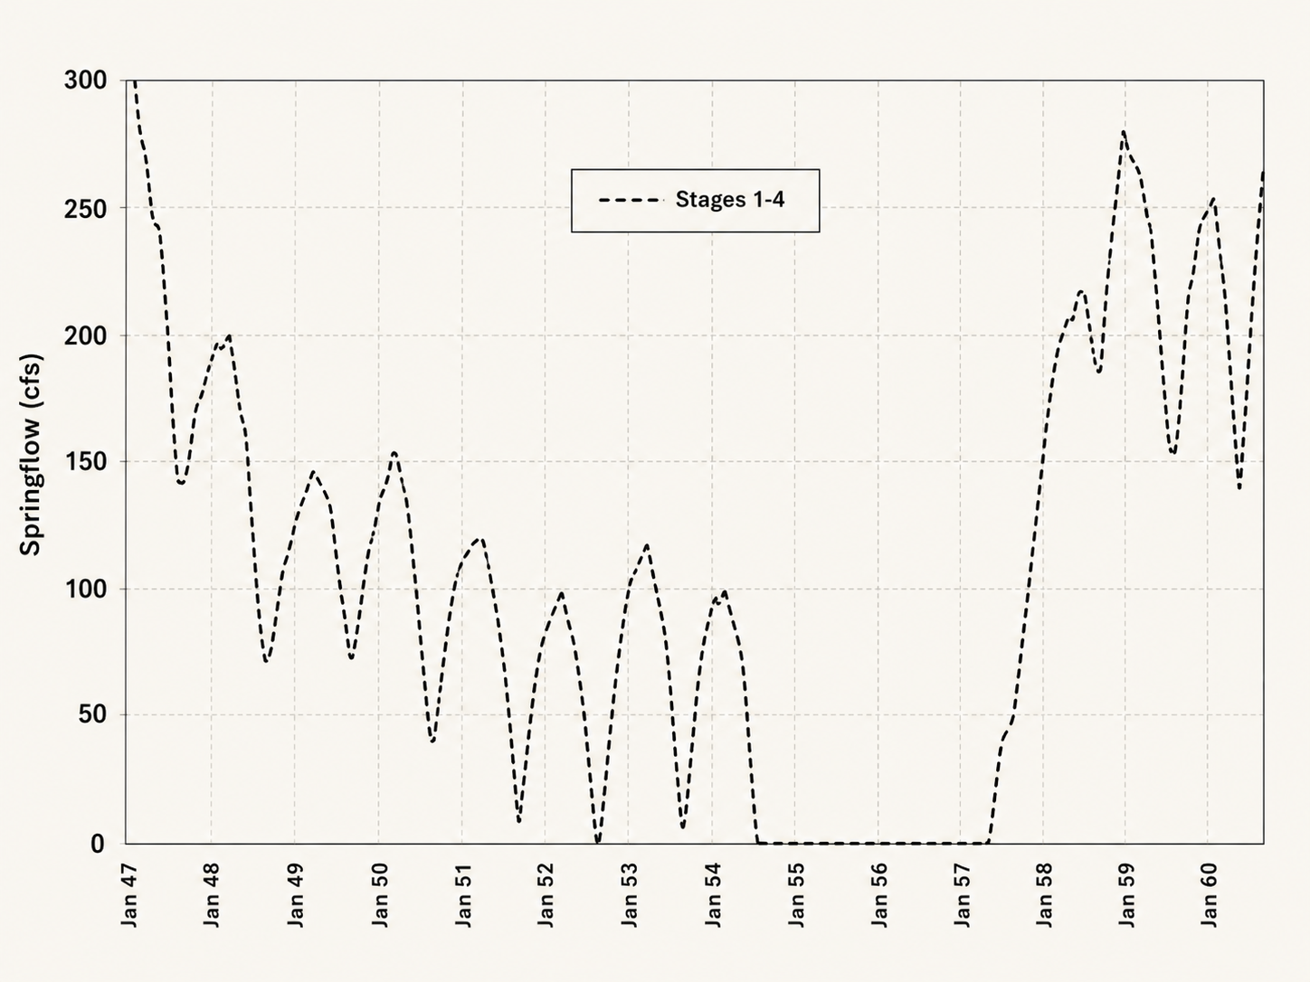
EAHCP Springflow Protection Measures
EARIP
DOR MODFLOW
Simulations
Stages 1-4 not adequate to achieve minimum flows during a repeat of the Drought of Record
EAHCP Appendix K
HDR, et al., Evaluation of Water Management Programs and Alternatives for Springflow Protection of Endangered Species at Comal and San Marcos Springs, 2011. 157p.
Adapted from Figure 3-9, Simulated Springflow at Comal Springs (1947-1960).
*AI generated, line values are approximate.
HYDROLOGIC UPDATE
05

Slide 21
EAHCP Springflow Protection Measures
The EAHCP ‘Bottom-Up’ package charted a way forward to achieve minimum springflows during a repeat of the DOR. These Programs were put into place starting in 2013 with acceptance of the HCP and issuance of the ITP.
REGIONAL WATER CONSERVATION
VOLUNTARY IRRIGATION SUSPENSION PROGRAM OPTION
SAWS AQUIFER STORAGE AND RECOVERY
STAGE V
01
02
03
04
20,000 ac-ft yr⁻¹
41,795 ac-ft yr⁻¹
50,000 ac-ft yr⁻¹
+
46,300 ac-ft yr⁻¹
44% Cutback to Permitted Pumping
Leak detection, high-efficiency plumbing, water reclamation.
Suspends the use of enrolled irrigation water during drought.
Permitted lease and forebearance agreements plus maximum amount of water delivered from ASR.
Assess hydrologic and biological response.
IMPLEMENTATION PATHWAY
08

Slide 22
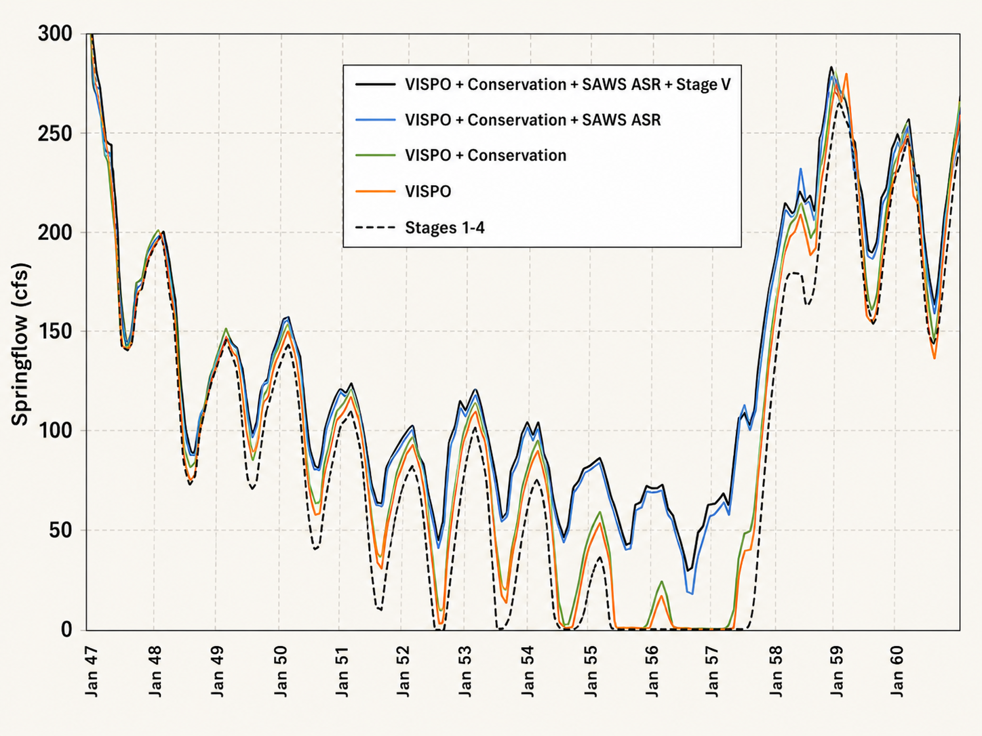
EAHCP Springflow Protection Measures
EAHCP
DOR MODFLOW
Simulations
Stages 1-4 plus EAHCP springflow protection measures achieve minimum flows during a repeat of the Drought of Record
EAHCP Strategic Adaptive Management
Blanton and Associates, Transition from Phase I to Phase II. Summary Report and Administrative Record: Process, Activities, and Decisions, 2020. 43p.
Adapted from Figure 3-9, Simulated Springflow at Comal Springs (1947-1960).
*AI generated, line values are approximate.
HYDROLOGIC UPDATE
05

Slide 23
PROGRAM STATUS
EAHCP Springflow Protection Measures
COMPONENT
2013-2026 ACTIVITY
2027 STATUS
Regional Water Conservation
Program has been completed.
Implemented
VISPO
VISPO triggered: 2015, 2023, 2024, 2025, 2026
?
ASR Leasing
First year of 50,000 ac-ft forebearance agreements 2027.
ACTIVE
Stage V Critical Period
Stage V has triggered in both pools.
?
ASR leasing is triggered when the 10-year average aquifer recharge falls below 500,000 ac-ft yr⁻¹
ASR LEASING
VISPO LEASING
VISPO forebearance is triggered in the following year when J-17 level is below 635 famsl on October 1st
PROGRAM STATUS
06

Slide 24
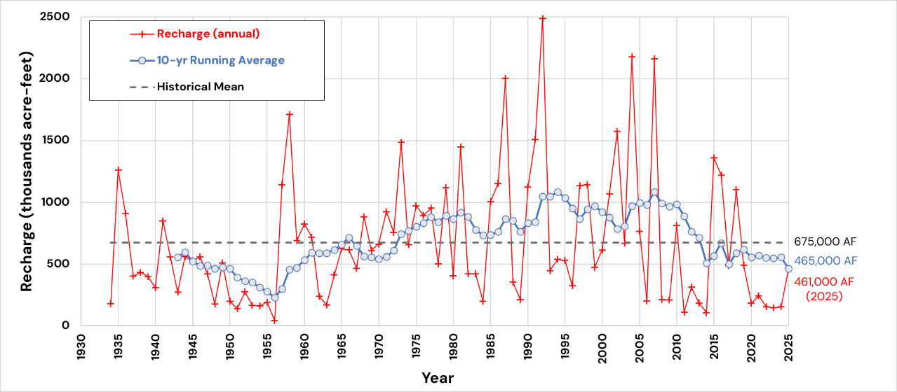
HYDROLOGIC UPDATE
EAHCP Springflow Protection Measures
10-yr average aquifer recharge values below 500,000 ac-ft yr-1 (2016-2025) will begin ASR forbearance in 2027
HYDROLOGIC UPDATE
05

Slide 25
EAHCP · SPRINGFLOW PROTECTION
Questions and
discussion
EAHCP SCIENCE COMMITTEE MEETING
Sep 16, 2026· Star Park San Marcos, Tx · Chad Furl PhD PE

