Slide 1
EAHCP
Landa Lake Drought Management
EAHCP Activities Through 2020s Drought
SCIENCE COMMITTEE IMPLEMENTATION MEETING
September 16, 2026 · STAR SMTX · Chad Furl PhD PE

Slide 2
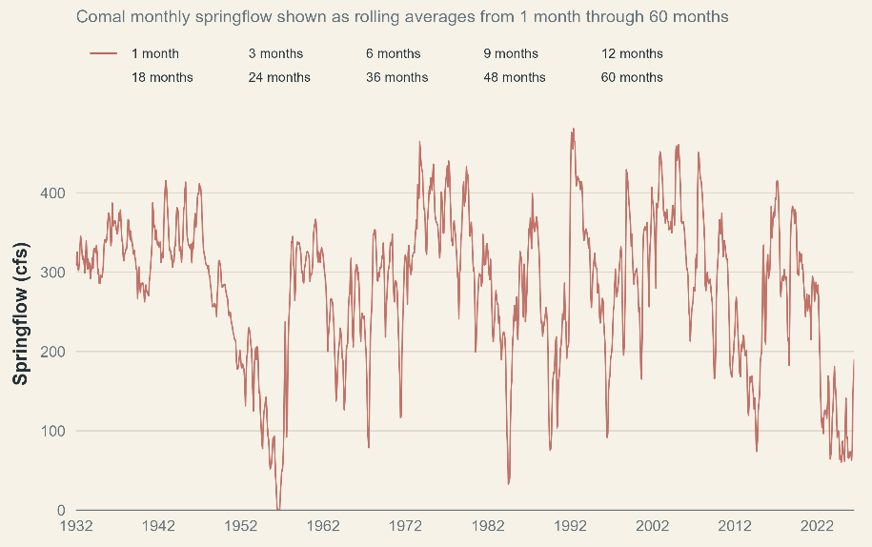
Edwards Aquifer Region Drought
04
ROLLING MONTHLY SPRINGFLOW
Current drought has reduced springflows at Comal to levels not experienced since the drought of record in the 1950s.
Daily mean springflow from USGS gage 08168710 – Comal Springs, was aggregated to monthly means. Rolling averages represent the mean of consecutive monthly springflow values over the indicated 1- to 60-month periods.

Slide 3
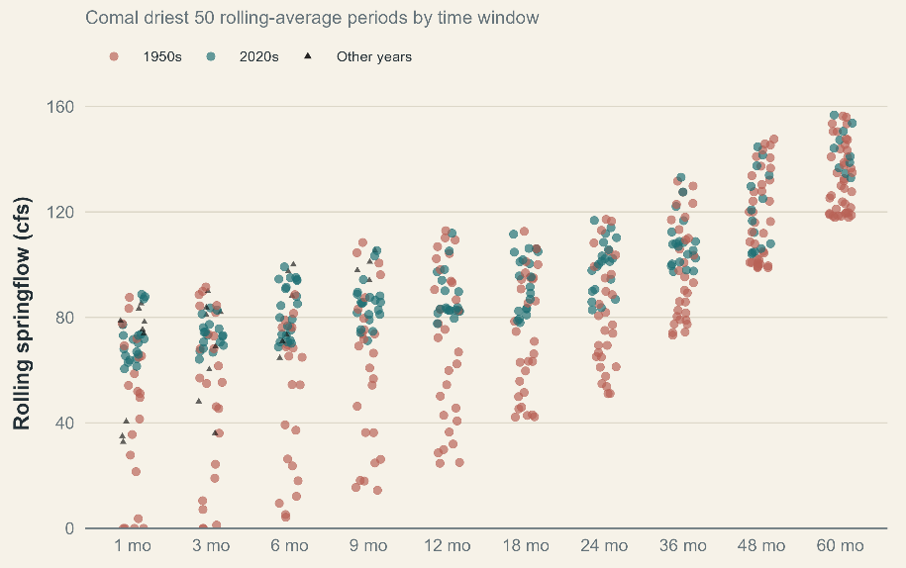
Edwards Aquifer Region Drought
04
ROLLING MONTHLY SPRINGFLOW
Current drought has reduced springflows at Comal to levels not experienced since the drought of record in the 1950s.
Points show the 50 lowest rolling-average springflow values for each averaging duration. Rolling periods overlap; for example, consecutive 12-month values may represent Jan–Dec 2024, Feb 2024–Jan 2025, and Mar 2024–Feb 2025. Colors identify periods ending in the 1950s and 2020s; all other periods are shown in black.

Slide 4
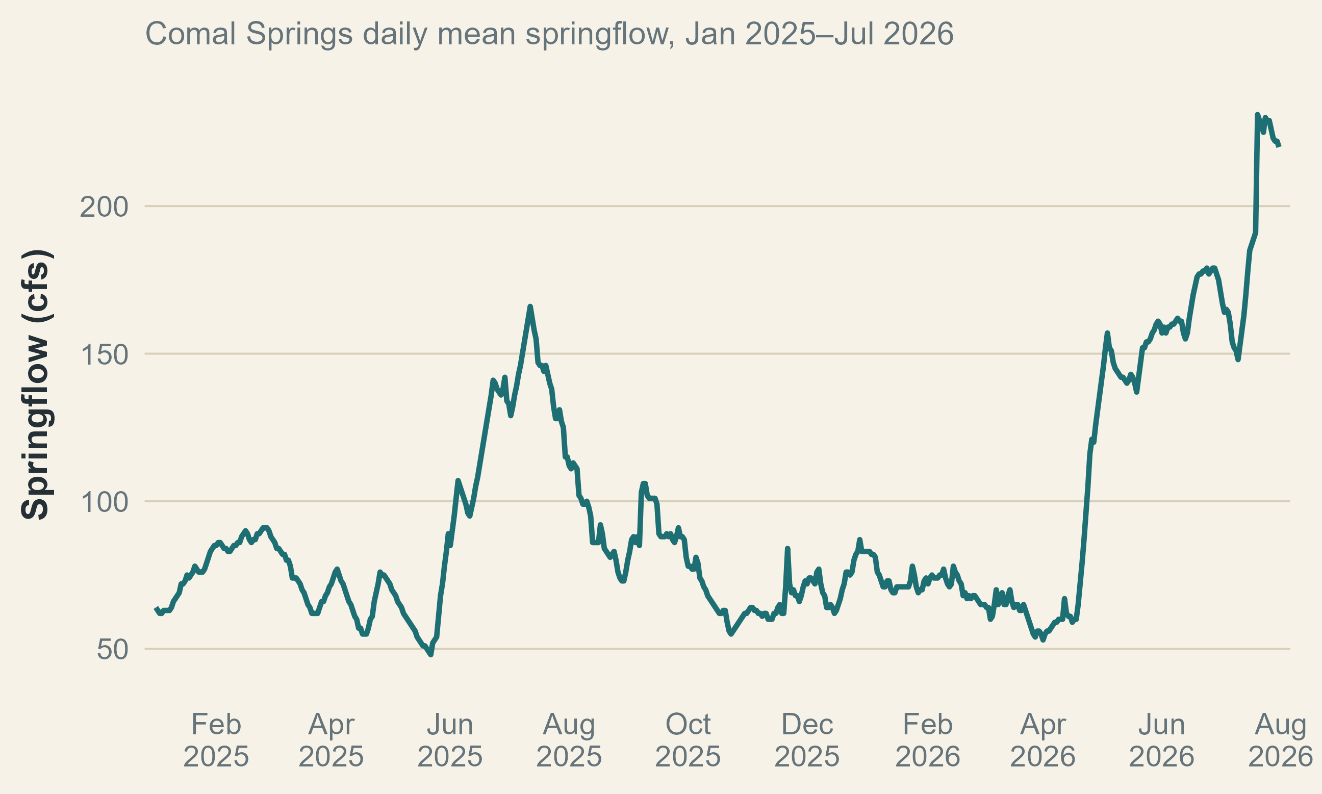
Landa Lake Under Drought Conditions
LAKE LEVEL AND WETTED AREA
May 22, 2025 – 48 cfs
April 1, 2026 – 53 cfs
Days under 50 cfs
1955 – 15
1956 – 273
1957 – 28
1984 – 96
1990 – 4
2025 – 2
Make a graph of LCRA well 2025-1-1 to present
Comal Springs discharge at USGS 08168710 2025 to presnet. August 1, 2026.

Slide 5
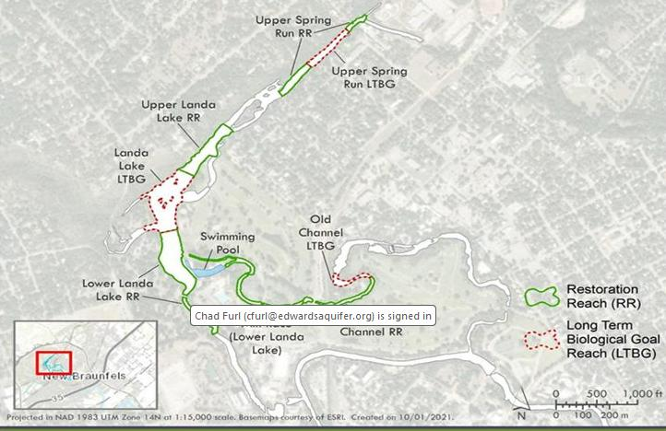
Landa Lake Drought Management
PRESSURE POINTS
Lake wetted area
Lake level and culvert works
Dissolved oxygen
Temperature
Vegetation
Need a map here fo sure
TIME / REACH / VEGETATION TYPE
MEASURE
TAKEAWAY · Explain what changed, why it matters for habitat, and what the program is doing about it.
CORE MESSAGE
04

Slide 6
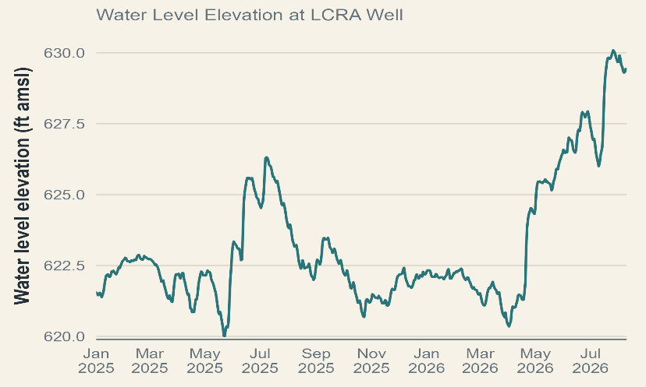
Landa Lake Under Drought Conditions
LAKE LEVEL AND WETTED AREA
LBG-Guyton 2004¹
SR 1 and 2 stop flowing
LCRA well ~ 625 ft.
Comal flow ~ 130 cfs.
SR3 stops flowing when LCRA well ~ 621.5 ft. Comal flow ~ 50 cfs.
Make a graph of LCRA well 2025-1-1 to present
¹LBG-Guyton Associates. 2004. Evaluation of Augmentation Methodologies in Support of In-Situ Refugia at Comal and San Marcos Springs, Texas. Prepared for the Edwards Aquifer Authority.

Slide 7
Landa Lake Under Drought Conditions
LAKE LEVEL AND WETTED AREA
LBG-Guyton 2004¹
SR 1 and 2 stop flowing
LCRA well ~ 625 ft.
Comal flow ~ 130 cfs.
SR3 stops flowing when LCRA well ~ 621.5 ft. Comal flow ~ 50 cfs.
Make a graph of LCRA well 2025-1-1 to present
2025-2026 Observations
SR3 stops flowing when LCRA well ~ 620.25 ft. Comal flow ~ 50 cfs.
¹LBG-Guyton Associates. 2004. Evaluation of Augmentation Methodologies in Support of In-Situ Refugia at Comal and San Marcos Springs, Texas. Prepared for the Edwards Aquifer Authority.

Slide 8
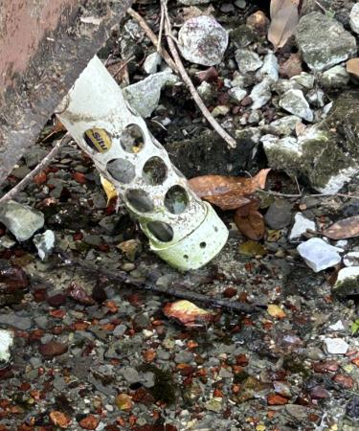
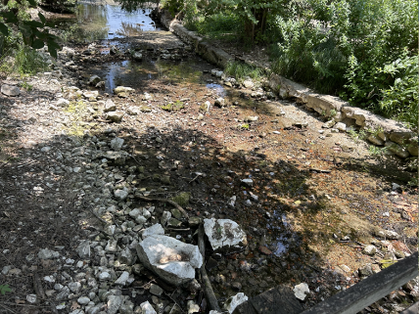
Landa Lake Under Drought Conditions
LAKE LEVEL AND WETTED AREA
LBG-Guyton 2004¹
SR 1 and 2 stop flowing
LCRA well ~ 625 ft.
Comal flow ~ 130 cfs.
SR3 stops flowing when LCRA well ~ 621.5 ft. Comal flow ~ 50 cfs.
Add one more sr3
2025-2026 Observations
SR3 stops flowing when LCRA well ~ 620.25 ft. Comal flow ~ 50 cfs.
Picture on left is Spring Run 3 facing downstream from walking bridge on May 21, 2025 (Total Comal discharge 49 cfs). Picture on the right is WQ monitoring equipment attached to same walking bridge on April 1, 2026 (Total Comal discharge 53 cfs).

Slide 9
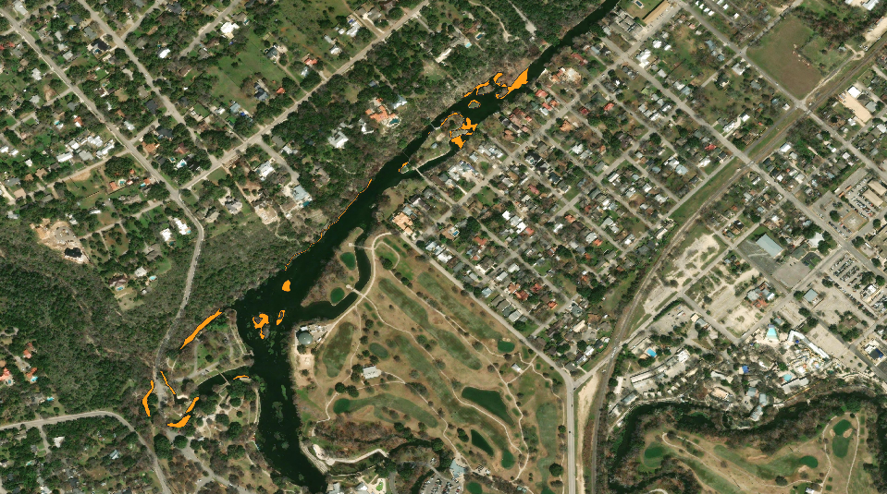
Landa Lake Under Drought Conditions

Slide 10
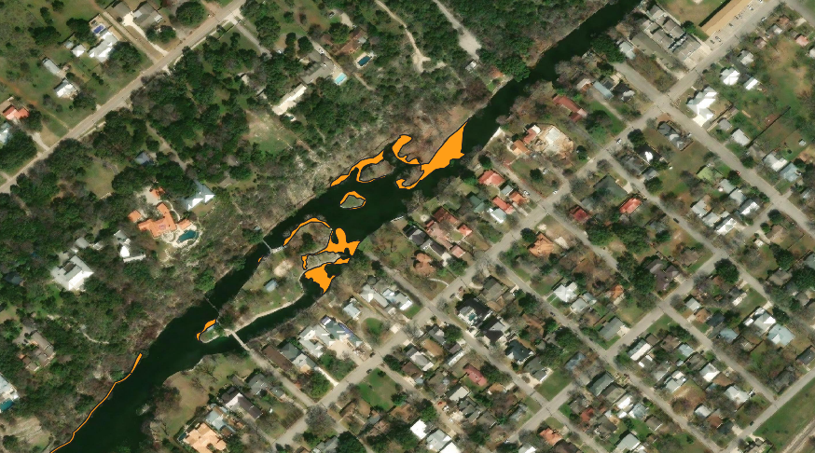
Landa Lake Under Drought Conditions
Picture on left is Spring Run 3 facing downstream from walking bridge on May 21, 2025 (Total Comal discharge 49 cfs). Picture on the right is WQ monitoring equipment attached to same walking bridge on April 1, 2026 (Total Comal discharge 53 cfs).

Slide 11
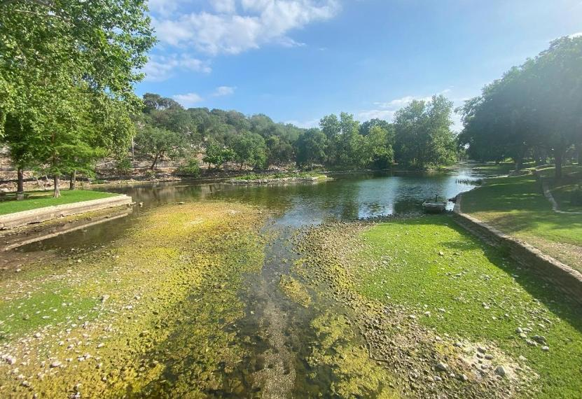
Landa Lake Under Drought Conditions
CORE MESSAGE
04
Spring Island looking upstream. May, 21, 2025, total Comal discharge ~ 50 cfs.

Slide 12
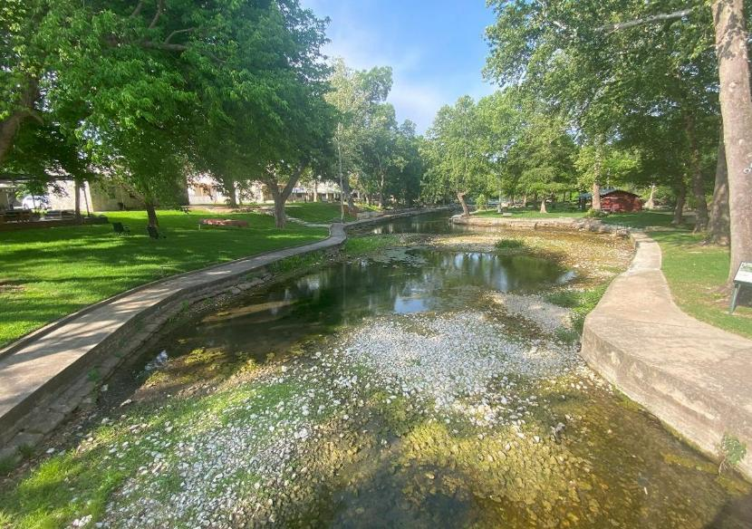
Landa Lake Under Drought Conditions
CORE MESSAGE
04
Spring Island looking downstream. May, 21, 2025, total Comal discharge ~ 50 cfs.

Slide 13
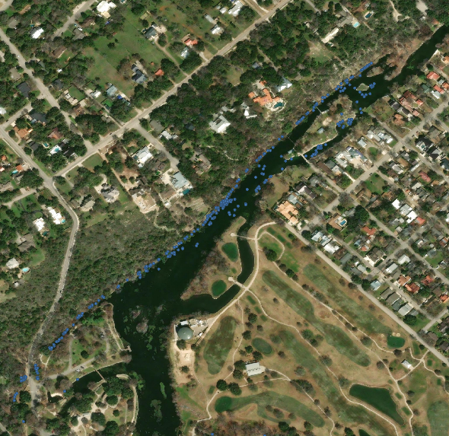
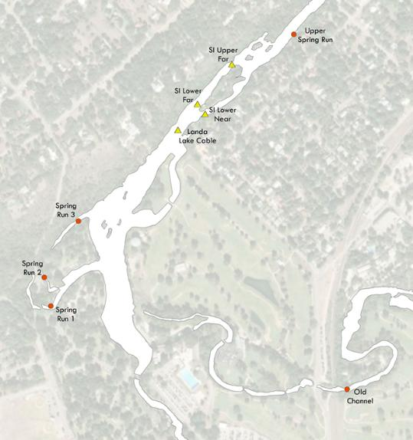
Landa Lake Under Drought Conditions
LANDA LAKE HYDROLOGY
Make a graph of spring orifices
04
Surface discharge is measured at four spring runs and four lake cross sections to estimate springflow contributions from different areas of the lake.

Slide 14
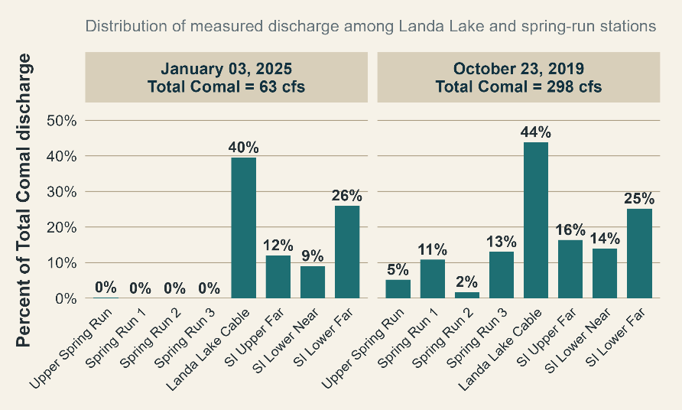
Landa Lake Under Drought Conditions
LANDA LAKE HYDROLOGY
Surface discharge is measured at four spring runs and four lake cross sections.
Allows estimates of springflow contributions from different areas of the lake.
CORE MESSAGE

Slide 15
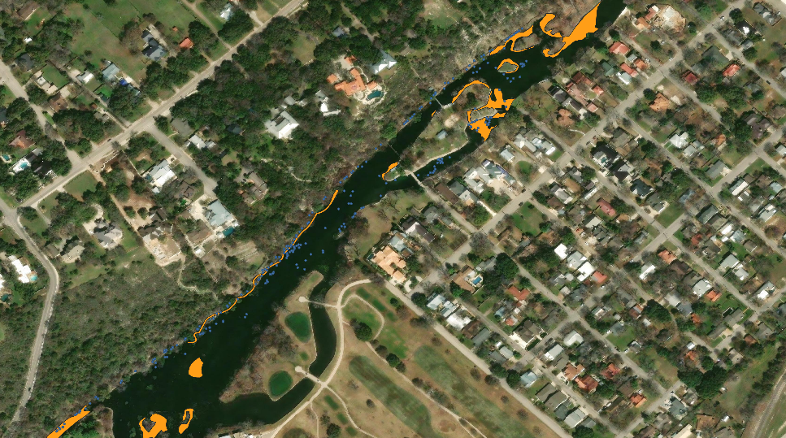
Landa Lake Under Drought Conditions

Slide 16
Landa Lake Flow Split Management
FLOW SPLIT MANAGEMENT
EAHCP § 5.2.1
Flow split management in the Old and New Channel
Old Channel Protection
Flow split management is intended to complement the ecological restoration of aquatic vegetation in the Old Channel, by reducing long-duration high flows and allowing for more seasonal variability to be maintained, mimicking a more natural flow pattern.
Culvert Management
Flow manipulations are managed by City of New Braunfels according to season and total system discharge.
Table 5-3 EAHCP Flow split management for Old and New Channels

Slide 17
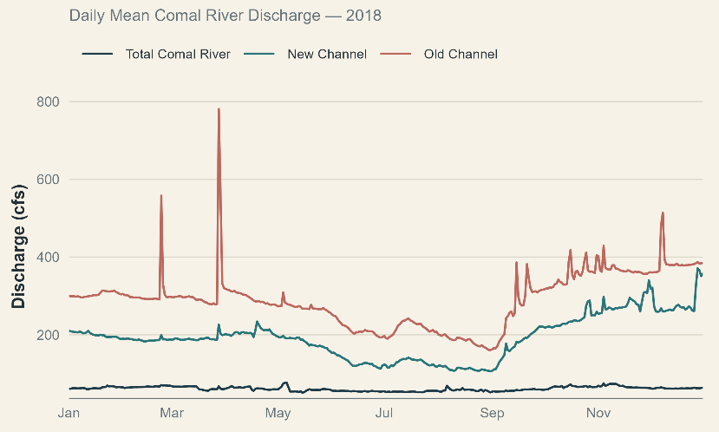
Landa Lake Flow Split
FLOW SPLIT
Priority will be given to achieving target flow rates in the Old Channel and, secondly, to flow rates in the New Channel.
City of New Braunfels staff will monitor streamflow conditions via USGS streamflow gages and operate the flow-control gates between Landa Lake and the Old Channel to achieve flow targets.
Maintenance activities associated with the flow-control gates will be conducted as needed to ensure continued operability.
Comal River discharge at USGS 08169000, New Channel of Comal River 08168932, and Old Channel of Comal River 08168913, 2018.
CORE MESSAGE
04

Slide 18
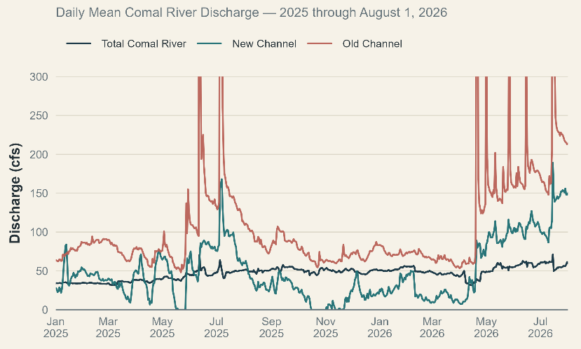
Landa Lake Flow Split
FLOW SPLIT
Priority will be given to achieving target flow rates in the Old Channel and, secondly, to flow rates in the New Channel.
City of New Braunfels staff will monitor streamflow conditions via USGS streamflow gages and operate the flow-control gates between Landa Lake and the Old Channel to achieve flow targets.
Maintenance activities associated with the flow-control gates will be conducted as needed to ensure continued operability.
Comal River discharge at USGS 08169000, New Channel of Comal River 08168932, and Old Channel of Comal River 08168913, 2025-2026.
CORE MESSAGE
04

Slide 19
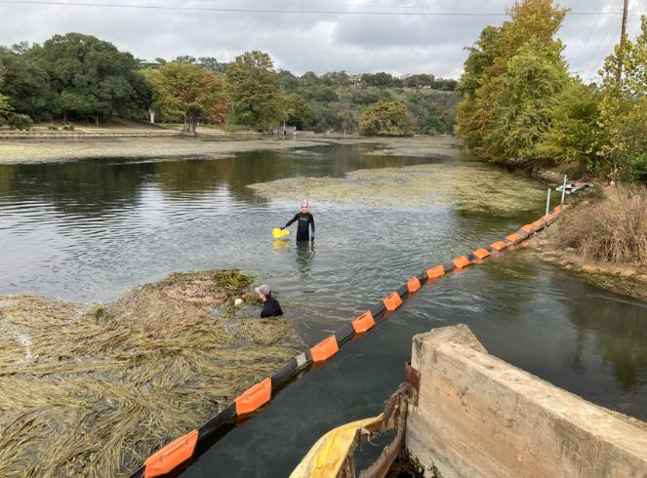
Landa Lake Flow Split
FLOW SPLIT
Priority will be given to achieving target flow rates in the Old Channel and, secondly, to flow rates in the New Channel.
City of New Braunfels staff will monitor streamflow conditions via USGS streamflow gages and operate the flow-control gates between Landa Lake and the Old Channel to achieve flow targets.
Maintenance activities associated with the flow-control gates will be conducted as needed to ensure continued operability.
Landa Lake at the entrance to the Old Channel culvert at approximately 60 cfs.
04

Slide 20
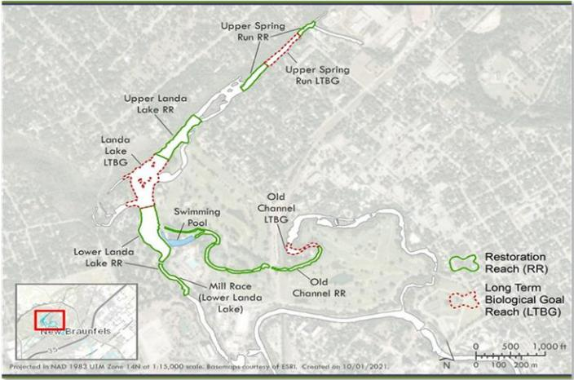
Landa Lake Vegetation Management
SUBMERGED AQUATIC VEGETATION
MAP / PHOTO / SITE FIGURE
Replace with Landa Lake reach map, drone image, transect photo, or monitoring station map.
1
EAHCP § 5.2.2
Native Aquatic Vegetation Restoration and Maintenance
2
Provide Beneficial Habitat
To minimize and mitigate the impacts of incidental take from low-flow events by providing better habitat conditions for the ecological community.
3
Restoration Goals
Restoration activities occur in Long-term Biological Goal Reaches designated by the EAHCP as well as supportive Restoration Reaches which provide further habitat enhancement objectives.
LAKE CONTEXT
05

Slide 21
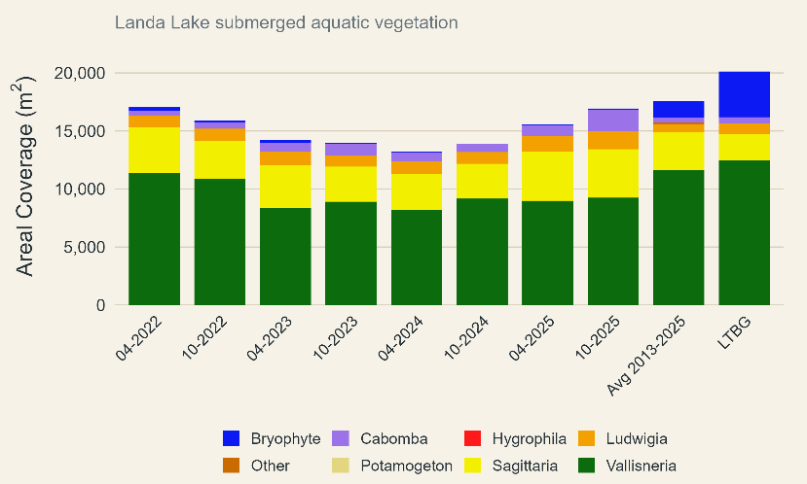
Landa Lake Vegetation Maintenance
SUBMERGED AQUATIC VEGETATION
Restoration activities have been moderated by Condition M of the permit with flows < 130 cfs.
Currently, only Ludwigia and Cabomba are propagated and planted.
~ 3500 plants were planted across six restoration plot areas (~ 750 m²)
Perhaps a few pictures here, visual tour
SAV in the Landa Lake LTBG reach from 2022-2025, long-term averages and Biological Goal for reach shown.
04

Slide 22
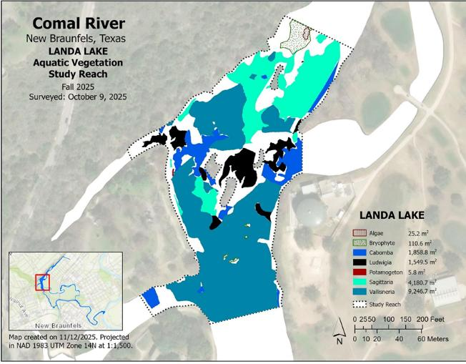
Landa Lake Vegetation Maintenance
SUBMERGED AQUATIC VEGETATION
Restoration activities have been moderated by Condition M of the permit with flows < 130 cfs.
Currently, only Ludwigia and Cabomba are propagated and planted.
~ 3500 plants were planted across six restoration plot areas (~ 750 m²)
Perhaps a few pictures here, visual tour
SAV from Fall 2025 mapping in the Landa Lake LTBG reach.
04

Slide 23
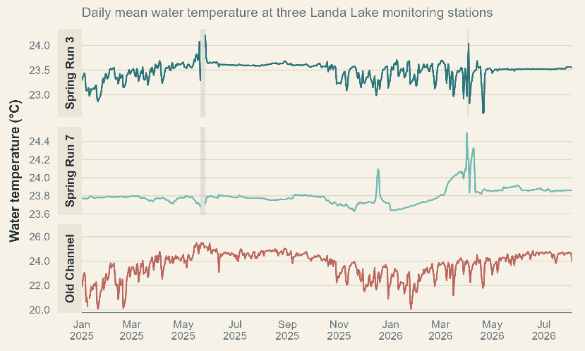
Landa Lake Water Quality
TEMPERATURE
Spring Run 3 and Spring Run 7 were unable to record data for 6 days in May of 2025 and 2 days in April of 2026 due to low/zero flows at the monitoring locations.
Temperatures in the Old Channel have largely remained under 25C at the RTWQ monitoring stations with the exception of a brief period in May 2025.
Temperature data from real-time water quality stations operating in the Comal system. Data from 2026 are unapproved and potentially contain incorrect values.
04

Slide 24
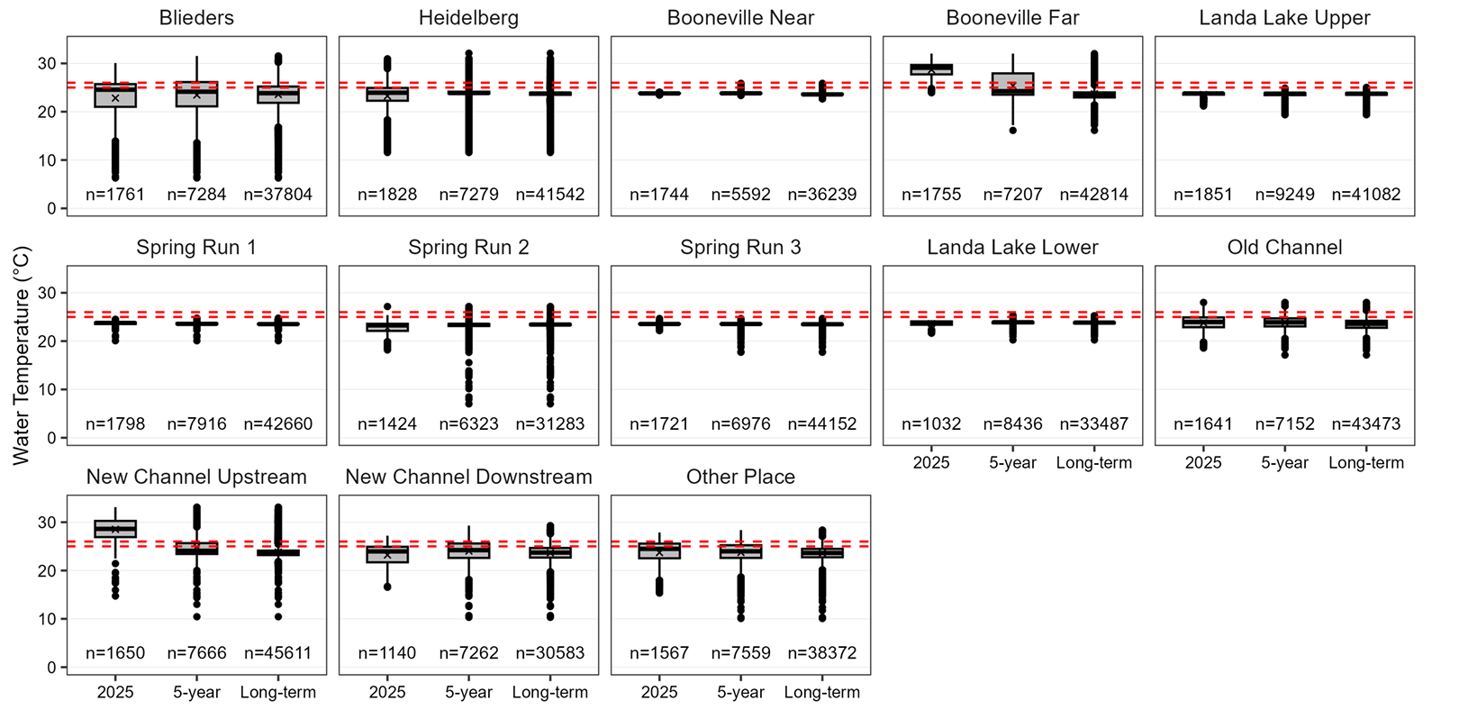
Landa Lake Water Quality
04

Slide 25
Landa Lake/ Comal Data Presented
1
Hydrologic
Springflow and River Dischage.
Comal Spgs at New Braunfels, TX – USGS-08168710
Comal Rv at New Braunfels, TX – USGS-08169000
Comal Rv (nc) nr Landa Lk, New Braunfels, TX – USGS-08168932
Comal Rv (oc) nr Landa Lk, New Braunfels, TX – USGS-08168913
Groundwater Height at LCRA Well - https://data.edwardsaquifer.org/GroundWater
Landa Lake Spring Run and Flow split discharge
2
Water Quality and Habitat
Spring Run 3, 7, and OC Temperature RTWQ
Landa Lake Thermistors
Landa Lake SAV maps
TPWD Spring Orifices Map
3
Github Repo
Data and scripts available at:
LAKE CONTEXT
05

Slide 26
EAHCP · LANDA LAKE
Questions and
discussion
Edwards Aquifer Habitat Conservation Plan
13

Slide 27
EAHCP
EAHCP Supporting Measures
SCIENCE COMMITTEE IMPLEMENTATION MEETING
September 16, 2026 · STAR SMTX · Chad Furl PhD PE

Slide 28
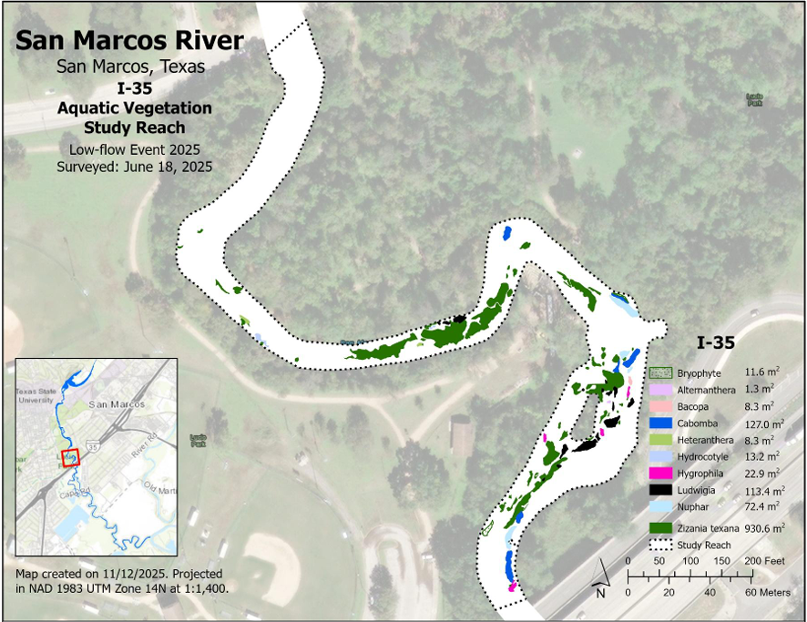
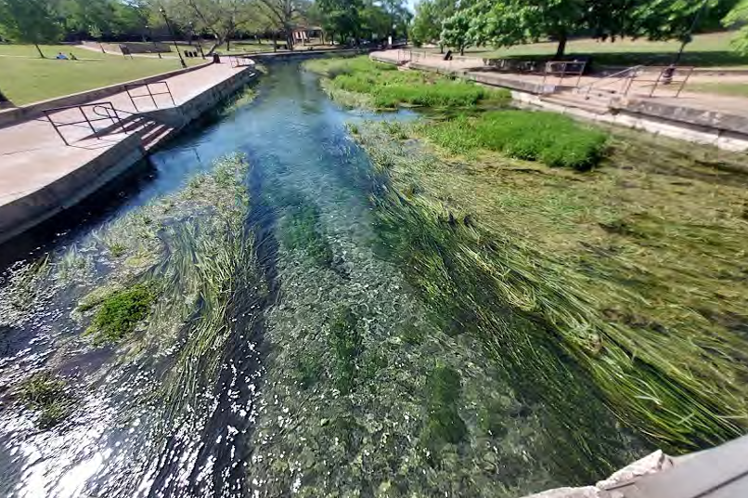
NEXT STEPS
Supporting Measures
MONITORING
RESEARCH
REFUGIA
Water Quality and Biological Monitoring
Applied Research
Edwards Aquifer Refugia Program
San Marcos salamander monitoring protocol
CSRB genetics across droughts
Comal Springs dryopid monitoring protocol
Data management

Slide 29
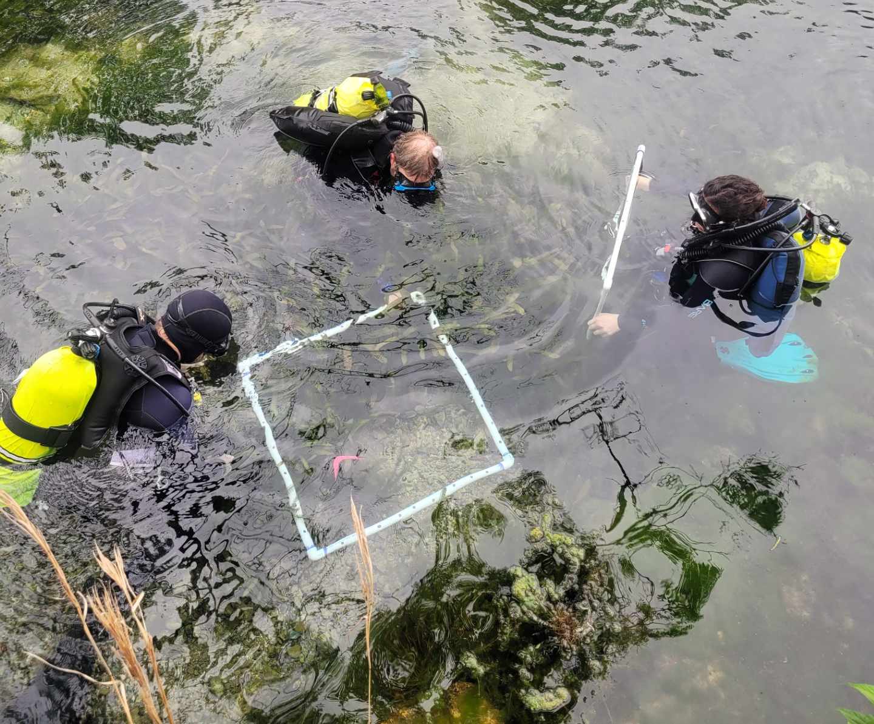
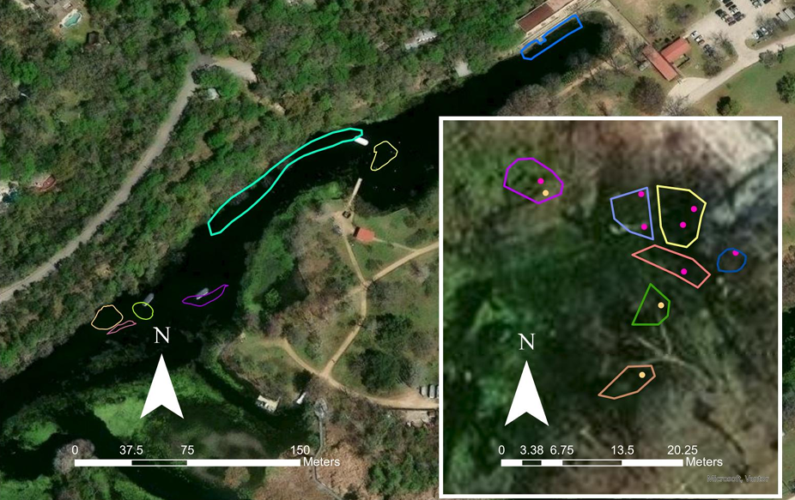
San Marcos salamander monitoring protocol
Goal: Develop sampling and analytical protocols to monitor occupancy and abundance dynamics of the San Marcos salamander.
Sampling occurred 2025-2026 for a total of 9 sampling events per year. Switched from transect to quadrat (0.5 m²) sampling in 2026. ~30% occupied habitat sampled.
Occupancy models look promising with site covariates substrate type and spring presence as top predictors.
Track juvenile and adults
Add fourth sampling event
per year
Final report will be finished by December 2026 with plans to complete an additional sampling event in 2027.

Slide 30
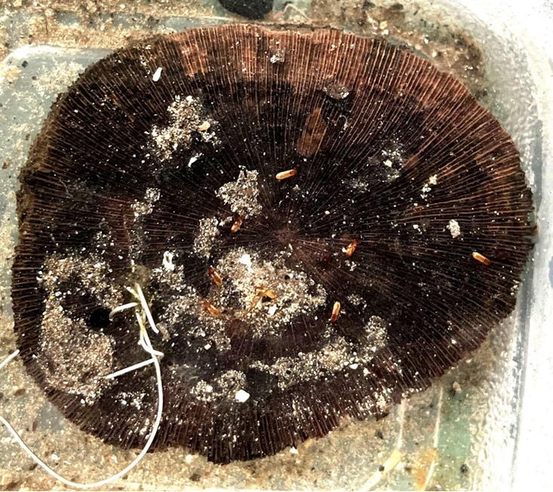
Comal Springs dryopid beetle monitoring protocol
Goal: Develop monitoring protocols for the previously unmonitored Comal Springs dryopid beetle.
Evaluate and standardize the use of wooden discs to capture the animal. Wooden disc have recently been proven as an effective capture technique during Refugia collections.
2026 findings:
Low flows limited areas that could be sampled for much of the year.
Spring Island served as the most useful area to test wooden disc techniques.
Early data suggests CSDB are more common or detectable during February-April.
Field sampling will be complete by end of 2026 with report available in 2027.

Slide 31
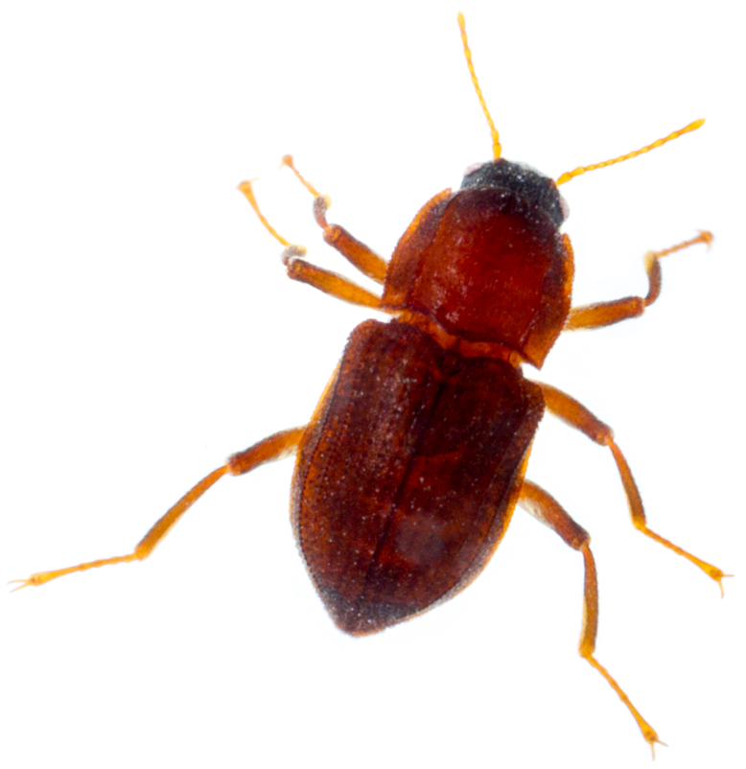
Comal Springs dryopid beetle monitoring protocol
Goal: Examine population genetics of the Comal Springs riffle beetle based on collected specimens from 2007-2024.
Estimate genetic diversity, patterns of gene flow, and population structure for each locality and temporal sample (n=4) and assess change over time.
Estimate effective population sizes at each locality and explore if there is evidence that any populations have gone through a genetic bottleneck.
2026 progress: Individuals of CSRB and CSDB were sent to genome sequencing lab. CSDB extraction was successful and ready for sequencing. CSRB extraction unsuccessful, additional specimens being sent to lab.
Final report planned by end of 2027.

Slide 32
EAHCP Data Management
Goal: Develop a simple, public-facing Shiny-based data portal that allows users to query, filter, and download approved EAHCP environmental monitoring datasets.
Provides access to core EAHCP datasets.
Focused on data discovery and standardized downloads, not analysis, modeling, or interpretation.
Built around a maintainable, configuration-driven framework so EAA can update datasets, metadata, schemas, and download packages annually without rebuilding the application.
Presently, in the data standardization and architecture design phase. Plan to hand off to a developer early 2027.

Slide 33
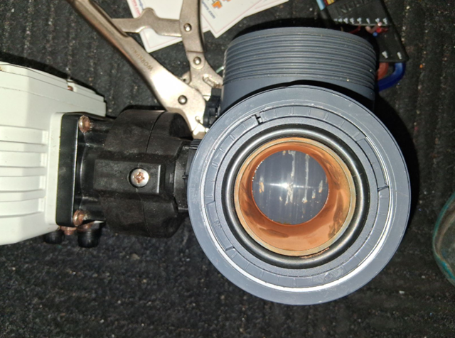
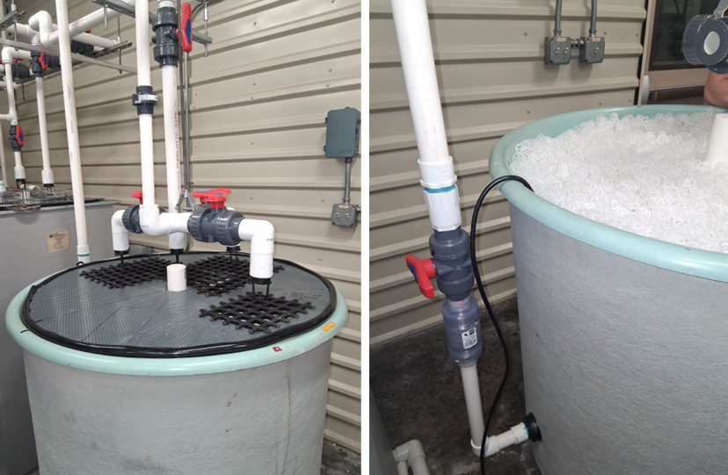
Refugia Program
Gas supersaturation event occurred at the Uvalde hatchery on June 6th resulting in the loss of 231 San Marcos salamanders and 92 Texas blind salamanders.
There was an interruption of power to the well pump and a malfunction of the diversion valve when supersaturated water was detected. A chunk of calcium carbonate was wedged into the valve allowing it to not fully close.
New standard operating procedures have been adopted:
Diversion valve exercised weekly and will be broken down and cleaned or replaced on a bi-annual basis.
Off-gassing chambers installed to reduce saturated gas before entering systems.

