Slide 1
EAA Presentation

Slide 2
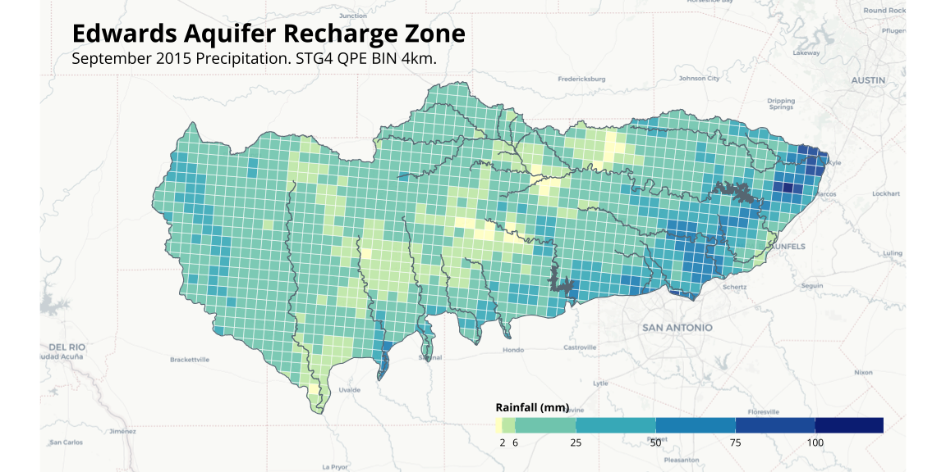
Recharge Zone Map - Light Mode

Slide 3
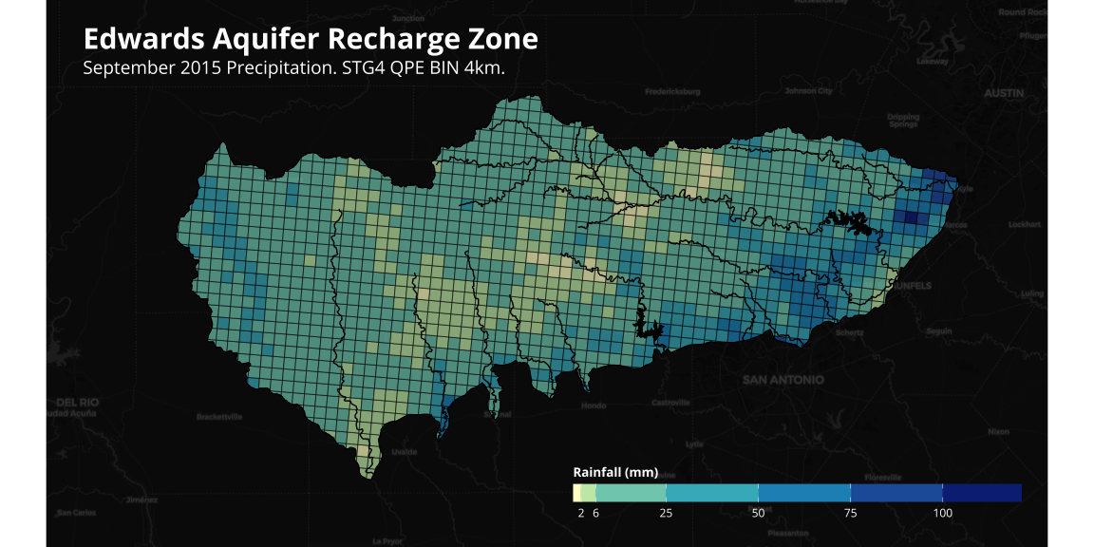
Recharge Zone Map - Dark Mode

Slide 4
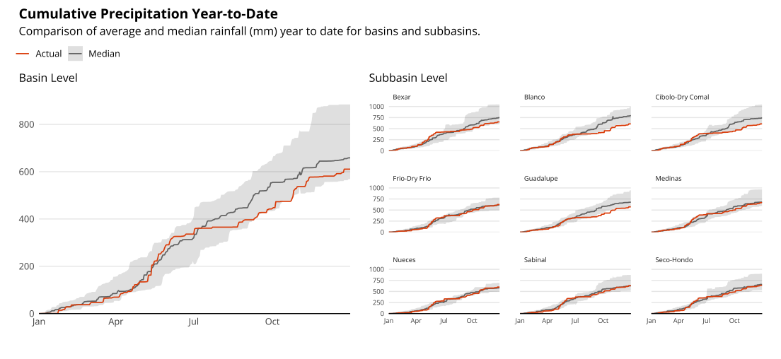
Ribbon Graph - Total + Facets

