Slide 1
Two Roads to Diversity:
Input Noise Sharpens, Negative Gradients Explore
Anna Grebenchtchikova & Chung Wong Stanford CS224R · Spring 2026
1

Slide 2
Compute is the new gold — and ‘diversity’ is how RL spends it
Exploration is expensive
‘Diversity’ is two knobs, not one.
$ + GPU
compute you pay for
Input noise
sharpens (entropy ↓)
tokens
RL burns them exploring
Negative gradient (e3)
explores (entropy ↑)
reasoning
the capability you want
Distinct — even opposing — interventions that happen to share one word.
RL-for-reasoning improves by exploring — and exploration costs tokens.
2

Slide 3
Today’s recipe for ‘diversity’ gives inconsistent returns
Do learned abstractions (RLAD) help? It depends on the model and the benchmark.
AIME
DeepScaleR
AMC
If a content-rich hint helps on one benchmark and hurts on another …
Qwen3-1.7B
▲ +2.5
▲ +1.9
▼ −8.4
+ DAPO
▼ −3.0
▲ +0.2
▼ −4.4
how much of the effect is the content of the hint — versus just perturbing the input?
+ RLAD
▲ +4.4
▲ +1.3
▲ +1.1
▲ abstractions help ▼ abstractions hurt
Our test: replace meaningful hints with the simplest content-free alternative — random trivia.
Δ = change w/o → w/ abstractions (avg). Source: Qu et al., RLAD (2025), Table 2.
3

Slide 4
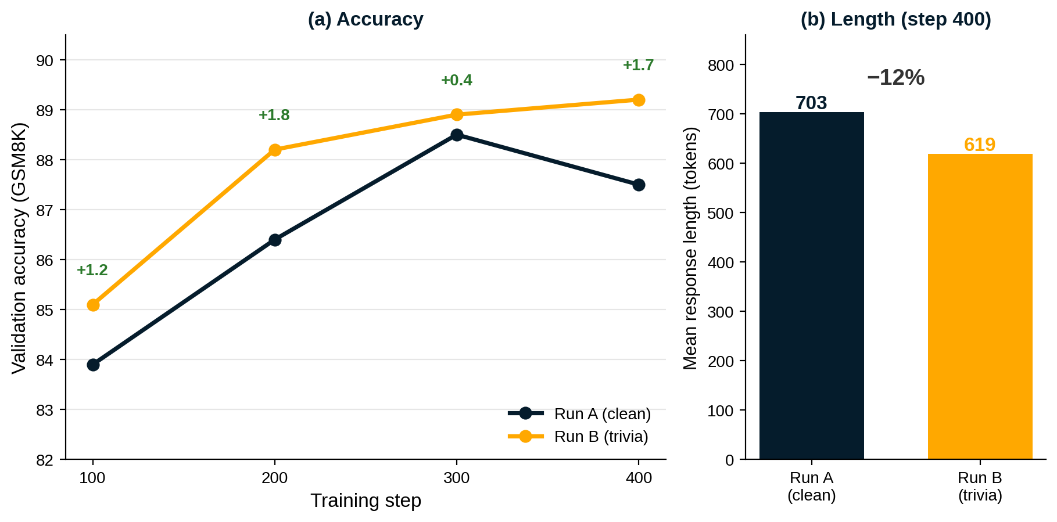
A one-line trick matched accuracy at lower cost — so we stress-tested it
Initial result
Trivia (Run B) matched clean accuracy with ~12% shorter responses.
What we ran
GRPO
clean · trivia
e3
clean · trivia · mixed
MATH
clean · trivia
Step-limited: ‘mixed’ = a 50/50 batch mixture, not more compute or data.
Initial GSM8K runs (later reruns differ — reconciled in the final report).
4

Slide 5
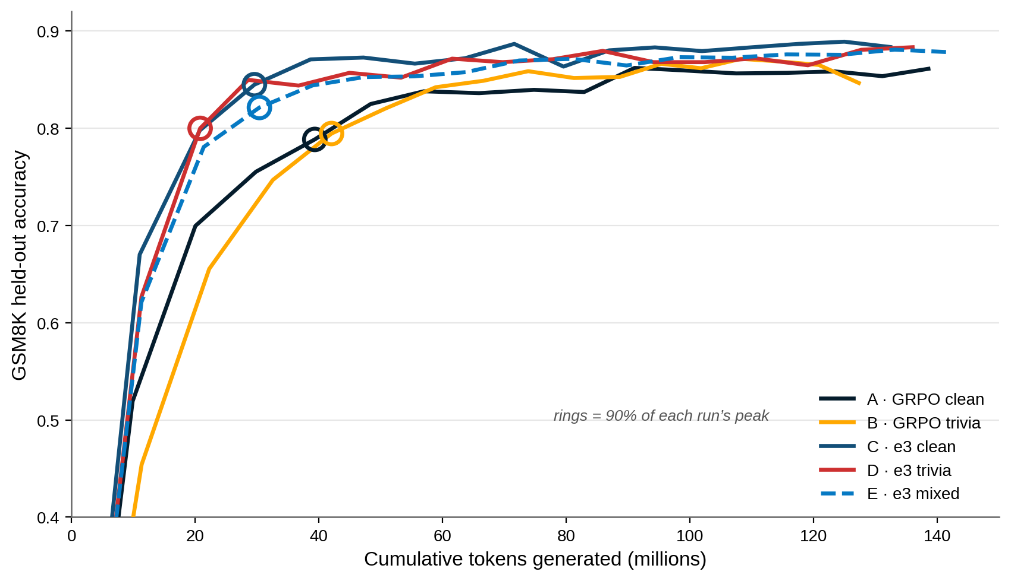
Trivia keeps accuracy and reaches peak on roughly half the tokens
Accuracy preserved
in-distribution, no cost
Truncations 16% → 14%
fewer cut-off answers
~21M
vs ~40M tokens to peak ↓
e3 + trivia (D) vs GRPO clean (A)
5

Slide 6
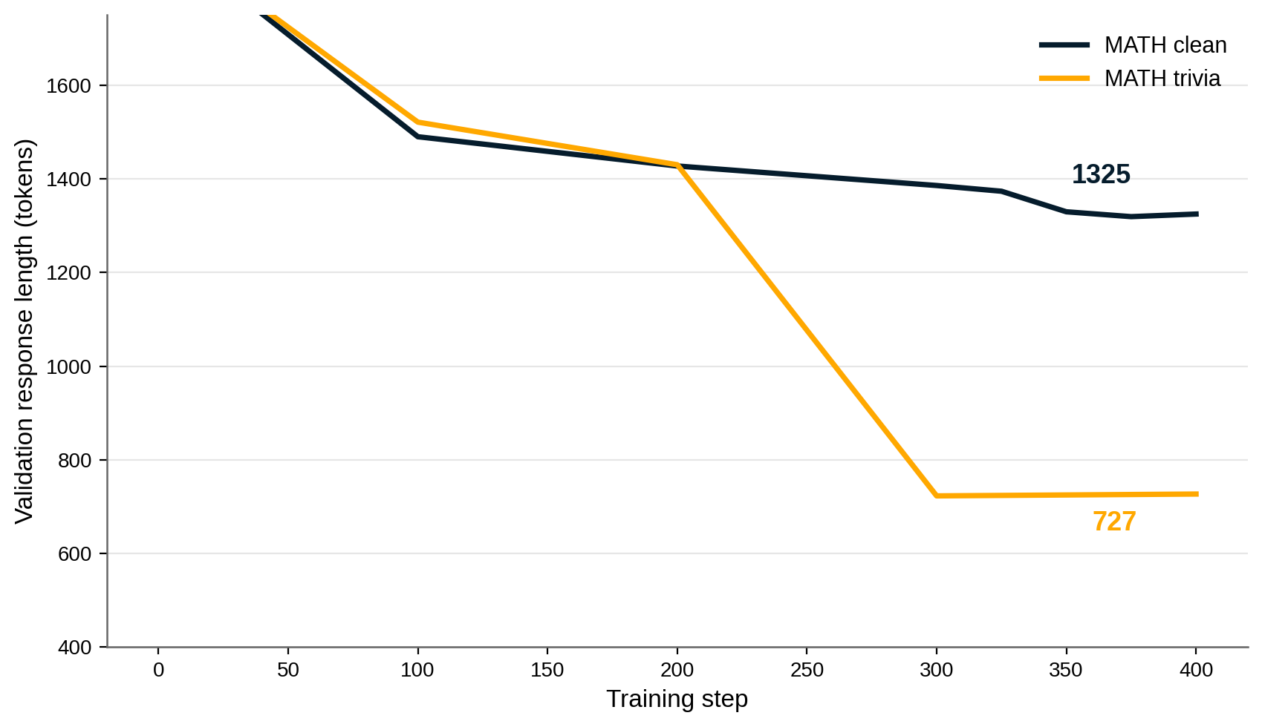
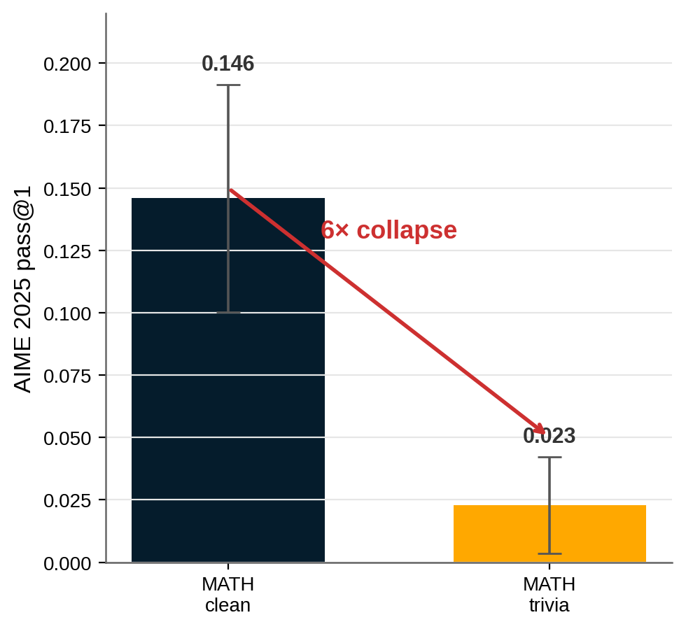
On MATH the model gets dramatically leaner — for a 2-point price
≈45% leaner
for ~2pp accuracy
Same speed, fewer tokens → trivia finished inside the 24h budget; clean exceeded the cap and had to be stitched.
… but out-of-distribution transfer (AIME 2025) collapses 6×.
In-distribution: ≈45% leaner (1325 → 727 tokens) for ~2pp accuracy.
Next: content-aware (e.g. Fibonacci) trivia could do even better.
6

Slide 7
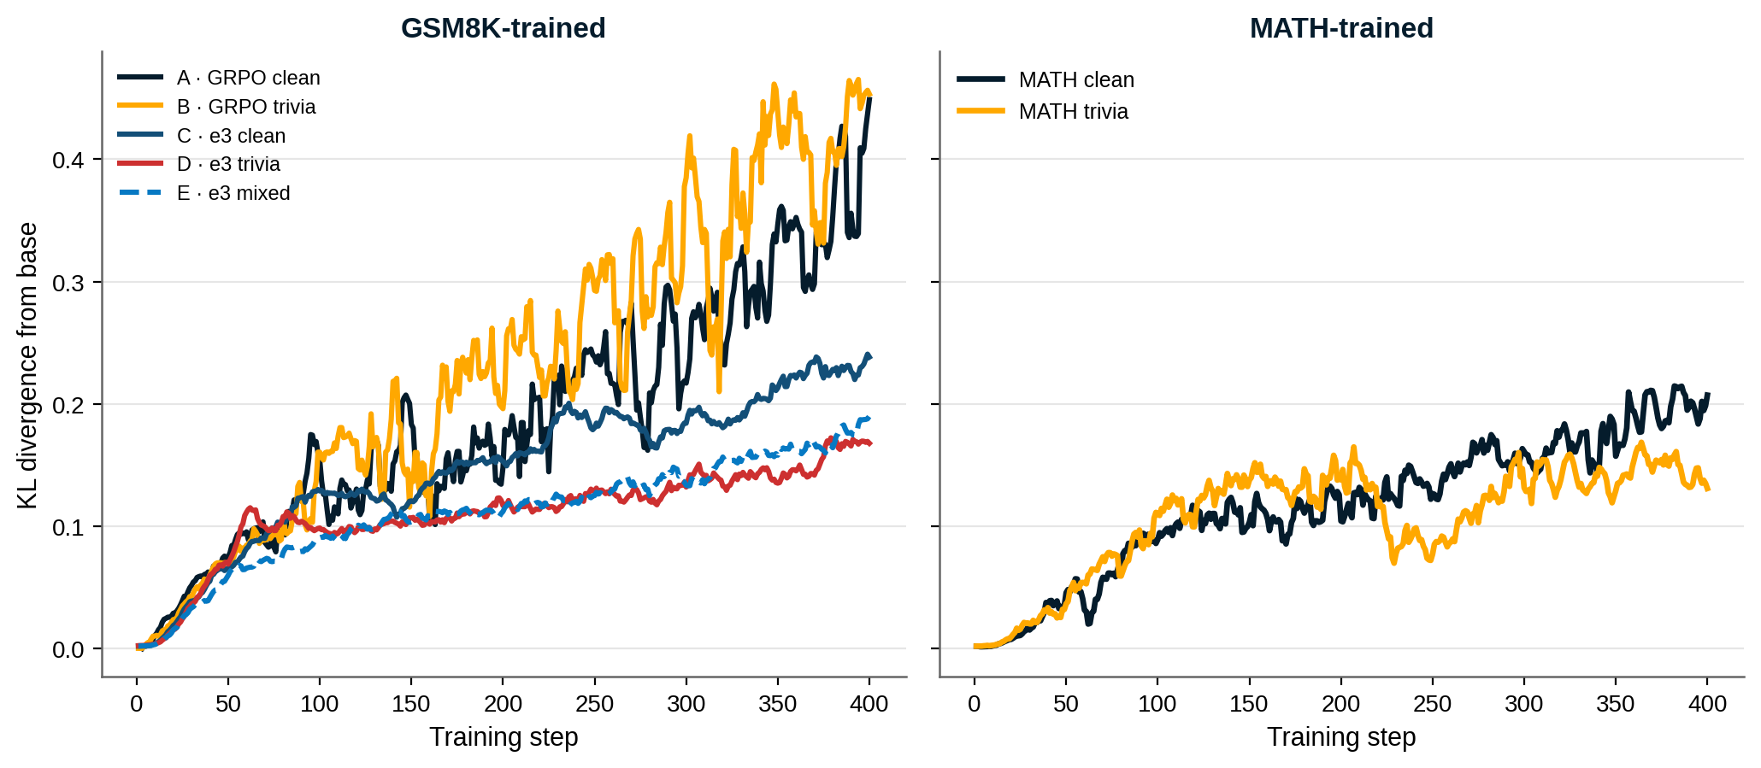
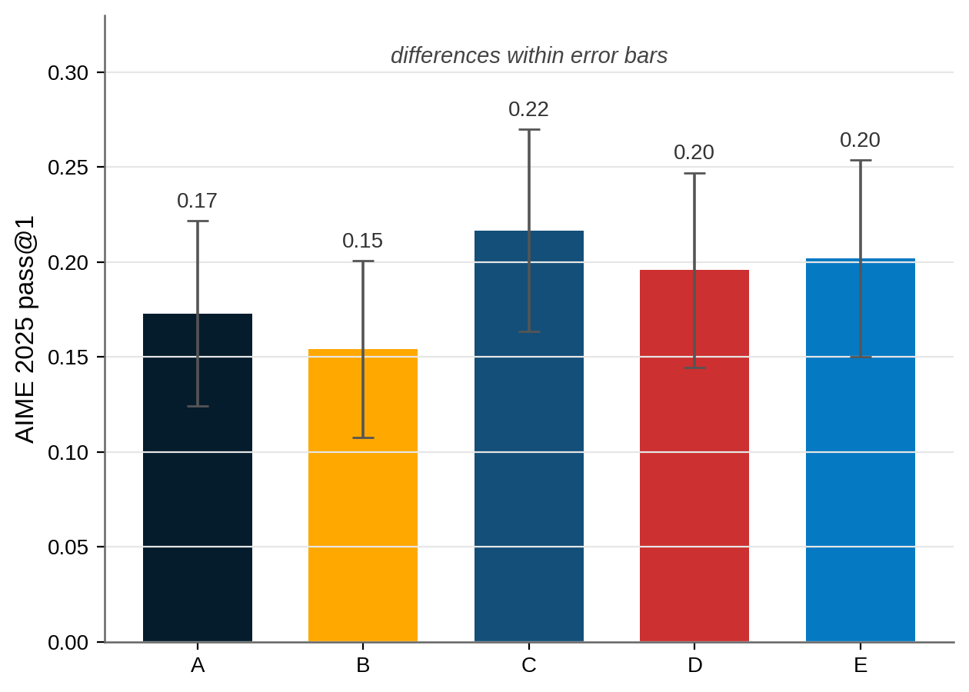
The mechanism: trivia sharpens, e3 explores — opposite knobs
Input noise
entropy ↓ · sharpen
Negative gradient
entropy ↑ · explore
All e3 runs stay far closer to base than either GRPO run.
The twist. MATH-trivia drifts least from base, yet transfers worst (AIME 0.023). Low KL is necessary, not sufficient for generalisation.
Entropy: GRPO & trivia collapse (~.02); e3 stays high (.13–.18). GSM8K-trained AIME gaps sit within error bars — only the e3 gradient is a clear lever.
7

Slide 8
Together they’re the sweet spot — and here’s where it goes next
Where it goes next
Trivia efficiency (↓ tokens)
Domain / content-aware trivia on MATH
e3 + trivia most token-efficient AND closest to base
More AIME conditions, with error bars
e3 exploration (closest to base)
Scale to o4-mini — ties to RLAD’s weak-to-strong
e3: Setlur et al. 2025 · RLAD: Qu et al. 2025 · DAPO: Yu et al. 2025 · Yue et al. 2025 · Reasoning Cache: Wu et al. 2026
8

