Slide 1

GO-FEED
SEA Final Project
COMPFEST X GO-JEK
Available at : https://github.com/cfx-cv/go-feed.git

Slide 2

Hello, we are
Devin
Nicky
Jojo
Max

Slide 3

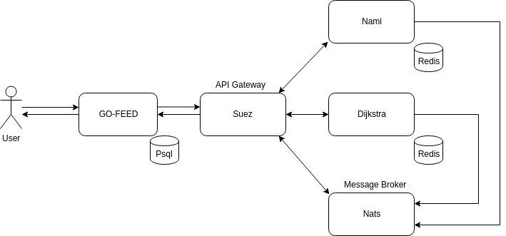
Diagram

Slide 4
DEMO -

Slide 5
Thank You

Slide 6
QnA

