Slide 1
Machine Learning Project
Charles Garman, Valentine Schmidt, Joel Thompson

Slide 2
Dataset
Subject: top 50 bestselling books from Amazon 2009-2019
Columns: Name, Author, User Rating, Reviews, Price, Year, Genre
Total Entries: 550
Source: kaggle.com
Dataset Author: Sooter Saalu
Date: October 2020

Slide 3
Objectives
Predict user rating value using other columns as input attributes
Compare human intuition between attributes and rating with machine prediction
How does human intuition compare with machine learning models?

Slide 4
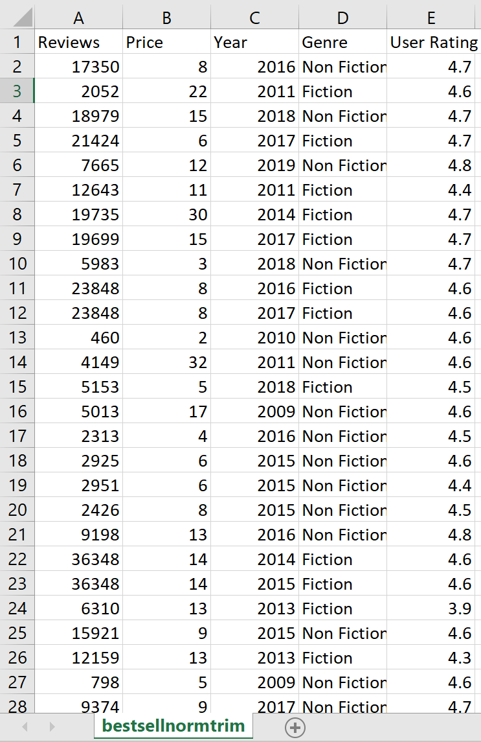
Design & Preprocessing
Programmed in Python with Scikit-Learn and pandas using the Spyder IDE
Removed name and author columns
Repositioned user ratings to rightmost side

Slide 5
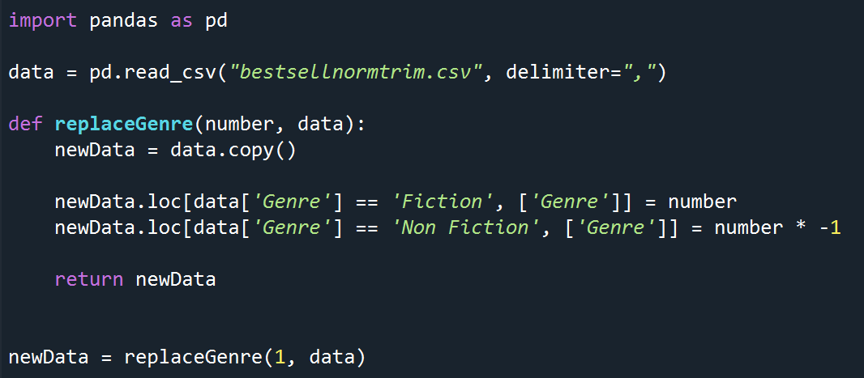
Design & Preprocessing cont.
Genre column is problematic since it was categorical
Used pandas DataFrame to write a function that replaces categorical data type with values
Fiction mapped to value supplied and Non Fiction for opposite value
Function returns dataset with replaced numerical parameters

Slide 6
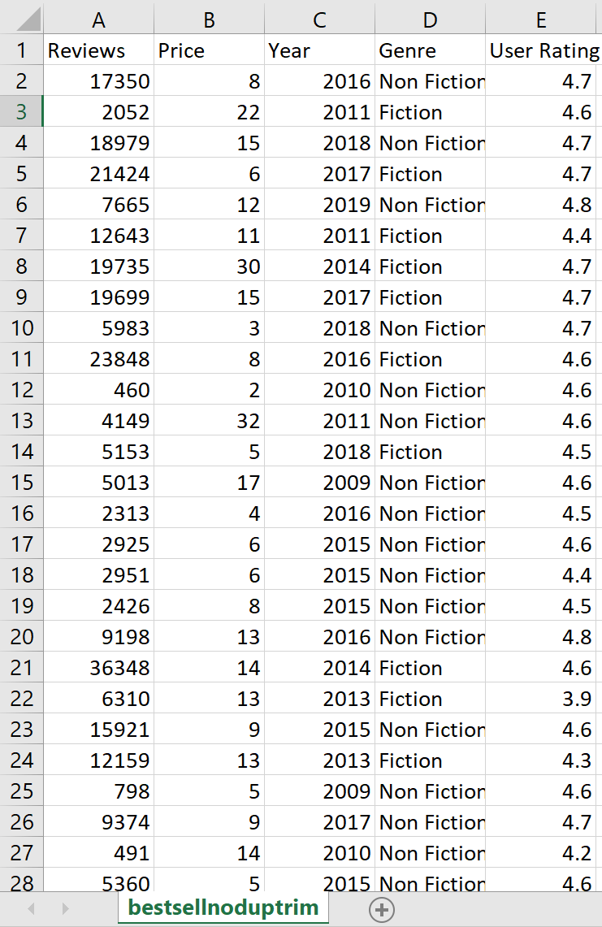
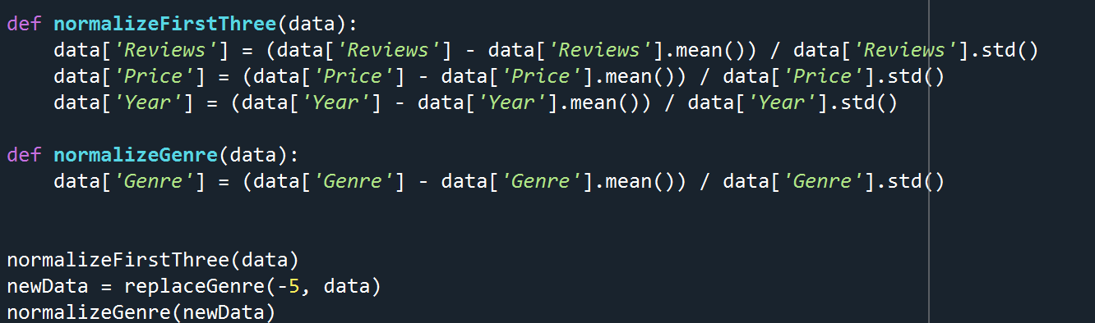
Design & Preprocessing cont.
Normalized columns have a mean of 0 and a standard deviation of 1
Duplicate data is removed using Microsoft Excel
Dataset with no duplicates consists of 350 entries
Oldest entry of multiple entries were left

Slide 7

Training and Testing
Used both normalized datasets with and without duplicates for comparison
First four columns converted to numpy array 'X'
Final column converted to numpy array 'y'

Slide 8
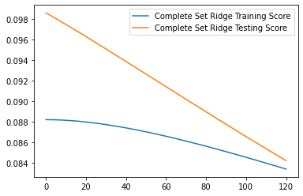
Training and Testing: Ridge Regression
Dataset: Complete
Model Selection: Train-Test Split
Alpha: 0
Score: 0.09859999943205422

Slide 9
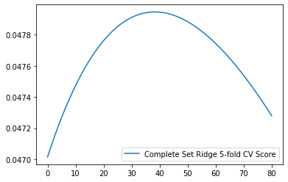
Training and Testing: Ridge Regression cont.
Dataset: Complete
Model Selection: 5-fold Cross Validation
Alpha: 38.27827827827828
Score: 0.0479460568457360

Slide 10
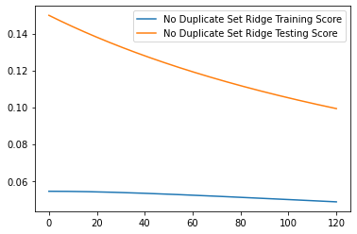
Training and Testing: Ridge Regression cont.
Dataset: No Duplicates
Model Selection: Train-Test Split
Alpha: 0
Score: 0.14991272421329827

Slide 11
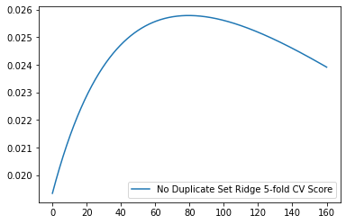
Training and Testing: Ridge Regression cont.
Dataset: No Duplicates
Model Selection: 5-fold Cross Validation
Alpha: 79.43943943943944
Score: 0.0257838977468253

Slide 12
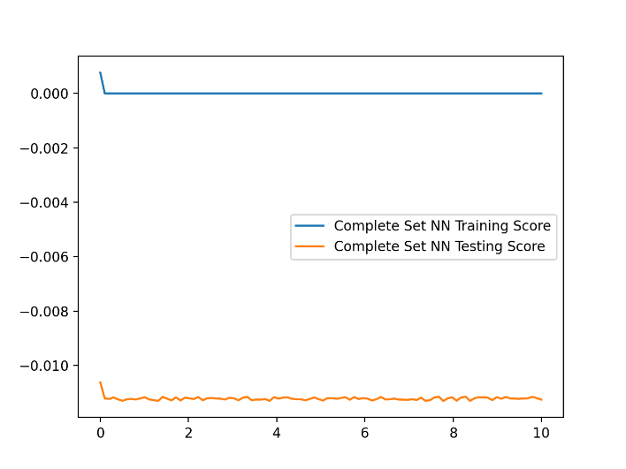
Training and Testing: Neural Networks
Dataset: Complete
Model selection: Train-Test Split
Hidden layer sizes: 1, 2, 8, 10, 11
Random state of 1
Max iterations: 5,000,000,000
Activation function: logistic sigmoid
Alpha: 0
Solver: lbfgs
Score: -0.011

Slide 13
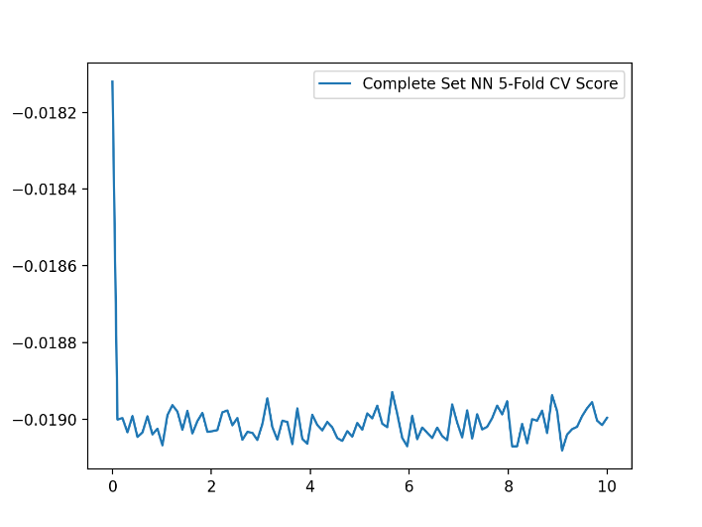
Training and Testing: Neural Networks cont.
Dataset: Complete
Model selection: 5-fold Cross Validation
Hidden layer sizes: 1, 2, 8, 10, 11
Random state: 1
Max iterations: 5,000,000,000
Activation function: logistic sigmoid
Alpha: 0
Solver: lbfgs
Score: -0.0181

Slide 14
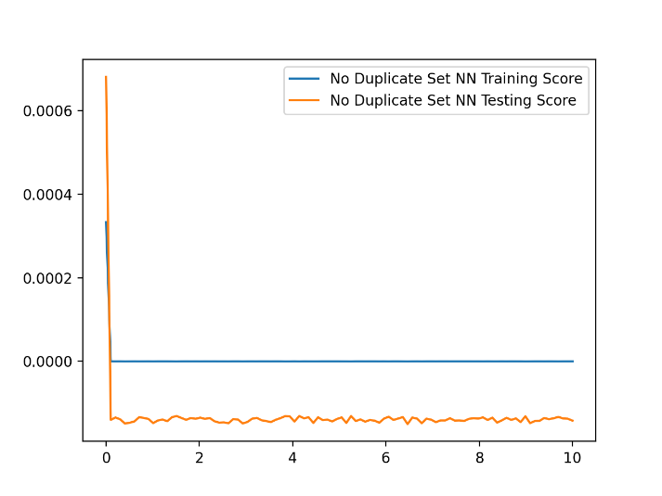
Training and Testing: Neural Networks cont.
Dataset: No Duplicates
Model Selection: Train-Test Split
Hidden layer sizes: 2, 4, 6, 8, 10
Random state: 1
Max iterations: 5,000,000,000
Activation function: logistic sigmoid
Alpha: 0
Solver: lbfgs
Score: 0.0007

Slide 15
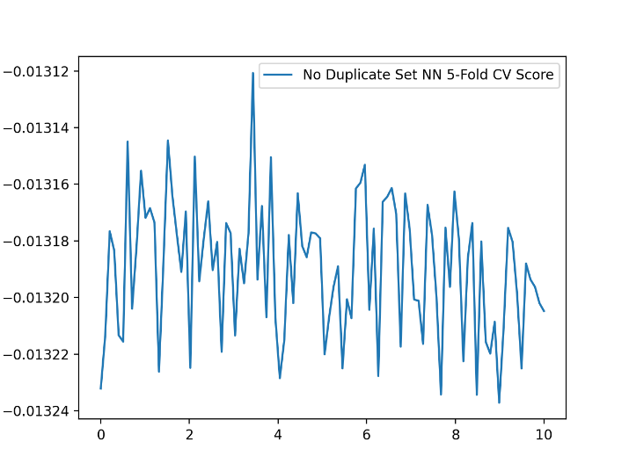
Training and Testing: Neural Networks cont.
Dataset: No Duplicates
Model Selection: 5-fold Cross Validation
Hidden layer sizes: 1, 2, 8, 10, 11
Random state: 1
Max iterations: 5,000,000,000
Activation function: logistic sigmoid
Alpha: 3.5
Solver: lbfgs
Score: -0.01312

Slide 16
Training and Testing: SVR
Dataset: Complete
Kernel: RBF
Model Selection: Train-Test Split
gamma value: 3.8891111111111103
C value: 1.566343434343434
score: 0.41444746017981693

Slide 17
Training and Testing: SVR cont.
Dataset: Complete
Kernel: RBF
Model Selection: 5-fold Cross Validation
gamma value: 0.057
C value: 0.203
Score: 0.0767435101601463

Slide 18
Training and Testing: SVR cont.
Dataset: No Duplicates
Kernel: RBF
Model Selection: Train-Test Split
Gamma value: 3.131686868686868
C value: 0.7584242424242423
Score: 0.3119525826546068

Slide 19
Training and Testing: SVR cont.
Dataset: No Duplicates
Kernel: RBF
Model Selection: 5-fold Cross Validation
Gamma value: 0.203
C value: 0.10200000000000001
Score: 0.03906219174649741

Slide 20
Results and Conclusion
Best result was from SVM with a score of 0.41444746017981693
Scores from all models were low
More data points could improve performance
More columns could improve performance
There could be no correlation between other attributes and user rating

