Slide 1
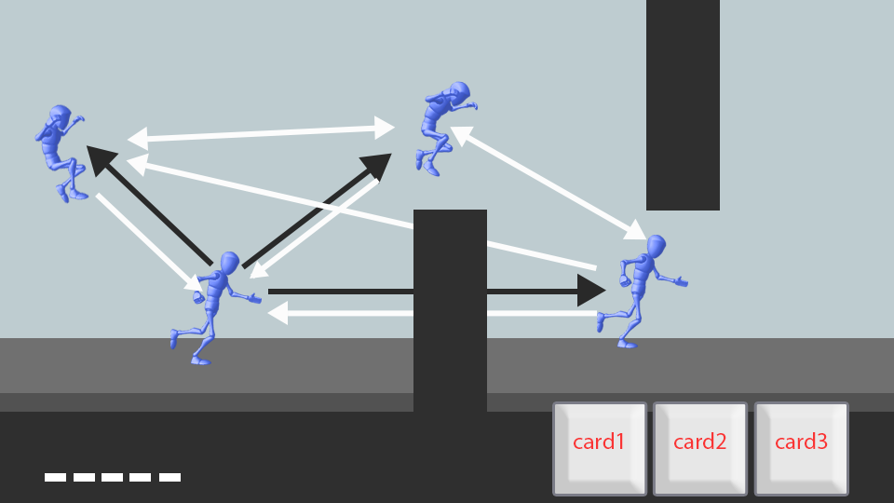
Koginja

Slide 2
Platform: Android/IOS
Intended to release for tablet and phone devices for larger audience, and easier control..

Slide 3
Genre: Platformer/Puzzle/Action
The player must explore the entire map gathering keys required to open the queens room containing the precious golden poop
The map is divided to different levels that consists of Puzzle Rooms like the legend of zelda temples and Action Rooms that consists of tricky level designs that the player must complete in order to clear.

Slide 4
Selling Points
Challenging level designs'
Easy/Simple Controls can be played using 1 hand
Physics Driven Traps/Puzzles
Challenging Boss Monsters
Platformer Exploration
Subtle Humor

Slide 5
Story Overview:
Kogimaru is on a quest to steal a valuable treasure from the queen. Help him escape traps and solve puzzles by dashing , grabbing to walls dashing through obstacles.

Slide 6
Basic Mechanics

Slide 7
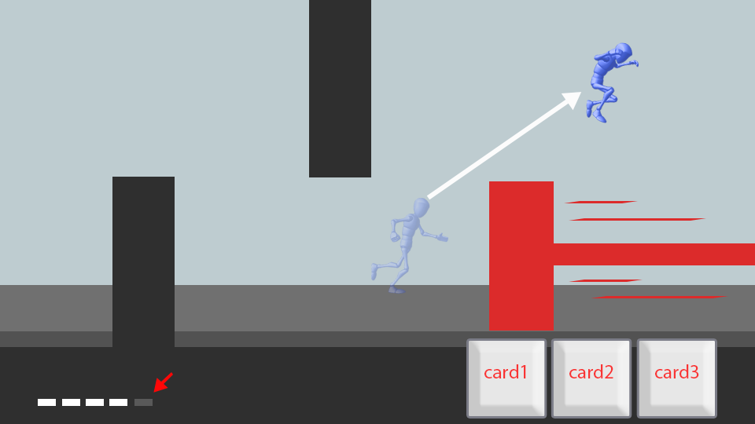
Evade by swiping to the direction
-reduce 1blink point per evade (5 total blink points)
- blink points regenerate every 10 secs.

Slide 8
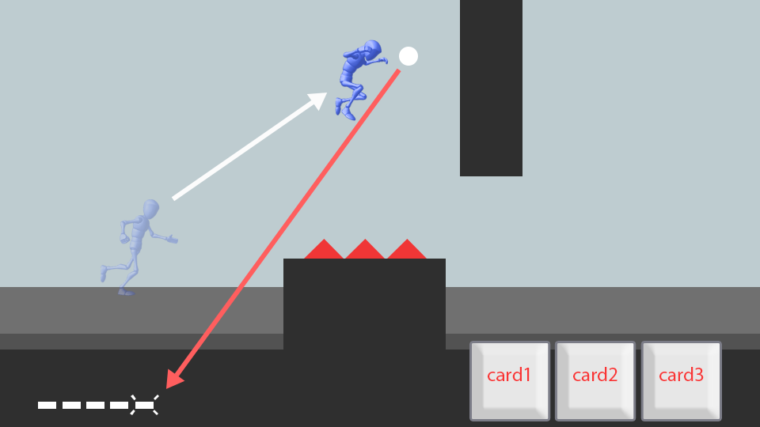
Blink orbs
-adds 1 blink point
- blink points regenerate every 10 secs.

Slide 9
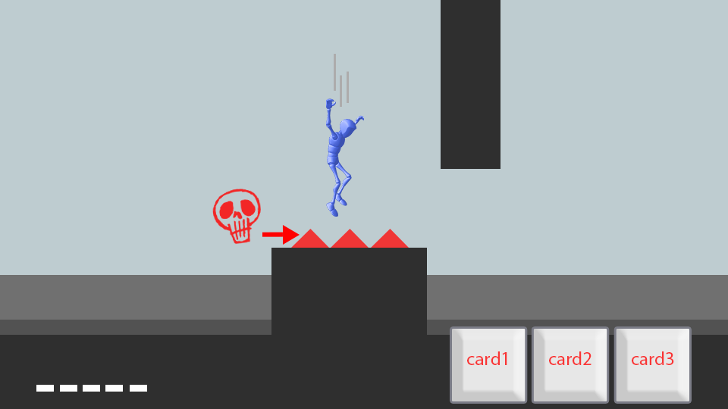
Harmful obstacles
- avoid some obstacles that are deadly for the player

Slide 10
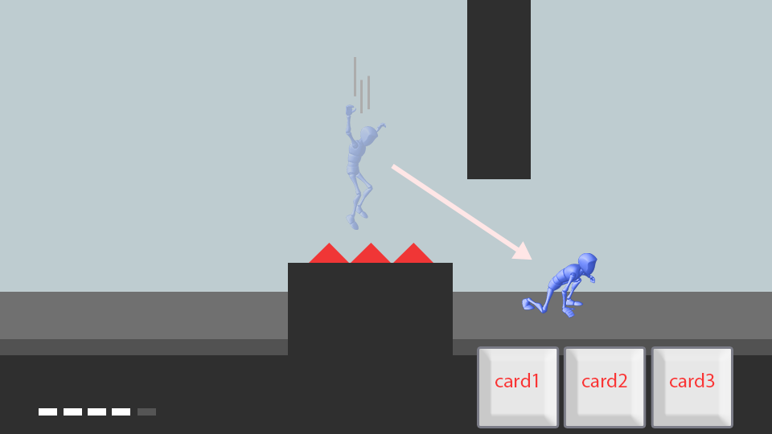
Blinking on mid air
- blink to safety to avoid obstacles

Slide 11
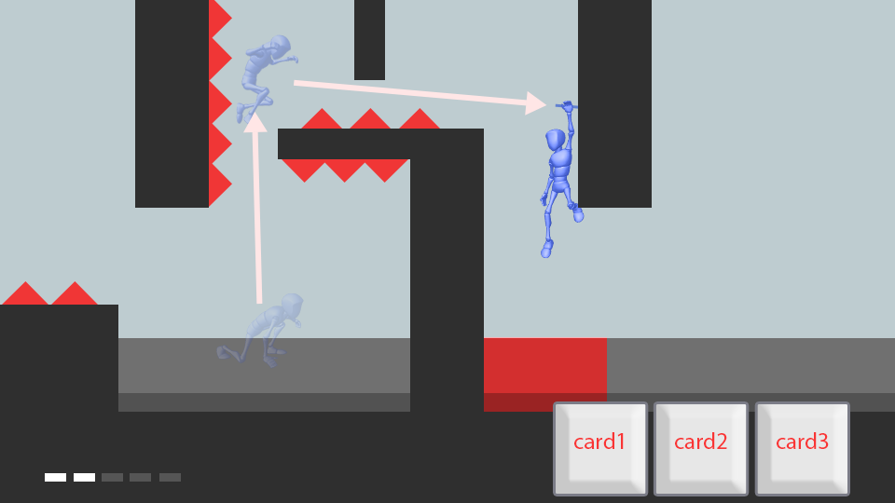
Blinking on walls
- aim blink projectiles on walls to prevent falling(some walls cant be used to hang player)
- tap to release from hanging.
- player cant blink while hanging.

Slide 12
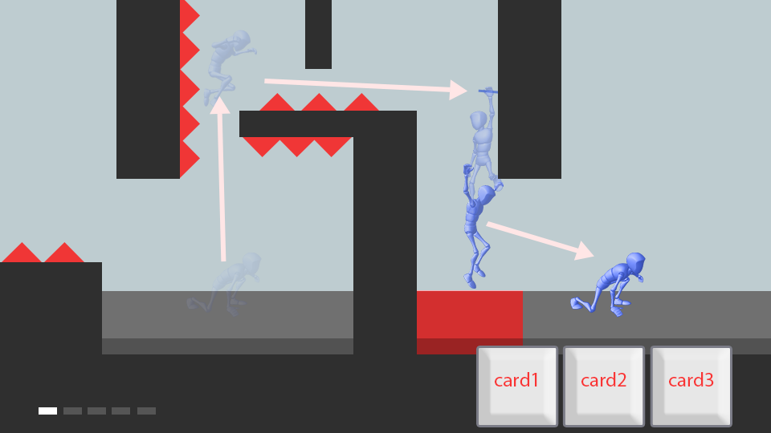
Blinking on walls
- tap to release from hanging.
- player cant blink while hanging.

