Slide 1
Introduction to Machine Learning

Slide 2
What is machine learning?
Machine learning is the use of statistical algorithms that can learn from data and generalize to unseen (new) data.
This learning allows these algorithms to perform tasks without explicit instructions from the user.
Build a model which can be used to predict values for new data

Slide 3
Machine Learning - Training
Evaluation & Reiteration
Data
Data
Model
…
Output
Data
Data
Data

Slide 4
Machine Learning
(Trained)
(New)
Model
Data
Prediction

Slide 5
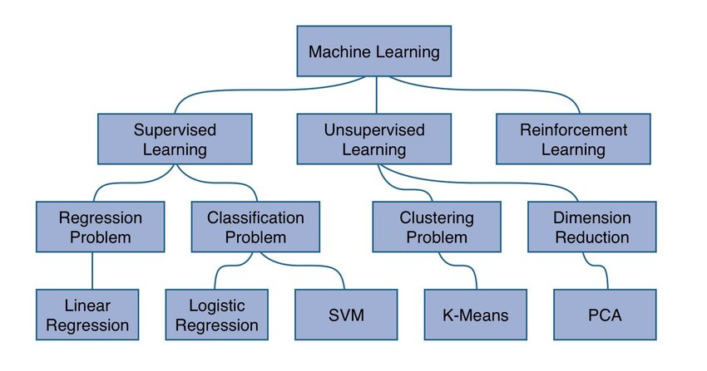
Machine Learning Hierarchy
Source

Slide 6
Supervised Vs. Unsupervised Learning
Supervised learning - uncover patterns in the data which show relations between features (data attributes) and a target attribute (or class)
Examples: Linear regression, logistic regression (classification), decision trees
Unsupervised learning - There is no target in the data so attributes of features are compared amongst themselves
Examples: Clustering, Principal Component Analysis (PCA)

Slide 7
Supervised Learning - Splitting the data
Features
Target
The training set constructs the model
Training
…
…
The test set remains unseen by the model
Used to evaluate the performance
…
…
Test

Slide 8
Supervised Learning - Training the model
Training Set
Model evaluated and parameters updated
Loss
Features
Prediction
Target
MODEL
…
…
…

Slide 9
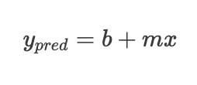
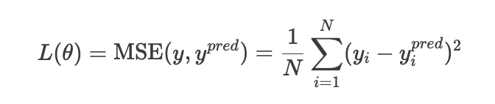
Supervised Learning - Loss Function
Parameters for the model are chosen by minimizing the loss (error)
For linear regression:
Source
Intercept
Slope

Slide 10
Supervised Learning - Evaluating the model
Test Set
Evaluation Metric
Features
Prediction
Target
MODEL
…
…
…

Slide 11
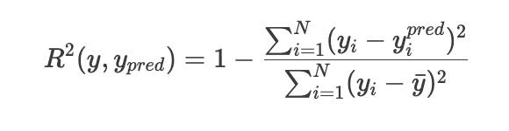
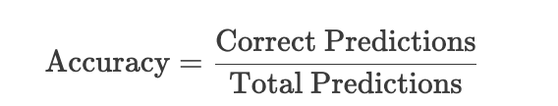
Supervised Learning - Evaluating the Model
To evaluate the model there are several metrics we can use depending on the type of model and the problem at hand
For linear regression the typical evaluation metric is R²
For classification models we will often use Accuracy, Recall, Precision or F1

Slide 12
TIME TO CODE
Use a new library scikit-learn which has many great tools for ML
Refresher on pandas and seaborn
Look at a logistic regression classification problem

