Slide 1
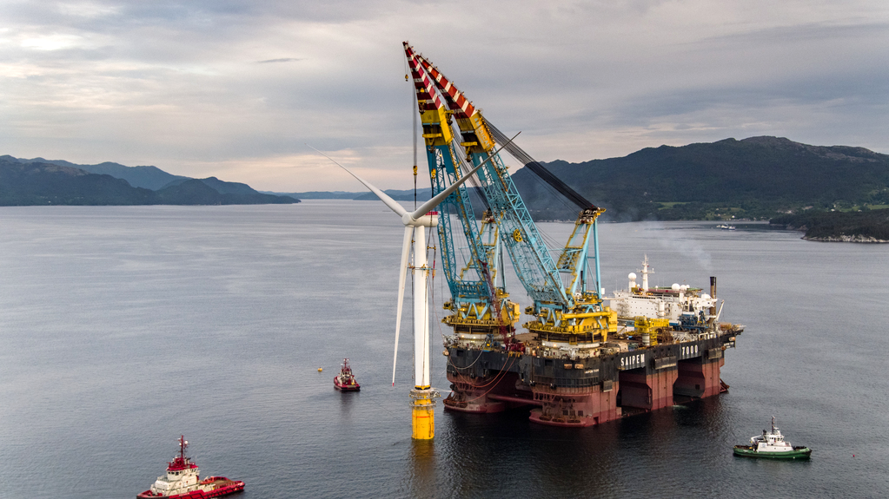






MeteoWind
LAMANI Bouabdellah
Web-GIS engineer
GALLARDO Cristobal
Ingénieur Structures
(en formation Data Science)
TIAZARA Gaëtan
Élève Ingénieur
2^{ième} année ENSG
MERZOUK Gaya
SIG
TOURNIER Thibault
Enseignant
(en formation Data Science)
Slide #1
Image © Saipem

Slide 2
1
2
3
Where to find wind data and how and in which format we acquire it …
How to convert / process ERA 5 Wind 100m U/V component, into wind speed and direction ? How to organize in a web-adapted input …
How to generate web composant, static-files and process outputs, in a GIS web-application ? How to automate that …
?
?
?
Slide #2

Slide 3

1
Where to find wind data and how and in which format we acquire it …
Request
Convert
Process
WebVisual
?
Slide #3

Slide 4
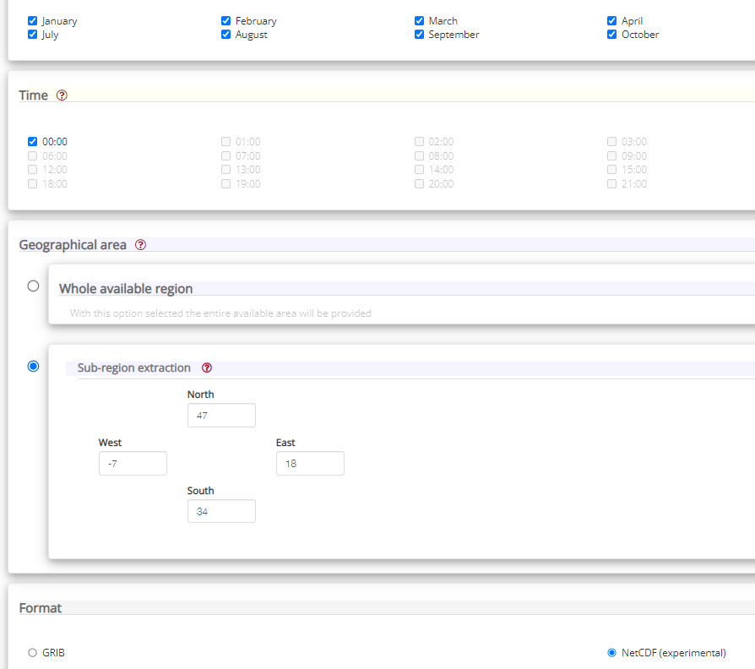

Wind 100m U/V component data acquisition
!
1979 – 2021
(42 Years)
ERA5 monthly averaged data on single levels from 1979 to present
Slide #4

Slide 5


$HOME/.cdsapirc
Wind 100m U/V component data acquisition
url: https://cds.climate.copernicus.eu/api/v2
key: 16840 : xxxxxxxx-xxxx-xxxx-xxxx-xxxxxxxxxxxxxxx
Request
1979 – 2021
(42 Years)
ERA5 monthly averaged data on single levels from 1979 to present
CDS API
Slide #5

Slide 6
2
How to convert / process ERA 5 Wind 100m U/V component, into wind speed and direction ? How to organize in a web-adapted input …
Request
Convert
Process
WebVisual
?
Slide #6

Slide 7
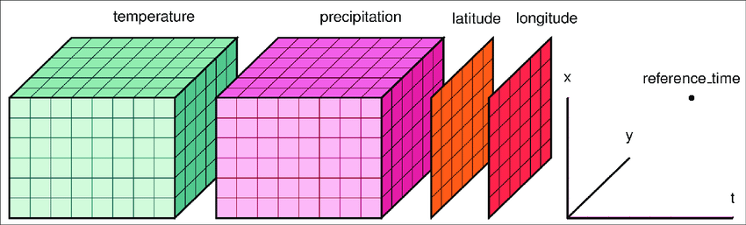
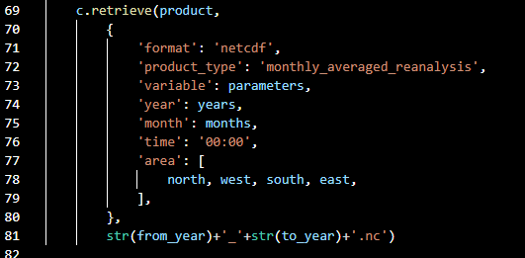
NCF file on server
Bathymetry
Wind speed
CONVERT
Script
Longitude
Latitude
Time
Wind speed
…
Bathymetry
Human activities
Fauna
Presence of infraestructure
Slide #7

Slide 8



3
User’s inputs (X, Y, T … )
How to generate web composant, static-files and process outputs, in a GIS web-application ? How to automate that …
Request
Convert
Process
WebVisual
?
Data-Frame
Functions
Slide #8

Slide 9
Questions ?
LAMANI Bouabdellah
GALLARDO Cristobal
TIAZARA
Gaëtan
MERZOUK Gaya
TOURNIER Thibault
Slide #9

