Slide 1
MLFF for UHTC Oxidation
January 2026

Slide 2
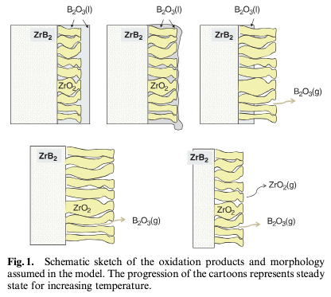
"Solid pillars, liquid roof"
O₂ (g)
ZrB₂ (s)
Parthasarathy et al. (2009). https://ceramics.onlinelibrary.wiley.com/doi/10.1111/j.1551-2916.2009.03031.x

Slide 3
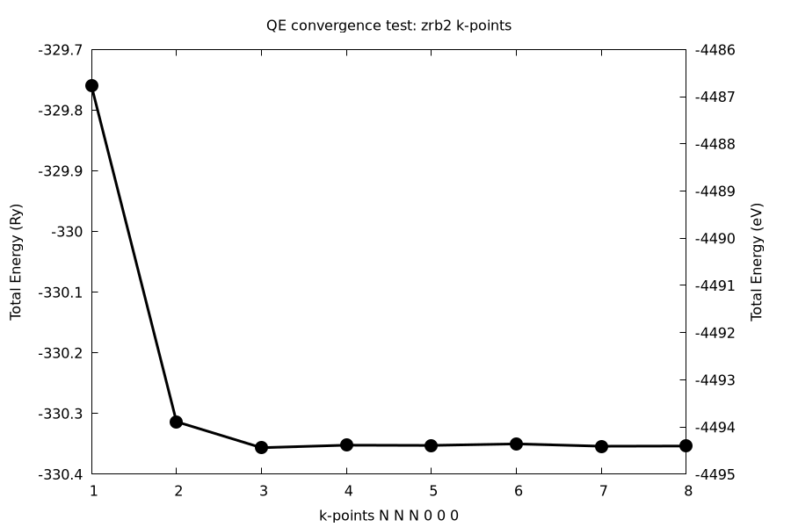
Convergence tests on bulk ZrB₂

Slide 4
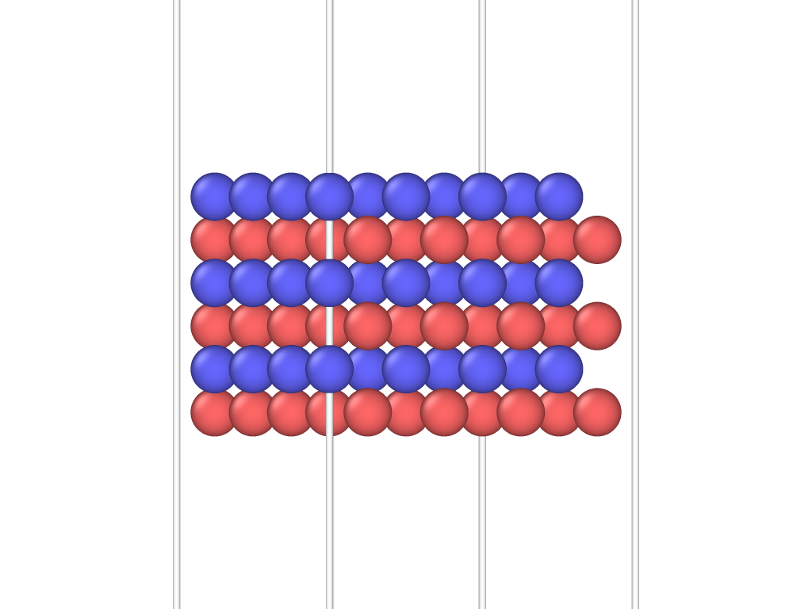
Surface construction
144 atoms
(001)

Slide 5
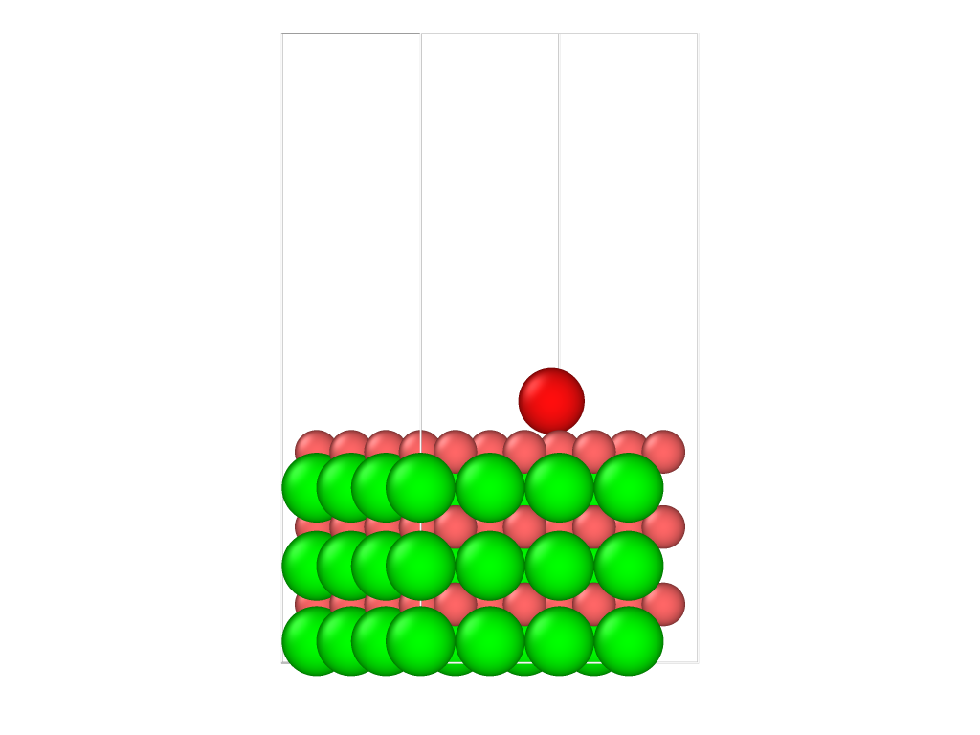
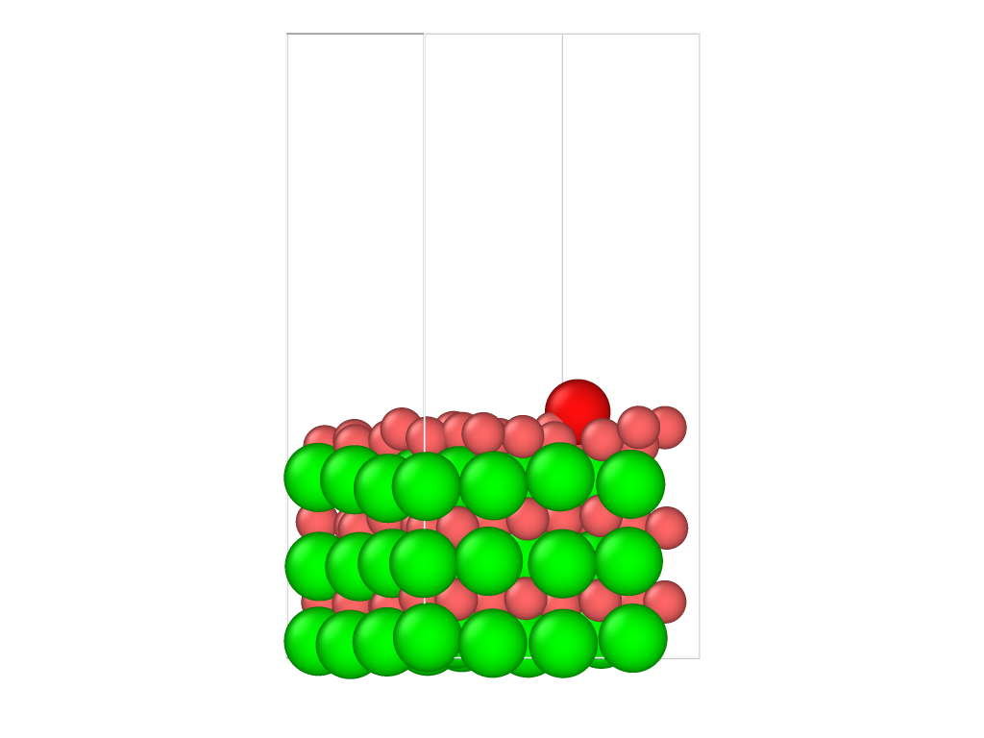
Ab initio molecular dynamics

Slide 6
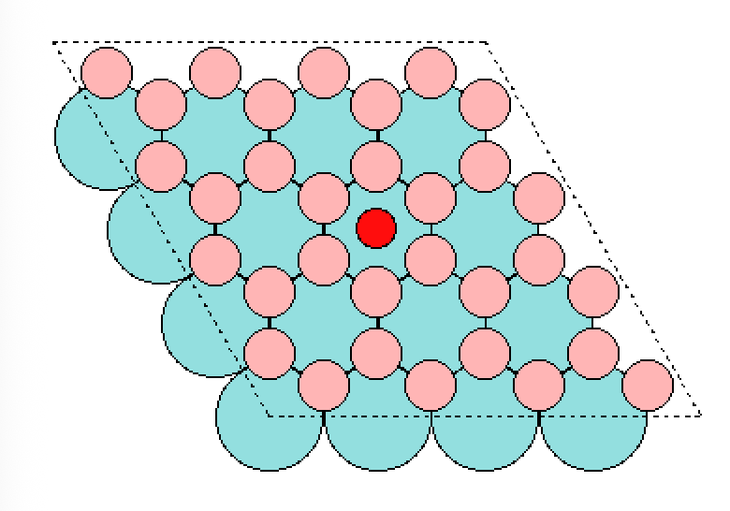
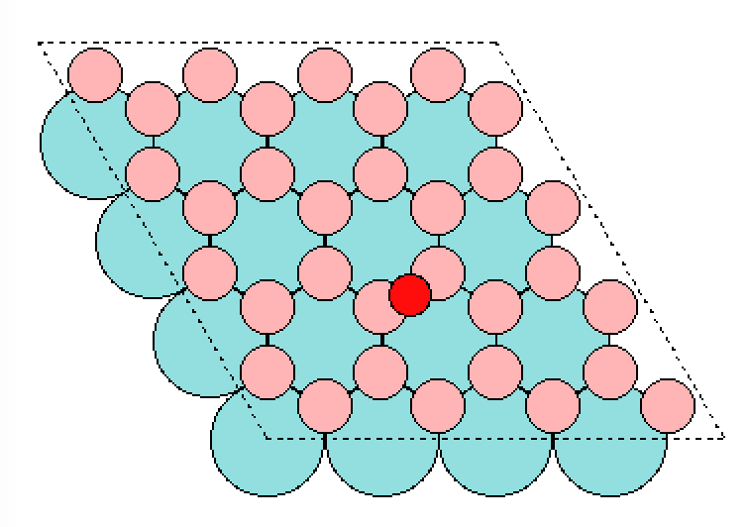
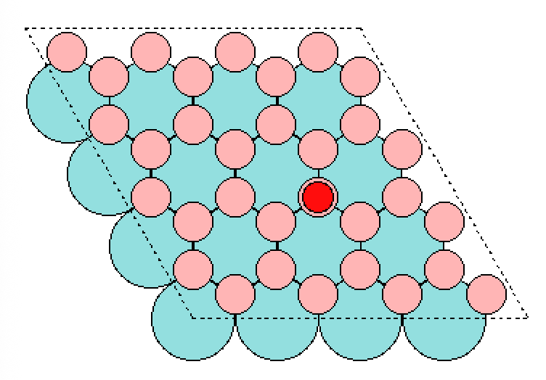
Surface symmetry: 3 adsorption sites (H, B, T)
H
B
T

Slide 7
Training: Large model
Label | E RMSE (meV/atom) | F RMSE (meV/Å) | Rel. F RMSE%
Train | 1.4 | 33.1 | 2.14
Validation | 1.5 | 46.5 | 3.05
Test | 1.4 | 45.9 | 2.96
“Patience” setting = 5 epochs
Training time = 36 hours on 64 CPUs

Slide 8
Training: Small model
Label | E RMSE (meV/atom) | F RMSE (meV/Å) | Rel. F RMSE%
Train | 2.8 | 50.4 | 3.26
Validation | 3.0 | 60.9 | 4.00
Test | 2.9 | 60.7 | 3.92
“Patience” setting = 5 epochs
Training time = 4 hours on 64 CPUs

Slide 9
Foundation models dynamics
Model Name
MACE-MP-0a
MACE-MP-0b3
MACE-MPA-0
MACE-OMAT-0
MACE-MATPES-PBE-0
MACE-MATPES-r2SCAN-0
MACE-OMOL-0

