Slide 1
git
- Distributed version contol

Slide 2

Chris von Rabenau
Cloud Architect, Redapt
Email: cgapperi@me.com
LinkedIn: https://www.linkedin.com/in/cvr/
Github: https://github.com/cgapperi

Slide 3

What is version control
Track changes
01
Manage changes
02
Over time
03

Slide 4
Why version control
Provides mechanism to manage and track changes
Easily revert to previous versions of code
Faster development
Easy collaboration
Understanding history of code
Backup

Slide 5
A short history of VCS
1972
SCCS
1982
RCS
Deltas introduced
Local version Control
1986
CVS
Client/Server
2000
SVN
Centralized version control system
Notes:
SCCS – tracked changes to files, but only one user could checkout and work on a file at a time. Whole files were tracked
- Bell Labs
RCS – Still only allowed the one user per file at a time, but introduced the concept of only tracking changes, rather than updates to the whole file
CSV – allowed multiple users to work a file at a time. Delta encoding introduced which tracks differences in a file, rather than the whole file
SVN – In a CVCS, files are stored on a centralized server where they are downloaded edited and updated to
Git – DVCS, copies of a repository and all history are downloaded by users with mechanisms for resolving differences

Slide 6

Local Version Control

Slide 7
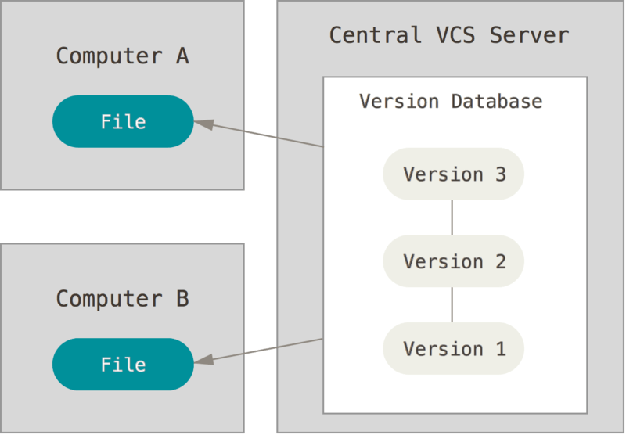
Centralized Version Control

Slide 8

Introducing git
“git means never having to say you are sorry” - PAK

Slide 9
What is git?
Linus Torvalds
Distributed version control system
All files and history come with repository
No ‘centralized’ repository
No ‘checkout’ strategy, but a full mirror

Slide 10
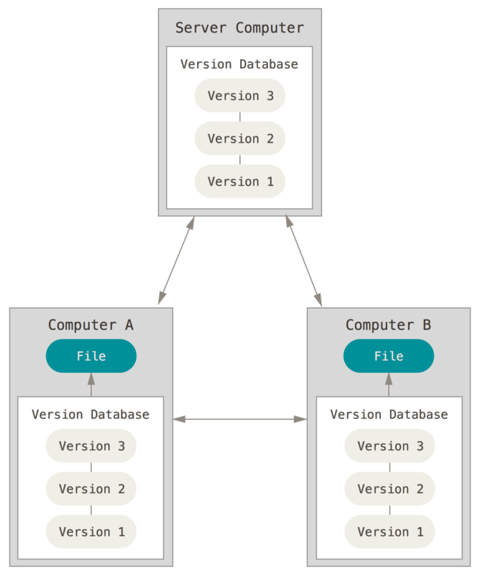
Distributed Version Control

Slide 11
Use cases
Local development
Single user development
Multi-party development

Slide 12
General concepts
Clone
Branch
Staging
Commit
SHA
log
HEAD

Slide 13
Preparing to use git
Installing git - https://git-scm.com/book/en/v2/Getting-Started-Installing-Git
Configuration:
Set user.name:
git config --global user.name "John Doe"
Set user.email:
git config --global user.email johndoe@example.com
Create userful alias (PAK):
git config --global alias.slog 'log --abbrev-commit --color=auto --decorate=short --pretty=oneline --graph --branches=* --remotes=* --tags=*'
See configuration:
git config --list

Slide 14
Let’s get started - Demo
Initiate git repository: `git init`
Create a branch: `git branch` or `git checkout –b`
Adding files: `git add`
Updates
Commits: `git commit`

Slide 15
Working with remotes
Cloning a remote: `git clone`
Forking a repo
Define a remote: `git remote`
Fetch: `git fetch`
Pull: `git pull`
Push: `git push`

Slide 16
Pulling branches in the main
Merge
Merge: `git merge`
--ff
--no-ff
Rebase
Rebase: `git rebase`
--onto
Conflict
Conflict resolution: `git mergetool`

Slide 17
Advanced concepts
`~`
Resetting:
Commit: `git reset`
File: `git checkout`
Find common ancestor: `git merge-base`
Grab a specific commit: `git cherry-pick`
Rewriting history: `git rebase –i`
Ignoring files: `.gitignore`
Removing files from index: `git rm –cached`

Slide 18

Question?

Slide 19
References
Super credit to my guru, Paul A Kennedy
Pro Git
10 years of Git: An Interview with Git Creator Linus Torvalds

