Slide 1


Blazor No way home
2023
Cristian Garrido
04/03/2023

Slide 3

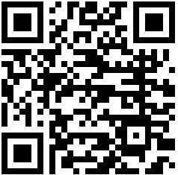
Cristian Garrido Méndez
Software Engineer & Grandma
cristiangarrido1989@gmail.com
/in/cristiangarridomendez/

Slide 4
Agenda
01
What is Blazor?
02
Blazor Server VS Blazor WASM
03
Binding & Forms
04
Components
05
Routing
06
CRUD

Slide 5

What is Blazor?
Microsoft Framework for SPA applications
MVVM
Components
Binding
Routing
DI
Bye bye JS? See you later JS?

Slide 6
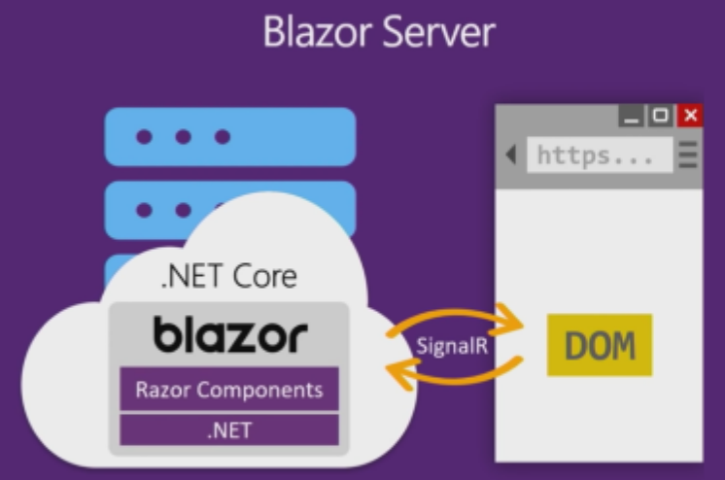
Blazor Server

Slide 7
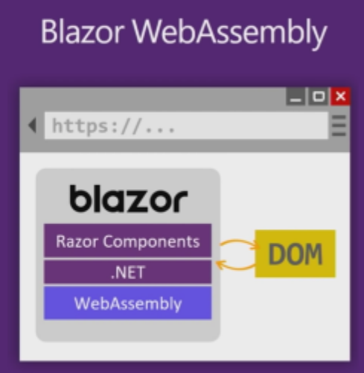
Blazor WASM

Slide 8

Blazor Server VS Blazor WASM
 | Blazor Server | Blazor WASM
Direct access to server resources
↓Download size (First request)
Safe code in server
Client resources use
Offline

Slide 9
Binding & Forms
Property binding
Event binding
Mouse binding: onclick, oncontextmenu, ondblclick, onmousedown, onmouseup, onmouseover, onmousemove, onmouseout…
Data input: onchange, oninput…
…
EditForm
InputText, InputCheckbox, InputDate, InputNumber, InputTextArea and InputSelect
Examples:
NetCoreConfBCN23.Binding
NetCoreConfBCN23.Forms

Slide 10
Components
Reusable UI Components
Razor syntax
Parametrs
Testing
Razor Libraries
Examples:
NetCoreConfBCN23.Components
NetCoreConfBCN23.Shared
NetCoreConfBCN23.Shared.Tests

Slide 11
Routing
Router
NavigationManager
NavLink
Example:
NetCoreConfBCN23.Routing
Notes:
Componente Router localiza todas las páginas de nuestra aplicación (componentes con directiva @page) y crea la tabla de rutas (App.razor). - AppAssembly referencia al proyecto actual - Cuando se encuentra la ruta, se renderiza este fragmento
- ROuteView renderiza la página

Slide 12
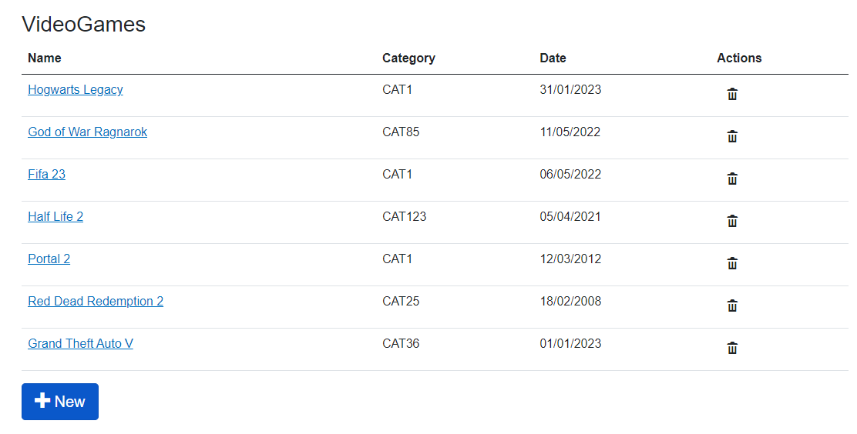
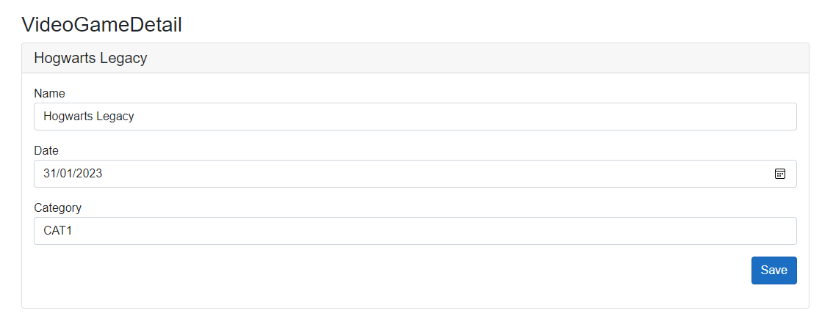
CRUD
Example:
NetCoreConfBCN23.Routing

Slide 13

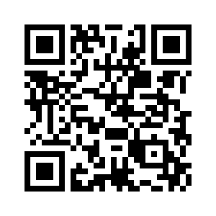
Questions

Slide 15
More information:
info@netcoreconf.com
@Netcoreconf
Visit on:
netcoreconf.com
Thank´s

