Slide 1
An Overview of the QOOH Project
Coire Gavin-Hanner
McCoy Group

Slide 2
Presentation Goal
Begin framing the QOOH project for future talks
Identify knowns and unknowns
Practice talking about the project

Slide 3
Outline
QOOH and TBHP background
Goals
Methods
Published results (short summary)
Ongoing research and results

Slide 4
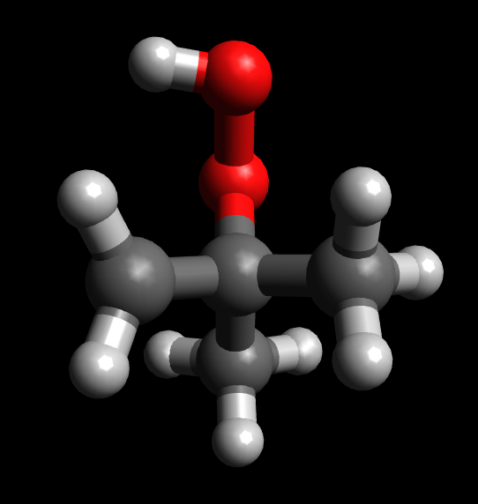
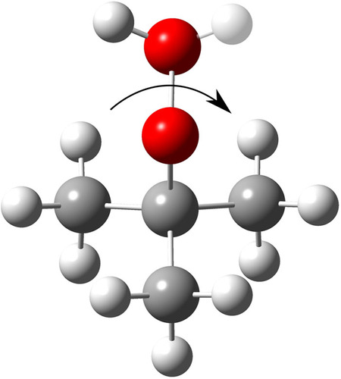
QOOH and TBHP

Slide 5
QOOH and TBHP- Why do other people care?
Hydroperoxides are formed from peroxy radicals in the atmosphere
They lead to highly oxygenated organic compounds and are of interest to atmospheric chemists
Hydroperoxides and their radical analogs are also involved in autoignition in internal combustion engines

Slide 6
QOOH and TBHP- Why do we care?
They’re funky!
Most vibrations can be described well with a harmonic approximation
Coupling between molecular motions results in anharmonicity in the vibrations
They are not described well with widely available and commonly used methods

Slide 7
Study Goals
Build a model of QOOH that will explain experimentally-observed spectra
Include Reaction path, local mode, and harmonic terms to describe the vibrational modes

Slide 8
Methods- Reaction Path Analysis
Cuts through the potential energy surface (PES) are calculated as a function of a coordinate of interest
This allows us to adiabatically separate coupled motions and calculate harmonic approximations for the remaining modes

Slide 9
Methods- Local Mode Analysis
Eigenvalues describe frequencies
Eigenvectors describe molecular motions
Normal modes:
eigenvectors are combinations of motions
Local modes:
Eigenvectors describe a single motion
We can use local modes to track frequencies as functions of other coordinates (coupling?)

Slide 10
TBHP Results
The model used to describe TBHP included
1 local mode OH-stretching coordinate
1 torsional rxn path coordinate
40 harmonic approximations for the remaining coordinates
Coupling between COOH torsion and OH-stretch
The reaction path model allowed for an adiabatic separation of the torsion and OH-stretch

Slide 11
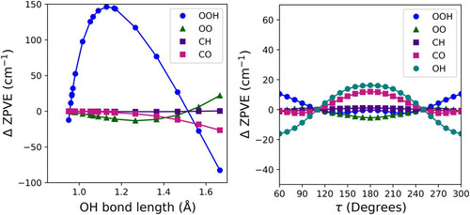
Current Results
Using local mode analysis to look for coupling between vibrational modes in QOOH
Example: TBHP

Slide 12
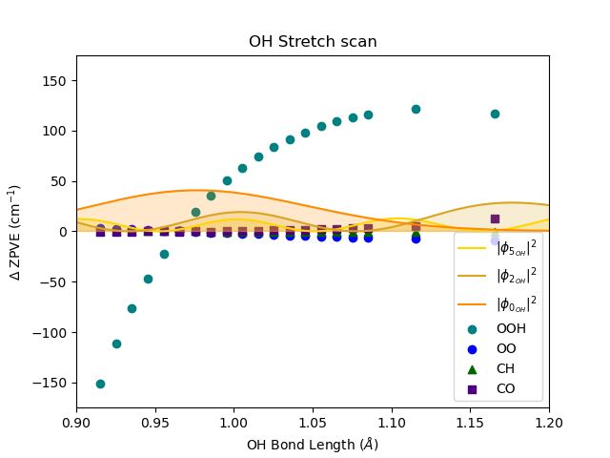
Current Results- OH scan

Slide 13
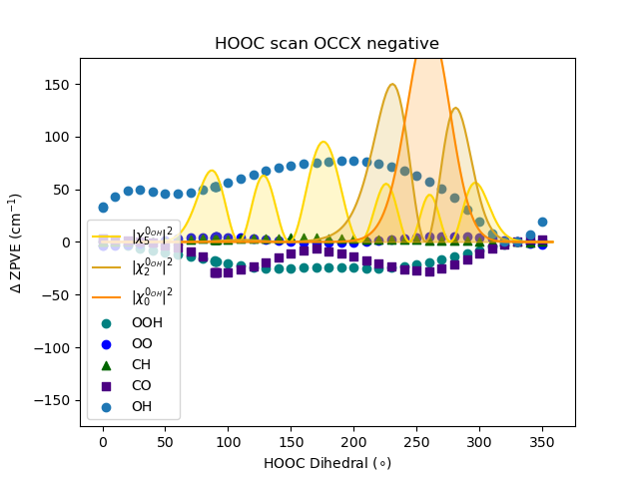
Current Results- HOOC scan

Slide 14
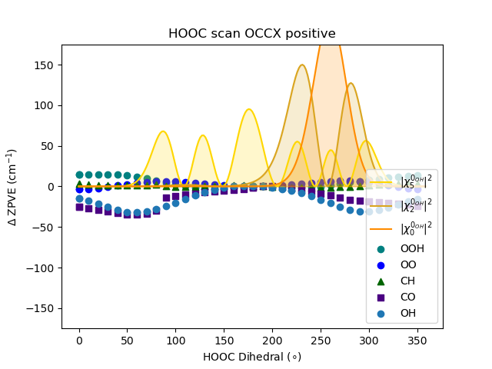
Current Results- HOOC scan

Slide 15
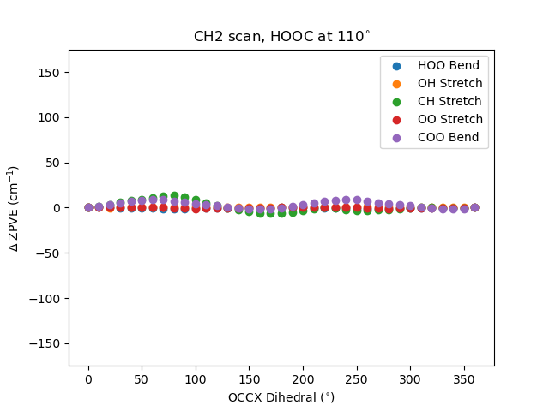
Current Results- CH2 Torsion scan

Slide 16
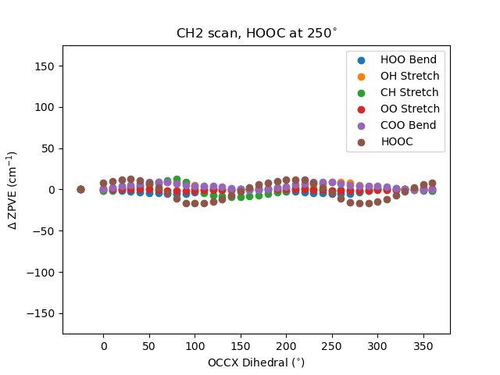
Current Results- CH2 Torsion

