Slide 1
PearlChain
Notes:
Intro Slide

Slide 2
Agenda
Business and Activities
Technologies and Tools
Application Server Architecture
Offer and Contract Architecture Landscape
Pre-flow: Lead Life Cycle
Quote to Cash flow
Integration
Pros Cons
Appendix/References

Slide 3
PearlChain – Business & Activities
Master Data
Delivery
Contract Management
CPQ
MIF Management
Commissioning
Shipping
Auto Launch
Data Conversion
Mass Upload
Billing Interface

Slide 4
Technologies and Tools (Canon specific)
Infrastructure
Web Server – Apache/Tomcat/WebLogic
Application Server - Unix
Database
Oracle DB – PLSQL/SQL/Toad Dev
Application Framework – Spring/Hibernate
J Dev/Eclipse
Interfaces/Services
BPM, STFP, Taviz, Informatica, DB Link
Others
Configuration Management – SVN Document Management – SharePoint/Aeris
Requirement and Defect Management - ALM

Slide 5
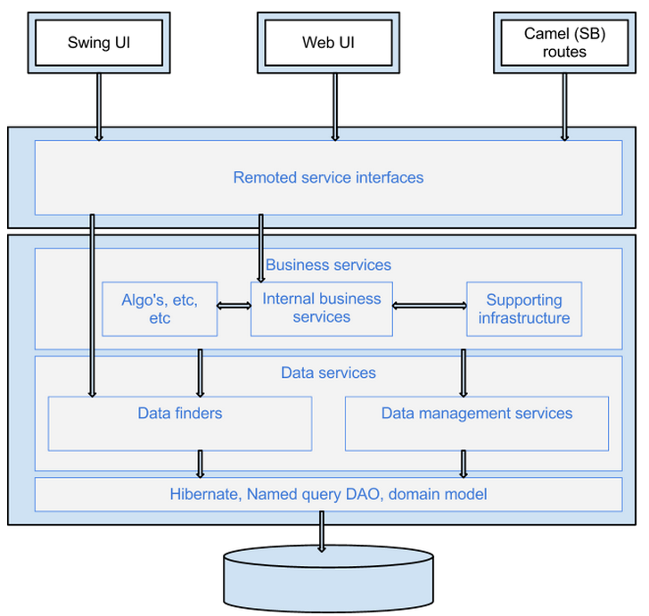
Application Server Architecture

Slide 6
Offer and Contract Architecture Landscape

Slide 7
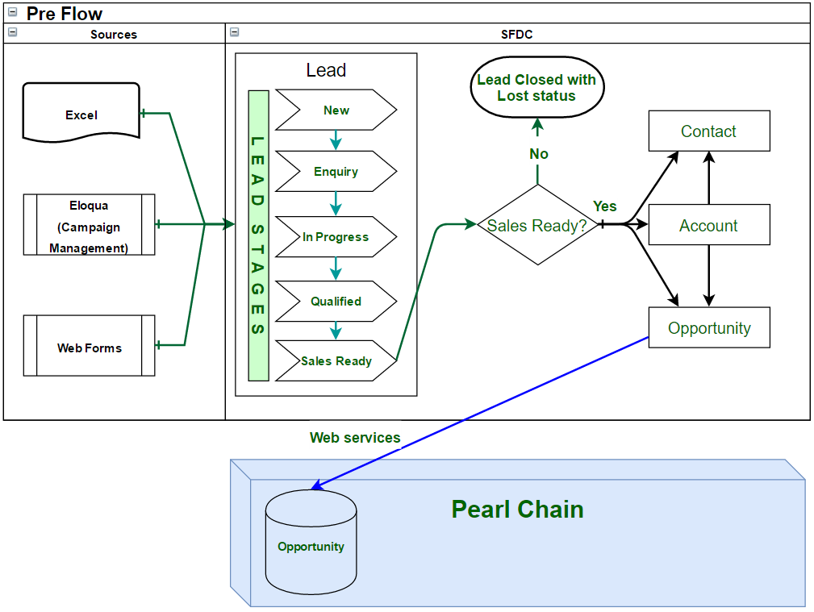
Pre-flow: Lead Life Cycle
Lead Stages: New: Lead is generated in this stage.
Enquiry: Lead owner changes the lead stage to Enquiry, to confirm prospect/customer enquiry (in this case his requirement).
In Progress: Lead owner changes lead to In Progress stage when he gets confirmation from prospect/customer about the requirement.
Qualified: Lead is moved to qualified after positive initial discussion
Sales Ready: When lead is reached this stage. Lead will be converted into Opportunity, Account and Contact (all would be inter-related)
Pearl Chain: Opportunity: Opportunity is loaded in PC from Salesforce via Web services. CPQ process will pick this opportunity and act on it.
Sources: Excel: Leads can directly be imported from Excel. Eloqua: This is Oracle campaign tool used for generating leads by Canon Web Form: This form belongs to Salesforce and leads are directly created in leads if someone fills the form.

Slide 8
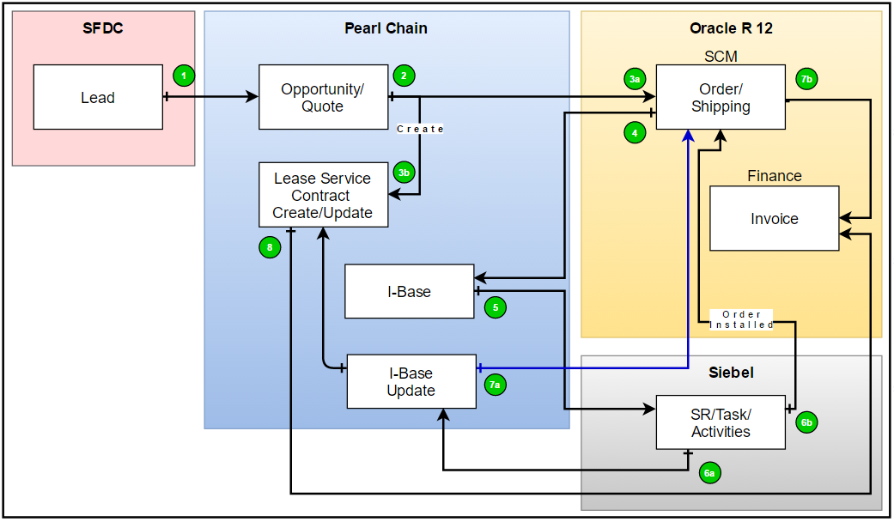
Quote to Cash Flow

Slide 9
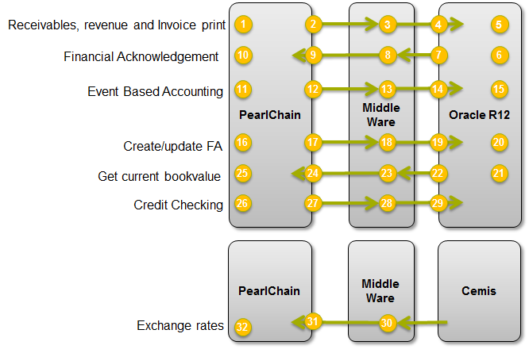
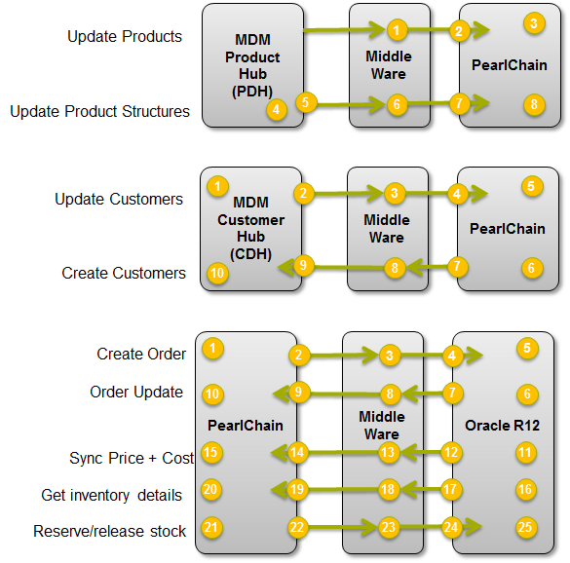
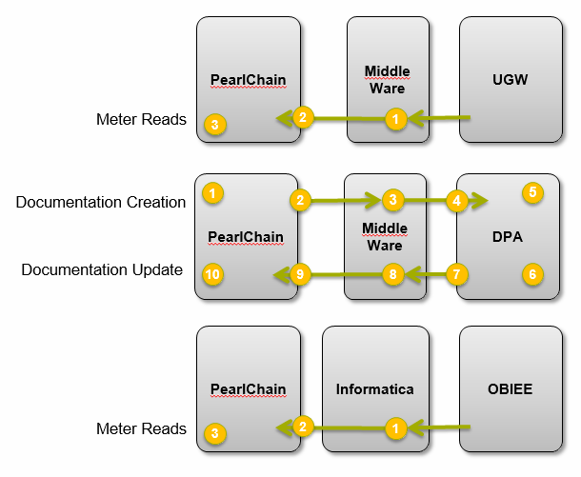
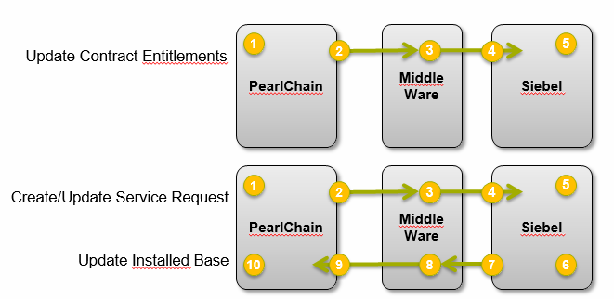
Integration w.r.t PearlChain

Slide 10
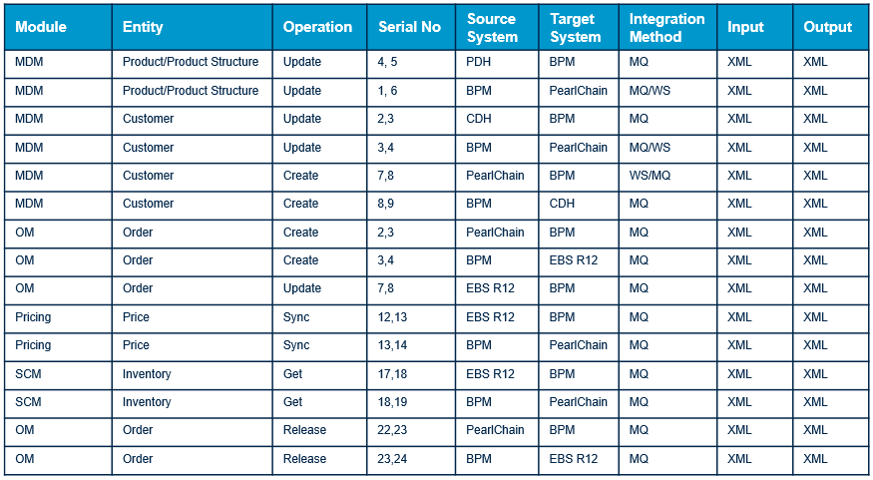
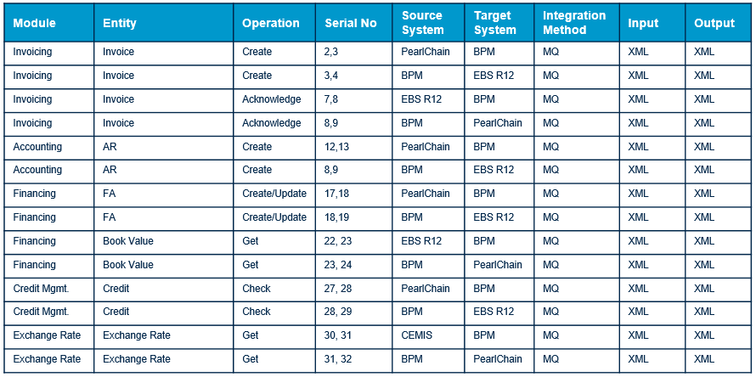
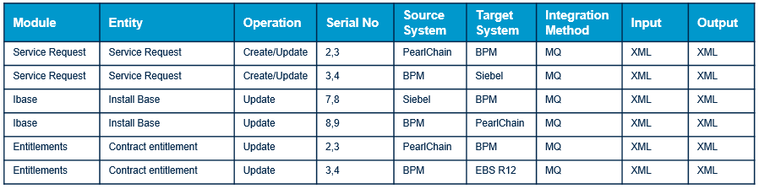
Integration w.r.t PearlChain

Slide 11
Pros and Cons of PearlChain
Pros | Cons
Enhanced User Interface & Experience for end user Real time meter and invoices calculations is available Customizable Invoice Template are available Additional feature related to CPQ real time progression and Contract billing and monitoring will improve the business handling. | PearlChain is still in the core product development mode. PearlChain has a very thick Modelling layer and thin database layer. All functionalities can be build using Shape-IT modelling tool which makes it difficult sometimes to draw a boundary b/w Vanilla and Custom. Customer screen is not available for user to check the customer data i.e. Reports need to be fetched Processing time is high e.g. 200ms to fetch 1 average size contract Nested table are used in DB, this would result in complex code development and difficult to debug and might impact the performance for few processes. Auto Launch is custom workflow designed for Canon Integration of multiple Databases and workflows is prone to error while data is transferred within system Data Model is different compared to existing system and hence a very complex logic resides in code base Multiple integration stage points makes the system error prone, speculated contracts to get affected – 1000 to1200 per month PearlChain has some risk for Supportability because of lack of Standard product documentation. Supporting PearlChain requires special skill set of Modelling and Java coding which is presently only with PearlChain modelers and their consultants.

Slide 12
Thank You

Slide 13
AppendiX

Slide 14
PearlChain – Components
Core Components/Infrastructure
Security, interfacing, document mgt, workflow, EDI core, notifications, excel import, standard texts, localizations
Master Data through Mapping
Partner, product, BOM, BOW, equipment, resource
(employee, machine), warehouse, locations, calendars
Functional Components
Finance Finance, Accounting
CPQ – Autolaunch Configure – Price - Quote
Orders/Contract Mgt Sales, Purchase, Service, Maintenance
Procurement Contracts, Purchase requisitions, Orders, Receipts, invoice matching
Cost control, cash mgt Activity based costing, cash resource mgt
Customer Projects Offers, projects, claims
Recurring billing Billing, meterread
CRM Lead, opportunities, SLM
Business Monitoring/KPI’s Trading Dashboard, KPI steering
Human Resources (HR) Wage calculation, expenses, capability management
Value Chain Automation
Integral Planning MRP, CRP, Purchase Planning, dynamic dispatching
Track & Trace Tracking, Quality control Coverage, Body passages, alerting
Warehousing Inventory, Picking, Stock corrections, reorder stock
Projects Projects, Activities
Logistical Planning Planning of inbound/outbound logistics
Available and Capable to Promise
Collaboration Negotation, cross-organization planning
Service (Field) service mgt, work request and orders, service parts
Fulfillment
S&OP
Operations
Capability Matching
Finite Capacity
Spare Parts Mgt
Resource Planning
Shopfloor Control
Crew Wages
Scheduling
Crew Planning
Fleet Service Mgt
Entitlements

Slide 15


Campaign to Cash (Direct) ⬄ ICT
Start of
contract
End of
contract
Demand & Lead Generation
Qualification
Proposing
Negotiate & Close
Prepare Order
Process & Execute Order
Manage Contract
Invoicing
Collection
Business Objectives
Sales accepted lead
Qualified opportunity
Initial consent of the proposal
Signed contract
Prepared order
Customer acceptance
Accurate invoice
Payment received in full
Eloqua
Excel
CPQ
Auto Launch Cockpit
Contract Management & Billing
Finance Oracle R12
Siebel FS/HH
Portal
Workflow Authorization Control
Products & Services Order
Activate
Contract
Contract
Billing
salesforce
Frame Work Contracts
Web to Lead Forms
Configure
Price
Quote
Sign Accept
Enrich
Create
Contract
Customer Accept
Product Rules
Create
I-Base
Manage Contract
Entitlements Rules
Activate
I-Base
MDM
Oracle R12
Advanced Pricing Rules
Accounting Hub
Pricing
Oracle R12
Order Fulfillment
Steelwedge
ICON
Professional Services
Oracle Projects
Oracle R12
Logistics
OM Oracle R12
Service
Siebel
OBIEE/EPM
15

Slide 16
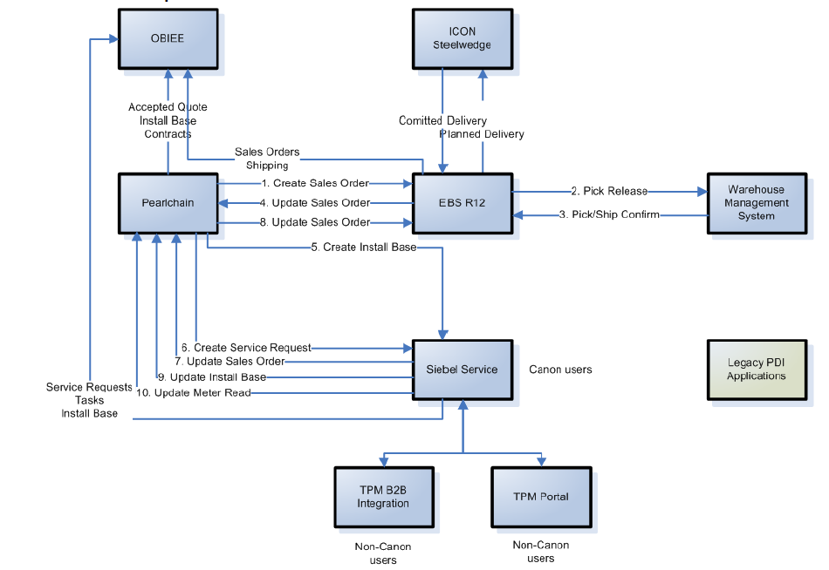
Process flow – Order to Fulfillment
Process | Integration | Input | Output
Create SO from PC to EBS R12 | BPM | XML | XML
Pick Release from EBS R12 to WMS | BPM | XML | XML
Pick/Ship Confirm from WMS to EBS R12 | BPM | XML | XML
Committed Delivery from EBS R12 to ICON | BPM | XML | XML
Planned Delivery from ICON to EBS R12 | BPM | XML | XML
Update SO from EBS R12 to PC | BPM | XML | XML
IB from PC to Siebel | BPM | XML | XML
Create SR from PC to Siebel | BPM | XML | XML
Update SO from Siebel to PC | BPM | XML | XML
Update SO from PC to EBS R12 | BPM | XML | XML
Update IB form Siebel to PC | BPM | XML | XML
Update MR from Siebel to PC | BPM | XML | XML
Quote, IB, Contract from PC to OBIEE | Informatica | DB Data | -
SR, Task and IB from Siebel to OBIEE | Informatica | DB Data | -
SO from EBS R12 | Informatica | DB Data | -

