Slide 1
COCO 2017 Challenge - Stuff Segmentation
Classifying Background for Context
By Reynaldo Martinez Cano & Carlos Beas

Slide 2
Outline
Dataset
Baseline and Methodology
Training Process
Results and Analysis
Conclusions and Improvements

Slide 3
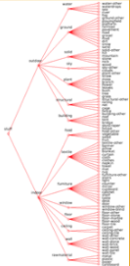
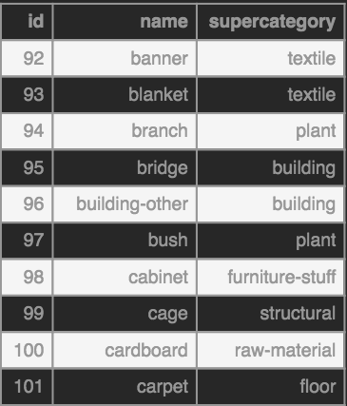
The Common Objects in Context (COCO) 2017 Dataset
COCO Dataset contains 172 classes:
A total of 335K training images, 115K of which are labeled, and 5k validation images
80 thing classes and 92 stuff classes
Follows a hierarchical categorization of classes (shown in figure).
Three key challenges: Detection, Keypoints, and Stuff
COCO Stuff (Our focus):
Sampled/Subset of 40K images from COCO dataset that has been augmented to include stuff classes annotations:
In total there are 2.5 billion annotated pixels in COCO-Stuff.

Slide 4
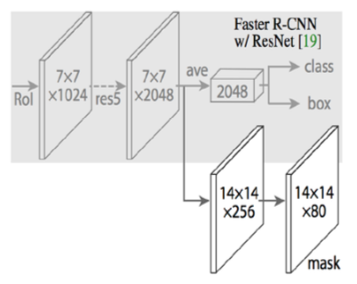
Baseline and Methodology
MASK R-CNN (Baseline)
State-of-the-Art CNN architecture developed by team at FAIR in 04’2017.
Extends the Faster R- CNN for pixel-level segmentation.
Adds a branch that outputs whether or not an individual pixel is part of an object class.
Introduces ROI-Alignment methodology
Our Approach
MASK R-CNN + COCO Stuff + ImageNet
Train/Eval:
Replicate net configuration used to train MASK R-CNN on COCO-things, but using stuff images/data.
Train using configuration variations:
RPN: 128 (as in paper), 256 & 512.
Learning Rate: 0.002 (as in paper), 0.005 & 0.01

Slide 5
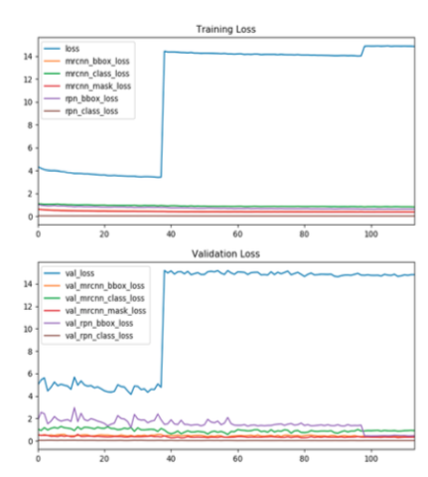
Training Process
Weight Initialization:
Utilized transfer learning by importing net weights pre-trained on ImageNet
Weight Train/Tuning:
Multi-staged approach (200 epochs total):
Stage 1 (head nodes): 40 epochs
Stages 4-5: Up to 60 epochs
Stages 3-5: Up to 100 epochs
Note: Not all stages completed due to time and budget limitations.
128 RPN: 115 epochs
256 RPN: 25 epochs
512 RPN: 25 epochs
Equipment
CUDA-enabled, Tesla K80 NVIDIA GPU
AWS p2.xlarge EC2 instance (~3 days)
Amazon Linux AMI

Slide 6
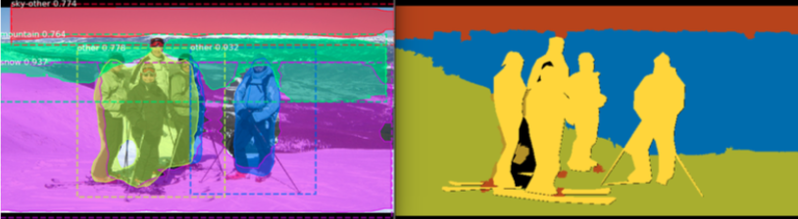
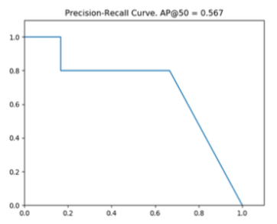
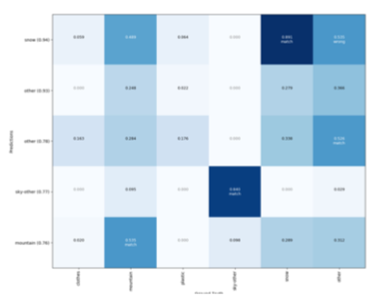
Analysis and Results
Model: 128RoI/lr=0.002/115epochs
Example of successful Classification
Most pixels in image classified correctly
Minimal Overlap
0 = no overlap between prediction and GT
1 = Full overlap between prediction and GT
Overlap Matrix

Slide 7
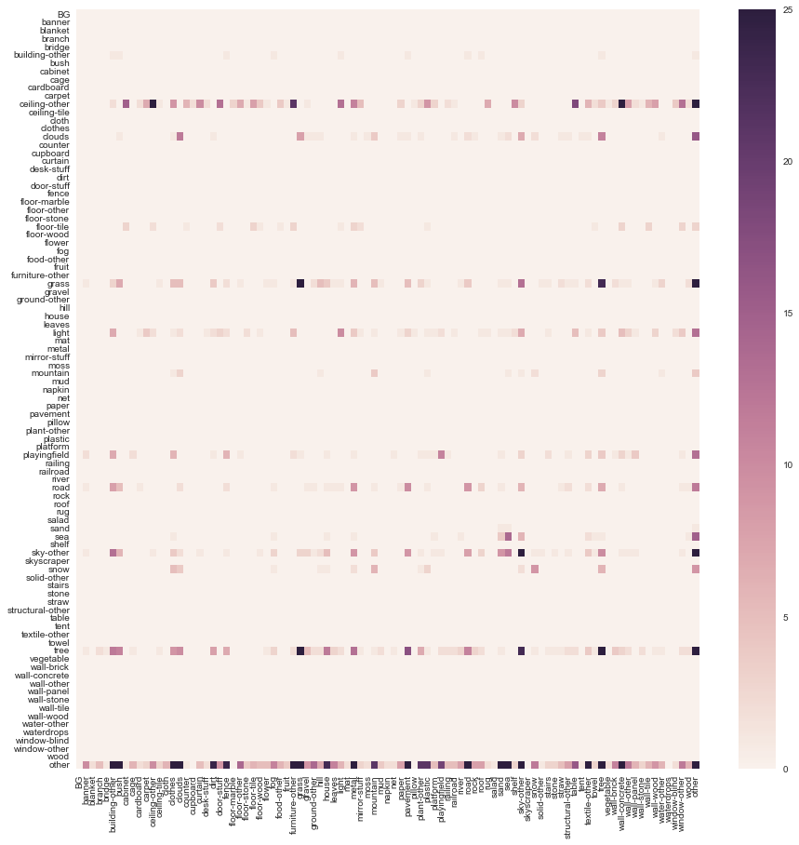
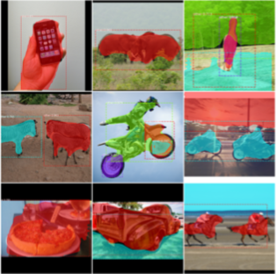
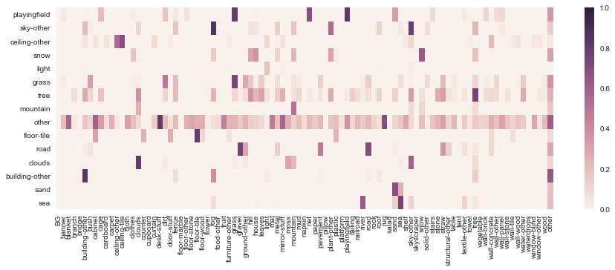
Analysis and Results
Confusion Matrix – 128RoI @ 115 epochs
Model: 128RoI/lr=0.002/115epochs
Natural preference to learn ‘other’ class (belonging to thing superset).
’Other’ class objects in stuff dataset have a wide range of possibilities.
Significant overlap between ‘other’ and rest of classes
Only a handful of classes are being learned well (‘snow’, ‘sky’, ‘tree’)
Mean Overalp – 128RoI @ 115 epochs

Slide 8
Conclusions and Improvements
Conclusions
MASK R-CNN + 2017 COCO-stuff Dataset + ImageNet ~= Stuff segmentation
Natural preference to learn ‘other’ class
A handful of classes resulted in adequate classification
RoI
Learning Rate
Desired Improvements
Complete all stages of training for 256rpn configuration
Augment training set for those classes not being learned
Use GAN to generate samples with a high concentration of pixels for un-learned classes.
Notes:
MASK R-CNN state-of-the-art architecture was combined with 2017 COCO Dataset and ImageNet pre-trained weights to tackle stuff segmentation challenge.

Slide 9
QUESTIONS

Slide 10
THANK YOU!

Slide 11
BACK-UP

Slide 12
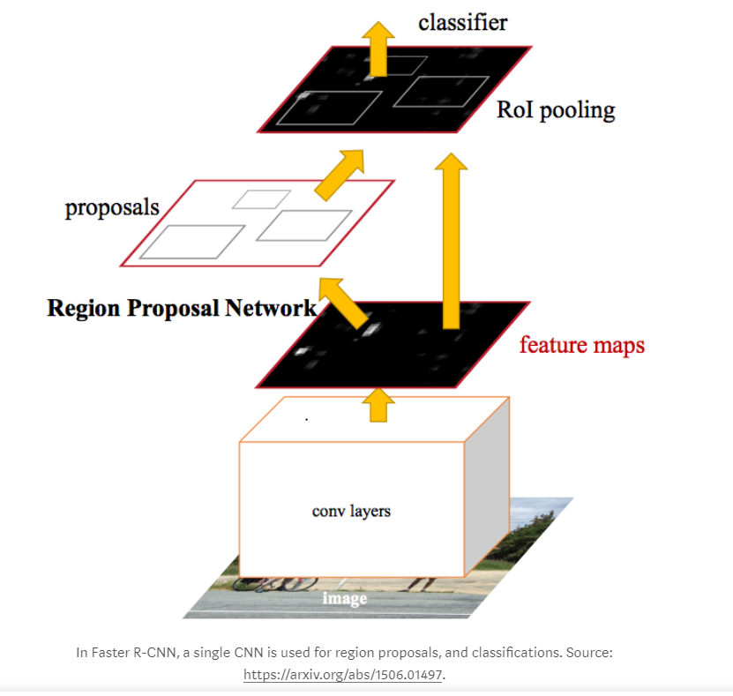
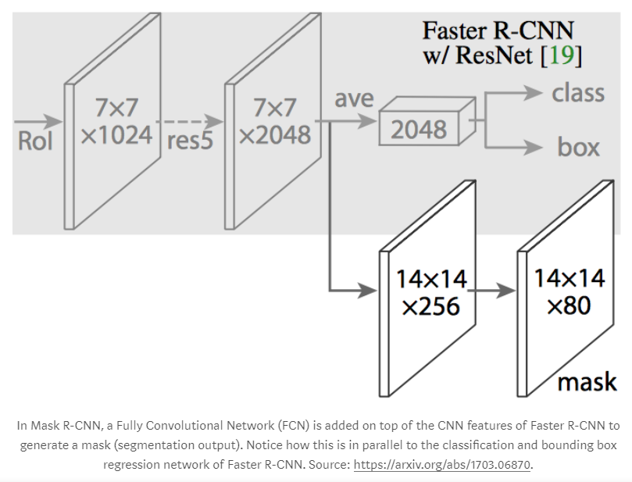
Faster R-CNN
| Regions CNN (2014) -> Fast R-CNN (2015 ) -> Faster R-CNN (2016) -> Mask R-CNN (2017)

Slide 13
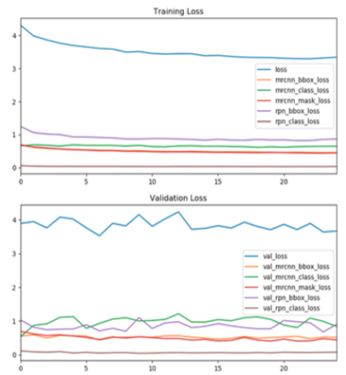
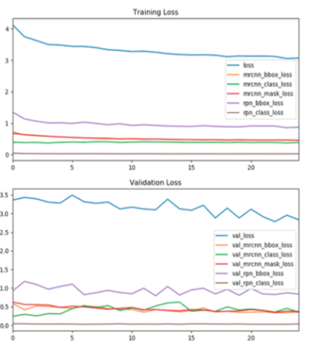
Training on 256RPN and 512RPN
…

Slide 14
Analysis and Results (256RoI/25 Epochs)
Confusion Matrix – 256RoI @ 25 epochs
Mean Overalp – 256RoI @ 25 epochs
Overlap:
0 = no overlap between prediction and GT
1 = Full overlap between prediction and GT
Only a handful of classes are being learned well (‘snow’, ‘sky’, ‘tree’)
Significant overlap occurring between most classes and ‘other’ class
High bias towards ‘other’ class is observed

