Slide 1
Is Grad School Worth It?
Team 4: Sophia Beard, Caroline Cordes, Sophia Forrester, Laasya Ravipati
Notes:
Sophia f.

Slide 2
Table of Contents
STEP 1
STEP 2
STEP 3
STEP 3
Background & Data
Graphical Analysis
Statistical Analysis
Results
Notes:
Sophia f

Slide 3
Background
Central Question: Is Grad School Worth It?
Since 2000, the number of people over the age of 25 whose highest degree is a:
Master’s doubled to 21 million
Doctorate doubled to 4.5 million
Now, 13.1% of U.S. adults have an advanced degree up from 8.6% in 2000
*Statistics from census.gov
Notes:
Sophia f

Slide 4
The Data Source
Where the data is from:
2021 National Survey of College Graduates conducted by the National Science Foundation.
Sampled individuals who are living in the United States, have at least a bachelor's degree, and are younger than 76
Web survey, mail survey, and computer-assisted telephone interview were all used to obtain the data
They processed about 164,000 samples
Notes:
Sophia f

Slide 5
The Data Set
Ages: < 29, 30-39, 40-49, 50-75
Field: major/area of study ex. Engineering
Degree-Level: Bachelor’s, Master’s, Doctorate, Professional
Total: median salary of both males and females
Female: median salary of females
Male: median salary of males
Notes:
Sophia f

Slide 6
The Data Cleaning
Only include rows with complete data
Removing the rows where salary/total field is 'S' and 'D'
'S' - suppressed for reliability (coefficient of variation exceeded publication standards)
'D' - suppressed to avoid disclosure of confidential information
Shortening field labels
Biological, agricultural, and other life scientists -> Life Scientists
Computer and mathematical scientists -> Comp and Math Scientists
Physical and related scientists <- Physical Scientists
Social and related scientists <- Social Scientists
Notes:
Sophia f
Suppressed meaning that it was not reported in the data

Slide 7
Exploratory Data Analysis
Notes:
Caroline
Besides what we will be presenting in a second, we did do a fairly robust amount of EDA to this dataset, looking at all type of post-bachelors programs(masters, professional, doctorate) as well as if gender had an effect held any sort of effect on salary in the future.
But, for what we were trying to prove we wanted to sick to just comparing the bachelors and masters degrees, their ages, salaries, as well as a few particular fields

Slide 8
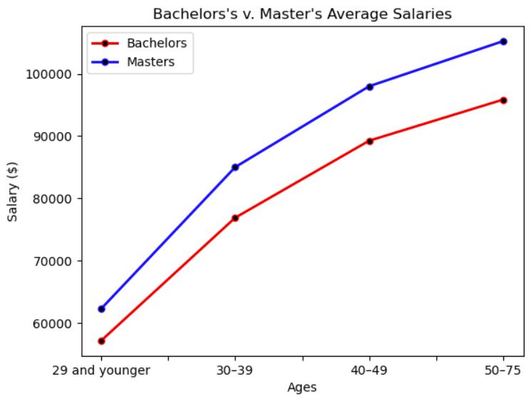
Bachelor’s vs Master’s Salaries by Age
Notes:
Caroline
The first thing we wanted to look at was the bachelors and masters salaries over time
After looking at the data we wanted to look at the salary differences of people with bachelors vs masters degrees
We are able to see in this graph that as graduates age we start to see a larger gap between the two lines, indicating a larger salary difference
To further visualize the difference grows between these two, we go to the next graph

Slide 9
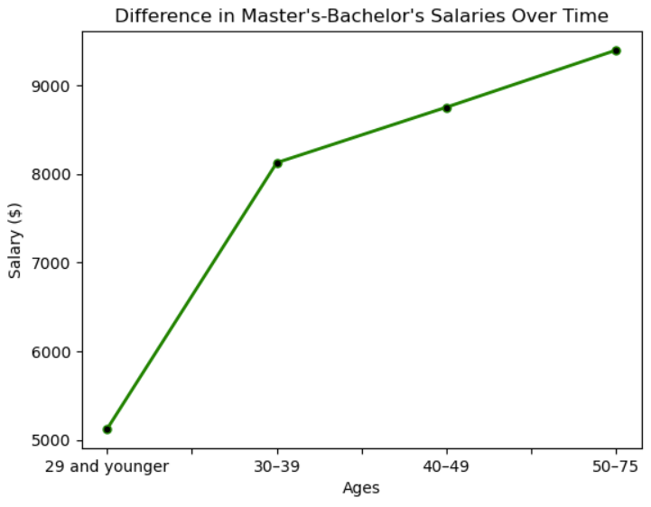
Difference in Salaries by Age
Notes:
Caroline
From this graph, we can clearly see the growth in difference between the two degree levels
Though the difference between the 2 does start out fairly minimal (around a 5k ), it does pretty quickly grow over the span of about 10 years to a difference of about (8k), so a 3k difference fairly fast
This amount then steadily rises to a point that is over 9k

Slide 10
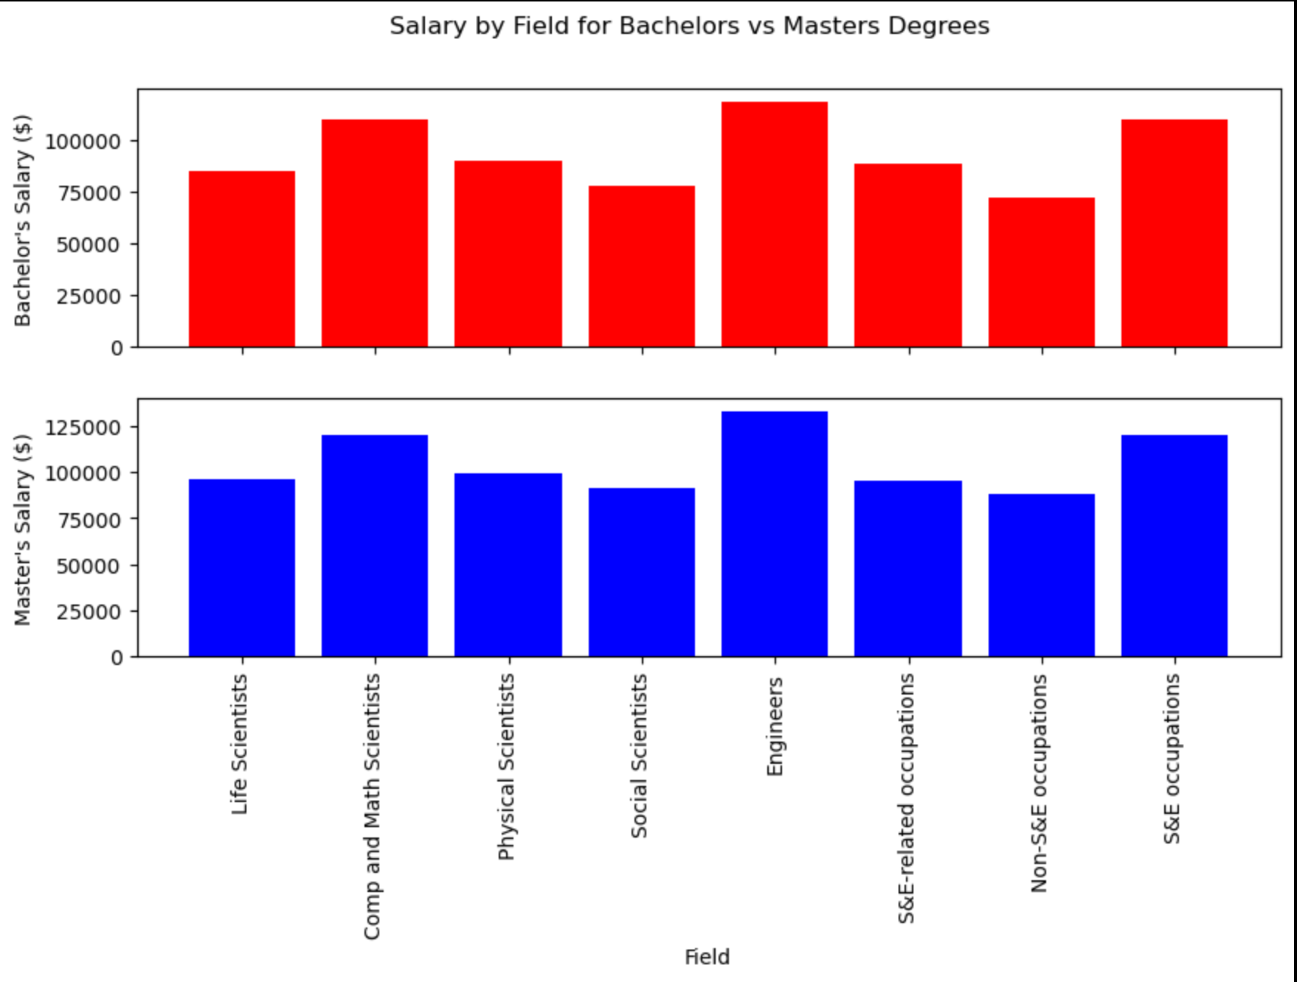
Bachelor’s vs Master’s Salaries by Field
Notes:
Laasya

Slide 11
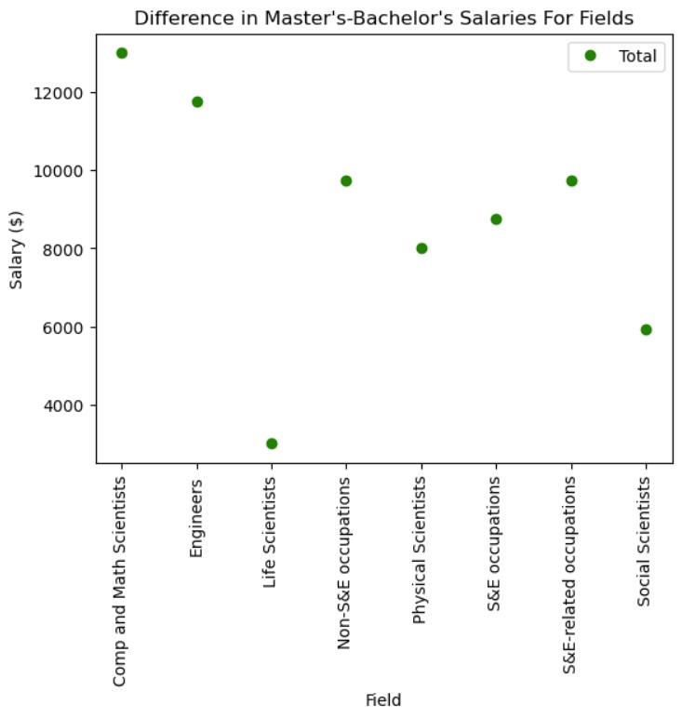
Difference in Salaries by Field
Notes:
Laasya

Slide 12
Statistical Significance
Notes:
Sophia b.

Slide 13
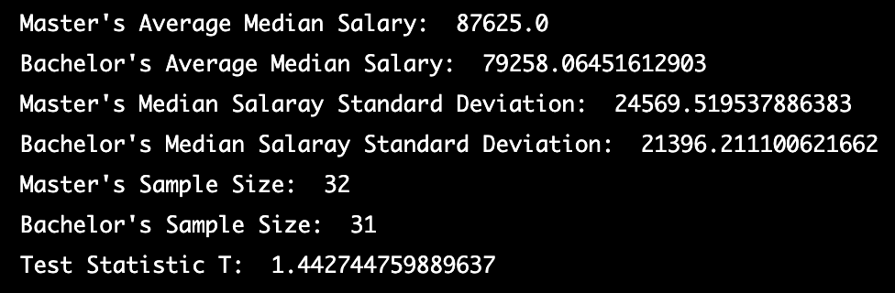
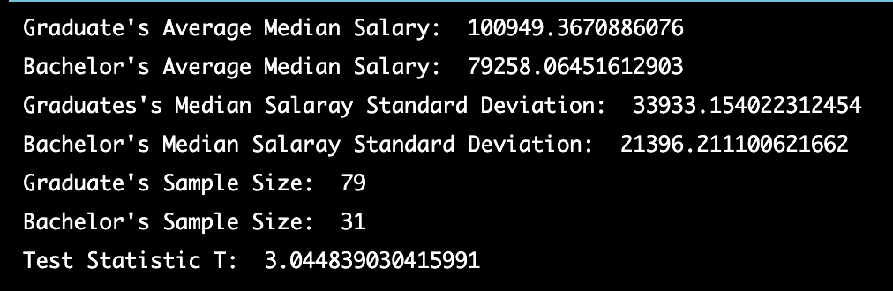
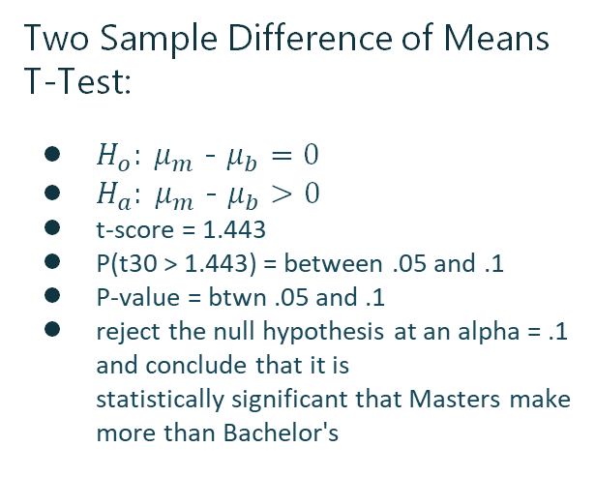
Hypothesis Test
Two Sample Difference of Means T-Test:
$H_{o}: μ_{m}$ - $μ_{b}=0$
$H_{a}: μ_{m}$ - $μ_{b}>0$
t-score = 1.443
P(t30 > 1.443) = between .05 and .1
P-value = btwn .05 and .1
reject the null hypothesis at an alpha = .1 and conclude that it is statistically significant that Masters make more than Bachelor's
Notes:
Sophia B.

Slide 14
Results
Notes:
Sophia b

Slide 15
Three Tiers of Pay
LOW PAY
MEDIUM PAY
HIGH PAY
i.e. Non-Science & Engineering
~$84,000
i.e. Science & Engineering
~$103,000
i.e. Computer & Math Science
~$112,000
Notes:
Sophia B
Average salary for all ages from our dataset

Slide 16
Master’s Degree- Low Pay
Costs
Benefits
Missing out ~$60,000 for 2 years of work
Paying ~$30,000 tuition for 2 years of school
Total cost ~$180,000
Average difference in salary ~$8,000
22 years to break even with bachelor's earnings
Make ~$8,000 a year more on average
Approximately a 20% increase in earnings
Increased opportunity for leadership roles
Ability to move up in a company
Ability to narrow focus on a priority field of study
Some fields require it
Notes:
Sophia B
$30,000 - $120,000
Depending on school
$60,000 of salary
Cost of Grad School
How long would it take to pay back

Slide 17
Master’s Degree- Medium Pay
Costs
Benefits
Missing out ~$80,000 for 2 years of work
Paying ~$30,000 tuition for 2 years of school
Total cost ~$220,000
Average difference in salary ~$12,000
18 years to break even with bachelor's earnings
Make ~$12,000 a year more on average
Approximately a 20% increase in earnings
Increased opportunity for leadership roles
Ability to move up in a company
Ability to narrow focus on a priority field of study
Some fields require it
Notes:
Sophia B
$30,000 - $120,000
Depending on school
$60,000 of salary
Cost of Grad School
How long would it take to pay back

Slide 18
Master’s Degree- High Pay
Costs
Benefits
Missing out ~$100,000 for 2 years of work
Paying ~$30,000 tuition for 2 years of school
Total cost ~$260,000
Average difference in salary ~$20,000
13 years to break even with bachelor's earnings
Make ~$20,000 a year more on average
Approximately a 20% increase in earnings
Increased opportunity for leadership roles
Ability to move up in a company
Ability to narrow focus on a priority field of study
Some fields require it
Notes:
Sophia B
$30,000 - $120,000
Depending on school
$60,000 of salary
Cost of Grad School
How long would it take to pay back
OVERALL Pay less for school, or get a high paying job to lessen this time

Slide 19
So, is Grad School Worth it?
Notes:
Laasya

Slide 20
So, is Grad School Worth it?...Depends
Do you want/need it?
How much is grad school?
How much more would you make?
If grad school is something that you want to do or is required, go for it.
If you have the money for it or if it’s being paid for, go for it.
If there is a significant difference in salaries for the specific position, go for it.
Notes:
Laasya
Do you want/need it:
if you are really commited, it is worth it in the long term
How much is grad school:
Could be paid for by scholarships, employer, or with research positions…

