Slide 1
Monocular Visual Odometry
Open Source Implementation by
Rainer Hessmer, PhD
August 2010

Slide 2
Agenda
Odometry
Visual Odometry
Implementation and Demo

Slide 3
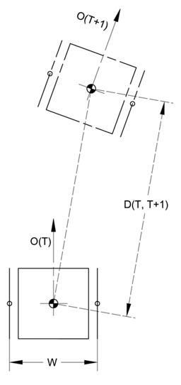
Odometry
Use sensors to estimate change in pose (location and orientation) over time
Examples
  Quadrature encoders on motors
  GPS and compass
  IMU (Inertial Measurement Unit)
  http://www.seattlerobotics.org/encoder/200610/article3/IMU%20Odometry,%20by%20David%20Anderson.htm
  Visual
Image source: http://www.simreal.com/content/Odometry

Slide 4
Visual Odometry
Stereo Vision
  Two Years of Visual Odometry on the Mars Exploration Rovers http://www-robotics.jpl.nasa.gov/publications/Mark_Maimone/rob-06-0081.R4.pdf
High Framerate Monocular Vision
  Optical Mouse
  Outdoor Downward-facing Optical Flow Odometry with Commodity Sensors
  http://www.ri.cmu.edu/pub_files/2009/7/DilleFSR09.pdf
What about using one regular Web cam?

Slide 5
See paper:
A Robust Visual Odometry and Precipice Detection
System Using Consumer-grade Monocular Vision
Jason Campbell, Rahul Sukthankar, Illah Nourbakhsh, Aroon Pahwa
http://www.cs.cmu.edu/~personalrover/PER/ResearchersPapers/CampbellSukthankarNourbakhshPahwa_VisualOdometryCR.pdf

Slide 6

Ingredients
One calibrated Web cam
(Microsoft Live Cam Cinema)
One laptop
OpenCV
EMGU CV (C# wrapper for OpenCV)
Lucas and Kanade pyramidal optical flow
The essence of the algorithm presented in the paper
Lots of custom C# code

Slide 7
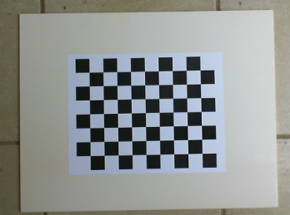
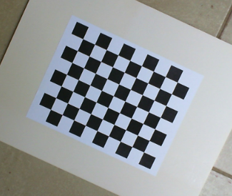
Camera Calibration
Install OpenCV
Print and mount a decent size
chessboard like grid
Turn off auto focus and take pictures of the chessboard in various orientations
Run C:\OpenCV2.1\samples\c\Calibration.exe with the appropriate command line parameters against the pictures to determine the camera parameters

Slide 8
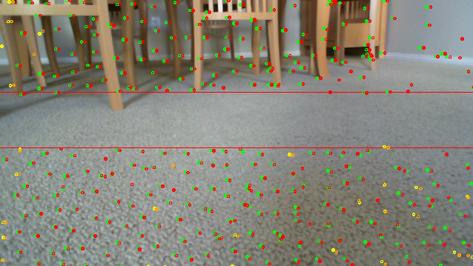
High-Level Algorithm
Rotation: From optical flow above the 'horizon'
Translation: From optical flow below the 'horizon'

Slide 9
More Details
Get camera image and correct it
Estimate optical flow field for recent video frames
Determine potential tracking errors and discard associated points
Project 'sky' points into robot centered cylindrical coordinates and estimate rotation
For ground region: Project onto floor plane, determine consensus x-y translation
Sum incremental rotation and translation
Periodically repopulate track points

Slide 10
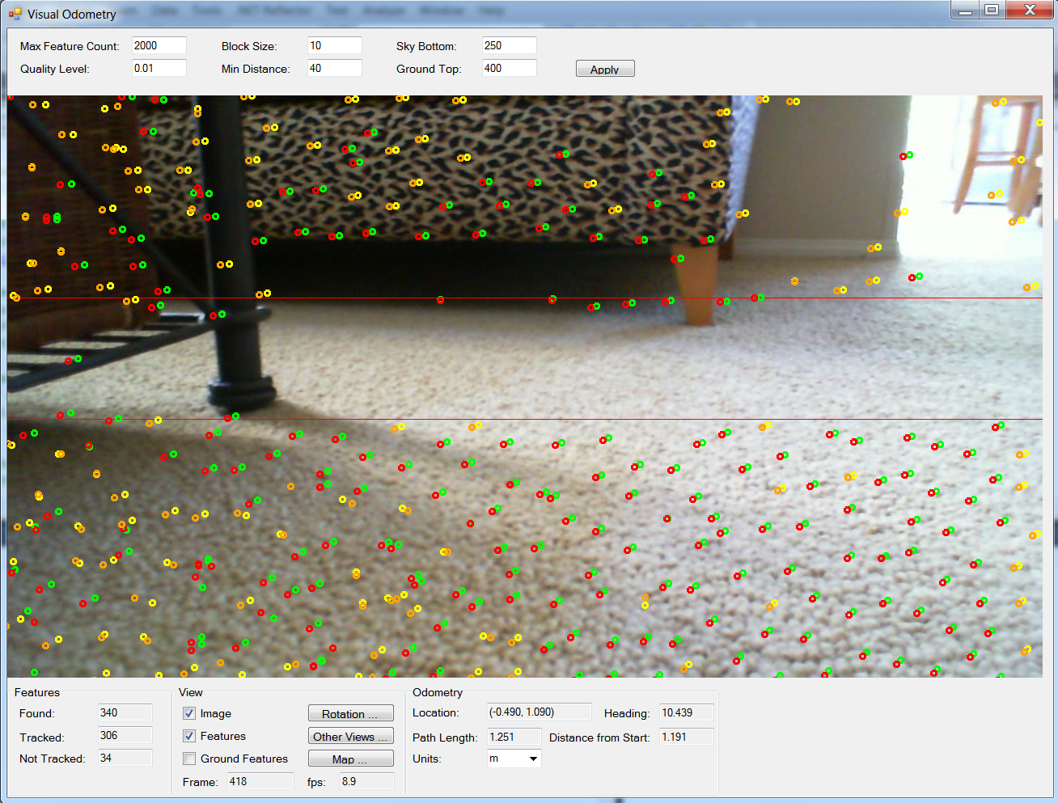
Determines how features are found for tracking: Harris corners with subpixel accuracy
(OpenCV functions cvGoodFeaturesToTrack and cvFindCornerSubPix)
Info about features tracked by the optical flow algorithm using the Pyramid Lucas-Kanade algorithm
(OpenCV function cvCalcOpticalFlowPyrLK)

Slide 11
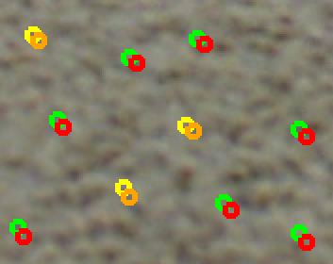
Smoothness of Tracked Features
Keep history of feature location over the last seven frames
Smoothness determined by comparing distance and direction changes over history
If most features are smooth, weed out the bad features; otherwise assume jerky robot movement and keep them all
Color code (previous vs current frame):
  Full history: green → red
  Incomplete: yellow → orange

Slide 12

Repopulate Features
Features are regularly removed
  Feature moves out of the frame
  Corresponding point cannot be found
If feature count drops below threshold, search for new
features using a
mask around the
existing features.

Slide 13
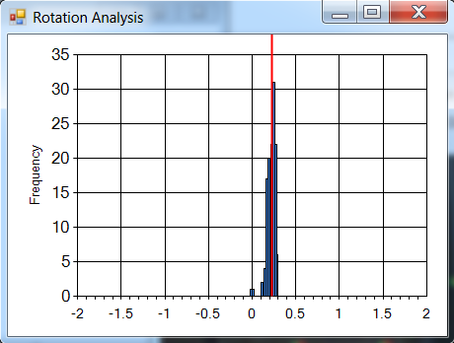
Direction Change (Robot Rotation)
Median of the angular rotation determined from previous / current feature pair in the sky region.
Requires camera calibration (center x, focal length x)
Histogram of measured angles. The red line marks the chosen calculated angle.

Slide 14
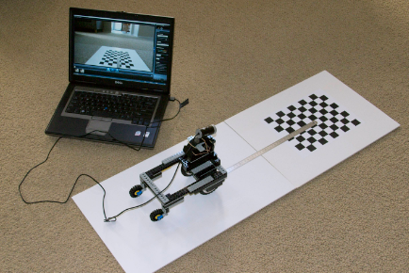
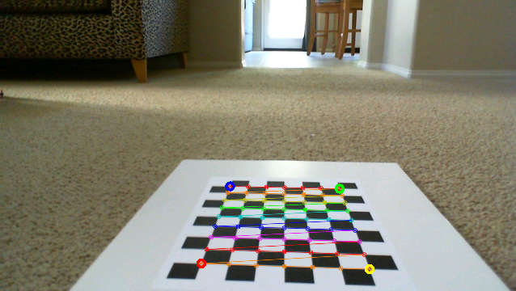
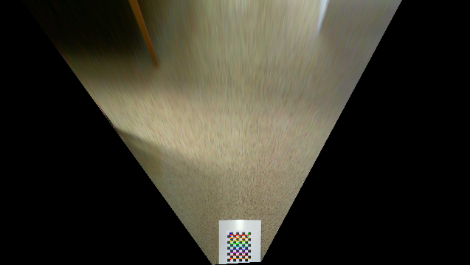
x-y Translation (Part 1)
Ground floor projection
Calibration: Chessboard
on the ground in known
location
cvGetPerspectiveTransform

Slide 15
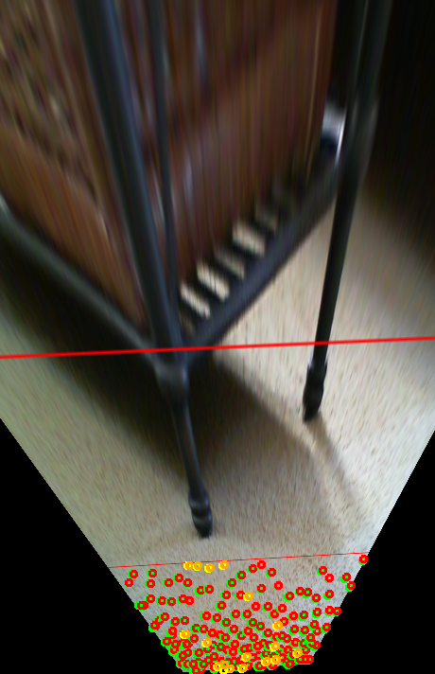
x-y Translation (Part 2)
Determine feature locations on the ground (below horizon)
Remove rotation effect
Consensus x-y translation:
  Randomly pick 40 features
  For each find number of other features with similar translation
  Use feature with the biggest following and take the median translation of the group

Slide 16
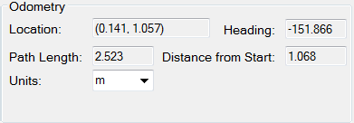
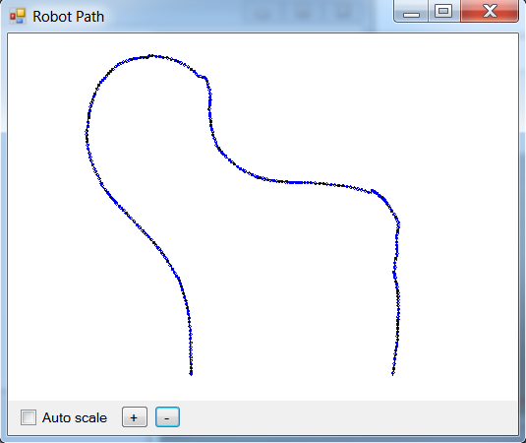
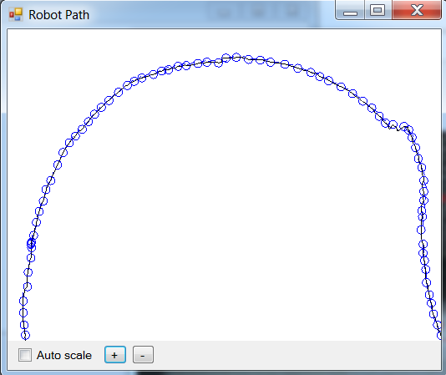
Robot Path
Sum of incremental rotations and translations

Slide 17
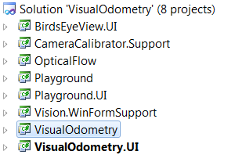
Software
C# 4.0 VisualStudio 2010
Open Source GPL 3.0
http://code.google.com/p/drh-visual-odometry/

