Slide 1

‘UMLator’
Our Solution to CS124 Group Project 2012
Connor Goddard (clg11), Sam Jackson (slj11) & Craig Heptinstall (crh13)

Slide 2
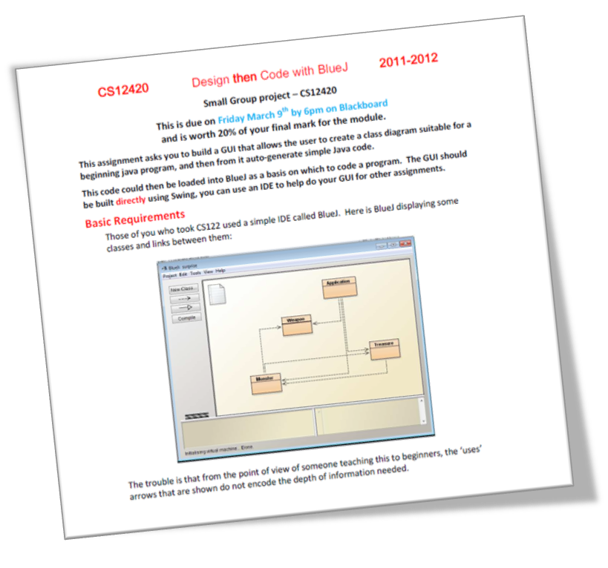
Analysis of the Task
Main Requirements:
  Draw UML class diagrams on screen (using interactive tools)
  Export those designs to Java code automatically
  Provide an intuitive and ‘easy-to-use’ UI
Other Requirements:
  Design GUI to replicate Blue-J interface
  ‘WOW Factor’ -:
    Save/load projects
    ‘Undo’ feature etc..

Slide 3
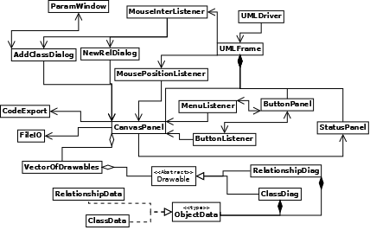
Our Design

Slide 4
Our Design
‘Main’ Class

Slide 5
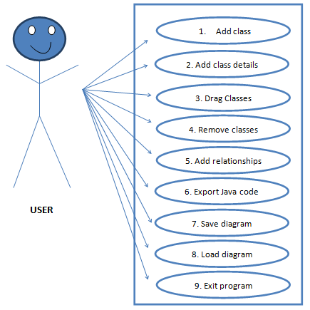
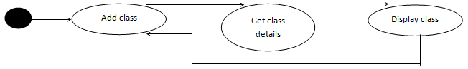
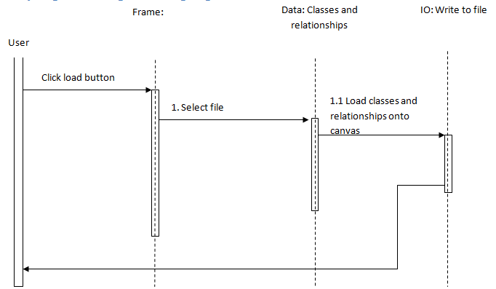
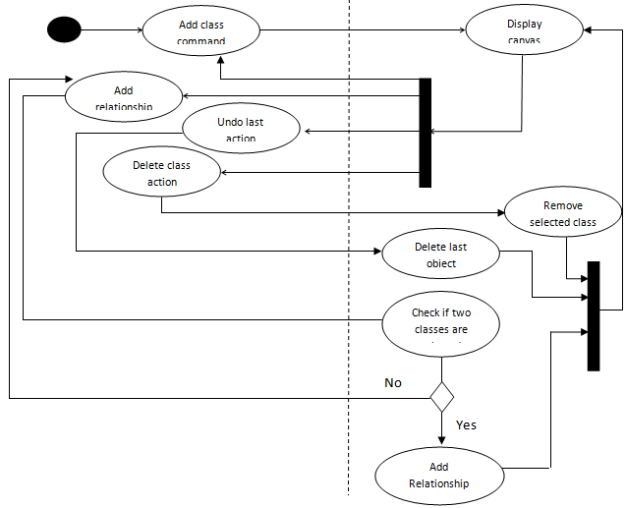
Use-Case Diagram
State Diagram
Sequence Diagram
Activity Diagram

Slide 6
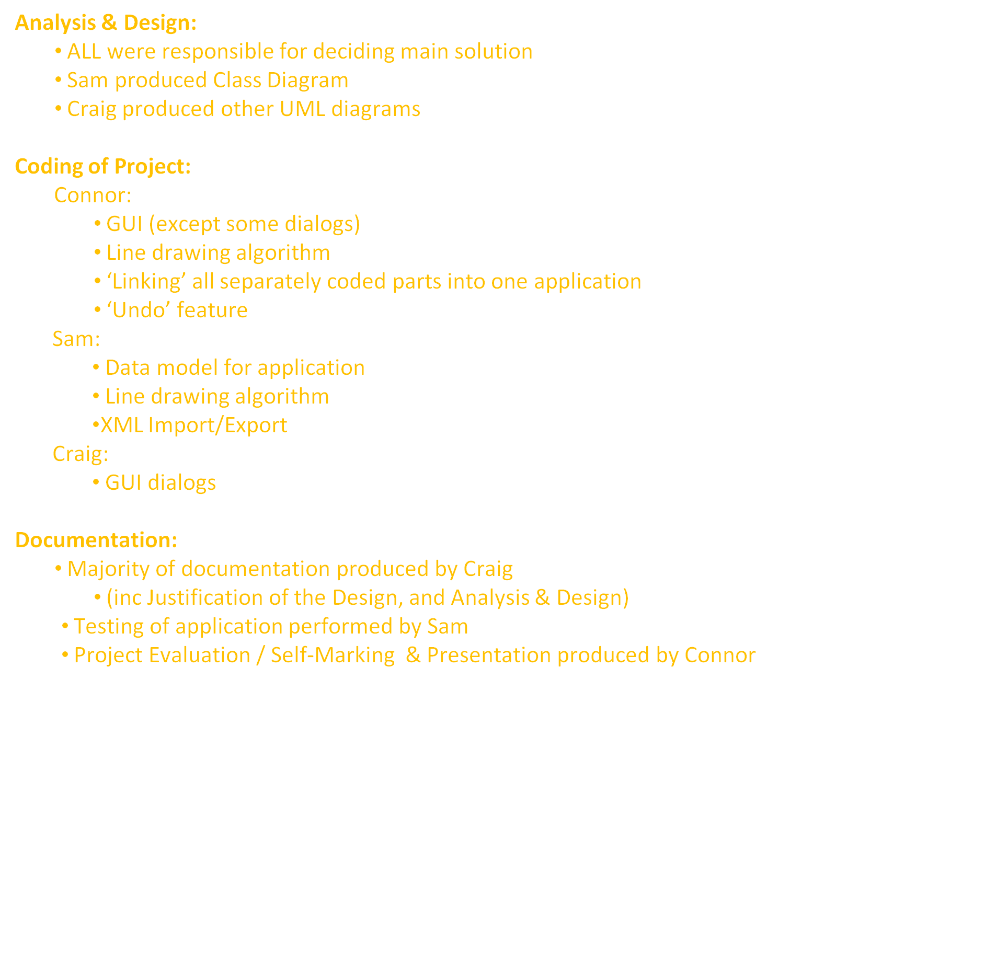
Tackling the Problem

Slide 7
Tackling the Problem
However...
We all worked TOGETHER in ALL ASPECTS of the project..
..and helped EACH OTHER as required to ensure we produced a GOOD RESULT as a TEAM!

Slide 8
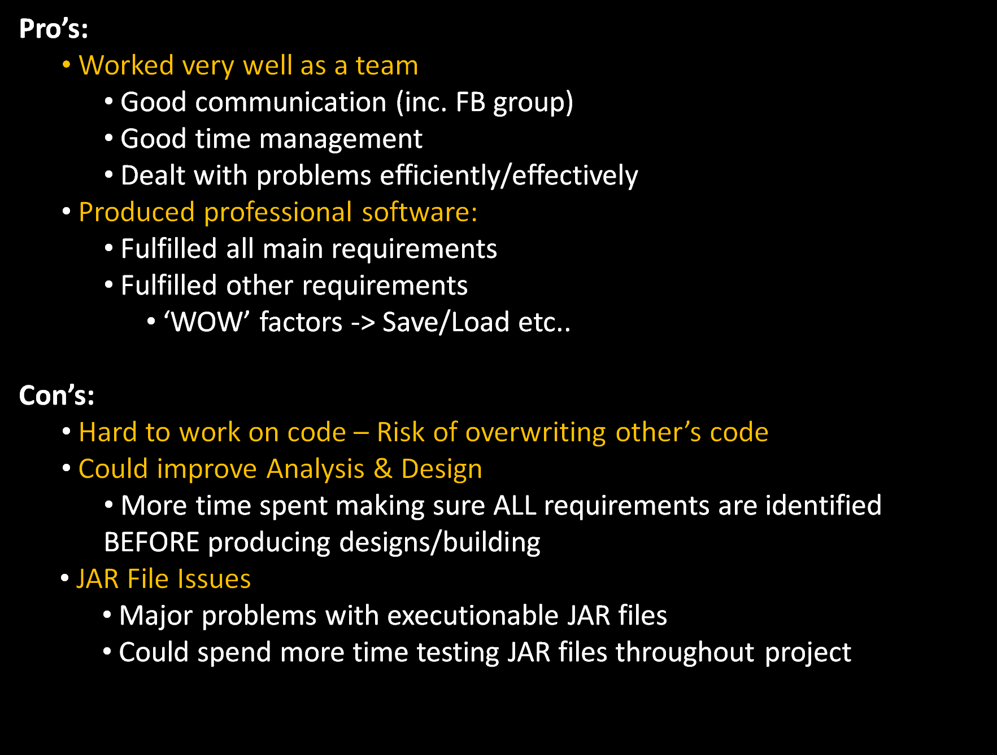
Evaluation
Overall, we were very happy with our team, and our final result:

Slide 9
..and now for the DEMONSTRATION!
(fingers crossed)

Slide 10
Thank You.
Any Questions?

