Slide 1
CS 5004: Object Oriented Design and Analysis
Chris Geeng, Tamara Bonaci
c.geeng@northeastern.edu

Slide 2
Agenda
Today’s lab – setting up the working environment
Steps:
Setup Github Classroom repo
Create your first Gradle project
Create your first Java class
Create your first Java test class
Push your work to your remote GitHub repo
Upload your work as zip file to Canvas – submitted!
Notes:
Think of an example

Slide 3
Note on submissions
Labs: Canvas
Homeworks: Gradescope

Slide 4
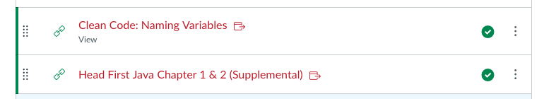
Readings for Next Week -> Module 01

Slide 5
IDE: IntelliJ is preferred; course staff can better help you troubleshoot with IntelliJ.

Slide 6
Introduction TO GIT

Slide 7
Introduction to Git
Git is a distributed version-control system
Allows project collaboration
Enables creation of backup version of the code
How git works:
You keep your files in a repository on your local machine.
You synchronize your repository with a repository on a server.
If you move from one machine to another, you can pick up the changes by synchronizing with the server.
If your partner uploads some changes to your files, you can pick those up by synchronizing with the server.

Slide 8
How Does Git Work?
Git represents history in a Directed Acyclic Graph (DAG)
Each node in the graph is a hashed git command
Since the backing data structures is a DAG, we are guaranteed that nodes representing later commits (in terms of time) will be organized after earlier commits

Slide 9
Simple Model of Git: Your Files
my-project
docs
manual.docx
user_docs.docx
src
main.rkt
module1.rkt
module2.rkt
module3.rkt
Here are your files, sitting in a directory called my-project

Slide 10
Your Files in Your git Repository
my-project
docs
manual.docx
user_docs.docx
src
main.rkt
module1.rkt
module2.rkt
module3.rkt
.git
When you have a git repository, you have an additional directory called .git, which points at a mini-filesystem.
This file system keeps all your data, plus the bells and whistles that git needs to do its job.
All this sits on your local machine.

Slide 11
The git Client
my-project
docs
manual.docx
user_docs.docx
src
main.rkt
module1.rkt
module2.rkt
module3.rkt
.git
This mini-filesystem is highly optimized and very complicated. Don’t try to read it directly.
The job of the git client (either Github for Windows, Github for Mac, or a suite of command-line utilities) is to manage this for you.

Slide 12
To remove repo and leave working directory:
rm –rf .git
X
my-project
docs
manual.docx
user_docs.docx
src
main.rkt
module1.rkt
module2.rkt
module3.rkt
.git
Be very careful with this command!!

Slide 13
Your Workflow
You edit your local files directly
You can edit, add files, delete files, etc., using whatever tools you like
This does not change the mini-filesystem, so now your mini-fs is behind

Slide 14
A Commit
my-project
docs
manual.docx
user_docs.docx
src
main.rkt
module1.rkt
module2.rkt
module3.rkt
.git
commit
When you do a “commit”, you record all your local changes into the mini-fs
The mini-fs is “append-only”. Nothing is ever over-written there, so everything you ever commit can be recovered

Slide 15
Synchronizing with the Server -1
a server, somewhere on the internet, eg. github.com
your local machine
my-project
docs
manual.docx
user_docs.docx
src
main.rkt
module1.rkt
module2.rkt
module3.rkt
.git
push
At the end of each work session, you need to save your changes on the server
This is called a “push”.
Now all your data is backed up
You can retrieve it, on your machine or some other machine.
We can retrieve it (that’s how we collect homework)

Slide 16
Synchronizing with the Server - 2
a server, somewhere on the internet, eg. github.com
your local machine
my-project
docs
manual.docx
user_docs.docx
src
main.rkt
module1.rkt
module2.rkt
module3.rkt
.git
pull
pull
To retrieve your data from the server, you do a “pull”. A “pull” takes the data from the server and puts it both in your local mini-fs and in your ordinary files.
If your local file has changed, git will merge the changes if possible. If it can’t figure out how to the merge, you will get an error message.

Slide 17
The Whole Picture
a server, somewhere on the internet, eg. github.com
your local machine
push
my-project
docs
manual.docx
user_docs.docx
src
main.rkt
module1.rkt
module2.rkt
module3.rkt
.git
pull
commit
pull

Slide 18
The Whole Picture using Desktop App
a server, somewhere on the internet, eg. github.com
your local machine
my-project
docs
manual.docx
user_docs.docx
src
main.rkt
module1.rkt
module2.rkt
module3.rkt
.git
sync
commit
sync
In Gihub For Windows or Github For Mac, “push” and “pull” are combined into a single operation called “sync”. So in these clients, there are only two steps (“commit” and “sync”) to worry about, not three.

Slide 19
Your Workflow - 2
sync
Best practice: commit your work whenever you’ve gotten one part of your problem working, or before trying something that might fail.
If your new stuff is screwed up, you can always “revert” to your last good commit.
(Remember: always “revert”, never “roll back”)
edit
commit
edit
commit
edit
commit
sync

Slide 20
Introduction TO UNIT TESTING and JUNIT 5

Slide 21
Unit Testing
Unit testing - search for errors in a subsystem in isolation
A "subsystem" typically means a particular class or object
The Java library JUnit helps us to easily perform unit testing
Basic idea:
For a given class Foo, create another class FooTest to test it, containing various "test case" methods to run
Each method looks for particular results and either passes or fails
JUnit provides "assert" commands to help us write tests
Idea - put assertion calls in your test methods to check things you expect to be true
If they are not, the test will fail
Notes:
Think of an example

Slide 22
JUnit Assertion Methods
Notes:
Think of an example

Slide 23
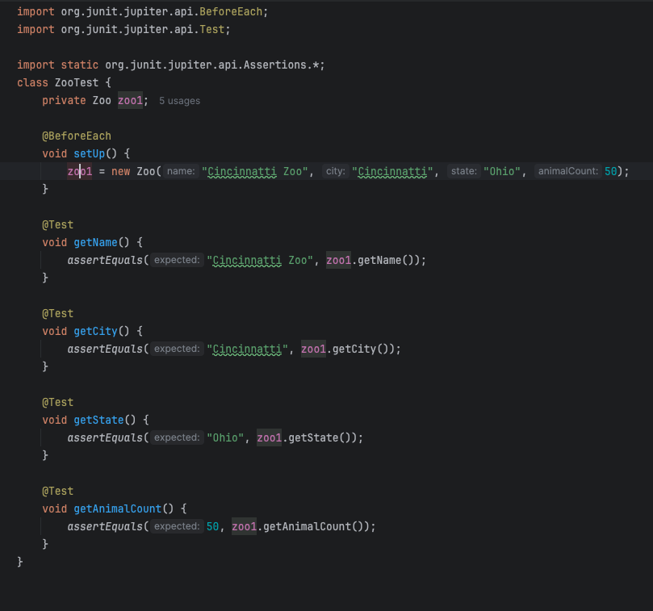
Import statements for assert…()

Slide 24
@BeforeEach method runs before tests

Slide 25
Each @Test tells JUnit this is a test method, not a helper method

Slide 26
JUnit – Summary
Tests need failure atomicity (ability to know exactly what failed)
Each test should have a clear, long, descriptive name
Assertions should always have clear messages to know what failed
Write many small tests, not one big test
Each test should have roughly just 1 assertion at its end
Test for expected errors / exception
Choose a descriptive assert method, not always assertTrue
Choose representative test cases from equivalent input classes
Avoid complex logic in test methods if possible
Use helpers, @Before to reduce redundancy between tests
Notes:
Think of an example

Slide 27
Documentation

Slide 28
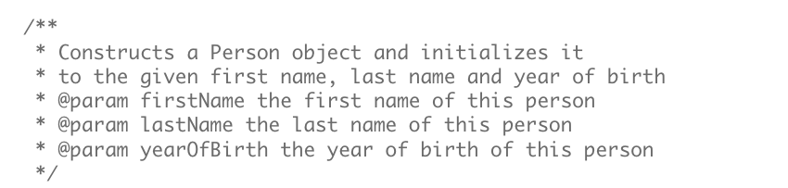
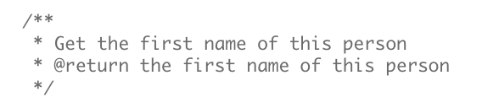
Javadoc style comments
Constructor comments with @param for parameter
Method comment with @return for return value

Slide 29
Assignment 1
Making a new package and a new class
General Design Rubric
Code documentation
Gradle-built
Testing: Jacoco code coverage
Constants
private final static type CONSTANTNAME = …;

Slide 30
Equals and Comparisons
Problem 2 in Assignment
AssertEquals(object1, object1) will return False even if values are the same
B/c pointing to two different locations
Compare primitive data types

