Slide 1

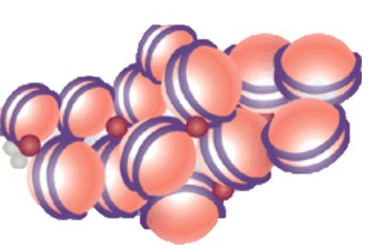
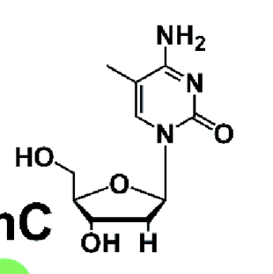
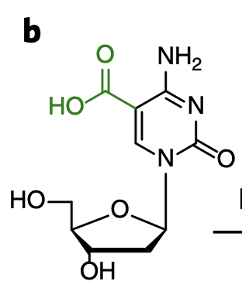
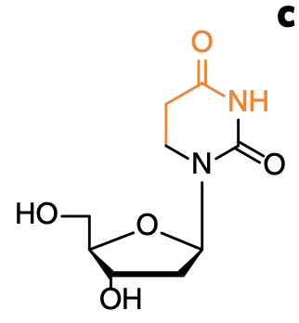
single-cell TAPS
single-cell TAPS + Tx
Single-cell chic + taps
Preparation
cell isolation
cell isolation
cell isolation + incubation
with MNase-coupled Ab
FACS
Single cells are sorted into 384w plates and processed independently
Proteinase K
MNase activation
CATG
CATG
Reverse
Transcription
Robot-assisted
plate processing
NlaIII digestion
CATG
CATG
Adapter ligation
Adapter ligation
barcoded
fragments
Same steps as in Nla-TAPS
Pooled processing
mTET1CD
Pyridine
Borane
5^{m}C → T
PLATES ARE POOLED
TAPS CONVERSION
IVT, Library prep
& Sequencing
Adapter: Cell
Read position: uninformative
Sequence: Methylation
Comparable: WGBS
Adapter: Cell, DNA vs. RNA
Read position: uninformative
Sequence: Methylation (DNA)
Comparable: WGBS + Tx
Adapter: Cell
Read position: Histone mod.
Sequence: Methylation
Comparable: ChIP + BS-Seq
DATA

