Slide 1
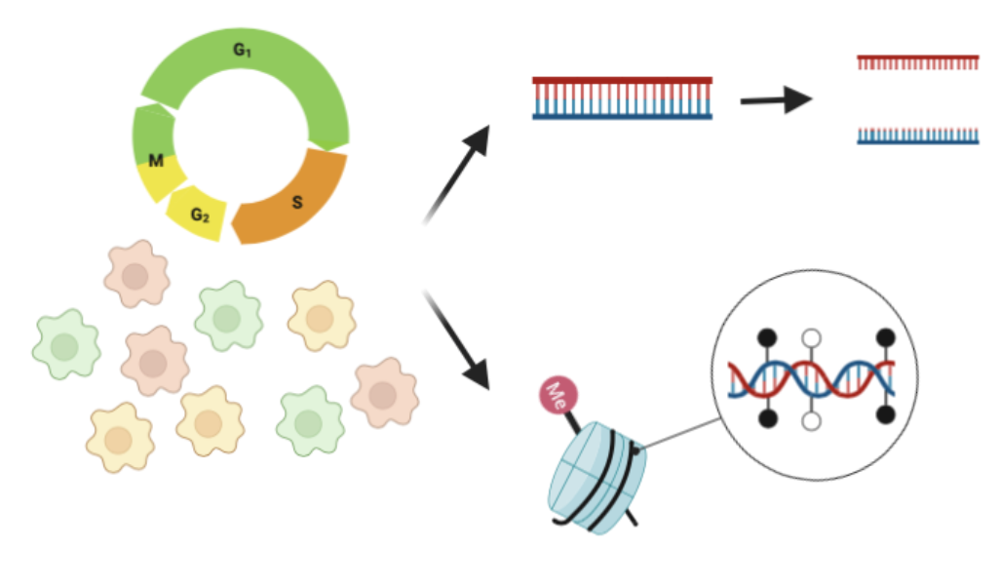
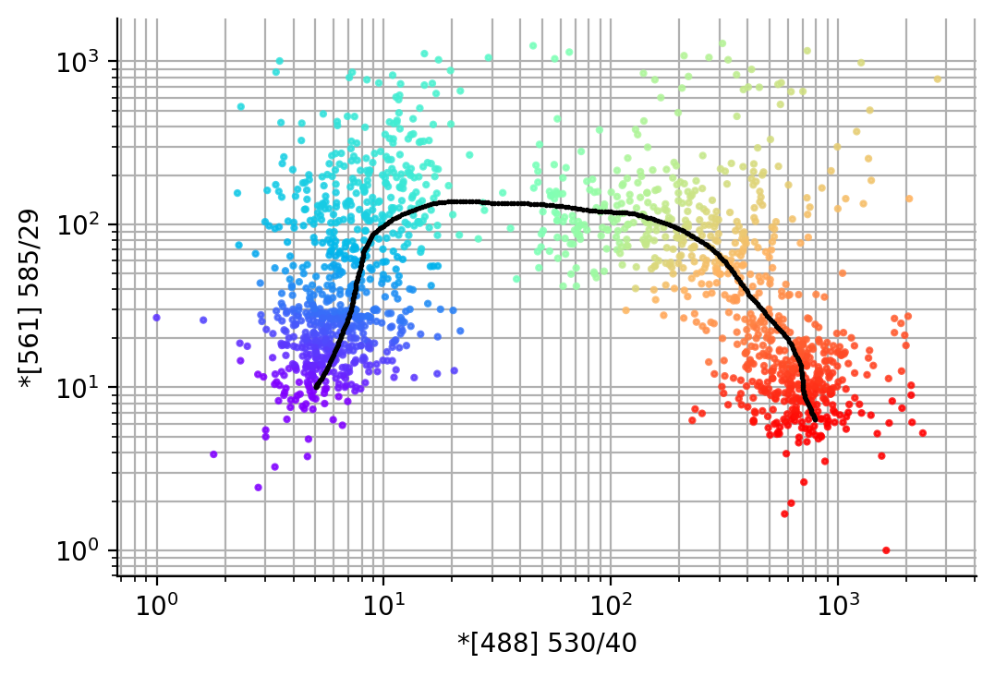
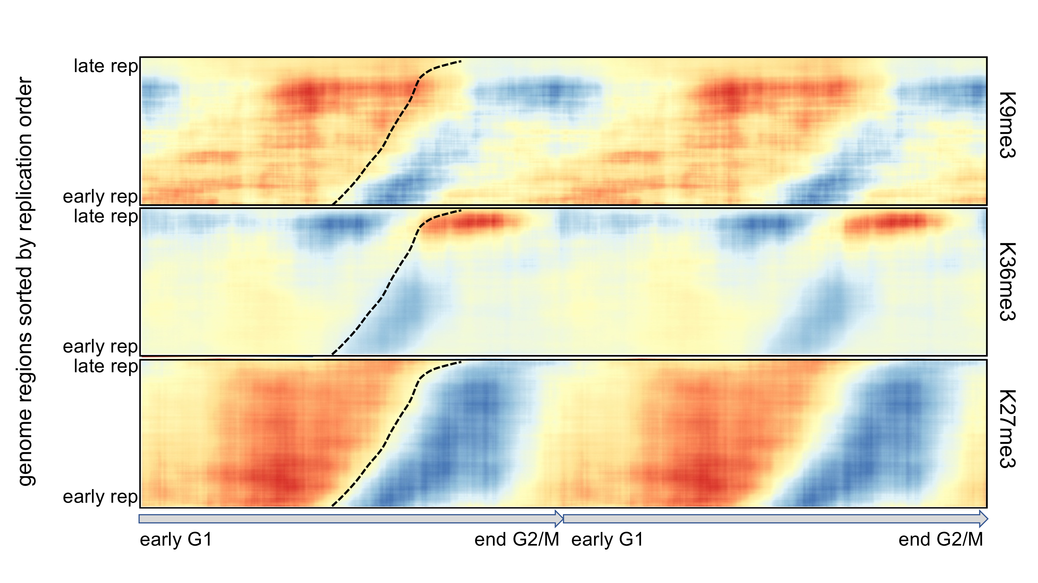
A
B
C
H3K9me3
H3K36me3
Replication timing
H3K27me3
Cell cycle progression
Cell cycle progression

