Slide 1
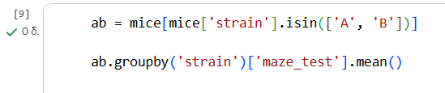
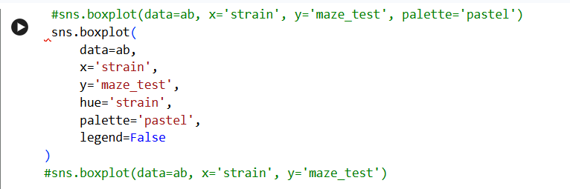
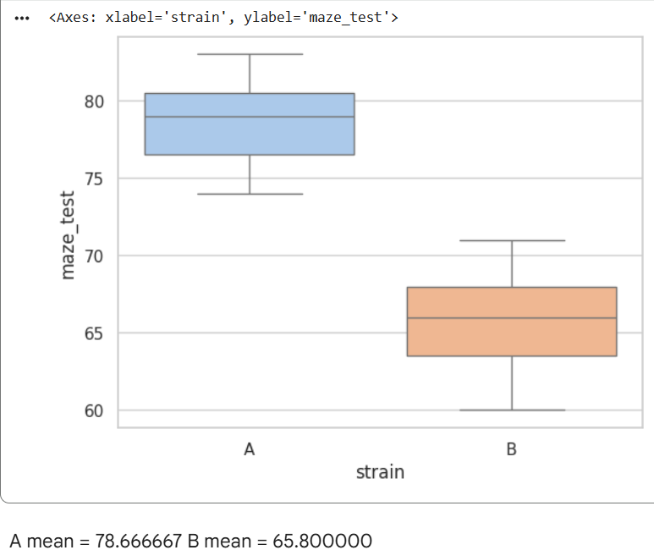
We create a new dataframe ab by filtering the original mice dataset in order to keep only the observations corresponding to strains A and B. This is done using the isin() function on the strain column.
The analytical plan is to compare the mean maze test scores between the two strains. To achieve this, we group the data by strain using the groupby('strain') function and compute the mean maze test score for each group using the .mean() command. This step provides the average maze performance for strain A and strain B, allowing a direct numerical comparison between the two groups.
To visually assess the differences between the two strains, we generate a boxplot using the sns.boxplot() function from the Seaborn library. The boxplot provides a clear representation of the distribution of maze test scores for each strain, including the median, interquartile range, and overall spread of the data.
Different colors are used to distinguish between strains A and B, making the comparison more intuitive. The boxplot shows that strain A has a clearly higher median maze test score than strain B. This observation is consistent with the mean values (mean A = 78.67, mean B = 65.80), and the limited overlap between the interquartile ranges indicates a consistent difference in performance across the two groups.Comments in the code are added using the # symbol and are used to describe each step of the analysis for clarity and reproducibility.

Slide 2
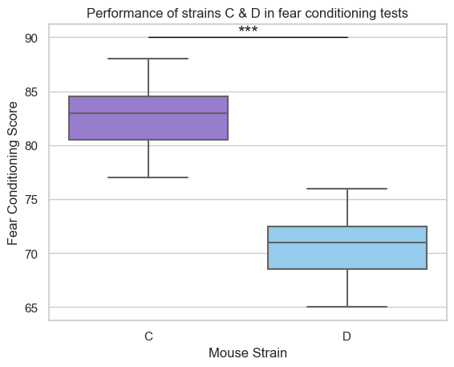
Q: Is strain C better at fear conditioning than strain D?
H₀: fear conditioning score of strain C = fear conditioning score of strain D H₁: fear conditioning score of strain C > fear conditioning score of strain D
Mean score of strain C: 82.6
Mean score of strain D: 70.6
Difference in scores: 12
Is this difference statistically significant (is it random or not?)
T-test (n=30)
p-value: 6.34e⁻¹¹ → p-value < 0.001
H₀ is rejected
There is a statistically significant difference (p<0.001) in fear conditioning scores between the two strains.
The results suggest that strain C performs better at fear conditioning tests → sign for better associative learning and memory capacity.
Figure 1. Box plot showing the score of strains C (n=15) (purple) and D (n=15) (blue) in fear conditioning tests. Triple asterisks denote high statistical significance (p<0.001 , t-test)
Elissavet Anna Petsalaki – Neuro105 (09/01/2026)

Slide 3
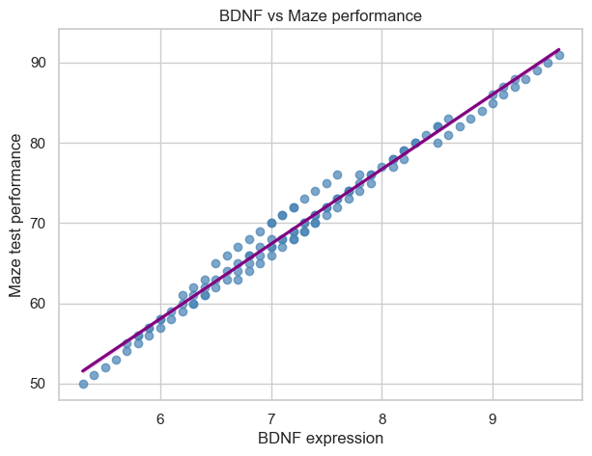
Does BDNF expression correlate with maze test performance?
Pearson correlation: r = 0.992
Strong positive association between BDNF expression and maze test performance
Permutation test: p < 1 × 10⁻⁴ (10,000 shuffles)
Therianou Maria Neuro-105

Slide 4
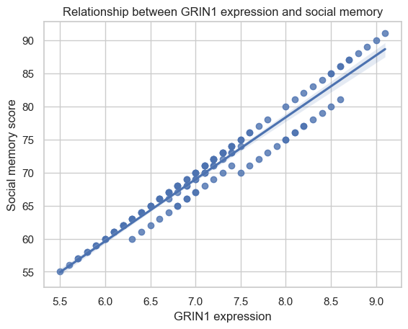
Does GRIN1 expression correlate with social memory
Pearson correlation analysis revealed a very strong positive relationship
between GRIN1 expression and social memory performance (r = 0.978, p < 0.001),
indicating that mice with higher GRIN1 expression tend to show better social
memory scores.
Given the role of GRIN1 in NMDA receptor function and synaptic plasticity, higher GRIN1
expression may contribute to neural mechanisms that support social cognitive
performance.

Slide 5
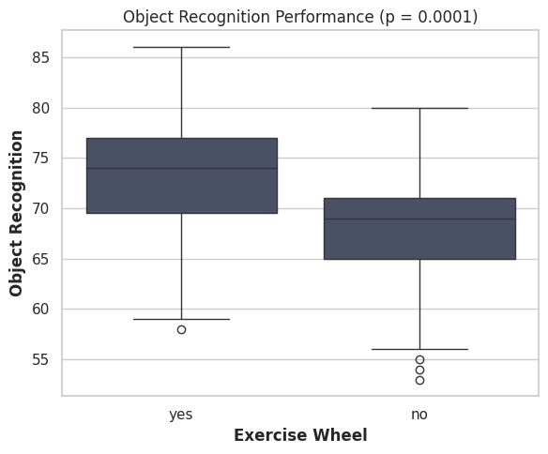
Do mice with exercise wheels perform better on object recognition?
An independent student’s t-test showed that mice who had access to exercise wheels in their cages performed significantly better in the object recognition test, t(118) = 4.03, p < 0.001.
NEURO-105 Maria Manousou

Slide 6
Do mice with exercise wheels perform better on object recognition?
An independent student’s t-test showed that mice who had access to exercise wheels in their cages performed significantly better in the object recognition test, t(118) = 4.03, p < 0.001.
NEURO-105 Maria Manousou

Slide 7
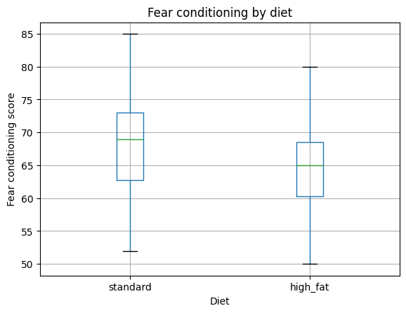
Does diet affect fear conditioning?
Standard diet: median = 69
High-fat diet: median = 65
Normality assessed with Shapiro–Wilk test (p > 0.05)
An independent t-test indicated: p < 0.05
So, high-fat diet is associated with lower fear conditioning performance

Slide 8
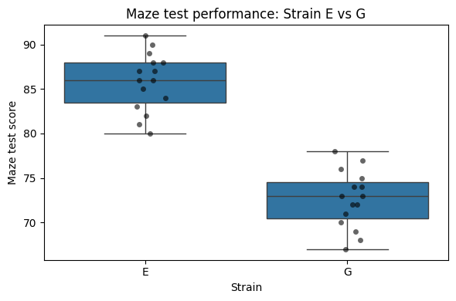
Maze Test Performance Differs Between Mouse Strains E and G
Maze test performance was compared between mouse strains E and G (n = 15 per group).
Strain E showed higher maze test scores than strain G (mean ± SD: 85.8 ± 3.28 vs 72.6 ± 3.22).
t-test revealed a highly significant difference (t = 11.12, p = 8.8 × 10⁻¹²).
Boxplot showing maze test scores for mouse strains E and G. Strain E exhibits a higher median and overall score distribution compared to strain G.
Using Python:
load data mice = and (infile)
select groups E, G: df, isin()
statistics groupby(‘strain’)[‘maze_test’]
plots sns.boxplot
normality stats.shapiro
t-test stats.ttest

Slide 9
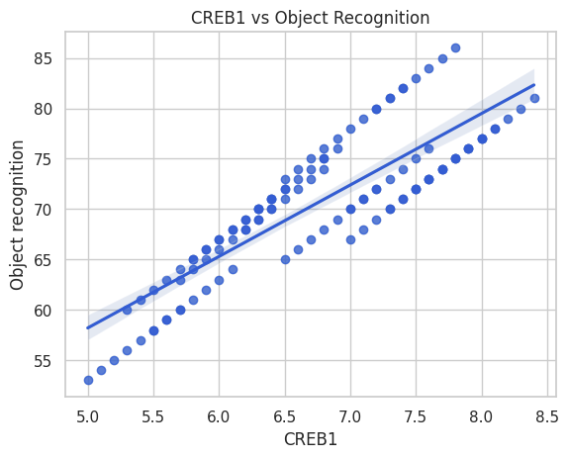
Neuro 105: Project Python
Does CREB1 expression correlate with object recognition performance?
A strong positive correlation was observed between CREB1 expression and object recognition performance. Higher CREB1 levels were associated with better cognitive performance
(r = .86, p < .001).
Figure 1. Relationship between CREB1 expression and object recognition performance.

Slide 10
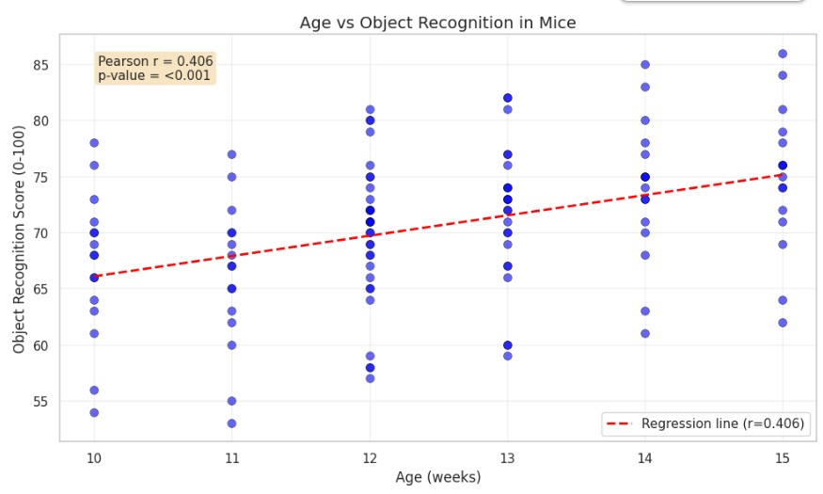
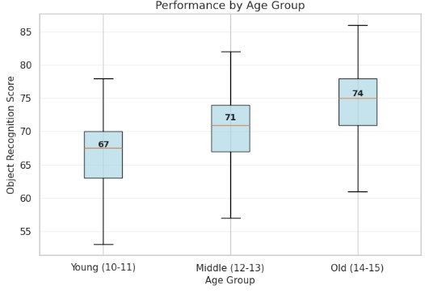
NEURO105 - Georgia Koromila (09.02.2026)
Mouse Cognition Study: Does Age Affect Object Recognition?
Age significantly predicts object recognition performance (r = 0.406, p < 0.001), explaining 16.5% of variance. Object recognition scores increase by approximately 1.8 points per week of age, indicating a moderate positive relationship where older mice consistently score higher.

