Slide 1
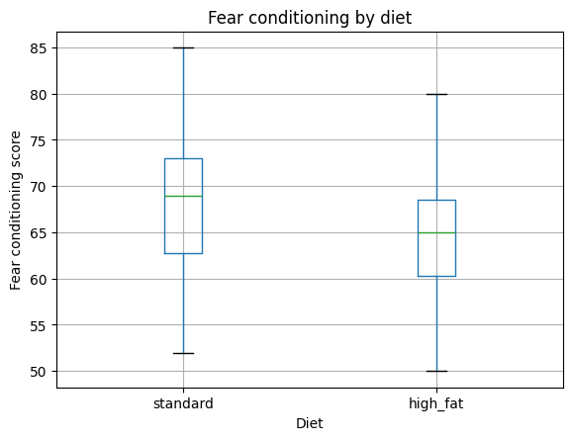
Does diet affect fear conditioning?
Standard diet: median = 69
High-fat diet: median = 65
Normality assessed with Shapiro–Wilk test (p > 0.05)
An independent t-test indicated: p < 0.05
So, high-fat diet is associated with lower fear conditioning performance

