Slide 1
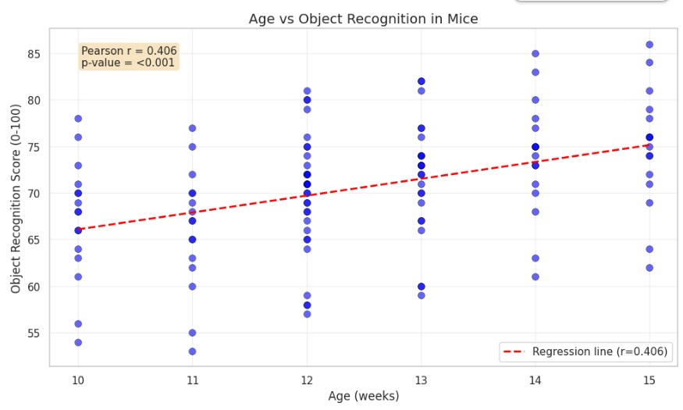
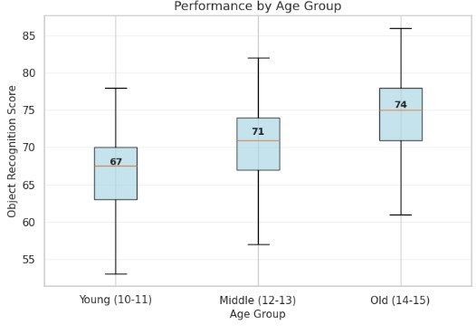
NEURO105 - Georgia Koromila (09.02.2026)
Mouse Cognition Study: Does Age Affect Object Recognition?
Age significantly predicts object recognition performance (r = 0.406, p < 0.001), explaining 16.5% of variance. Object recognition scores increase by approximately 1.8 points per week of age, indicating a moderate positive relationship where older mice consistently score higher.

