Slide 1
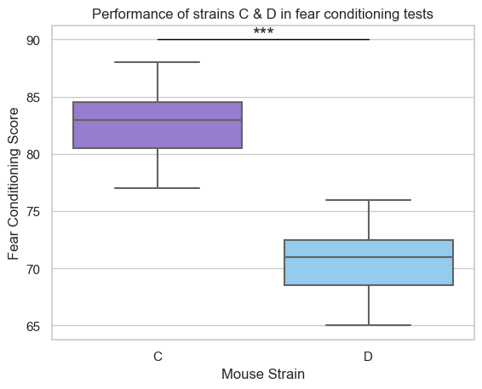
Q: Is strain C better at fear conditioning than strain D?
H₀: fear conditioning score of strain C = fear conditioning score of strain D H₁: fear conditioning score of strain C > fear conditioning score of strain D
Mean score of strain C: 82.6
Mean score of strain D: 70.6
Difference in scores: 12
Is this difference statistically significant (is it random or not?)
T-test (n=30)
p-value: 6.34e⁻¹¹ → p-value < 0.001
H₀ is rejected
There is a statistically significant difference (p<0.001) in fear conditioning scores between the two strains.
The results suggest that strain C performs better at fear conditioning tests → sign for better associative learning and memory capacity.
Figure 1. Box plot showing the score of strains C (n=15) (purple) and D (n=15) (blue) in fear conditioning tests. Triple asterisks denote high statistical significance (p<0.001 , t-test)
Elissavet Anna Petsalaki – Neuro105 (09/01/2026)

