Slide 1
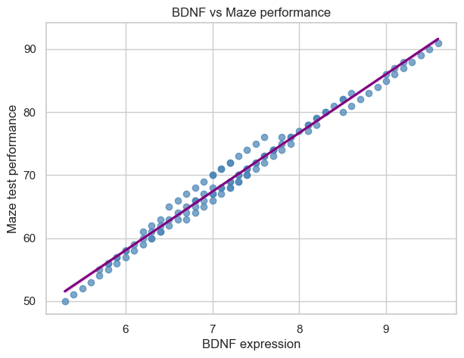
Does BDNF expression correlate with maze test performance?
Pearson correlation: r = 0.992
Strong positive association between BDNF expression and maze test performance
Permutation test: p < 1 × 10⁻⁴ (10,000 shuffles)
Therianou Maria Neuro-105

