Slide 1
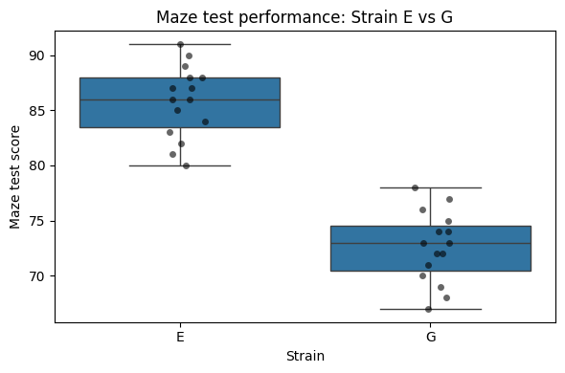
Maze Test Performance Differs Between Mouse Strains E and G
Maze test performance was compared between mouse strains E and G (n = 15 per group).
Strain E showed higher maze test scores than strain G (mean ± SD: 85.8 ± 3.28 vs 72.6 ± 3.22).
t-test revealed a highly significant difference (t = 11.12, p = 8.8 × 10⁻¹²).
Boxplot showing maze test scores for mouse strains E and G. Strain E exhibits a higher median and overall score distribution compared to strain G.
Using Python:
load data mice = and (infile)
select groups E, G: df, isin()
statistics groupby(‘strain’)[‘maze_test’]
plots sns.boxplot
normality stats.shapiro
t-test stats.ttest

