Slide 1
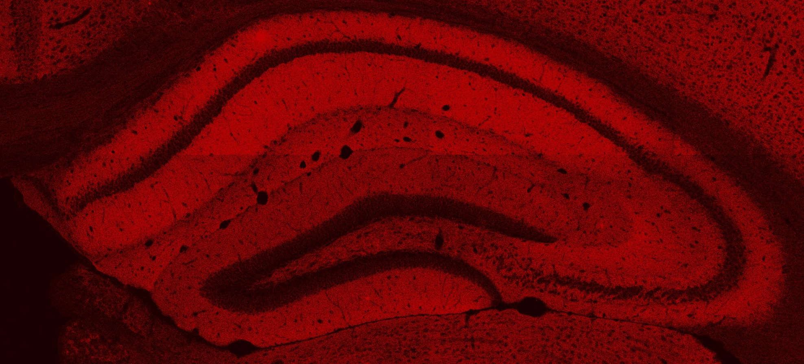
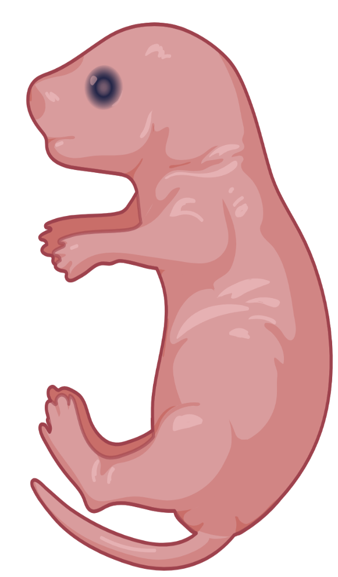
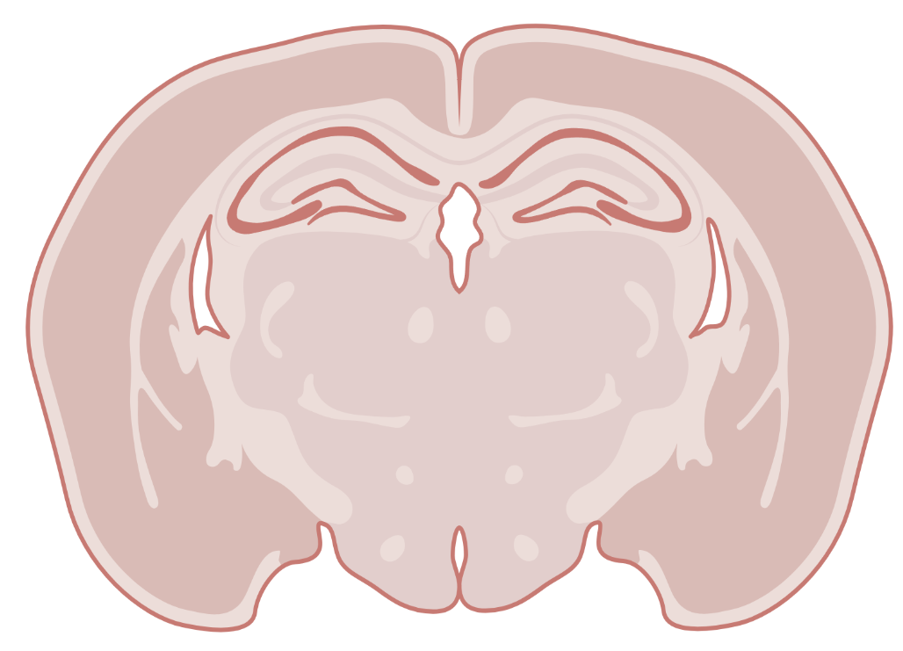
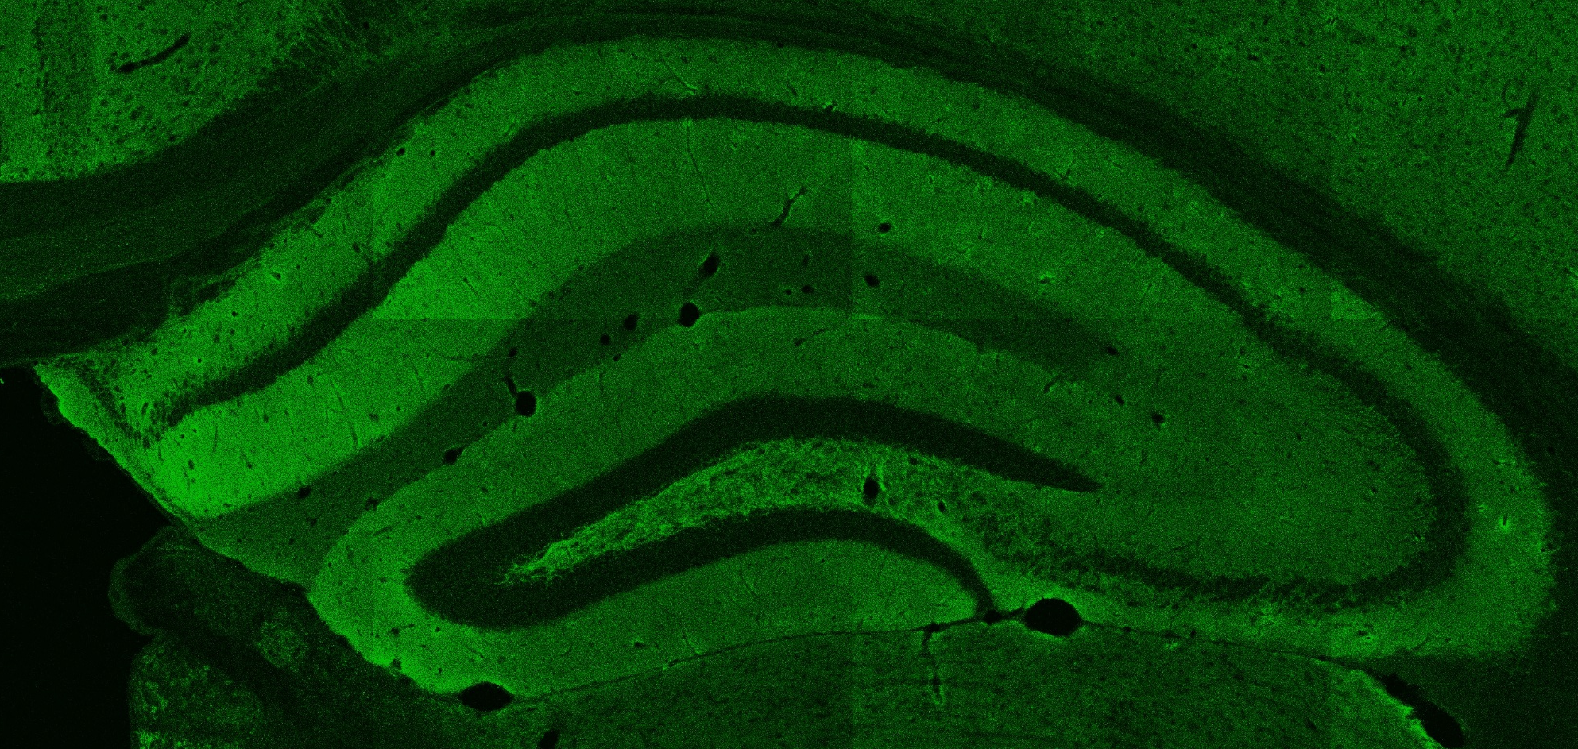
Experimental set-up: CRISPR screen
P2
P21 or P28
Viral injection
Histology & IHC
gRNA
control
Imaging synaptic layers of the hippocapus
PSD95
CA1
CA3
+ Inhibitory markers
(VGAT & Gephyrin)
+ other markers
(Vglut2, SPO, … )
DG
Total: gRNAs for 5 proteins (5 different conditions)
Vlgut1
Goal of the image analysis:
quantifying the colocalized synaptic puncta in gRNA vs Control
- with gRNAs for 5 different proteins
- in different synaptic layers of the hippocampus
- with different synaptic markers
- with different analyses: coloc, overlap, mfi, puncta density…
CA1
CA3
DG

Slide 2

Image analysis pipeline
Input: high res images 63X
Script1: getting optimal parameters
for each VGLUT1-PSD95 image within
an experimental batch control
Output: csv file with optimal parameters for each image
Script2: calculate the mean parameters
of that experimental batch
Output: (1) mean parameters & (2) figure of binned mean parameters
Script3: actually calculating the colocalized
synaptic puncta nr between gRNA and control
Output: (1) image with spots & (2) figures &
(3) csv file with colocalized puncta
Synaptic layer | Synaptic markers | Condition | Colocalized puncta
CA1 SR | VLGUT1-PSD95 | Controls vs protein1 gRNA | 80 vs 67
CA1 SLM | VLGUT1-PSD95 | Controls vs protein1 gRNA | 78 vs 84
…

Slide 3




Original pipeline
Synapse counting image analysis pipeline
- For each experimental replicate
Output:
opt-param.csv
spots.tiff
Input:
mean-param.csv
Extracting optimal
parameters
Calculate mean
parameters
mean-param.png
Calculate
colocalized spots
statistics.csv
…_ProteinX_VGLUT1-PSD95_CA1-SLM.czi
statistics_fig.csv
…_ProteinX_VGLUT1-PSD95_CA3-SL.czi
…
image_spots.csv
File export for inspection
opt-param.csv
Optimal parameters for each imported image
mean-param.csv
Mean parameters for each region
statistics.csv
All statistics concerning the calculation
spots.tiff
Detected spots on each image with optimal parameters for that image
mean-param.png
Binned mean parameters to check the distribution
statistics.png
All statistics in figures
image_spots
Detected spots for each image with mean optimal parameters

Slide 4
Simplified
surrogate pipeline
Synapse counting image analysis pipeline – surrogate pipeline
- For each experimental replicate
Output:
thresholds.csv
mean-thresholds.csv
overlap.csv
overlap.csv
Input:
Input:
Calculate
thresholds
Calculate mean
thresholds
Calculate
overlap
Make
Figure
…_ProteinX_VGLUT1-PSD95_CA1-SLM.czi
…_ProteinX_VGLUT1-PSD95_CA3-SL.czi
dotplot.png
…
File export for inspection
Simplified operation on images:
Preprocessing → autothreshold (traingle) → calculate overlap (with internal rotated cntrl) → calculate mean overlap → apply to images

Slide 5
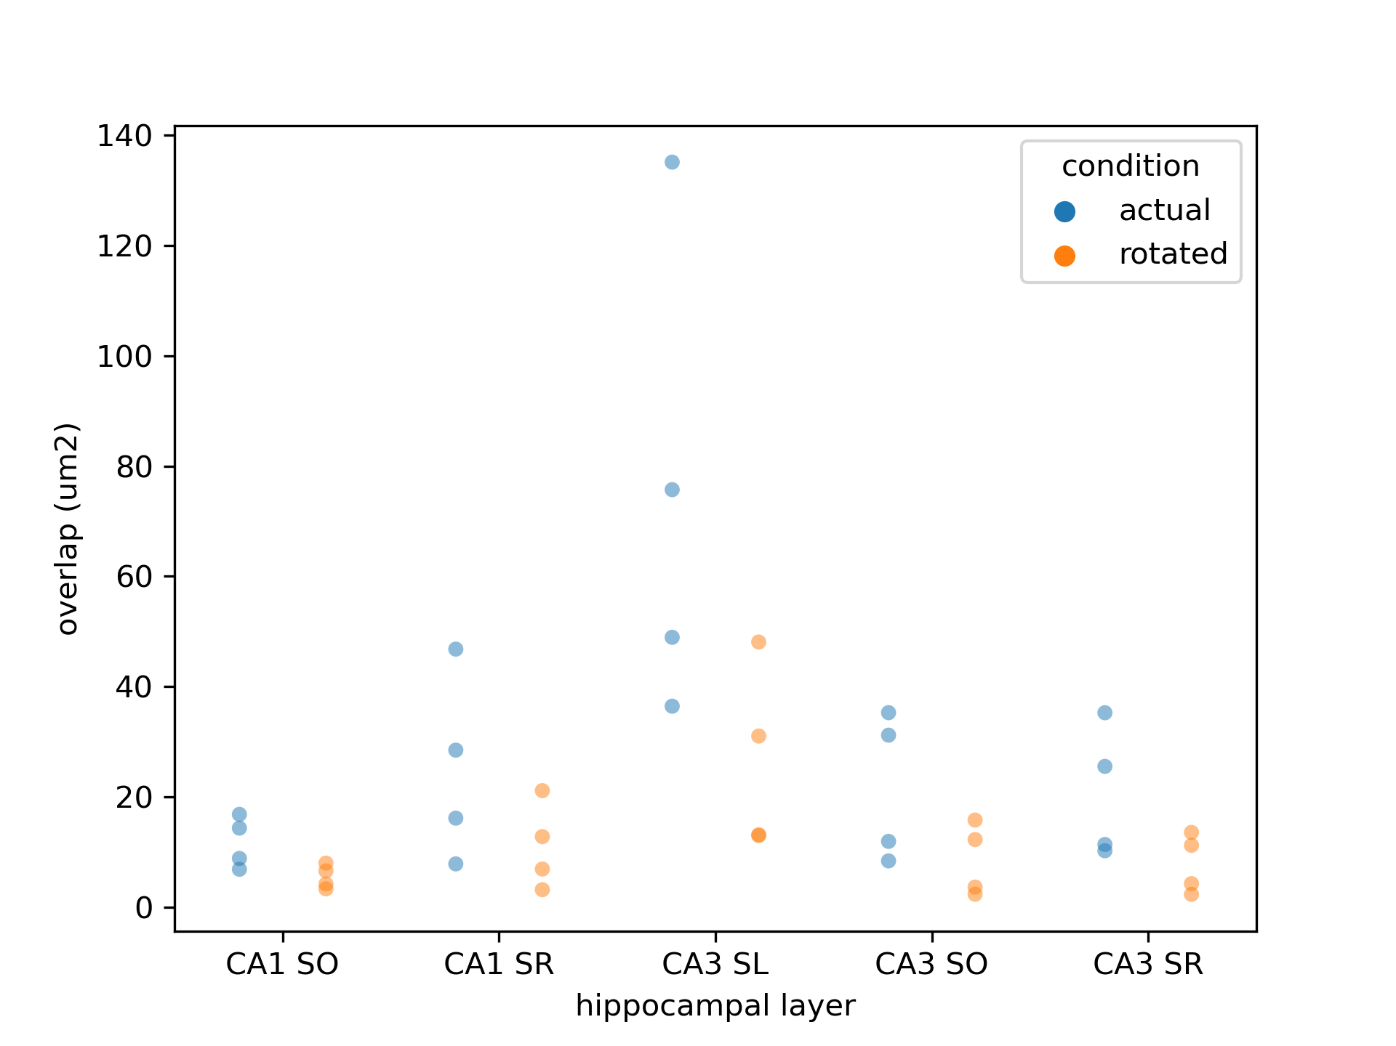
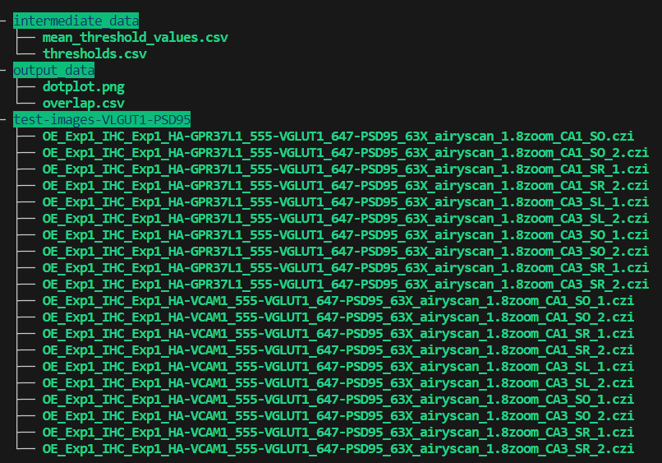
Simplified
surrogate pipeline

