Slide 1
Finding computational relevant VCAM1 interactors (heatmap)
Database selection
Back-end data
verification
UniProt
X et al.
STRING
IntAct
BioGrid
APID
Benchmark:
Bajpai et al. 2020
Experimental
evidence
Subcellular
location
Hippocampal
expression

Slide 2
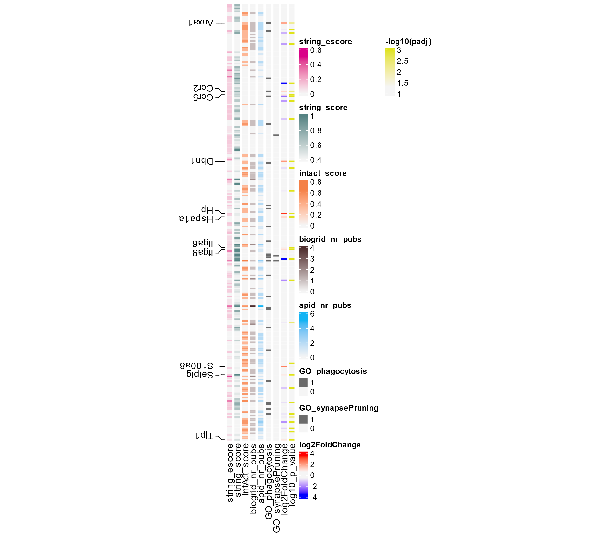
STRING – exp score
STRING – gen score
PPI databases
IntAct - score
BioGRID – nr of pubs
APID – nr of pubs
GO terms
phagocytosis
synapse pruning
Danyang 2022
log2Foldchange
-log10(padj)
phagoLOW
+3
phagoHIGH

Slide 3
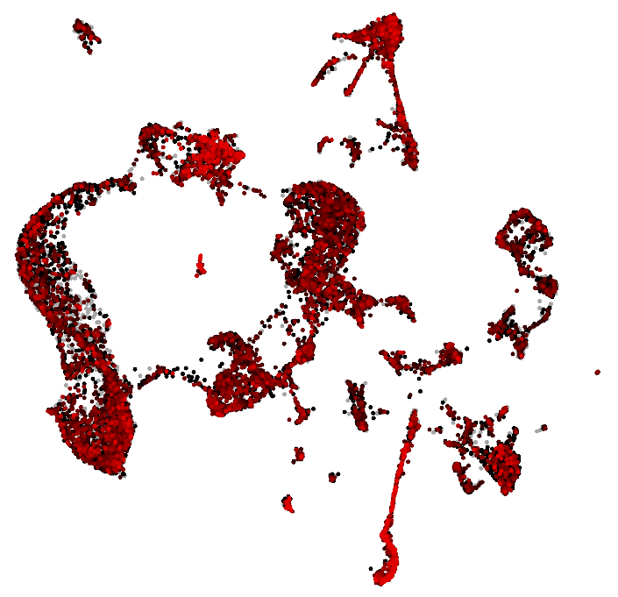
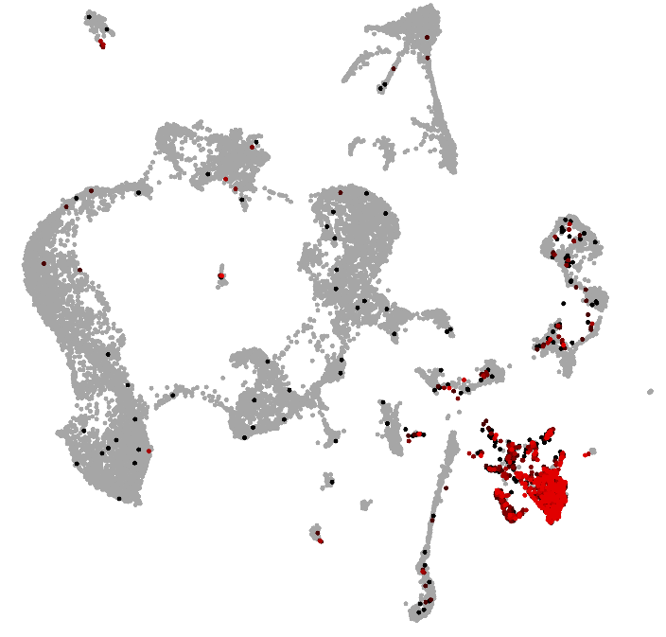
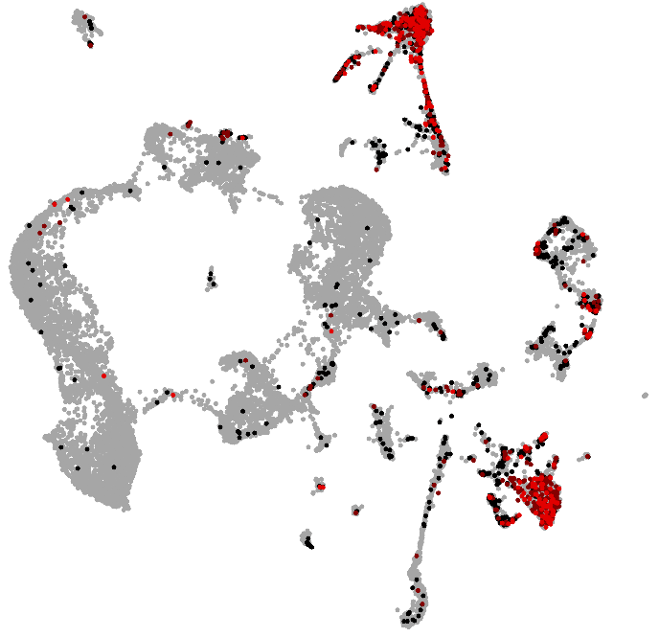
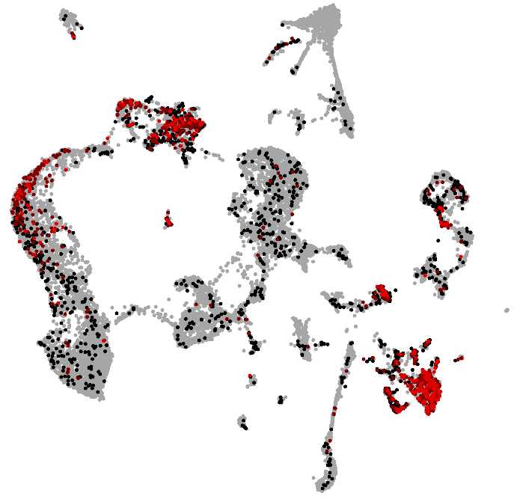
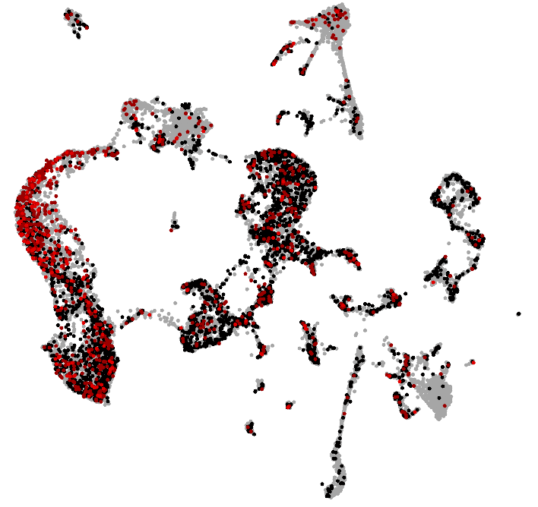
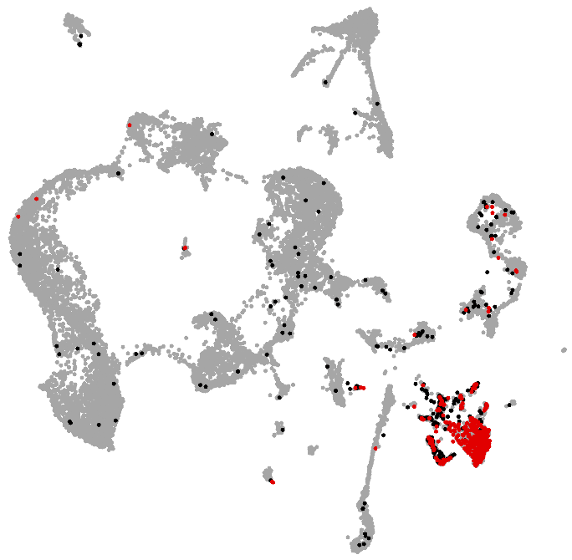
Tjp1
Selplg
Itga9
OPC
Micro
Micro
Itga6
Dbn1
Ccr5
Astro
Granule
cells
Granule
cells
Hip
neurons
Micro
Micro
Hippocampus scRNAseq P15 data from Blanca & Danie
(low nr oR not detected: S100a8, Hspa1a, Ccr2, Anxa1)

Slide 4
Finding computational relevant VCAM1 interactors (heatmap)
Interactors
data bases (experimental interactions)
PPI
docking (AlphaFold-Multimer)
Descriptive
Cell-type expression
Checking cell-type expression (microglia & OPCs) from Blanca and Danies single-cell
Developmental expression
Checking developmental expression from Blanca and Danies single-cell
GO terms
Check GO terms (phagocytosis, synapse phagocytosis, … ) of interactors
Public data
Reanalyzing public RNAseq data related to synapse phagocytosis
- danyang et al. 2022 Mg tau-GFP+ and tau GFP-
- danyang et al. 2022 Mg high and low TRPM
- grubman et al. 2021 Mg Ab phago
- Masuda et al. 2019 Mg subclasses throughout development
- Hammond et al. 2019 Mg over development
- Keren-shaul et al. 2017. DAM microglia (because the phagocytic pathway is induced in these type of microglia in AD context)
- Li et al. 2019. Microglia developement
Functional

Slide 5
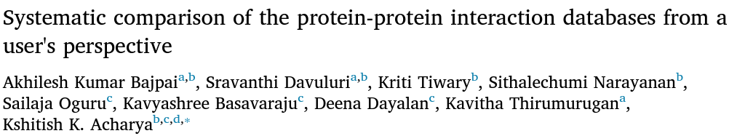
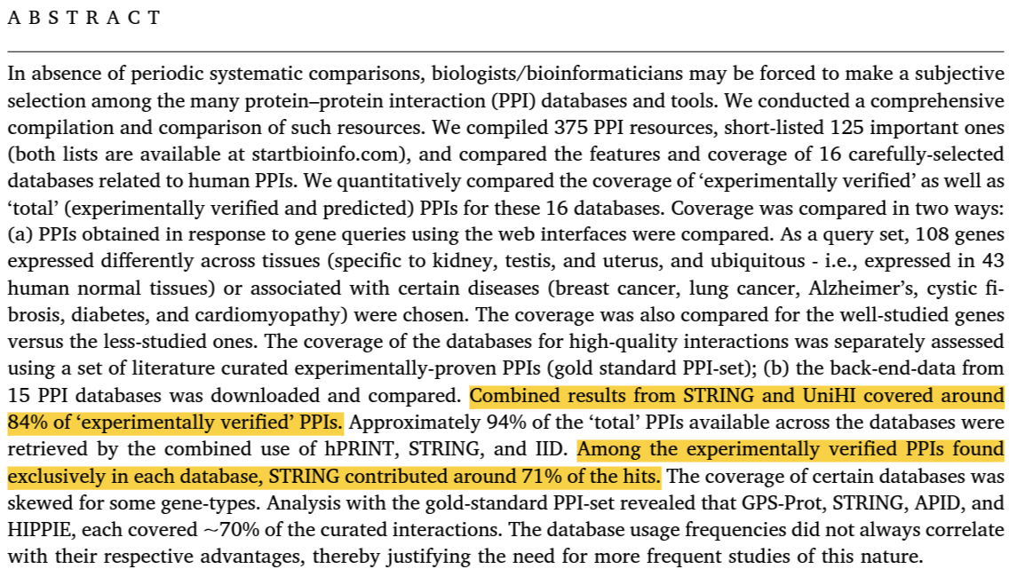
STRING & UniHI
UniHi is down

Slide 6
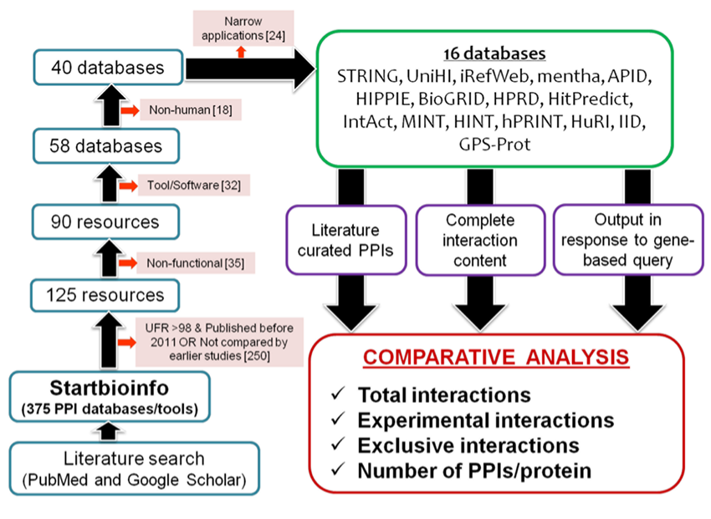
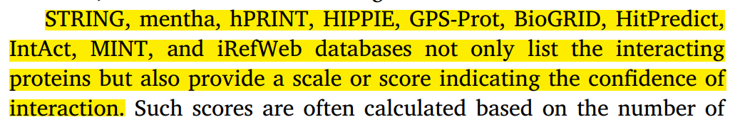
Database selection

Slide 7
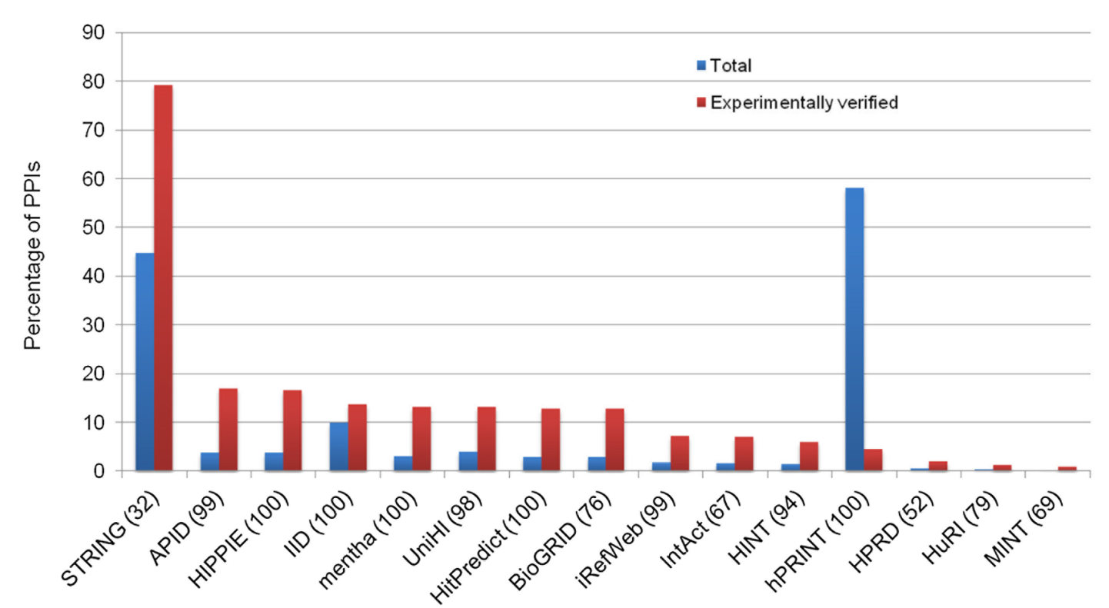
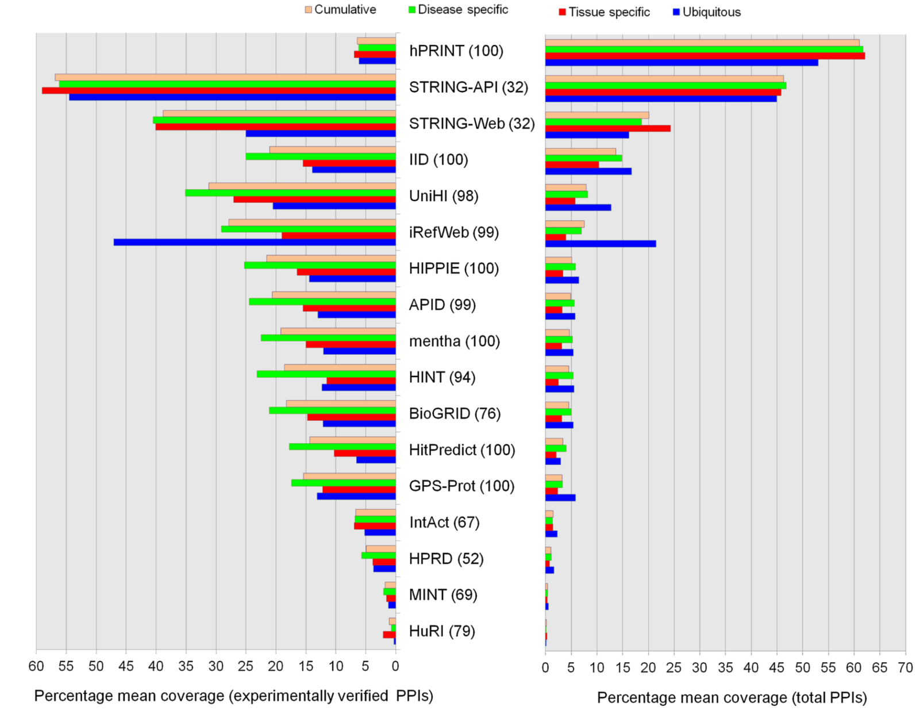
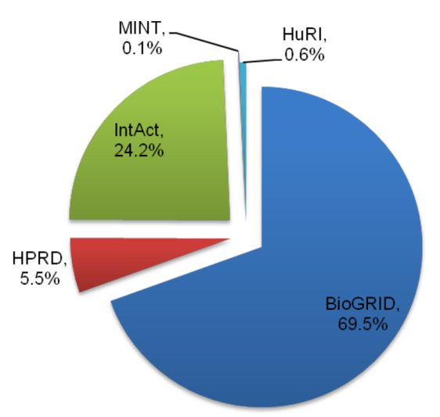
Mean yield coverage of protein interactions across databases for ubiquitous, tissue-specific, and disease-associated gene-sets.
Coverage of protein interactions across the databases based on complete downloaded data.
Coverage of exclusive protein interactions among the primary databases, based on the analysis of complete downloaded data.
STRING
APID (BioGRID, InAct, MINT, HPRD, …)
HIPPIE (BioGRID, InAct, MINT, HPRD, … )
IID (BioGRID, InAct, MINT, HPRD, … )

Slide 8


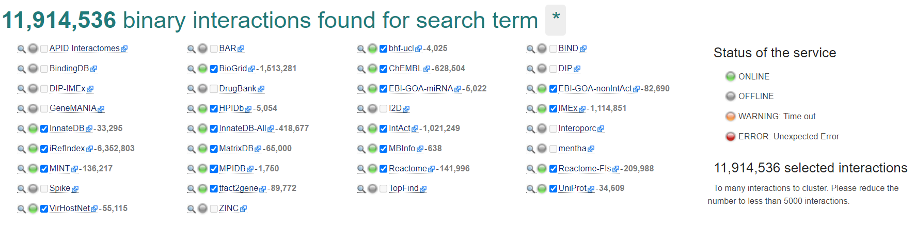
STRING
APID (BioGRID, InAct, MINT, HPRD, …)
HIPPIE (BioGRID, InAct, MINT, HPRD, … )
IID (BioGRID, InAct, MINT, HPRD, … )
STRING (scoring system)
PSICQUIC (no scoring system, nr of publications)
HIPPIE (scoring system)
+ APID (as backup to HIPPIE, scoring system)
STRING
PSICQUIC
HIPPIE
APID

