Slide 1

Cardiovascular Disease: Diagnosis and Treatment
Medical Grand Rounds
Department of Cardiology
Presented by: Dr. Smith

Slide 2
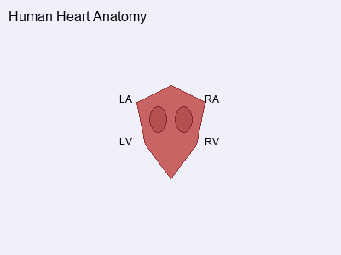
Cardiac Anatomy and Physiology
Key Anatomical Structures:
• Left Atrium (LA) - Receives oxygenated blood
• Right Atrium (RA) - Receives deoxygenated blood
• Left Ventricle (LV) - Pumps blood to systemic circulation
• Right Ventricle (RV) - Pumps blood to pulmonary circulation
• Valves regulate unidirectional blood flow
Notes:
This anatomical diagram shows the four-chamber structure of the human heart. The diagram illustrates the left and right atria (upper chambers) and left and right ventricles (lower chambers). This is essential for understanding cardiac physiology and pathology.

Slide 3
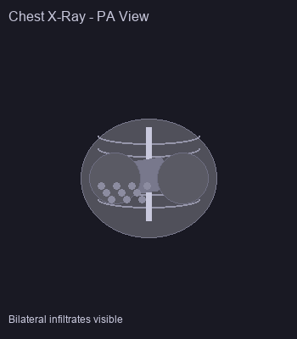
Chest Radiography: Pneumonia Case Study
Patient Presentation:
• 65-year-old male with fever and cough
• Shortness of breath for 3 days
• Physical exam: Crackles in bilateral lower lobes
Radiographic Findings:
• Bilateral lower lobe infiltrates
• No pleural effusion
• Normal cardiac silhouette
Notes:
This posterior-anterior (PA) chest X-ray demonstrates bilateral lower lobe infiltrates consistent with community-acquired pneumonia. The infiltrates appear as increased opacity in the lung bases. The cardiac silhouette is normal in size and contour.

Slide 4
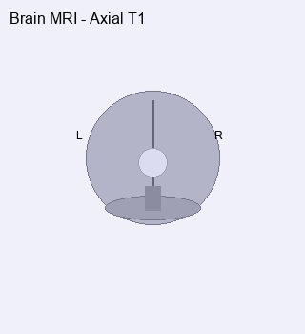
Neuroimaging: Brain MRI Interpretation
MRI Technique:
• T1-weighted axial sequences
• 1.5 Tesla field strength
• Contrast: Gadolinium-enhanced
Normal Structures Visible:
• Cerebral hemispheres
• Lateral ventricles
• Brainstem and cerebellum
• Gray and white matter differentiation
Notes:
Axial T1-weighted MRI image of the brain showing normal anatomical structures. The image demonstrates good gray-white matter differentiation with normal ventricular system. No acute abnormalities are identified.

Slide 5
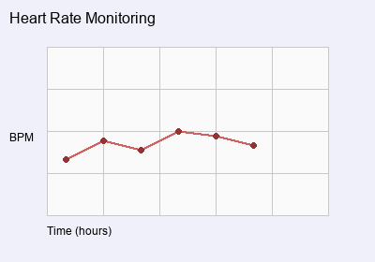
Patient Monitoring: Vital Signs Trending
24-Hour Monitoring Results:
• Continuous cardiac monitoring
• Hourly vital sign assessment
• Blood pressure: Stable 120/80
• Temperature: Resolved fever
• Oxygen saturation: 98% on room air
Clinical Interpretation:
• Improving hemodynamic status
• Response to treatment evident
Notes:
This graph shows heart rate monitoring over a 24-hour period. The data demonstrates gradual stabilization of heart rate following treatment initiation. The trend indicates positive response to therapeutic intervention.

Slide 6

Treatment Protocol and Outcomes
Evidence-Based Treatment:
• Antibiotic therapy: Azithromycin 500mg daily
• Supportive care: Oxygen therapy PRN
• Monitoring: Serial chest X-rays
• Duration: 7-day course
Clinical Outcomes:
• Fever resolution within 48 hours
• Improved respiratory symptoms
• Radiographic improvement on day 5
• Successful outpatient management

