Slide 1
$$0$$
$$0$$
$$1$$
$$1$$
$$2$$
$$2$$
$$3$$
$$3$$
$$4$$
$$4$$
$$5$$
$$5$$
$$6$$
$$6$$
$$7$$
$$7$$
$$8$$
$${\dot{Q}}_{o}$$
$${\dot{Q}}_{i}$$
- +
$$0$$
$$0$$
$$1$$
$$1$$
$$2$$
$$2$$
$$3$$
$$3$$
$$4$$
$$4$$
$$5$$
$$5$$
$$6$$
$$6$$
$$7$$
$$7$$
$$T_{o}$$
$${\dot{Q}}_{o}$$
$${\dot{Q}}_{i}$$
$$0$$
$$0$$
$$1$$
$$1$$
$$2$$
$$2$$
$$3$$
$$3$$
$$4$$
$$4$$
$$5$$
$$5$$
$$6$$
$$6$$
$$7$$
$$7$$
+ -
$${\dot{Q}}_{o}$$
$${\dot{Q}}_{i}$$
$$T_{i}$$
- +
$$0$$
$$0$$
$$1$$
$$1$$
$$2$$
$$2$$
$$3$$
$$3$$
$$4$$
$$4$$
$$5$$
$$5$$
$$6$$
$$6$$
$$7$$
+ -
$$T_{o}$$
$${\dot{Q}}_{o}$$
$${\dot{Q}}_{i}$$
$$T_{i}$$
wall_in.csv
$$0$$
$$0$$
$$1$$
$$1$$
$$2$$
$$2$$
$$3$$
$$3$$
$$4$$
$$4$$
$$5$$
$$5$$
$$6$$
$$6$$
$$7$$
$$7$$
$$8$$
$${\dot{Q}}_{o}$$
$${\dot{Q}}_{i}$$
wall_out.csv
- +
$$0$$
$$1$$
$$2$$
$$3$$
$$4$$
$$5$$
$$6$$
$$7$$
$$T_{o}$$
$$0$$
$$1$$
$$2$$
$$3$$
$$4$$
$$5$$
$$6$$
$$7$$
$${\dot{Q}}_{o}$$
$${\dot{Q}}_{i}$$

Slide 2














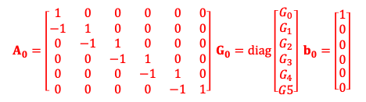
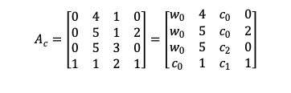

TCw0=TC0
$$Φ_{i}$$
$$Φ_{i}$$
- +
- +
$$0$$
$$0$$
$$1$$
$$1$$
$$2$$
$$2$$
$$3$$
$$3$$
$$4$$
$$4$$
$$5$$
$$0$$
$$1$$
$$0$$
$$1$$
$$3$$
$$0$$
$$T_{o}$$
$$0$$
$$1$$
$$2$$
$$2$$
$$3$$
$$3$$
$$4$$
$$4$$
$$5$$
$$5$$
$$T_{o}$$
$$0$$
$$1$$
$$2$$
$$2$$
$$3$$
$$4$$
$$4$$
$$5$$
$$Φ_{o}$$
$$0$$
TCc0=TC1
$$Φ_{o}$$
$$0$$
$${\dot{Q}}_{a1}$$
$$0$$
$$6$$
$${\dot{Q}}_{aux}/2$$
$$Φ_{a}$$
$$8$$
$$Φ_{a}$$
$$7$$
$$5$$
$$11$$
$$9$$
$$2$$
$$5$$
$$6$$
- +
$$1$$
$$2$$
- +
$$7$$
$$1$$
+ -
$$T_{o}$$
$$0$$
$$0$$
$$1$$
$$1$$
$$1$$
$$T_{o}$$
$$0$$
$$0$$
$$1$$
$$1$$
$$1$$
$$0$$
$$1$$
$$T_{i,sp}$$
TCc1=TC2
$$0$$
$$1$$
+ -
$${\dot{Q}}_{aux}/2$$
$$T_{i,sp}$$
- +
$$10$$
TCc2=TC3
$${\dot{Q}}_{a2}$$
$$T_{o}$$
$$0$$
- +
$$0$$
$$T_{o}$$
$$A_{c}=\left[\begin{matrix}0 & 4 & 1 & 0 \\ 0 & 5 & 1 & 2 \\ 0 & 5 & 3 & 0 \\ 1 & 1 & 2 & 1\end{matrix}\right]=\left[\begin{matrix}w_{0} & 4 & c_{0} & 0 \\ w_{0} & 5 & c_{0} & 2 \\ w_{0} & 5 & c_{2} & 0 \\ c_{0} & 1 & c_{1} & 1\end{matrix}\right]$$
outputs:
TC0 node 0
TC0 node 4
TC0 node end (5)
TC1 node 2
TC3 node 0: not mentioned
but common TC0-5 & TC1-2
(a)
$A_{0}=\left[\begin{matrix}1 & 0 & 0 & 0 & 0 & 0 \\ −1 & 1 & 0 & 0 & 0 & 0 \\ 0 & −1 & 1 & 0 & 0 & 0 \\ 0 & 0 & −1 & 1 & 0 & 0 \\ 0 & 0 & 0 & −1 & 1 & 0 \\ 0 & 0 & 0 & 0 & −1 & 1\end{matrix}\right] G_{0}=diag\left[\begin{matrix}G_{0} \\ G_{1} \\ G_{2} \\ G_{3} \\ \begin{aligned}G_{4} \\ G5\end{aligned}\end{matrix}\right] b_{0}=\left[\begin{matrix}1 \\ 0 \\ 0 \\ 0 \\ \begin{aligned}0 \\ 0\end{aligned}\end{matrix}\right]$
$C_{0}=diag {\left[\begin{matrix}0 & { C}_{c} & 0 & { C}_{i} & 0 & 0\end{matrix}\right]}^{T}$
$f_{0}={\left[\begin{matrix}1 & 0 & 0 & 0 & 0 & 0\end{matrix}\right]}^{T}$
$$A_{1}=\left[\begin{matrix}−1 & 1 & 0 \\ 0 & −1 & 1\end{matrix}\right] G_{1}=diag\left[\begin{matrix}G_{0} \\ G_{1}\end{matrix}\right] b_{1}=\left[\begin{matrix}0 \\ 0\end{matrix}\right]$$
$C_{1}=diag {\left[\begin{matrix}0 & 0 & C_{a}/2\end{matrix}\right]}^{T}$
$f_{1}={\left[\begin{matrix}1 & 0 & 1\end{matrix}\right]}^{T}$
$$A_{2}=\left[\begin{matrix}1 & 0 \\ −1 & 1\end{matrix}\right] G_{2}=diag\left[\begin{matrix}G_{0} \\ G_{1}\end{matrix}\right] b_{2}=\left[\begin{matrix}1 \\ 0\end{matrix}\right]$$
$C_{2}=diag {\left[\begin{matrix}C_{g} & 0\end{matrix}\right]}^{T}$
$f_{2}={\left[\begin{matrix}1 & 0\end{matrix}\right]}^{T}$
$$A_{3}=1 G_{3}=G_{v} b_{3}=1$$
$$C_{3}=C_{a}/2$$
$f_{3}=1$
(b)

Slide 3
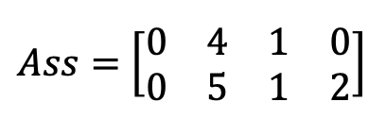
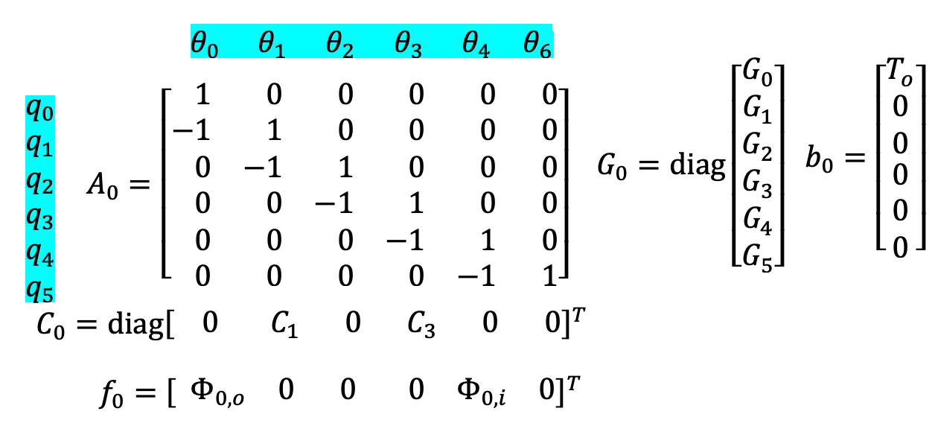
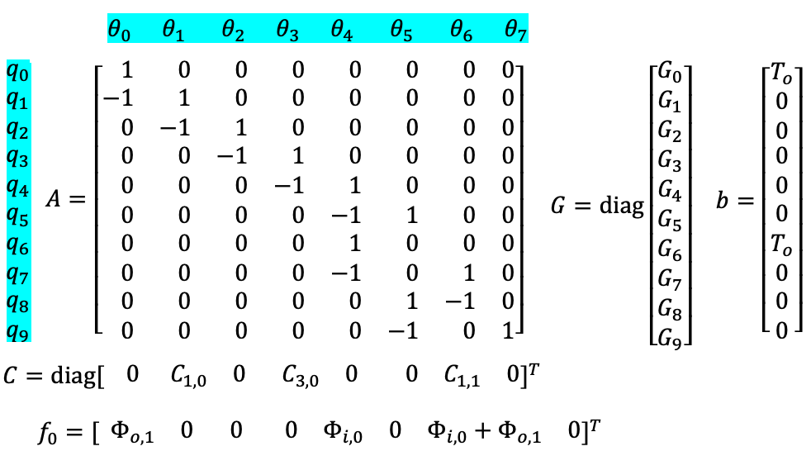
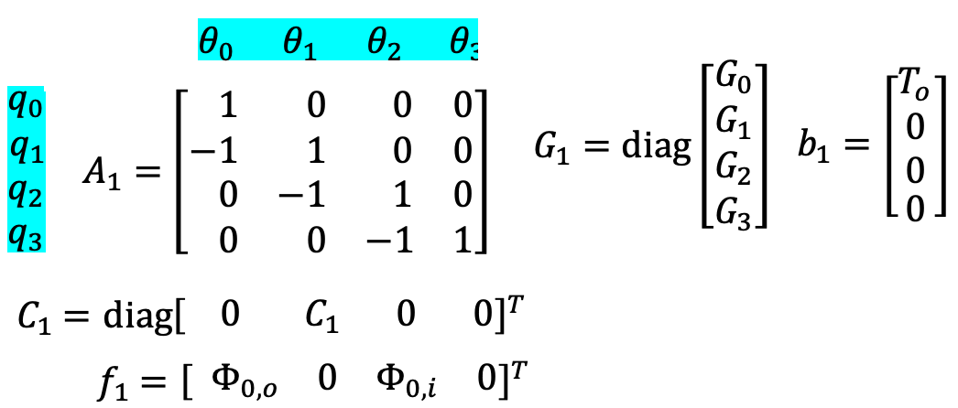
TCd0
$$Φ_{i,0}$$
- +
$$0$$
$$1$$
$$2$$
$$3$$
$$4$$
$$5$$
- +
$$0$$
$$0$$
$$1$$
$$1$$
$$2$$
$$2$$
$$3$$
$$3$$
$$4$$
$$5$$
$$T_{o}$$
$$0$$
$$1$$
$$2$$
$$3$$
$$4$$
$$5$$
$$T_{o}$$
$$0$$
$$0$$
$$1$$
$$1$$
$$2$$
$$2$$
$$3$$
$$3$$
$$4$$
$$5$$
$$Φ_{o,0}$$
$$Φ_{o,1}$$
- +
$$0$$
$$0$$
$$1$$
$$1$$
$$2$$
$$2$$
$$3$$
$$3$$
$$6$$
$$4$$
$$7$$
$$6$$
$$8$$
$$9$$
$$7$$
$$4$$
$$5$$
$$T_{o}$$
$$Φ_{o,1}$$
$$Φ_{o,2}$$
- +
$$0$$
$$0$$
$$1$$
$$1$$
$$2$$
$$5$$
$$2$$
$$3$$
$$3$$
TCd1
$$T_{o}$$
$$Φ_{o,2}$$
$$Φ_{i,0}+Φ_{o,1}$$
TCd1

