Slide 1
CryptKeeper FINAL PROJECT REPORT
Team Member: Wesley Davis, Melissa Myers, Rahul Goud, & Chiranjibi Ghimire
December 20, 2018

Slide 2
Project Info
Chiranjibi Ghimire: spent ~ 100 hours
Built entire web-based application. However, we decided to switch to the Java application because of some complexity in the web base application.
Melissa started to code with Java, and I helped her with coding and functionality testing.
Prepared PowerPoint Presentation
Helped Wesley to make a user guide and development guide
Melissa Myers: spent ~ 50 hours
Worked on the original JavaScript application for user management before switching
Built entire Java application, integrating both AES and DES algorithms into the program

Slide 3
Project Info Contd..
Tested the software functionality
Helped edit PowerPoint Presentation
Wesley Davis: spent ~ 50 hours
Helped to write specification, user guide, and developer guide; Worked on GUI and user register and login component when the program was under the html and JavaScript iteration
Rahul Goud: He was hospitalized for couple of weeks, so he could not contribute to build the software.

Slide 4
Team Operation
Most of the time we communicated via email, and we had a couple of meetings in the college
We also used GitHub for the version control
Development Methodology and Tools
We used agile methodology to develop the software in short timeboxes where requirements and solutions evolve via collaboration between self-organizing cross-functional teams
We choose Agile methods because it emphasizes real-time communication, preferably face-to-face, over written documents.
We used NetBeans IDE and JDK installer (for Windows) to run and test the Java code. We often used XCode to write the code.

Slide 5
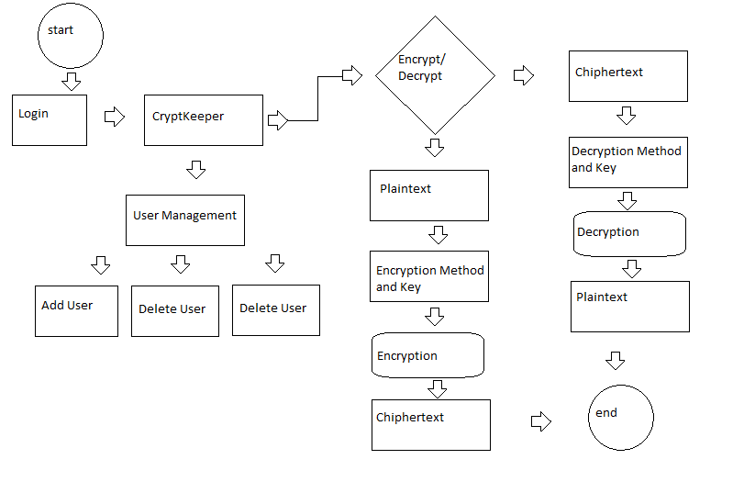
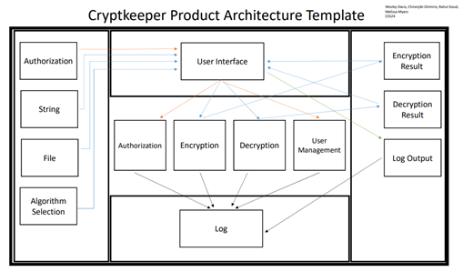
System Architecture

Slide 6
Accomplished Work
Allows a user to register both a user name and password
Error if login is incorrect
User management screen
Encryption/Decryption to/from text and file using AES & DES algorithms
Combined total of 150+ hours of work
3 custom classes (User, AES, DES) + the GUI
Java with Swing GUI
NetBeans IDE with JDK 8
Compatible on all platforms

Slide 7
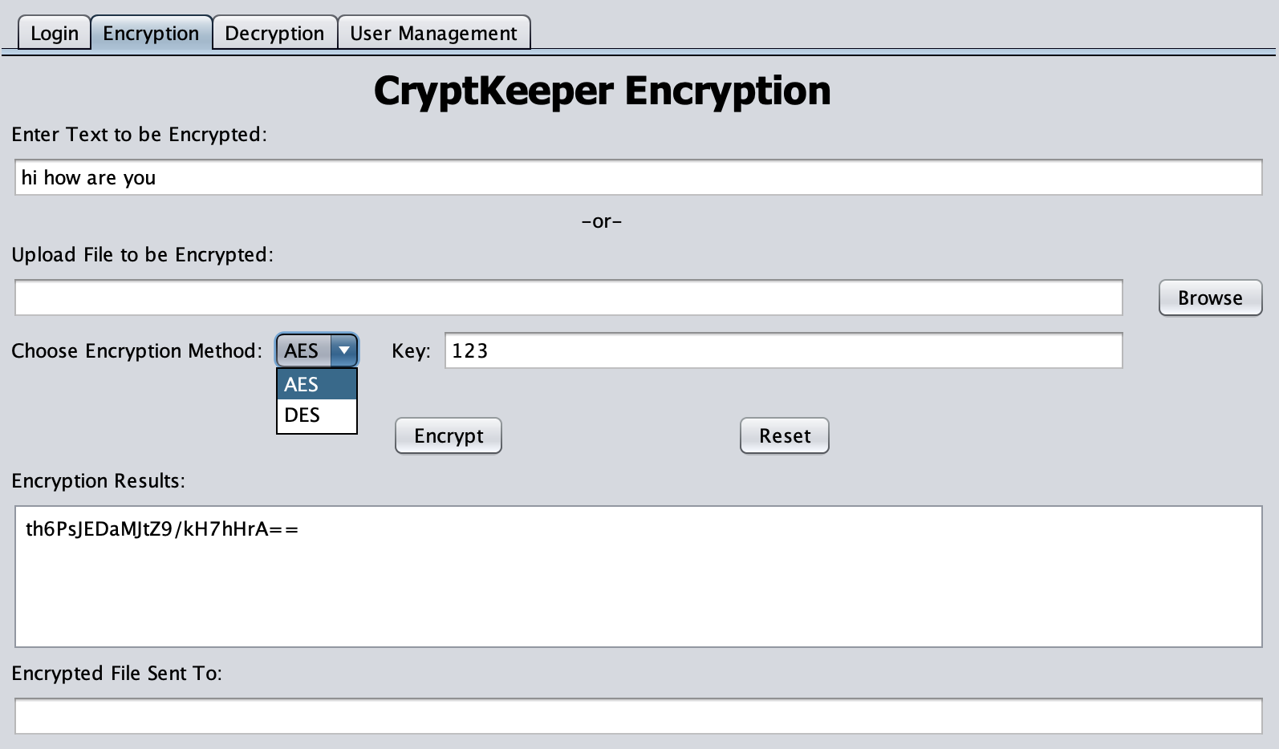
Our Product
Three key UI features
Encrypt/Decrypt with text and file
File selection/upload
Algorithm selection

Slide 8
Lesson Learned
What went right?
Communication between team member
Time management was crucial after second half of the semester
Selection of optimal language
Mainly, we have built the working software
What went wrong?
We had a communication problem at the beginning
Had to work in isolation at the beginning
We started work on three languages (C++, javascript, html) and platform
Rahul did not get chance to contribute
Changing to java late in program development lead to two team members unfamilair with language

Slide 9
Lesson Learned Contd..
What would we do differently?
Research optimal language
We took biggest risk on switching the platform and programming language
We chased the deadline

Slide 10
Demo

