Slide 1

Intro to R
Chris Hoehne
Ph.D. Candidate, Graduate Research Associate
Civil, Environmental, and Sustainable Engineering
Arizona State University

Slide 2




What is R (and related software)?
R: programing language for statistical computing and graphics
R Studio: Integrated development environment (IDE) for R language
Git: version control system for tracking changes in computer files
GitHub: web-based hosting service for version control using Git

Slide 3
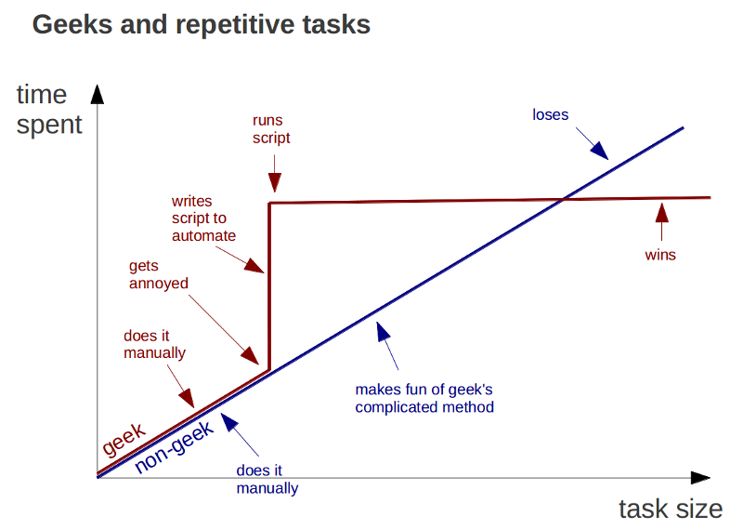
Functionalities of R (why use R or similar languages)?
For example, why use R over Excel?
Can handle large data more efficiently
Task automation and reproducible source code
Highly customizable visualization
Free and open-source
Ongoing support from a large community

Slide 4
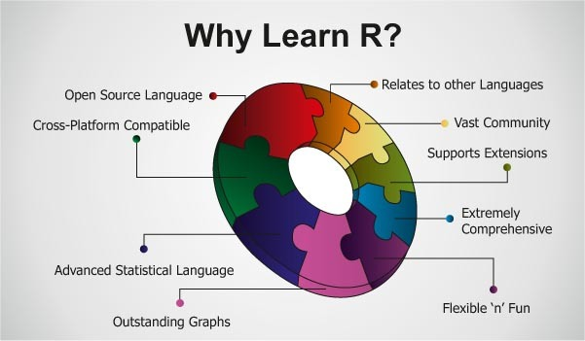
Functionalities of R (why use R or similar languages)?
Even more reasons!
Can handle many types of data (geospatial, raster, time series)
Many tools to clean & manipulate data
Advanced statistical capability (matrix arithmetic, regression, machine learning, etc.)

Slide 5
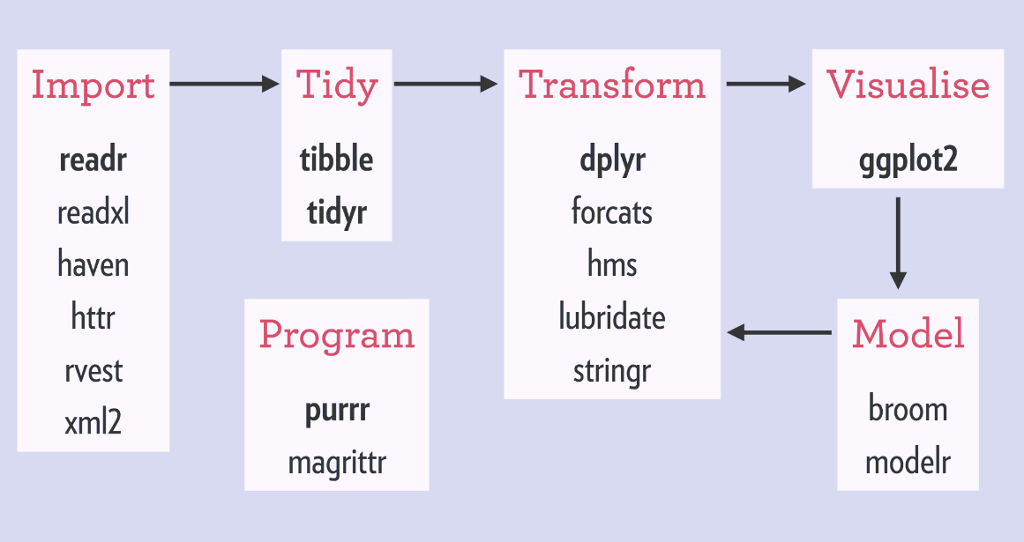
Some Staple Libraries
Libraries (or packages): user-created add-ons that increase programming capabilities. For example, libraries can allow for handling and analyzing non-standard data formats, and implementing complex algorithms
“tidyverse”
“data.table”
“here”
“lubridate”
“sp”
“rgdal”
“rgeos”
There are many libraries within the ‘tidyverse’ library (it is a library of libraries!)

Slide 6
Data Types & Structures in R
Object Classes (data structure)
Data Classes (data types)
Vectors
Matrices
Arrays
Data Frames
Lists
Factors
Functions
Data Table (with “data.table”)
Spatial Points (with “sp”)
…and many more
Logical
Numeric
Integer
Character
Lists
Factors
POSIXct (date/time)
…and many more
Objects and have attributes such as names, row names, column names, class (structure type), etc..

Slide 7
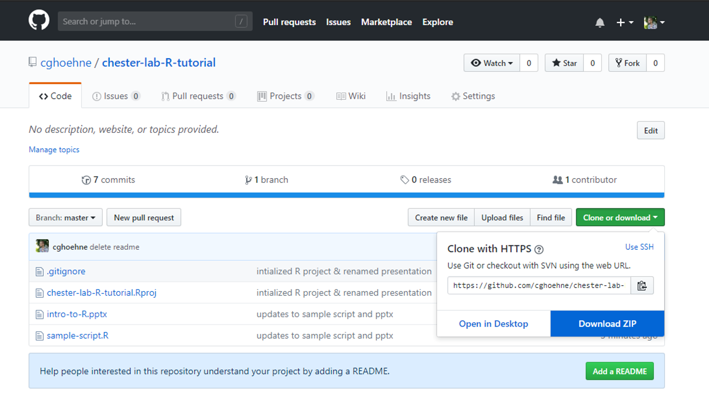
Tutorial Time
https://github.com/cghoehne/chester-lab-R-tutorial

Slide 8

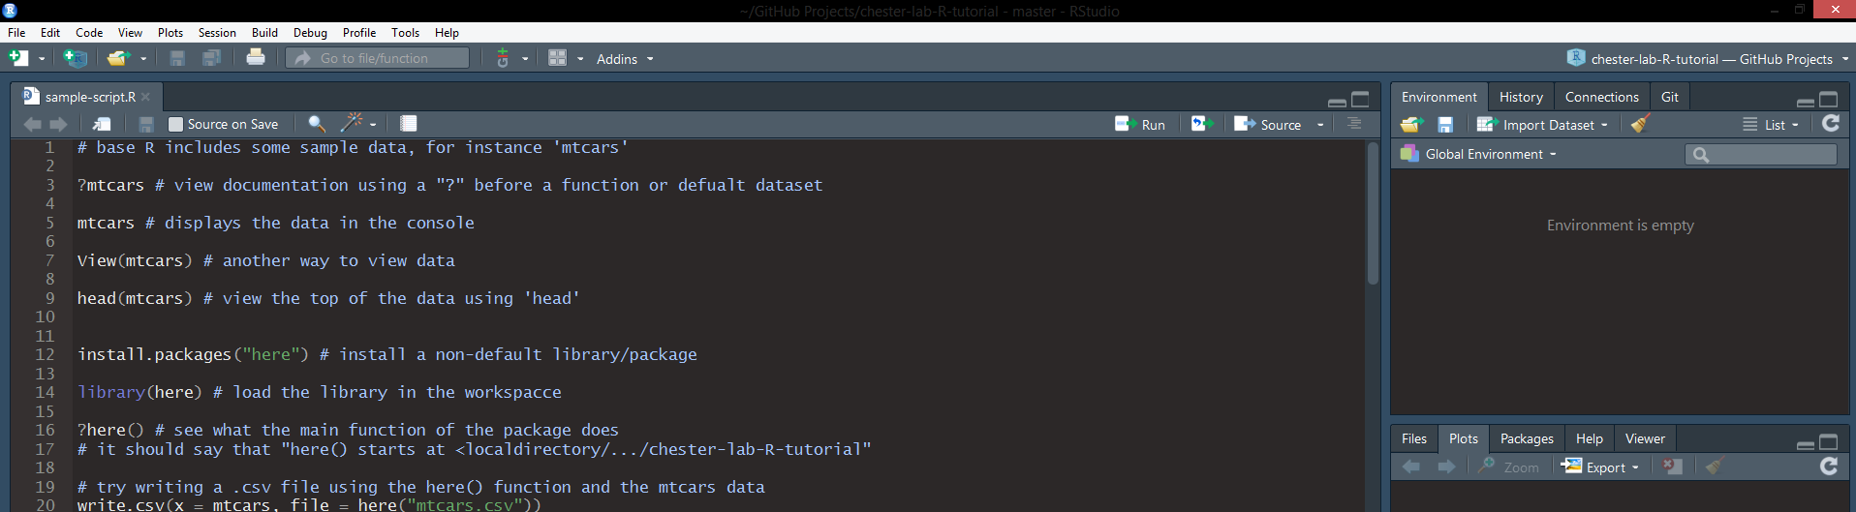
Tutorial Time
Instructions
If you want to follow along, download R and R Studio
Unzip the downloaded repository
Open the .Rproj file or the .R file
With your cursor on a line or a segment of code highlighted, use or [ctrl] + [enter] to run the line or highlighted segment
If you want to change the appearance of R Studio (like I have so the theme is dark), go to Tools > Global Options > Appearance

Slide 9
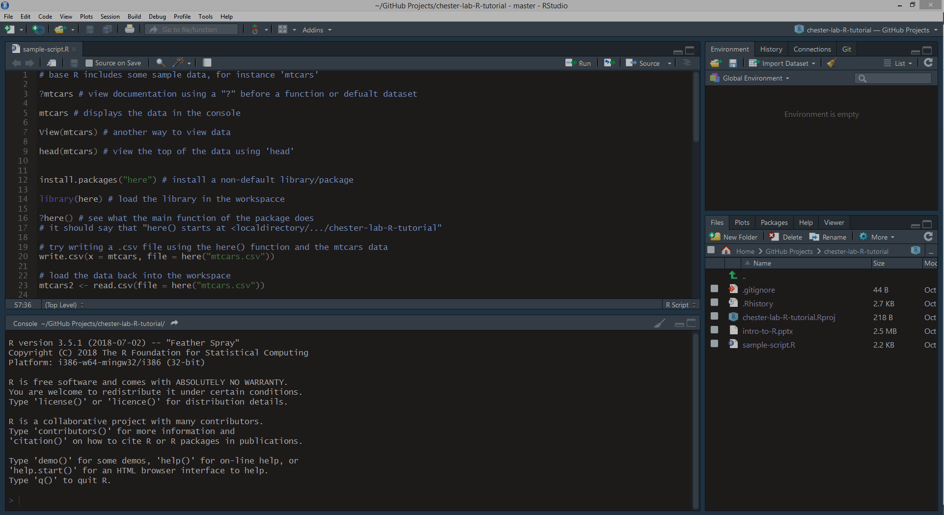
R Studio Interface
Button to Run Scripts (or use [ctrl]+[enter])
You can have multiple tabs open (scripts, data, etc.)
Environment & History
Editor
Files/Plots/Help etc..
Terminal

Slide 10
Some Additional Resources
Online book “Efficient R programming:” https://bookdown.org/csgillespie/efficientR/
Online book “R for Data Science:” http://r4ds.had.co.nz/
Online book “Geocomputation with R:” https://geocompr.robinlovelace.net/
Setting up and using Git/GitHub with R: http://happygitwithr.com/
Intro to the ‘tidyverse’ library: https://www.tidyverse.org/
R Studio cheat sheet: https://www.rstudio.com/wp-content/uploads/2016/01/rstudio-IDE-cheatsheet.pdf
“ggplot2” (plotting) cheat sheet: https://www.rstudio.com/wp-content/uploads/2015/03/ggplot2-cheatsheet.pdf
“data.table” cheat sheet: https://s3.amazonaws.com/assets.datacamp.com/blog_assets/datatable_Cheat_Sheet_R.pdf

Slide 11



Questions?
chris.hoehne@asu.edu
/in/chrishoehne
Background Photo Credit: John Samora / The Republic

Slide 12
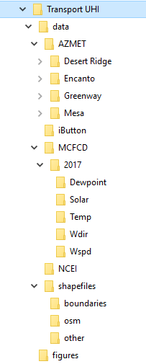
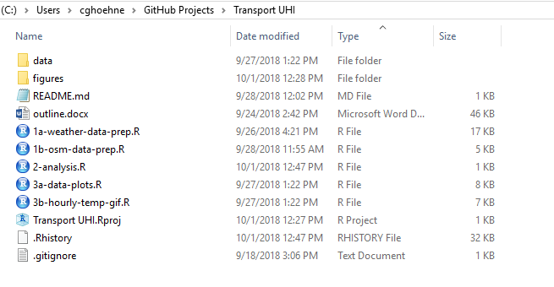
Sample Repository

