Slide 1
J2EEBasic with Frameworks
Same as last project, but using some common frameworks
Same two webapps as last presentation
  Hello webapp that just returns a hard-coded String of HTML with the current date inserted
  Address webapp that lets you view/edit an address object, which is validated and persisted to an in-memory HSQL database
This presentation focuses on using the frameworks
  How to create the project
  How to configure the frameworks

Slide 2
MVC
MVC is used incorrectly in most every web app
The model is not just plain beans – it is supposed to also encapsulate business logic
This lack of encapsulation causes business logic to be randomly strewed about the controller, and is one of the primary reasons why web app projects devolve over time

Slide 3
HSQL
HyperSQL
Mature SQL database, been around for years
Has an in-memory database option, great for unit testing and simple example applications
Has a "resources" option, a read-only database pre-filled with data that gets loaded into memory, good for unit testing
Does not require any configuration, but a simple properties file can be used
Easy to run and configure programmatically
Single jar file

Slide 4
Maven
Common build system to replace Ant
  Gradle is the new shiny tool to replace Maven
  Downloads dependencies - no libs in repo
  Compiles code
  Builds artifacts (jar file, war file, etc)
  Imposes a specific directory structure
  Understands variations like a web app versus a command line app
  Can copy properties such as passwords from a local file in your home directory, to keep them out of the repo

Slide 5
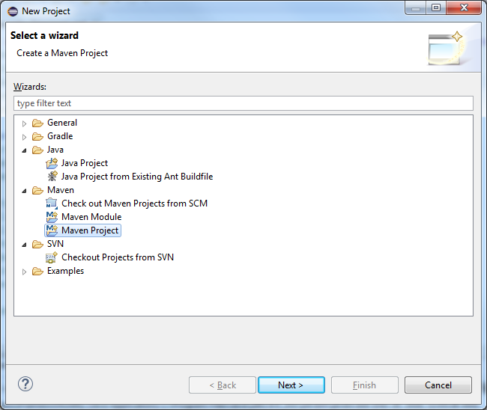
Maven

Slide 6
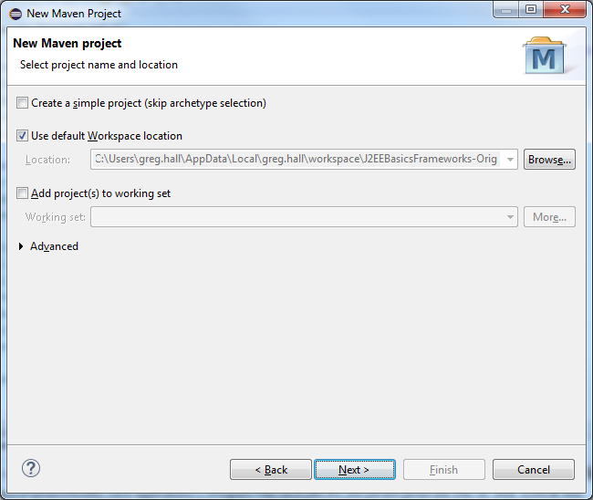
Maven

Slide 7
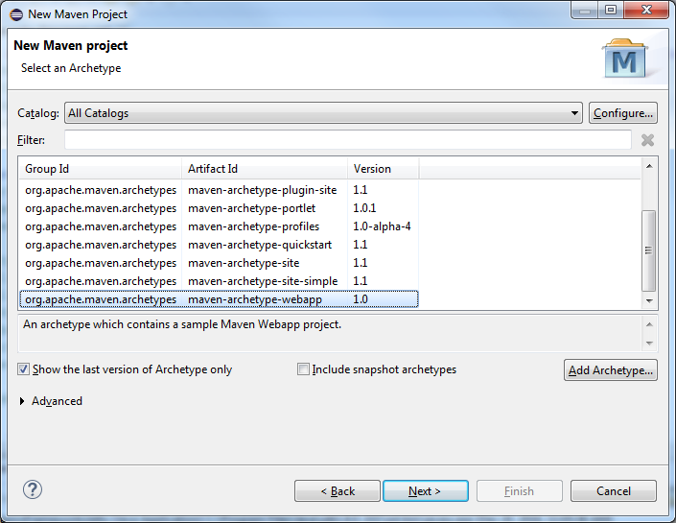
Maven

Slide 8
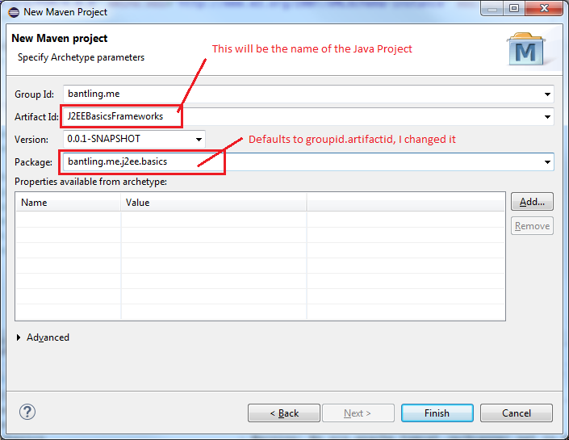
Maven

Slide 9
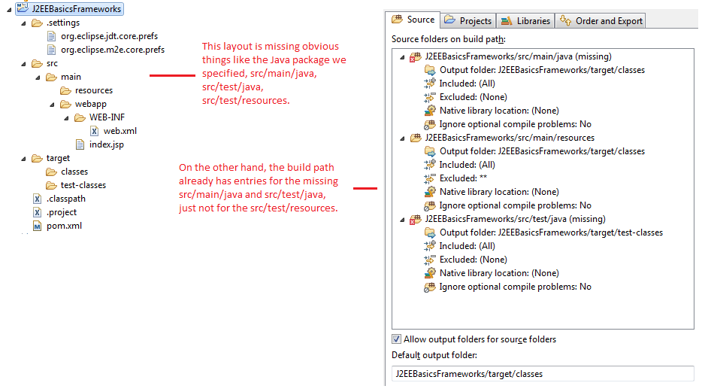
Maven

Slide 10
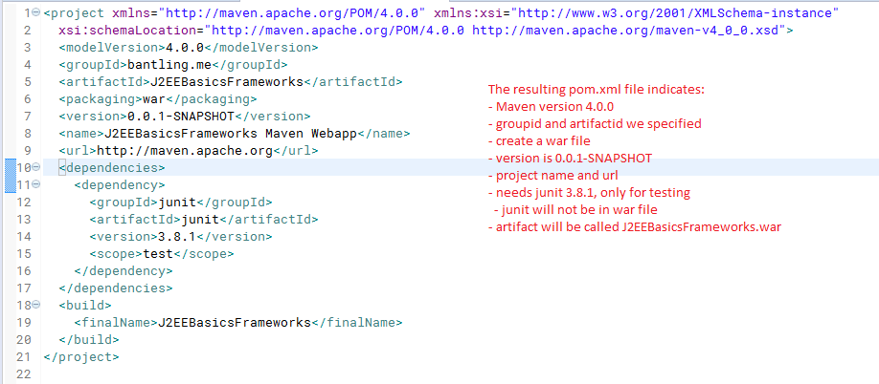
Maven
The generated pom.xml file looks as follows:

Slide 11
Maven
pom.xml is "the" configuration file for Maven
We don't need the name and url elements
We do need:
  Set Java compiler source and target (I chose 1.8)
  Dependencies:
    Jetty (web application container)
    HSQL (in-memory SQL database)
    JPA
    SLF4J and Logback (logging)
    Newer JUnit

Slide 12
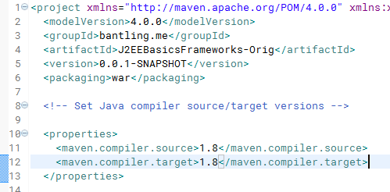
Maven
Set Java compiler source and target to 1.8

Slide 13
Maven
Maven defaults to Java 1.5
Certain changes to the POM, like adding the java compiler, require manually updating Maven
  Right click Project
  Maven > Update Project...
Other changes to the POM, like adding dependencies trigger an update automatically

Slide 14
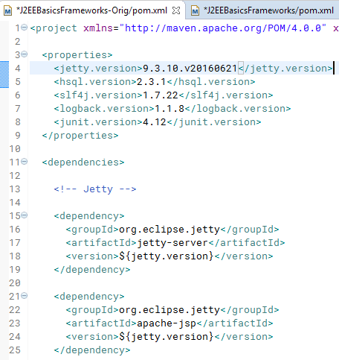
Maven
Set variables for dependencies
  Often, there are multiple libraries for a given
  dependency that are all the same version

Slide 15
JPA
Java Persistance Architecture
  Abstracts translation of SQL rows to/from Java objects
  Every SQL data-driven project uses it
  Uses annotations
    Specify table name (never matches the class name)
    Specify column names when they don't match the field name
Hibernate is a very popular implementation
Often used with JTA (Java Transaction API)
  You don't have to use JTA, this project doesn't
Configured via META-INF/persistence.xml, which must be on the classpath somewhere

Slide 16
JPA queries
Native queries
  vendor specific query strings, like you'd use with JDBC
JPQL (Java Persistence Query Language)
  abstracted query strings
HQL (Hibernate Query Language)
  Hibernate specific variant of JPQL
JPA Criteria API (introduced in JPA 2)
  Method chaining (fluent API)
  Essentially an OOP representation of a select query
Most projects use these more or less at random
  Many do not use JPA Criteria API at all
  Approach used here is Native queries and JPA Criteria API only
    Avoid JPA specific strings
    Easier to figure out how to run the query manually in a GUI database tool

Slide 17
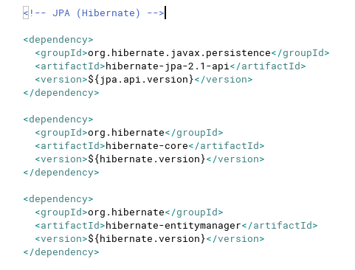
JPA in Maven POM

Slide 18
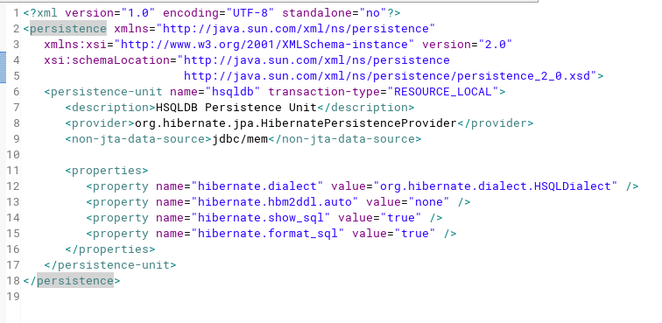
JPA persistence.xml

Slide 19
JPA
Define entities
  List them in the persistence.xml
  Use annotations instead (approach used in this project)
Can automatically create/update table definitions based on entities
  In practice, projects manage such changes through custom SQL scripts
EntityManager is entry point to making queries
  Effectively wraps a database connection
  Tracks entities, which can be attached or detached
    Attached means the EntityManager is tracking it (EG, read from database via select), and will write out changes when transaction is committed
    Detached means the EntityManager is not tracking it
      Entities created via constructor
      Entities specifically detached by calling EntityManager.detach
  Two methods for writing changes back to database
    persist: use it for entities that have never been explicitly detached
    merge: use it to reattach entities that were explicitly detached and changed
  Can also call flush to empty caches

Slide 20
JPA
Common point of confusion is the usage of persist versus merge
  Commonly, the logic in projects is obfuscated by layers of method calls in the controller,
  hard to follow
  Approach used here is to abstract these details into the model, the caller doesn't even need to know JPA is being used
  Never uses merge, because objects are never explicitly detached
  Easier to understand

Slide 21
JPA
Common point of confusion is the usage of flush to empty the cache
Necessary when rows are updated in a way where JPA does not know which entity(s)
are affected
  Most commonly by using an HQL/JPQL/Native query to update only specific columns of a row
  Useful in cases where you don't want to read in the entire row before making changes. EG, maybe you have a CLOB column that can be many MB in size, and all you want to do is update one or two columns
  Detach the entity for the row being updated, flush the cache, perform the update query

Slide 22
JPA Native queries
// hsqldb is the value of the persistence-unit name in
// persistence.xml
EntityManagerFactory emf =
Persistence.createEntityManagerFactory("hsqldb");
EntityManager em = emf.createEntityManager();
Query q = em.createNativeQuery("update ...");
// returns the number of rows affected
q.executeUpdate();

Slide 23
JPA Criteria Query API
// hsqldb is the value of the persistence-unit name in
// persistence.xml
EntityManagerFactory emf =
Persistence.createEntityManagerFactory("hsqldb");
EntityManager em = emf.createEntityManager();
CriteriaBuilder builder = em.getCriteriaBuilder();
CriteriaQuery<AddressEntity> query =
builder.createQuery(AddressEntity.class);
Root<AddressEntity> root = query.from(AddressEntity.class);
ParameterExpression<Integer> byId =
builder.parameter(Integer.class);
query.select(root).where(builder.equal(root.get("id"), byId));
TypedQuery<AddressEntity> typed = em.createQuery(query);
// "id" is a value passed to this code by the caller
typed.setParameter(byId, new Integer(id));
List<AddressEntity> results = typed.getResultList();

Slide 24
JPA Caching
JPA can use writeback caching, where rows are not actually written to the database until an explicit flush or commit is executed
  Hibernate does this by default
This means you should ensure that the cache is flushed before rendering your view
  If you wait until after the view has rendered to flush the cache, then there is no opportunity to display any error to the user. The user thinks the operation succeeded, but the logs show an error.

Slide 25
JPA Lifecycle
EntityManagerFactory = connection pool
EntityManager = connection
An EntityManagerFactory should be acquired as part of initialization during application startup (this is true for any kind of app, not just webapps)
The web app request/response cycle should do the following:
  Get a new EntityManager
  Start a transaction
  Perform controller actions
  Flush the cache
  Render the view
  Commit or rollback

Slide 26
JPA Lifecycle in the example
App initialization
  ServletContextTransactionFilter dynamically adds a filter to each servlet defined in the app that comes before any other filter. This filter is the ServletTransactionFilter class.
Request/Response cycle
  ServletTransactionFilter
    acquires a connection
    starts transaction
    executes filter chain (including servlet and rendering of view)
    commit if no exception caught, else rollback
  AddressServlet
    gets transaction, performs operation (select or update)
    flushes cache
    renders view

Slide 27
Proper usage of MVC
In MVC, the model is not just plain old beans, but all business logic
The model should be able to work in a web app just as well as a desktop app
Server-side validation should really only be done by the model
  Only the model should know details like the length limit on a field
  Multiple controllers can use the same model, and get consistent behaviour (EG, all controllers get the same validations applied)
Practially speaking, the server side view may need validation
  EG, A single view field for a phone number may be split into multiple model fields for country code, area code, phone, and extension. The view may need to validate the field before parsing it.
Client side validation is useful to reduce wasted round trips for basic problems like missing required fields
  Need to find a balance of not doing too much on the client
  Focus on low hanging fruit that aid the user in entering data faster

Slide 28
Model considerations
API that completely abstracts database
  Perhaps some operations will use SQL, while others may use a document database like MongoDB, a graph database like Neo4J, etc.
  Validation API that provides useful errors
  Transactions
Better yet, abstract all data outside the JVM
  Files on disk, configuration parameters, remote service calls, etc
  Localization
  Can all be considered part of the model

