Slide 1






SynCron
Efficient Synchronization Support
for Near-Data-Processing Architectures
Christina Giannoula
Nandita Vijaykumar, Nikela Papadopoulou, Vasileios Karakostas
Ivan Fernandez, Juan Gómez Luna, Lois Orosa
Nectarios Koziris, Georgios Goumas, Onur Mutlu

Slide 2

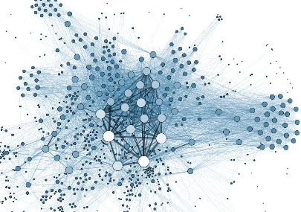

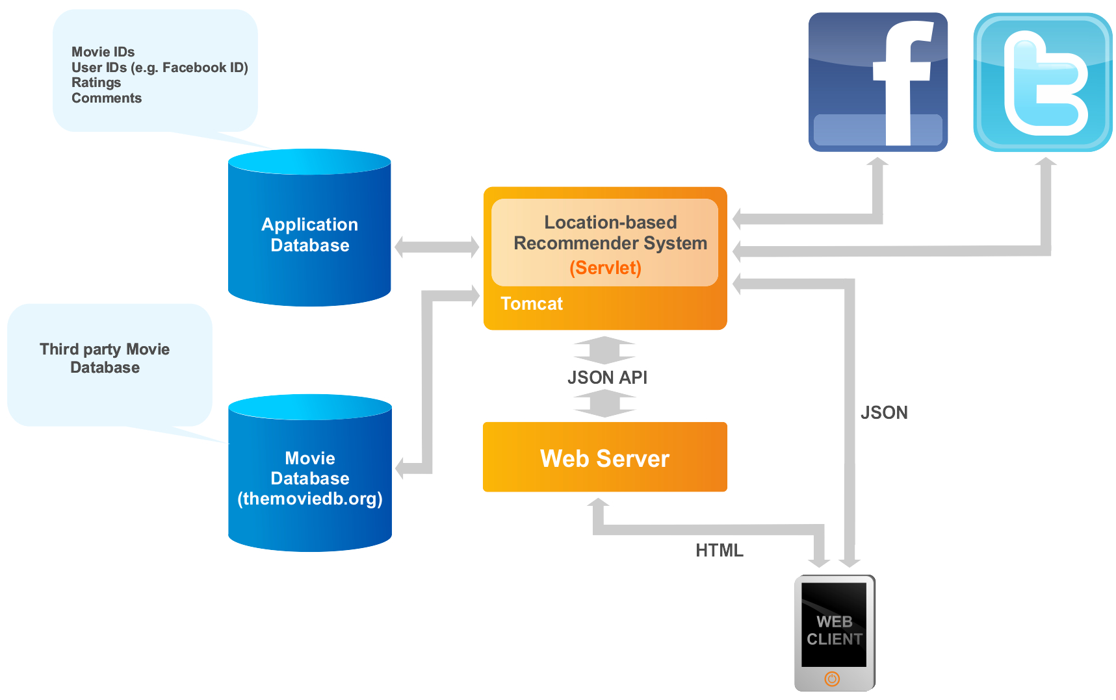

Near-Data-Processing (NDP) Systems
CPU
NDP
Logic
DRAM
Graph Analytics
Recommendation Systems
Neural Networks
Bioinformatics

Slide 3



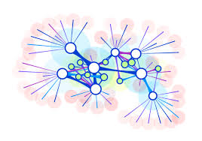

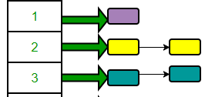


Synchronization is Necessary
Image Processing
Bioinformatics
Graph Analytics
Databases
Single Source Shortest Path (SSSP)
for v in Graph:
for u in neighbors[v]:
if distance[v] + edge_weight[v, u] < distance[u]
if distance[v] + edge_weight[v, u] < distance[u]
distance[u] = distance[v] + edge_weight[v, u]
Locks
Barriers
Concurrent
Data Structures
lock_acquire(u)
lock_release(u)

Slide 4
Challenge: Efficient Synchronization
NDP Unit
NDP Unit
NDP Core
Main Memory
NDP Core
Main Memory
NDP Core
NDP Core
NDP Core
NDP Core
Expensive
Communication
No Shared Caches
Programmable Core / Accelerator
PrivateCache
No Hardware Cache Coherence

Slide 5
SynCron
SynCron’s Benefits:
High System Performance
Low Hardware Cost
Programming Ease
General Synchronization Support
The first end-to-end synchronization solution for NDP architectures

Slide 6
Outline
NDP Synchronization Solution Space
Our Mechanism: SynCron
Evaluation

Slide 7
Baseline NDP Architecture
Synchronization challenges in NDP systems:
NDP System
NDP Unit
NDP Core
Main Memory
Programmable Core / Accelerator
NDP Core
Private Cache
NDP Core
(1) Lack of hardware cache coherence support
(2) Expensive communication across NDP units
(3) Lack of a shared level of cache memory

Slide 8
NDP Synchronization Solution Space
(1) Shared Memory
(2) Message-passing
Hardware Cache
Coherence
Remote
Atomics
Specialized Hardware Support
Software-based Schemes
Specialized Hardware Support

Slide 9
NDP Synchronization Solution Space
(1) Shared Memory
(2) Message-passing
Hardware Cache
Coherence
Remote
Atomics
Specialized Hardware Support
Software-based Schemes
Specialized Hardware Support
CPUs:
Hierarchical CLH Locks [EuroPar’06]
Cohort Locks [TOPC’15]
Ticket Locks [TOCS’91] …
MPPs:
QOLB [ASPLOS’89]
Lack of hardware cache coherence support

Slide 10
NDP Synchronization Solution Space
(1) Shared Memory
(2) Message-passing
Hardware Cache
Coherence
Remote
Atomics
Specialized Hardware Support
Software-based Schemes
Specialized Hardware Support
GPUs:
Fermi GF100 [IEEE Micro’10] …
MPPs:
SGI Origin [ISCA’97]
Cray T3E [ASPLOS’96] …
CPUs:
SSB [ISCA’07]
Lock Cache [CASES’01] …
MPPs:
Full/Empty Bits [ISCA’83] …
NDPs:
Tesseract [ISCA’15]
CPUs:
MiSAR [ISCA’15]
LCU [MICRO’10]
Glocks [IPDPS’11] …
GPUs:
HQL [IPDPS’13] …
Expensive communication across NDP units

Slide 11

NDP Synchronization Solution Space
(1) Shared Memory
(2) Message-passing
Hardware Cache
Coherence
Remote
Atomics
Specialized Hardware Support
Software-based Schemes
Specialized Hardware Support
CPUs:
SSB [ISCA’07]
Lock Cache [CASES’01]
BarrierFilter [MICRO’06]
NDPs:
Tesseract [ISCA’15], Near-Data Processing for In-memory Analytics [PACT’15]
CPUs:
MiSAR [ISCA’15]
GPUs:
HQL [IPDPS’13]
Lack of a shared level of cache memory

Slide 12
NDP Synchronization Solution Space
(1) Shared Memory
(2) Message-passing
Hardware Cache
Coherence
Remote
Atomics
Specialized Hardware Support
Software-based Schemes
Specialized Hardware Support
Prior schemes are not suitable or efficient
for NDP systems

Slide 13

NDP Synchronization Solution Space
(1) Shared Memory
(2) Message-passing
Hardware Cache
Coherence
Remote
Atomics
Specialized Hardware Support
Software-based Schemes
Specialized Hardware Support
SynCron’s Design Choices
NDPs:
Hardware Message-passing
to Avoid Synchronization via Shared Memory
Hierarchical Communication
to Eliminate Expensive Network Traffic
SynCron [HPCA’21]
Specialized Cache Structure
to Minimize Latency Costs

Slide 14
Outline
NDP Synchronization Solution Space
Our Mechanism: SynCron
Evaluation

Slide 15
SynCron: Overview
SynCron consists of four key techniques:
1. Hardware support for synchronization acceleration
2. Direct buffering of synchronization variables
3. Hierarchical message-passing communication
4. Integrated hardware-only overflow management

Slide 16

1. Hardware Synchronization Support
NDP Unit 0
NDP Unit 1
NDP Core 0
Main Memory
NDP Core 0
Main Memory
`````
ISA
NDP Core 1
NDP Core 1
Synchronization
Engine 0
Synchronization
Engine 1
Local
lock acquire
No Complex Cache Coherence Protocols
No Expensive Atomic Operations
Low Hardware Cost

Slide 17
2. Direct Buffering of Variables
NDP Unit 0
NDP Unit 1
NDP Core 0
Main Memory
NDP Core 0
Main Memory
NDP Core 1
NDP Core 1
Synchronization
Engine 0
Synchronization
Engine 1
Synchronization
Processing Unit
Synchronization
Table
Address
…
--
…
Local
lock acquire
Indexing Counters
--
…
--
…
--
…

Slide 18
2. Direct Buffering of Variables
NDP Unit 0
NDP Unit 1
NDP Core 0
Main Memory
NDP Core 0
Main Memory
NDP Core 1
NDP Core 1
Synchronization
Engine 0
Synchronization
Engine 1
Synchronization
Processing Unit
Synchronization
Table
Address
…
0x33A9
…
Local
lock acquire
No Costly Memory Accesses
Low Latency
Indexing Counters
--
…
--
…
--
…

Slide 19
3. Hierarchical Communication
NDP Unit 0
NDP Unit 1
NDP Core 0
Main Memory
NDP Core 0
Main Memory
NDP Core 1
NDP Core 1
Synchronization
Engine 0
Synchronization
Engine 1
syncronVar
NDP Unit 2
NDP Unit 3
NDP Core 0
Main Memory
NDP Core 0
Main Memory
NDP Core 1
NDP Core 1
Synchronization
Engine 2
Synchronization
Engine 3

Slide 20
3. Hierarchical Communication
Local
lock acquire
NDP Unit 0
NDP Unit 1
NDP Core 0
Main Memory
NDP Core 0
Main Memory
NDP Core 1
NDP Core 1
Synchronization
Engine 0
Synchronization
Engine 1
syncronVar
NDP Unit 2
NDP Unit 3
Master
NDP Core 0
Main Memory
NDP Core 0
Main Memory
NDP Core 1
NDP Core 1
Synchronization
Engine 2
Synchronization
Engine 3

Slide 21

3. Hierarchical Communication
Global
lock acquire
NDP Unit 0
NDP Unit 1
NDP Core 0
Main Memory
NDP Core 0
Main Memory
NDP Core 1
NDP Core 1
Synchronization
Engine 0
Synchronization
Engine 1
syncronVar
NDP Unit 2
NDP Unit 3
Master
NDP Core 0
Main Memory
NDP Core 0
Main Memory
NDP Core 1
NDP Core 1
Synchronization
Engine 2
Synchronization
Engine 3

Slide 22
3. Hierarchical Communication
NDP Unit 0
NDP Unit 1
NDP Core 0
Main Memory
NDP Core 0
Main Memory
NDP Core 1
NDP Core 1
Synchronization
Engine 0
Synchronization
Engine 1
syncronVar
Master
Synchro-nization
Process-ing Unit
Synchronization Table 0
Synchro-nization
Process-ing Unit
Synchronization Table 1
Address
Global
Waitlist
Local
Waitlist
…
Address
Global
Waitlist
Local
Waitlist
…
Minimize Expensive Traffic
0x33A9
0000
11
…
0x33A9
1101
11
…
Indexing Counters
Indexing Counters

Slide 23
4. Integrated Overflow Management
NDP Unit 0
NDP Unit 1
NDP Core 0
Main Memory
NDP Core 0
Main Memory
NDP Core 1
NDP Core 1
Synchronization
Engine 0
Synchronization
Engine 1
syncronVar
Master
Fully Occupied
Address
…
Synchronization
Processing Unit
0x33A9
…
Synchronization
Table
0x2241
…
0x438C
…
0x6B4A
…
Indexing Counters
Counter0 = 0
syncronVar
Address
Counter1 > 0
Counter2 = 0
Counter3 = 0

Slide 24
4. Integrated Overflow Management
NDP Unit 0
NDP Unit 1
NDP Core 0
Main Memory
NDP Core 0
Main Memory
NDP Core 1
NDP Core 1
Synchronization
Engine 0
Synchronization
Engine 1
syncronVar
Global
overflow
lock acquire
Master
Fully Occupied
Address
…
Synchronization
Processing Unit
0x33A9
…
Low Performance Degradation
High Programming Ease
Synchronization
Table
0x2241
…
0x438C
…
0x6B4A
…
Indexing Counters

Slide 25
SynCron’s Supported Primitives
Lock primitive
Barrier primitive
Semaphore primitive
Condition variable primitive
lock_acquire()
lock_release ()
barrier_wait_within_NDP_unit()
barrier_wait_across_NDP_units()
sem_wait()
sem_post()
cond_wait()
cond_signal()
cond_broadcast()

Slide 26
Lock Operation
NDP Unit 0
NDP Unit 1
lock
acquire
NDP Core 0
Main Memory
lock
acquire
NDP Core 0
Main Memory
lock
acquire
NDP Core 1
lock
acquire
NDP Core 1
Synchronization
Engine 0
Synchronization
Engine 1
syncronVar
Master
All NDP cores compete for the same lock variable

Slide 27
Lock Operation
Local
lock acquire
NDP Unit 0
NDP Unit 1
NDP Core 0
Main Memory
NDP Core 0
Main Memory
NDP Core 1
NDP Core 1
Synchronization
Engine 0
Synchronization
Engine 1
syncronVar
Master
Synchro-nization
Process-ing Unit
Synchronization Table 0
Synchro-nization
Process-ing Unit
Synchronization Table 1
Address
Global
Waitlist
Local
Waitlist
…
Address
Global
Waitlist
Local
Waitlist
…
0x33A9
00
11
…
0x33A9
00
11
…
Indexing Counters
Indexing Counters

Slide 28
Lock Operation
Global
lock acquire
NDP Unit 0
NDP Unit 1
NDP Core 0
Main Memory
NDP Core 0
Main Memory
NDP Core 1
NDP Core 1
Synchronization
Engine 0
Synchronization
Engine 1
syncronVar
Master
Synchro-nization
Process-ing Unit
Synchronization Table 0
Synchro-nization
Process-ing Unit
Synchronization Table 1
Address
Global
Waitlist
Local
Waitlist
…
Address
Global
Waitlist
Local
Waitlist
…
0x33A9
00
11
…
0x33A9
00
11
…
Indexing Counters
Indexing Counters

Slide 29
Lock Operation
Global
lock acquire
NDP Unit 0
NDP Unit 1
NDP Core 0
Main Memory
NDP Core 0
Main Memory
NDP Core 1
NDP Core 1
Synchronization
Engine 0
Synchronization
Engine 1
syncronVar
Master
Synchro-nization
Process-ing Unit
Synchronization Table 0
Synchro-nization
Process-ing Unit
Synchronization Table 1
Address
Global
Waitlist
Local
Waitlist
…
Address
Global
Waitlist
Local
Waitlist
…
0x33A9
00
11
…
0x33A9
01
11
…
Indexing Counters
Indexing Counters

Slide 30

Lock Operation
Local
lock grant
NDP Unit 0
NDP Unit 1
NDP Core 0
Main Memory
NDP Core 0
Main Memory
NDP Core 1
NDP Core 1
Synchronization
Engine 0
Synchronization
Engine 1
syncronVar
Master
Synchro-nization
Process-ing Unit
Synchronization Table 0
Synchro-nization
Process-ing Unit
Synchronization Table 1
Address
Global
Waitlist
Local
Waitlist
…
Address
Global
Waitlist
Local
Waitlist
…
0x33A9
00
11
…
0x33A9
01
11
…
Indexing Counters
Indexing Counters

Slide 31
Lock Operation
Global
lock grant
NDP Unit 0
NDP Unit 1
NDP Core 0
Main Memory
NDP Core 0
Main Memory
NDP Core 1
NDP Core 1
Synchronization
Engine 0
Synchronization
Engine 1
syncronVar
Master
Synchro-nization
Process-ing Unit
Synchronization Table 0
Synchro-nization
Process-ing Unit
Synchronization Table 1
Address
Global
Waitlist
Local
Waitlist
…
Address
Global
Waitlist
Local
Waitlist
…
0x33A9
00
11
…
0x33A9
01
00
…
Indexing Counters
Indexing Counters

Slide 32
Lock Operation
Local
lock grant
NDP Unit 0
NDP Unit 1
NDP Core 0
Main Memory
NDP Core 0
Main Memory
NDP Core 1
NDP Core 1
Synchronization
Engine 0
Synchronization
Engine 1
syncronVar
Master
Synchro-nization
Process-ing Unit
Synchronization Table 0
Synchro-nization
Process-ing Unit
Synchronization Table 1
Address
Global
Waitlist
Local
Waitlist
…
Address
Global
Waitlist
Local
Waitlist
…
0x33A9
00
11
…
0x33A9
01
00
…
Indexing Counters
Indexing Counters

Slide 33
Lock Operation
NDP Unit 0
NDP Unit 1
NDP Core 0
Main Memory
NDP Core 0
Main Memory
NDP Core 1
NDP Core 1
Synchronization
Engine 0
Synchronization
Engine 1
syncronVar
Master
Synchro-nization
Process-ing Unit
Synchronization Table 0
Synchro-nization
Process-ing Unit
Synchronization Table 1
Address
Global
Waitlist
Local
Waitlist
…
Address
Global
Waitlist
Local
Waitlist
…
0x33A9
00
00
…
0x33A9
01
00
…
Indexing Counters
Indexing Counters

Slide 34
Lock Operation
Global
lock release
NDP Unit 0
NDP Unit 1
NDP Core 0
Main Memory
NDP Core 0
Main Memory
NDP Core 1
NDP Core 1
Synchronization
Engine 0
Synchronization
Engine 1
syncronVar
Master
Synchro-nization
Process-ing Unit
Synchronization Table 0
Synchro-nization
Process-ing Unit
Synchronization Table 1
Address
Global
Waitlist
Local
Waitlist
…
Address
Global
Waitlist
Local
Waitlist
…
--
--
--
…
0x33A9
01
00
…
Indexing Counters
Indexing Counters

Slide 35
Lock Operation
Global
lock release
NDP Unit 0
NDP Unit 1
NDP Core 0
Main Memory
NDP Core 0
Main Memory
NDP Core 1
NDP Core 1
Synchronization
Engine 0
Synchronization
Engine 1
syncronVar
Master
Synchro-nization
Process-ing Unit
Synchronization Table 0
Synchro-nization
Process-ing Unit
Synchronization Table 1
Address
Global
Waitlist
Local
Waitlist
…
Address
Global
Waitlist
Local
Waitlist
…
--
--
--
…
0x33A9
00
00
…
Indexing Counters
Indexing Counters

Slide 36
Lock Operation
NDP Unit 0
NDP Unit 1
NDP Core 0
Main Memory
NDP Core 0
Main Memory
NDP Core 1
NDP Core 1
Synchronization
Engine 0
Synchronization
Engine 1
syncronVar
Master
Synchro-nization
Process-ing Unit
Synchronization Table 0
Synchro-nization
Process-ing Unit
Synchronization Table 1
Address
Global
Waitlist
Local
Waitlist
…
Address
Global
Waitlist
Local
Waitlist
…
--
--
--
…
--
--
--
…
Indexing Counters
Indexing Counters

Slide 37
Lock Operation
NDP Unit 0
NDP Unit 1
NDP Core 0
Main Memory
NDP Core 0
Main Memory
NDP Core 1
NDP Core 1
Synchronization
Engine 0
Synchronization
Engine 1
syncronVar
Master
Synchro-nization
Process-ing Unit
Synchronization Table 0
Synchro-nization
Process-ing Unit
Synchronization Table 1
Address
Global
Waitlist
Local
Waitlist
…
Address
Global
Waitlist
Local
Waitlist
…
More details in the paper
--
--
--
…
--
--
--
…
Indexing Counters
Indexing Counters

Slide 38
Outline
NDP Synchronization Solution Space
Our Mechanism: SynCron
Evaluation

Slide 39
Evaluation Methodology
Simulators:
Zsim [Sanchez+, ISCA’13]
Ramulator [Kim+, CAL’15]
System Configuration:
4x NDP units of 16 in-order cores
16KB L1 Data + Instr. Cache
4GB HBM memory
SynCron’s Default Parameters:
Synchronization Processing Unit @1GHz
12-cycle worst-case latency for a message to be served [Aladdin]
64 entries in Synchronization Table, 1-cycle latency [CACTI]
256 entries in indexing counters 2-cycle latency [CACTI]
Workloads:
9x Pointer-chasing Data Structures from ASCYLIB [David+, ASPLOS’15]
6x Graph Applications from Crono [Ahmad+, IISWC’15]
Time Series Analysis from Matrix Profile [Yeh+, ICDM’16]

Slide 40
Comparison Points for SynCron
SynCron
Central [Ahn+, ISCA’15]:
Synchronization Server: One NDP core of the NDP system
Centralized hardware message-passing communication
Hier [Gao+, PACT’15 / Tang+, ASPLOS’19]:
Synchronization Servers: One NDP core per NDP unit
Hierarchical hardware message-passing communication
Ideal
Zero overhead for synchronization

Slide 41
Throughput of Pointer Chasing
Stack – 100K
Hash Table – 1K
Linked List – 20K
1.78x
1.68x
1.19x
1.26x
Operations / μs
Operations / μs
Operations / ms
1.18x
1.59x
Number of NDP Cores
Number of NDP Cores
Number of NDP Cores
High Contention
Medium Contention
Low Contention
Small # of Variables
Medium # of Variables
High # of Variables

Slide 42
Throughput of Pointer Chasing
Stack – 100K
Hash Table – 1K
Linked List – 20K
1.11x
1.19x
1.07x
Operations / μs
Operations / μs
Operations / ms
SynCron achieves the highest throughput
under all scenarios
Number of NDP Cores
Number of NDP Cores
Number of NDP Cores
Small # of Variables
Medium # of Variables
High # of Variables

Slide 43
Speedup in Real Applications
Synchronization
Intensive
1.23x
-9.5%
SynCron performs best across all real applications
Low Contention - High # of Variables

Slide 44
System Energy in Real Applications
1.94x
-6.2%
SynCron reduces system energy significantly

Slide 45
Area and Power Overheads
 | Synchronization Engine | ARM Cortex A7
Technology | 40nm | 28nm
Area | Total: 0.0461mm2 | Total: 0.45mm2
Power | 2.7mW | 100mW
9.78%
2.70%
SynCron has low area and power overheads

Slide 46
Sensitivity Studies
Different memory technologies (HBM, HMC, DDR4)
Various data placement techniques
Various transfer latencies on links across NDP units
Overflow management cost
Various sizes for the Synchronization Table
SynCron is effective for a wide variety
of configurations

Slide 47
Summary & Conclusion
Synchronization is a major system challenge for NDP systems
Prior schemes are not suitable or efficient for NDP systems
SynCron is the first end-to-end synchronization solution for NDP architectures
Syncron consists of four key techniques:
i. Hardware support for synchronization acceleration
ii. Direct buffering of synchronization variables
iii. Hierarchical message-passing communication
iv. Integrated hardware-only overflow management
SynCron’s benefits: 90.5% and 93.8% of performance and energy of an Ideal zero-overhead scheme
SynCron is highly-efficient, low-cost, easy-to-use, and general to support many synchronization primitives

Slide 48
SynCron
Efficient Synchronization Support
for Near-Data-Processing Architectures
Christina Giannoula
christina.giann@gmail.com
Nandita Vijaykumar, Nikela Papadopoulou, Vasileios Karakostas
Ivan Fernandez, Juan Gómez Luna, Lois Orosa
Nectarios Koziris, Georgios Goumas, Onur Mutlu

