Slide 1





SparseP
Towards Efficient Sparse Matrix Vector Multiplication
on Real Processing-In-Memory Architectures
Christina Giannoula
Ivan Fernandez, Juan Gomez-Luna,
Nectarios Koziris, Georgios Goumas, Onur Mutlu

Slide 2
Our Work
Efficient Algorithmic Designs
The first open-source Sparse Matrix Vector Multiplication (SpMV) software package, SparseP, for real Processing-In-Memory (PIM) systems
Extensive Characterization
The first comprehensive analysis of SpMV on the first real commercial PIM architecture
SparseP is Open-Source
SparseP: https://github.com/CMU-SAFARI/SparseP
Recommendations for Architects and Programmers
Full Paper: https://arxiv.org/pdf/2201.05072.pdf

Slide 3
Sparse Matrix Vector Multiplication
Sparse Matrix Vector Multiplication (SpMV):
Widely-used kernel in graph processing, machine learning, scientific computing …
A highly memory-bound kernel
Roofline Model
Peak Compute Performance
Performance
Peak Memory Bandwidth
SpMV
Operational Intensity

Slide 4
Real Processing-In-Memory Systems
Real Near-Bank Processing-In-Memory (PIM) Systems:
High levels of parallelism
Low memory access latency
Large aggregate memory bandwidth
Host CPU
Main Memory
PIM-Enabled Memory
PIM-Enabled Memory
PIM-Enabled Memory
Bus
DRAM Bank
DRAM Bank
DRAM Bank
DRAM Bank
PIM-Enabled Memory
PIM-Enabled Memory
PIM-Enabled Memory
PIM Core
PIM Core
PIM Core
PIM Core
PIM-Enabled Memory
Bus
DRAM Bank
DRAM Bank
DRAM Bank
DRAM Bank

Slide 5
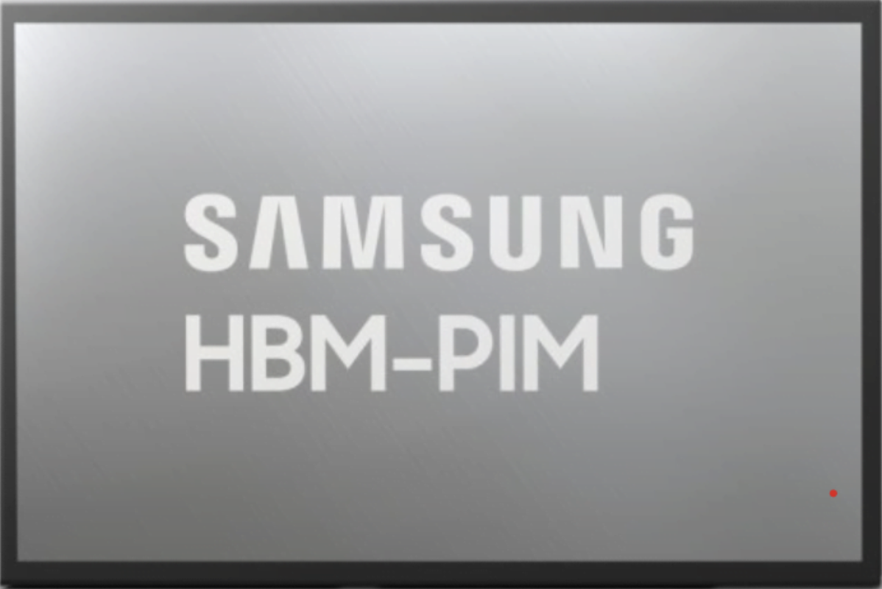
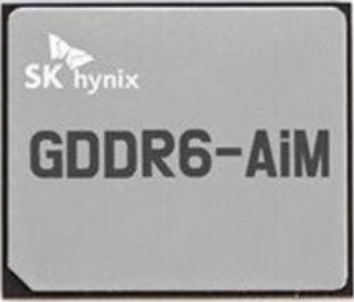
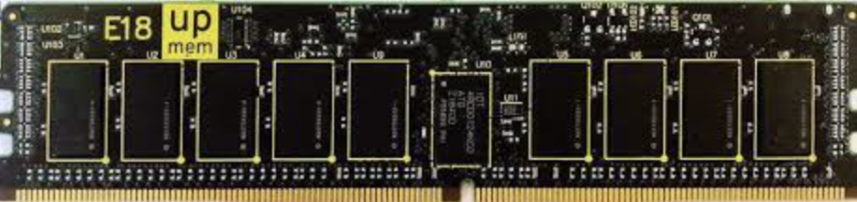
Real Processing-In-Memory Systems
Real Near-Bank Processing-In-Memory (PIM) Systems:
High levels of parallelism
Low memory access latency
Large aggregate memory bandwidth
Host CPU
Main Memory
PIM-Enabled Memory
Lee+, [ISSCC 2022]
Kwon+, [ISSCC 2021]
PIM-Enabled Memory
PIM-Enabled Memory
Bus
DRAM Bank
DRAM Bank
DRAM Bank
DRAM Bank
https://www.upmem.com
PIM-Enabled Memory
PIM-Enabled Memory
PIM-Enabled Memory
PIM Core
PIM Core
PIM Core
PIM Core
PIM-Enabled Memory
Bus
DRAM Bank
DRAM Bank
DRAM Bank
DRAM Bank

Slide 6

SparseP: SpMV Library for Real PIMs
Our Contributions:
Design efficient SpMV kernels for current and future PIM systems
25 SpMV kernels
4 compressed matrix formats (CSR, COO, BCSR, BCOO)
6 data types
4 data partitioning techniques
Various load balancing schemes among PIM cores/threads
3 synchronization approaches
Provide a comprehensive analysis of SpMV on the first commercially-available real PIM system
26 sparse matrices
Comparisons to state-of-the-art CPU and GPU systems
Recommendations for software, system and hardware designers

Slide 7
Outline
SpMV Kernels for Real PIM Systems
Key Takeaways from Our Study
Conclusion

Slide 8
SpMV Execution on a PIM System
1
2
3
4
Load the
input vector
Execute the kernel
Retrieve the
partial results
Merge the
partial results
PIM-Enabled Memory
Host CPU
Main Memory
PIM Core
PIM Core
PIM Core
DRAM Bank
DRAM Bank
bus
DRAM Bank
DRAM Bank
DRAM Bank
bus
+

Slide 9
Data Partitioning Techniques
SparseP supports two types of data partitioning techniques:
1D Partitioning
2D Partitioning
Core 1
Core 1
Core 2
Core 2
=
*
=
4x input vector
1x output vector
*
2x output vector
Core 3
2x input vector
Core 4
Core 3
Core 4
perform the complete
SpMV computation
only on PIM cores
trade-off
computation vs
data transfer costs

Slide 10
1D Partitioning Technique
Load-Balancing Approaches:
CSR, COO:
Balance Rows
Balance NNZs *
BCSR, BCOO:
Balance Blocks ^
Balance NNZs ^
* row-granularity for CSR
^ block-row-granularity for BCSR

Slide 11
1D Partitioning Technique
Load-Balancing of #NNZs:
CSR (row-granularity), COO
CSR
COO
row-
granularity
nnz-
granularity
Core 1
Core 1
Core 2
Core 2
Core 3
Core 3
row-order
nnz-order
rowptr
0
1
3
5
7
7
8
8
9
rowind
0
1
1
2
2
3
3
5
7
colind
0
2
5
3
5
3
6
4
4
colind
0
2
5
3
5
3
6
4
4
values
2
1
8
3
6
9
3
4
7
values
2
1
8
3
6
9
3
4
7

Slide 12
1D Partitioning Technique
Load-Balancing of #NNZs:
CSR (row-granularity), COO
BCSR (block-row-granularity), BCOO
ΒCSR
ΒCOO
block-row-
granularity
block-
granularity
Core 1
Core 1
Core 2
Core 2
Core 3
Core 3
block-row-order
block-order
rowptr
0
1
3
5
7
7
8
8
9
rowind
0
1
1
2
2
3
3
5
7
colind
0
2
5
3
5
3
6
4
4
colind
0
2
5
3
5
3
6
4
4
values
2
1
8
3
6
9
3
4
7
values
2
1
8
3
6
9
3
4
7

Slide 13
2D Partitioning Technique
Equally-Sized Tiles
Equally-Wide Tiles
Variable-Sized Tiles
input vector
input vector
input vector
2x
2x
2x
4x
4x
4x
4x
3x
5x
Core 1
Core 3
Core 3
Core 1
Core 1
Core 3
+
+
+
Core 4
Core 2
Core 2
Core 4
Core 2
Core 4
output vector
output vector
output vector
High NNZ imbalance
across PIM cores
High NNZ balance across PIM cores of the same vertical partition
High NNZ balance
across all PIM cores

Slide 14

Parallelization across Threads
Multithreaded PIM Cores:
1D Partitioning
2D Partitioning
Core 1
Multithreaded
PIM Core
Core 1
Core 2
Core 2
Core 3
DRAM
Bank
Core 3
Core 4
Core 4
Balance NNZs
Balance NNZs
Thread 1
Thread 1
Thread 2
Thread 2
Various load-balance schemes across threads
Various synchronization approaches among threads

Slide 15
SparseP Software Package
25 SpMV kernels for PIM Systems →
https://github.com/CMU-SAFARI/SparseP
Partitioning | Matrix Format | Load-Balancing
9x 1D Kernels | CSR | rows, nnzs *
 | COO▵ | rows, nnzs *, nnzs
 | BCSR | blocks ^, nnzs ^
 | BCOO▵ | blocks, nnzs
4x 2D Equally-Sized Tiles | CSR | --
 | COO▵ | --
 | BCSR | --
 | BCOO▵ | --
6x 2D Equally-Wide Tiles | CSR | nnzs *
 | COO▵ | nnzs
 | BCSR | blocks ^, nnzs ^
 | BCOO▵ | blocks, nnzs
6x 2D Variable-Sized Tiles | CSR | nnzs *
 | COO▵ | nnzs
 | BCSR | blocks ^, nnzs ^
 | BCOO▵ | blocks, nnz
Load-balance
across PIM cores/threads:
* row-granularity (CSR)
^ block-row-granularity (BCSR)
Synchronization
among threads of a PIM core:
▵ lb-cg, lb-fb, lf (COO, BCOO)
Data Types:
8-bit integer
16-bit integer
32-bit integer
64-bit integer
32-bit float
64-bit float

Slide 16
Outline
SpMV Kernels for Real PIM Systems
Key Takeaways from Our Study
Conclusion

Slide 17
UPMEM-based PIM System
20 UPMEM PIM DIMMs with 2560 PIM cores in total
Each multithreaded PIM core supports 24 threads
Host CPU
(2-socket,
Intel Xeon)
128 GB Main Memory
PIM-Enabled Memory
PIM-Enabled Memory
PIM-Enabled Memory
Bus
DRAM Bank
DRAM Bank
DRAM Bank
DRAM Bank
160 GB PIM-Enabled Memory
PIM-Enabled Memory
PIM-Enabled Memory
PIM Core
PIM Core
PIM Core
PIM Core
PIM-Enabled Memory
Bus
DRAM Bank
DRAM Bank
DRAM Bank
DRAM Bank
DISPATCH
24 KB
Instr. Mem.
64
bits
64 MB
DRAM
Bank
24x
threads
14-stage
Pipeline
FETCH
DMA Engine
ALU
64 KB
Data Mem.
MERGE

Slide 18
Sparse Matrix Data Set
26 sparse matrices*:
Diverse sparsity patterns
Variability on irregular patterns
Variability on block patterns
Regular Matrix
Scale-Free Matrix
* Suite Sparse Matrix Collection: https://sparse.tamu.edu/

Slide 19
Kernel Execution on PIM Cores
1
2
3
4
Load the
input vector
Execute the kernel
Retrieve the
partial results
Merge the
partial results
PIM-Enabled Memory
Host CPU
Main Memory
PIM Core
PIM Core
PIM Core
DRAM Bank
DRAM Bank
bus
DRAM Bank
DRAM Bank
DRAM Bank
bus
+

Slide 20
Comparison of Compressed Formats
2048 PIM Cores, 32-bit integer
1D
6.86x
Scale-free: COO, BCOO →
10.26x CSR, BCSR
13.66x
CSR
(row-granularity)
COO
Core 1
Core 1
Core 2
Core 2
In scale-free matrices, COO + BCOO provide higher non-zero element balance across PIM cores than CSR + BCSR, respectively.

Slide 21
Comparison of Compressed Formats
2048 PIM Cores, 32-bit integer
2D Equally-Sized Tiles
Core 1
Core 3
Scale-free:
COO, BCOO →
1.39x CSR, BCSR
1.23x
Core 2
Core 4
1.55x
Thread 1
Thread 1
Thread 2
Thread 2
CSR
(row-granularity)
COO
In scale-free matrices, COO + BCOO provide higher non-zero element balance across threads than CSR + BCSR, respectively.

Slide 22
Comparison of Compressed Formats
2048 PIM Cores, 32-bit integer
COO, BCOO → 32.38x CSR, BCSR
44x
46x
42x
40x
22x
24x
20x
21x
COO + BCOO formats provide higher non-zero element balance across PIM cores + threads than CSR + BCSR, respectively.

Slide 23
Comparison of Compressed Formats
2048 PIM Cores, 32-bit integer
The compressed matrix format used to store the input matrix determines the data partitioning across DRAM banks of PIM-enabled memory. As a result, it affects the load-balance across PIM cores (and threads of a PIM core) with corresponding performance implications.
Key Takeaway 1
Design compressed data structures that can be effectively partitioned across DRAM banks, with the goal of providing high computation balance across PIM cores (and threads of a PIM core).
Recommendation 1

Slide 24
End-to-End Performance
1
2
3
4
Load the
input vector
Execute the kernel
Retrieve the
partial results
Merge the
partial results
PIM-Enabled Memory
Host CPU
Main Memory
PIM Core
PIM Core
PIM Core
DRAM Bank
DRAM Bank
bus
DRAM Bank
DRAM Bank
DRAM Bank
bus
+

Slide 25
Scalability
The scalability is limited by the load time
COO format, 32-bit integer
1D
2D
Equally-Sized
2D
Equally-Wide
2D
Variable-Sized
#PIM Cores
#PIM Cores
#PIM Cores
#PIM Cores
1D: #bytes to load the input vector grows linearly to #PIM cores

Slide 26
Scalability
COO format, 32-bit integer
2D
Equally-Sized
2D
Equally-Wide
2D
Variable-Sized
The 1D-partitioned kernels are severely bottlenecked by the high data transfer costs to broadcast the whole input vector into DRAM banks of all PIM cores, through the narrow off-chip memory bus.
Key Takeaway 2
1D
Optimize the broadcast collective collective in data transfers to PIM-enabled memory to efficiently copy the input data into DRAM banks in the PIM system.
Recommendation 2
#PIM Cores
#PIM Cores
#PIM Cores
#PIM Cores

Slide 27
Scalability
The scalability is limited by the kernel time
COO format, 32-bit integer
1D
2D
Equally-Sized
2D
Equally-Wide
2D
Variable-Sized
#PIM Cores
#PIM Cores
#PIM Cores
#PIM Cores
2D Equally-Sized: kernel time is limited by only
a few PIM cores assigned to the 2D tiles with the largest #NNZs

Slide 28
Scalability
The scalability is limited by the retrieve time
COO format, 32-bit integer
1D
2D
Equally-Sized
2D
Equally-Wide
2D
Variable-Sized
> 88% of data is zeros
#PIM Cores
#PIM Cores
#PIM Cores
#PIM Cores
2D Equally-Wide + 2D Variable-Sized:
high amount of zero padding to gather the output vector →
parallel transfers supported at rank granularity = 64 PIM cores

Slide 29
Scalability
COO format, 32-bit integer
2D
Equally-Sized
2D
Equally-Wide
2D
Variable-Sized
The 2D equally-wide and variable-sized kernels need fine-grained parallel data transfers at DRAM bank granularity (zero padding) to be supported by the PIM system to achieve high performance.
Key Takeaway 3
1D
88.6%
88.0%
Optimize the gather collective operation at DRAM bank granularity in data transfers from PIM-enabled memory to efficiently retrieve the output results to the host CPU.
Recommendation 3
#PIM Cores
#PIM Cores
#PIM Cores
#PIM Cores

Slide 30
1D vs 2D
Up to 2528 PIM Cores, 32-bit float
>1100 Idle Cores
>2200 Idle Cores
1.31x
1.45x
regular
scale-free
Best-performing SpMV execution:
trades off computation with lower data transfer costs

Slide 31
1D vs 2D
2528 PIM Cores, 32-bit float
Expensive data transfers to/from PIM-enabled memory performed via the narrow memory bus impose significant performance overhead to end-to-end SpMV execution. Thus, it is hard to fully exploit all available PIM cores of the system.
Key Takeaway 4
1329 Cores
253 Cores
1.31x
1.45x
Design high-speed communication channels and optimized libraries in data transfers to/from PIM-enabled memory, provide hardware support to effectively overlap computation with data transfers in the PIM system, and/or integrate PIM-enabled memory as the main memory of the system.
Recommendation 4
regular
scale-free

Slide 32
SpMV Execution on Various Systems
GPU System
CPU System
2
Execute the kernel
1
Execute the kernel
Load the
input vector
GPU Cores
Retrieve
the final vector
1
3
Host CPU
Main Memory
bus
DRAM Bank
DRAM Bank
Main Memory
GPU Global Memory
Host CPU
bus
DRAM Bank
DRAM Bank
DRAM Bank
DRAM Bank
SMX2
SMX2
Real PIM
System
1
2
3
4
Load the
input vector
Execute
the kernel
Retrieve the
partial results
Merge the
partial results
PIM-Enabled Memory
Main Memory
PIM Core
PIM Core
PIM Core
Host CPU
DRAM Bank
DRAM Bank
DRAM Bank
DRAM Bank
DRAM Bank
+
bus
bus

Slide 33
CPU/GPU Comparisons
System | Cores | Peak Performance | Bandwidth | TDP
CPU | Intel Xeon Silver 4110 | 660 GFlops | 23.1 GB/s | 2x85 W
GPU | NVIDIA Tesla V100 | 14.13 TFlops | 897 GB/s | 300 W
PIM | UPMEM 1st Gen. | 4.66 GFlops | 1.77 TB/s | 379 W
Processor-
Centric
Memory-Centric

Slide 34
CPU/GPU Comparisons
Kernel-Only (COO, 32-bit float):
CPU = 0.51% of Peak Perf.
GPU = 0.21% of Peak Perf.
PIM (1D) = 50.7% of Peak Perf.
System | Cores | Peak Performance | Bandwidth | TDP
CPU | Intel Xeon Silver 4110 | 660 GFlops | 23.1 GB/s | 2x85 W
GPU | NVIDIA Tesla V100 | 14.13 TFlops | 897 GB/s | 300 W
PIM | UPMEM 1st Gen. | 4.66 GFlops | 1.77 TB/s | 379 W
Processor-
Centric
Memory-Centric

Slide 35
CPU/GPU Comparisons
Kernel-Only (COO, 32-bit float):
CPU = 0.51% of Peak Perf.
GPU = 0.21% of Peak Perf.
PIM (1D) = 50.7% of Peak Perf.
End-to-End (COO, 32-bit float):
CPU = 4.08 GFlop/s
GPU = 1.92 GFlop/s
PIM (1D) = 0.11 GFlop/s
System | Cores | Peak Performance | Bandwidth | TDP
CPU | Intel Xeon Silver 4110 | 660 GFlops | 23.1 GB/s | 2x85 W
GPU | NVIDIA Tesla V100 | 14.13 TFlops | 897 GB/s | 300 W
PIM | UPMEM 1st Gen. | 4.66 GFlops | 1.77 TB/s | 379 W
Processor-
Centric
Memory-Centric

Slide 36
CPU/GPU Comparisons
Kernel-Only (COO, 32-bit float):
CPU = 0.51% of Peak Perf.
GPU = 0.21% of Peak Perf.
PIM (1D) = 50.7% of Peak Perf.
End-to-End (COO, 32-bit float):
CPU = 4.08 GFlop/s
GPU = 1.92 GFlop/s
PIM (1D) = 0.11 GFlop/s
Many more results in the full paper: https://arxiv.org/pdf/2201.05072.pdf

Slide 37
Outline
SpMV Kernels for Real PIM Systems
Key Takeaways from Our Study
Conclusion

Slide 38
Conclusion
SpMV is a fundamental linear algebra kernel for important applications (HPC, machine learning, graph analytics… )
SpMV is a highly memory-bound kernel in processor-centric systems (e.g., CPU and GPU systems)
Real near-bank PIM systems can tackle the data movement bottleneck (high parallelism, large aggregate memory bandwidth)
Key Contributions:
SparseP : first open-source SpMV library for real PIM systems
Comprehensive characterization and analysis of SPMV on the first real PIM system
Recommendations to improve multiple aspects of future PIM hardware and software
SparseP: https://github.com/CMU-SAFARI/SparseP
Full Paper: https://arxiv.org/pdf/2201.05072.pdf
Our Work

Slide 39
SparseP
Towards Efficient Sparse Matrix Vector Multiplication
on Real Processing-In-Memory Architectures
Christina Giannoula
Ivan Fernandez, Juan Gomez-Luna,
Nectarios Koziris, Georgios Goumas, Onur Mutlu

