Slide 1






SynCron
Efficient Synchronization Support
for Near-Data-Processing Architectures
Christina Giannoula
Nandita Vijaykumar, Nikela Papadopoulou, Vasileios Karakostas
Ivan Fernandez, Juan Gómez Luna, Lois Orosa
Nectarios Koziris, Georgios Goumas, Onur Mutlu

Slide 2
Executive Summary
Problem:
Synchronization support is challenging for NDP systems
Prior schemes are not suitable or efficient for NDP systems
Contribution:
SynCron: the first end-to-end synchronization solution for NDP architectures
Key Results:
SynCron comes within 9.5% and 6.2% of performance and energy of an Ideal zero-overhead synchronization scheme

Slide 3

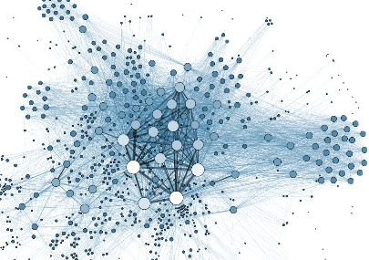
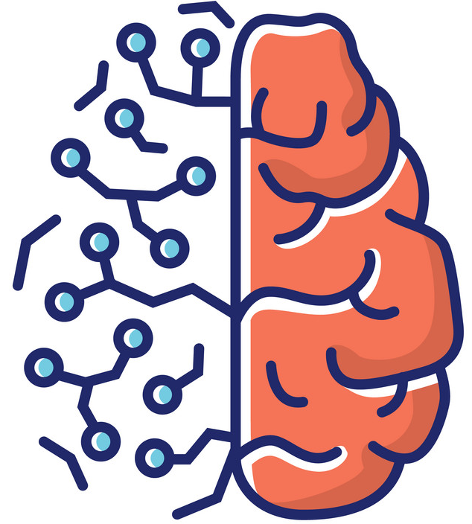
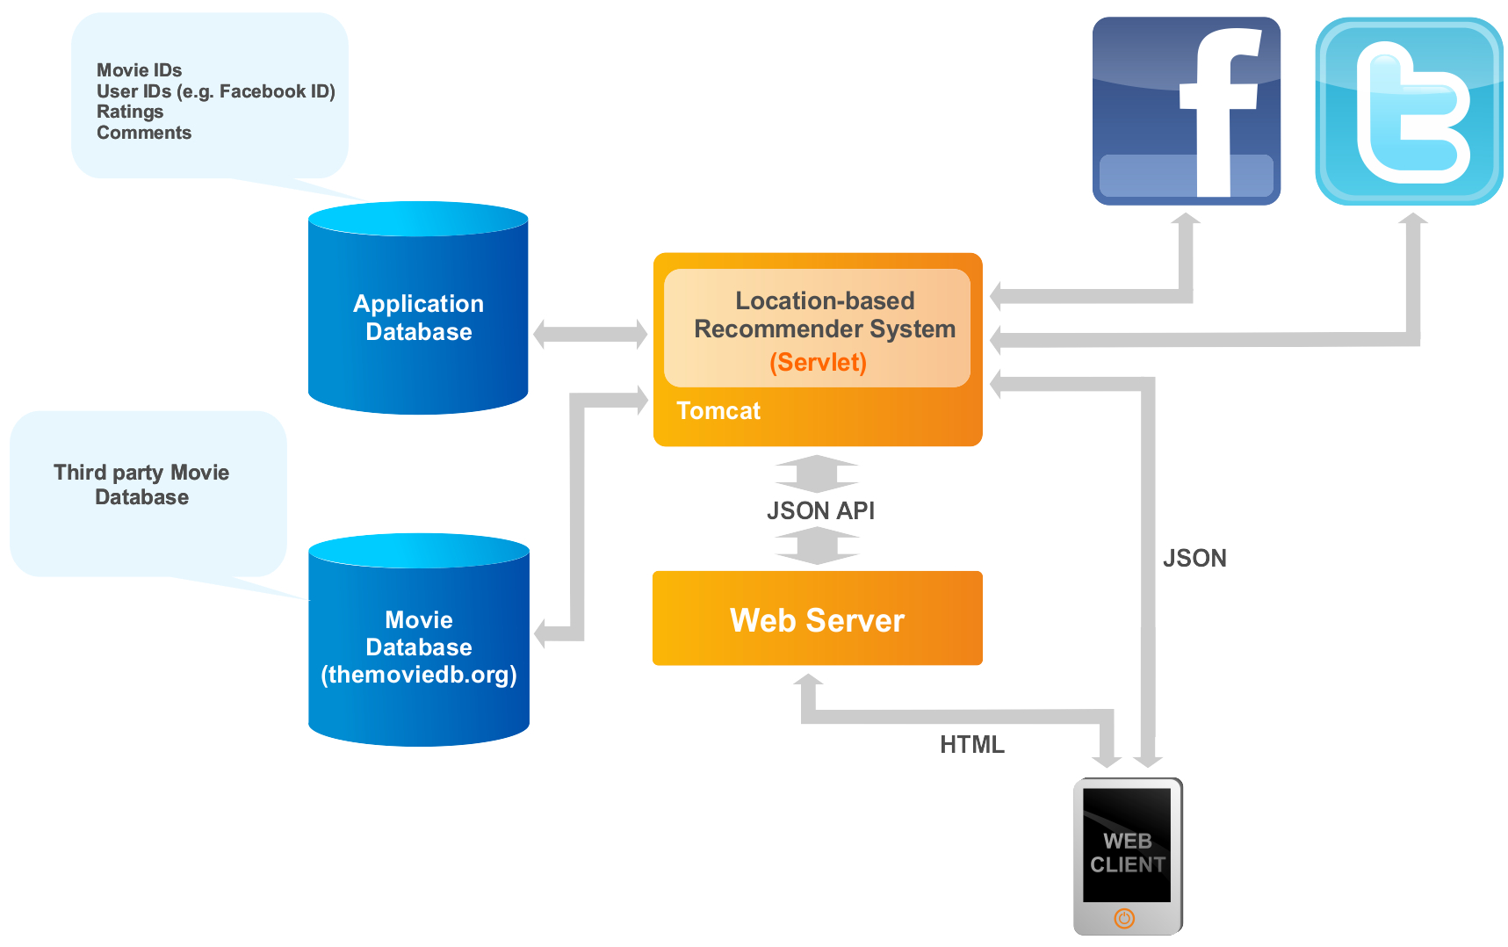

Near-Data-Processing (NDP) Systems
CPU
NDP
Logic
DRAM
Graph Analytics
Recommendation Systems
Neural Networks
Bioinformatics

Slide 4



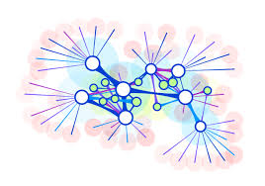

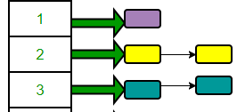


Synchronization is Necessary
Image Processing
Bioinformatics
Graph Analytics
Databases
Single Source Shortest Path (SSSP)
for v in Graph:
for u in neighbors[v]:
if distance[v] + edge_weight[v, u] < distance[u]
if distance[v] + edge_weight[v, u] < distance[u]
distance[u] = distance[v] + edge_weight[v, u]
Locks
Barriers
Concurrent
Data Structures
lock_acquire(u)
lock_release(u)

Slide 5
Baseline NDP Architecture
Synchronization challenges in NDP systems:
NDP System
NDP Unit
NDP Core
Main Memory
Programmable Core / Accelerator
NDP Core
Private Cache
NDP Core
(1) Lack of hardware cache coherence support
(2) Expensive communication across NDP units
(3) Lack of a shared level of cache memory

Slide 6
NDP Synchronization Solution Space
(1) Shared Memory
(2) Message-passing
Hardware Cache
Coherence
Remote
Atomics
Specialized Hardware Support
Software-based Schemes
Specialized Hardware Support

Slide 7
NDP Synchronization Solution Space
(1) Shared Memory
(2) Message-passing
Hardware Cache
Coherence
Remote
Atomics
Specialized Hardware Support
Software-based Schemes
Specialized Hardware Support
CPUs:
Hierarchical CLH Locks [EuroPar’06]
Cohort Locks [TOPC’15]
Ticket Locks [TOCS’91] …
MPPs:
QOLB [ASPLOS’89]
Lack of hardware cache coherence support

Slide 8
NDP Synchronization Solution Space
(1) Shared Memory
(2) Message-passing
Hardware Cache
Coherence
Remote
Atomics
Specialized Hardware Support
Software-based Schemes
Specialized Hardware Support
GPUs:
Fermi GF100 [IEEE Micro’10] …
MPPs:
SGI Origin [ISCA’97]
Cray T3E [ASPLOS’96] …
CPUs:
SSB [ISCA’07]
Lock Cache [CASES’01] …
MPPs:
Full/Empty Bits [ISCA’83] …
NDPs:
Tesseract [ISCA’15]
CPUs:
MiSAR [ISCA’15]
LCU [MICRO’10]
Glocks [IPDPS’11] …
GPUs:
HQL [IPDPS’13] …
Expensive communication across NDP units

Slide 9

NDP Synchronization Solution Space
(1) Shared Memory
(2) Message-passing
Hardware Cache
Coherence
Remote
Atomics
Specialized Hardware Support
Software-based Schemes
Specialized Hardware Support
CPUs:
SSB [ISCA’07]
Lock Cache [CASES’01]
BarrierFilter [MICRO’06]
NDPs:
Tesseract [ISCA’15], Near-Data Processing for In-memory Analytics [PACT’15]
CPUs:
MiSAR [ISCA’15]
GPUs:
HQL [IPDPS’13]
Lack of a shared level of cache memory

Slide 10
NDP Synchronization Solution Space
(1) Shared Memory
(2) Message-passing
Hardware Cache
Coherence
Remote
Atomics
Specialized Hardware Support
Software-based Schemes
Specialized Hardware Support
Prior schemes are not suitable or efficient
for NDP systems

Slide 11

NDP Synchronization Solution Space
(1) Shared Memory
(2) Message-passing
Hardware Cache
Coherence
Remote
Atomics
Specialized Hardware Support
Software-based Schemes
Specialized Hardware Support
SynCron’s Key Techniques:
1. Hardware support for synchronization acceleration
2. Direct buffering of synchronization variables
3. Hierarchical message-passing communication
4. Integrated hardware-only overflow management
NDPs:
SynCron [HPCA’21]

Slide 12

1. Hardware Synchronization Support
NDP Unit 0
NDP Unit 1
NDP Core 0
Main Memory
NDP Core 0
Main Memory
`````
ISA
NDP Core 1
NDP Core 1
Synchronization
Engine 0
Synchronization
Engine 1
Local
lock acquire
No Complex Cache Coherence Protocols
No Expensive Atomic Operations
Low Hardware Cost

Slide 13
2. Direct Buffering of Variables
NDP Unit 0
NDP Unit 1
NDP Core 0
Main Memory
NDP Core 0
Main Memory
NDP Core 1
NDP Core 1
Synchronization
Engine 0
Synchronization
Engine 1
Synchronization
Processing Unit
Synchronization
Table
Address
…
--
…
Local
lock acquire
Indexing Counters
--
…
--
…
--
…

Slide 14
2. Direct Buffering of Variables
NDP Unit 0
NDP Unit 1
NDP Core 0
Main Memory
NDP Core 0
Main Memory
NDP Core 1
NDP Core 1
Synchronization
Engine 0
Synchronization
Engine 1
Synchronization
Processing Unit
Synchronization
Table
Address
…
0x33A9
…
Local
lock acquire
No Costly Memory Accesses
Low Latency
Indexing Counters
--
…
--
…
--
…

Slide 15
3. Hierarchical Communication
NDP Unit 0
NDP Unit 1
NDP Core 0
Main Memory
NDP Core 0
Main Memory
NDP Core 1
NDP Core 1
Synchronization
Engine 0
Synchronization
Engine 1
syncronVar
NDP Unit 2
NDP Unit 3
NDP Core 0
Main Memory
NDP Core 0
Main Memory
NDP Core 1
NDP Core 1
Synchronization
Engine 2
Synchronization
Engine 3

Slide 16
3. Hierarchical Communication
Local
lock acquire
NDP Unit 0
NDP Unit 1
NDP Core 0
Main Memory
NDP Core 0
Main Memory
NDP Core 1
NDP Core 1
Synchronization
Engine 0
Synchronization
Engine 1
syncronVar
NDP Unit 2
NDP Unit 3
Master
NDP Core 0
Main Memory
NDP Core 0
Main Memory
NDP Core 1
NDP Core 1
Synchronization
Engine 2
Synchronization
Engine 3

Slide 17

3. Hierarchical Communication
Global
lock acquire
NDP Unit 0
NDP Unit 1
NDP Core 0
Main Memory
NDP Core 0
Main Memory
NDP Core 1
NDP Core 1
Synchronization
Engine 0
Synchronization
Engine 1
syncronVar
NDP Unit 2
NDP Unit 3
Master
NDP Core 0
Main Memory
NDP Core 0
Main Memory
Minimize Expensive Traffic
NDP Core 1
NDP Core 1
Synchronization
Engine 2
Synchronization
Engine 3

Slide 18
4. Integrated Overflow Management
NDP Unit 0
NDP Unit 1
NDP Core 0
Main Memory
NDP Core 0
Main Memory
NDP Core 1
NDP Core 1
Synchronization
Engine 0
Synchronization
Engine 1
syncronVar
Master
Fully Occupied
Address
…
Synchronization
Processing Unit
Synchronization
Table
0x33A9
…
Low Performance Degradation
High Programming Ease
0x2241
…
0x438C
…
Indexing Counters
0x6B4A
…

Slide 19
SynCron
SynCron’s Benefits:
High System Performance
Low Hardware Cost
Programming Ease
General Synchronization Support
The first end-to-end synchronization solution for NDP architectures
SynCron comes within 9.5% and 6.2% of performance and energy of Ideal zero-overhead synchronization

Slide 20
SynCron
Efficient Synchronization Support
for Near-Data-Processing Architectures
Christina Giannoula
Nandita Vijaykumar, Nikela Papadopoulou, Vasileios Karakostas
Ivan Fernandez, Juan Gómez Luna, Lois Orosa
Nectarios Koziris, Georgios Goumas, Onur Mutlu

