Slide 1








PyGim: An Efficient Graph Neural Network Library for Real Processing-In-Memory Architectures
Christina Giannoula, Peiming Yang, Ivan Fernandez, Jiacheng Yang, Sankeerth Durvasula, Yu Xin Li, Mohammad Sadrosadati, Juan Gomez Luna, Onur Mutlu, Gennady Pekhimenko

Slide 2
Executive Summary
Problem: The memory-intensive kernels of Graph Neural Networks (GNNs) dominate execution time (~91%) and are significantly bottlenecked by memory bandwidth in procesor-centric systems (CPUs/GPUs)
Motivation: PIM provide significantly high memory bandwidth by enabling computation to be performed close to the application data
PyGim: An efficient and easy-to-use GNN library for real Processing-In-Memory (PIM) systems
Key Ideas & Benefits:
Cost Effectiveness: Heteregenous GNN kernels are executed in the best-fit hardware
High Performance: (i) Enabling three levels of parallelism with various strategies in the PIM side and (ii) adapting best-performing parallelization strategy to the graph’s unique characteristics
High Programming Ease: (i) Providing a handy Python API and (ii) automatically tuning the best-fit parallelization strategy without programmer intervention
Key Results: PyGim improves (i) performance and energy efficiency by 3.7× and 2.3× over state-of-the-art schemes, and (ii) core utilization on PIM system by 11.6× over PyTorch on GPUs
github.com/CMU-SAFARI/PyGim

Slide 3
Talk Outline
Background & Motivation
PyGim Design
Evaluation

Slide 4



GNNs Are Widely Used in Real-World Applications
GNNs are state-of-the-art ML models for analyzing graph-structure data
GNN has a lot of applications:
Drug Discovery
Recommendation Systems
Fraud Detection

Slide 5
Execution Steps of GNN Layers
GNNs comprise a few layers (e.g., 3-5 layers)
Each GNN layer has two execution steps:
4
2
1
5
6
Adjacency (Sparse) Matrix
Input Feature
Notes:
Full matrix of results.

Slide 6
Execution Steps of GNN Layers
GNNs comprise a few layers (e.g., 3-5 layers)
Each GNN layer has two execution steps:
4
4
2
2
1
1
5
5
6
6
Adjacency (Sparse) Matrix
Input Feature
Input Feature
Notes:
Full matrix of results.

Slide 7
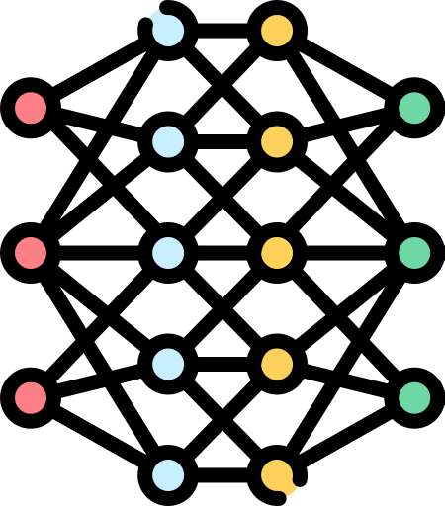
Execution Steps of GNN Layers
GNNs comprise a few layers (e.g., 3-5 layers)
Each GNN layer has two execution steps:
4
4
2
2
4
2
1
1
1
5
5
6
5
6
6
Adjacency (Sparse) Matrix
Input Feature
Aggregation Result
Neural Network (NN)
Output Feature
Notes:
Full matrix of results.

Slide 8
Execution Steps of GNN Layers
GNNs comprise a few layers (e.g., 3-5 layers)
Each GNN layer has two execution steps:
4
4
2
2
4
2
1
1
1
5
5
6
5
6
6
Adjacency (Sparse) Matrix
Input Feature
Aggregation Result
Neural Network (NN)
Output Feature
Aggregation
Combination
Aggregate neighbor’s feature, corresponds to Sparse Matrix Matrix Multiplication (SpMM)
Combine features by NN. Typically comprises compute-intensive kernels (e.g., GEMMs)
Notes:
sparse V V mul

Slide 9
GNN Aggregation Is Memory-Bandwidth-Bound In GPUs
Using a RTX 3090 GPU with ~900 GB/s bandwidth, we find that GNN Aggregation
takes ~91% of the inference time
achieves less than 2% core utilization
Roofline Analysis
Bandwidth-Bound

Slide 10
PIM Alleviates The Data Movement Bottleneck
Near-bank PIM: each PIM core is tightly coupled with one (or a few) DRAM banks
Near-bank PIM cores have significantly higher memory bandwidth than Host cores
A Near-Bank PIM System
Host Processor
(e.g., CPU/GPU)
Standard Memory Modules
PIM-Enabled Memory
PIM-Enabled Memory
PIM-Enabled Memory
Host Cores
Bus
PIM-Enabled Memory
PIM Provides A Promising Solution for GNN Aggregation
PIM-Enabled Memory
PIM-Enabled Memory
PIM Core
PIM Core
PIM Core
PIM Core
Shared Cache
PIM-Enabled Memory
DRAM Bank
DRAM Bank
DRAM Bank
DRAM Bank
Bus
Notes:
- Here I changed the title of the slide!
- Here you need to animate a banner: I added a draft banner please fix the text

Slide 11
Talk Outline
Background & Motivation
PyGim Design
Evaluation

Slide 12
PyGim Overview
An efficient and easy-to-use GNN library for real PIM systems
PyGim incorporates 4 key components:
Cooperative Acceleration (CoA)
Run heterogeneous kernels in the best-fit hardware
Parallelism Fusion (PaF)
Parallelism Fusion (PaF)
Strives a balance between computation and data transfer
Strives a balance between computation and data transfer
Lightweight Tuning
Lightweight Tuning
Automatically tunes the best-performing PaF strategy
Automatically tunes the best-performing PaF strategy
Handy Programming Interface
Handy Programming Interface
Integrates a handy Python (PyTorch) API
Integrates a handy Python (PyTorch) API

Slide 13
1. Cooperative Acceleration (CoA)
Heterogeneous kernels are running in the best-fit underlying hardware
Combination runs on Host cores
Aggregation runs on PIM cores
A Near-Bank PIM System
Host Processor
(e.g., CPU/GPU)
Standard Memory Modules
PIM-Enabled Memory
GNN Combination
PIM-Enabled Memory
PIM-Enabled Memory
Host Cores
Bus
GNN Aggregation
PIM-Enabled Memory
PIM-Enabled Memory
PIM-Enabled Memory
PIM Core
PIM Core
PIM Core
PIM Core
Shared Cache
PIM-Enabled Memory
DRAM Bank
DRAM Bank
DRAM Bank
DRAM Bank
Bus

Slide 14
Challenge 1: Expensive Data Transfer Costs
Alleviate the overheads of passing the output data of the one step as input data to the next step
A Near-Bank PIM System
Host Processor
(e.g., CPU/GPU)
Standard Memory Modules
PIM-Enabled Memory
GNN Combination
PIM-Enabled Memory
PIM-Enabled Memory
Host Cores
Bus
GNN Aggregation
PIM-Enabled Memory
PIM-Enabled Memory
PIM-Enabled Memory
PIM Core
PIM Core
PIM Core
PIM Core
Shared Cache
data
PIM-Enabled Memory
DRAM Bank
DRAM Bank
DRAM Bank
DRAM Bank
Bus

Slide 15
PyGim Overview
An efficient and easy-to-use GNN library for real PIM systems
PyGim incorporates 4 key components:
Cooperative Acceleration (CoA)
challenge
Expensive Data Transfer Costs
Parallelism Fusion (PaF)
Lightweight Tuning
Handy Programming Interface

Slide 16

PyGim Overview
An efficient and easy-to-use GNN library for real PIM systems
PyGim incorporates 4 key components:
Cooperative Acceleration (CoA)
challenge
Expensive Data Transfer Costs
Parallelism Fusion (PaF)
solution
Lightweight Tuning
Handy Programming Interface

Slide 17
2. Parallelism Fusion (PaF)
PaF (i) strives a balance between computation and data transfer costs and
(ii) covers various graphs with diverse characteristics
PaF enables 3 levels of parallelism:
Across PIM Clusters: Edge- and Feature-level parallelism
Within PIM Cluster: Vertex- or Edge-level parallelism
Within PIM Core: Vertex- or Edge-level parallelism
Reduces data transfer costs
Within PIM Core
PIM Core
Threads
Reduce computation costs
PIM-Enabled Memory
PIM-Enabled Memory
Cluster 1
Cluster 2
Cluster 3
Cluster 4
PIM Core
PIM Core
PIM Core
PIM Core
PIM Core
PIM Core
PIM Core
PIM Core
Within PIM Cluster
DRAM Bank
DRAM Bank
DRAM Bank
DRAM Bank
DRAM Bank
DRAM Bank
DRAM Bank
DRAM Bank
Across PIM Clusters
Notes:
- This slide is a bit crowded and dense. Probably if we make the images a bit smaller it might look better

Slide 18
An Aggregation Example
E.g., a graph with 8 vertices and 14 edges
SPMM is used for aggregation
8
6
6
8
2
SPMM
2
3
1
3
1
4
5
5
7
4
7
Adjacency (Sparse) Matrix
Input Feature Matrix
Aggregation Results
Notes:
This is an example of aggregation, …..

Slide 19
2.1 PaF Parallelism Across PIM Clusters
PaF (i) strives a balance between computation and data transfer costs and
(ii) covers various graphs with diverse characteristics
PaF enables 3 levels of parallelism:
Across PIM Clusters: Edge- and Feature-level parallelism
Within PIM Cluster: Vertex- or Edge-level parallelism
Within PIM Core: Vertex- or Edge-level parallelism
PIM Core
Threads
PIM-Enabled Memory
PIM-Enabled Memory
Cluster 1
Cluster 2
Cluster 3
Cluster 4
PIM Core
PIM Core
PIM Core
PIM Core
PIM Core
PIM Core
PIM Core
PIM Core
DRAM Bank
DRAM Bank
DRAM Bank
DRAM Bank
DRAM Bank
DRAM Bank
DRAM Bank
DRAM Bank
Across PIM Clusters
Notes:
- This slide is a bit crowded and dense. Probably if we make the images a bit smaller it might look better

Slide 20
Across PIM Clusters: Edge- & Feature-Level Parallelism
E.g., creating 4 PIM clusters with 2 Edge partitions and 2 Feature partitions
8
6
2
3
1
4
5
7
Edge-level partition
Clusters 1,2
Clusters 1,2
Clusters 3,4
Clusters 3,4
Adjacency (Sparse) Matrix
Input Feature Matrix
Notes:
4 features for each cluster
Add host core merge
Show “cluster” under graph in next click

Slide 21
Across PIM Clusters: Edge- & Feature-Level Parallelism
E.g., creating 4 PIM clusters with 2 Edge partitions and 2 Feature partitions
8
6
8
6
2
2
3
1
3
1
4
5
4
5
7
7
Clusters 1,2
Clusters 3,4
Edge-level partition
Feature-level partition
Clusters 1,2
Cluster
1
Cluster
2
Clusters 1,2
Clusters 3,4
Clusters 3,4
Cluster
3
Cluster
4
Adjacency (Sparse) Matrix
Input Feature Matrix
Notes:
4 features for each cluster
Add host core merge
Show “cluster” under graph in next click

Slide 22
Across PIM Clusters: Edge- & Feature-Level Parallelism
E.g., creating 4 PIM clusters with 2 Edge partitions and 2 Feature partitions
8
6
8
6
8
6
8
6
2
2
2
2
3
1
3
1
3
1
3
1
4
5
4
5
4
5
4
5
7
7
7
7
Cluster 1
Cluster 2
Cluster 3
Cluster 4
Edge-level partition
Feature-level partition
Merged by Host cores
Cluster
1
Cluster
2
Clusters 1,2
Clusters 3,4
Cluster 1
Cluster 3
Cluster 2
Cluster 4
Cluster
3
Cluster
4
Adjacency (Sparse) Matrix
Input Feature Matrix
Partial Results for Output
Notes:
4 features for each cluster
Add host core merge
Show “cluster” under graph in next click

Slide 23
2.2 PaF Parallelism Within PIM Cluster
PaF (i) strives a balance between computation and data transfer costs and
(ii) covers various graphs with diverse characteristics
PaF enables 3 levels of parallelism:
Across PIM Clusters: Edge- and Feature-level parallelism
Within PIM Cluster: Vertex- or Edge-level parallelism
Within PIM Core: Vertex- or Edge-level parallelism
PIM Core
Threads
PIM-Enabled Memory
PIM-Enabled Memory
Cluster 1
Cluster 2
Cluster 3
Cluster 4
PIM Core
PIM Core
PIM Core
PIM Core
PIM Core
PIM Core
PIM Core
PIM Core
Within PIM Cluster
DRAM Bank
DRAM Bank
DRAM Bank
DRAM Bank
DRAM Bank
DRAM Bank
DRAM Bank
DRAM Bank
Notes:
Title, another color
- This slide is a bit crowded and dense. Probably if we make the images a bit smaller it might look better

Slide 24
Within a PIM Cluster: Vertex- or Edge-Level Parallelism
E.g., balancing vertices or balancing edges across PIM cores within the cluster
Balance Vertices Across PIM Cores
Balance Edges Across PIM Cores
Core 1
Core 1
Core 2
Core 2
Adjacency (Sparse) Matrix
Adjacency (Sparse) Matrix
Cluster 1 has 2 PIM Cores
PIM-Enabled Memory
Cluster 2
PIM Core
PIM Core
PIM Core
PIM Core
DRAM Bank
DRAM Bank
DRAM Bank
DRAM Bank

Slide 25
2.3 PaF Parallelism Within PIM Core
PaF (i) strives a balance between computation and data transfer costs and
(ii) covers various graphs with diverse characteristics
PaF enables 3 levels of parallelism:
Across PIM Clusters: Edge- and Feature-level parallelism
Within PIM Cluster: Vertex- or Edge-level parallelism
Within PIM Core: Vertex- or Edge-level parallelism
Within PIM Core
PIM Core
Threads
PIM-Enabled Memory
PIM-Enabled Memory
Cluster 1
Cluster 2
Cluster 3
Cluster 4
PIM Core
PIM Core
PIM Core
PIM Core
PIM Core
PIM Core
PIM Core
PIM Core
DRAM Bank
DRAM Bank
DRAM Bank
DRAM Bank
DRAM Bank
DRAM Bank
DRAM Bank
DRAM Bank
Notes:
Titile
- This slide is a bit crowded and dense. Probably if we make the images a bit smaller it might look better

Slide 26

Within a PIM Core: Vertex- or Edge-Level Parallelism
E.g., balancing vertices or balancing edges across threads within a PIM core
Balance Vertices Across Threads
Balance Edges Across Threads
Thread 1
Thread 1
Thread 2
Thread 2
Thread 3
Thread 3
Thread 4
Thread 4
Adjacency (Sparse) Matrix
Adjacency (Sparse) Matrix
PIM Core
PIM Core supports 4 threads
Synchronization is implement
with lock-free or fine-grained locking schemes
Threads

Slide 27
Challenge 2: Programmability in Real-World Graphs
PaF supports a wide variety of parallelization strategies:
Typically there is no one-size-fits-all solution
Challenge = manually tuning the parallelization strategy poses significant burdens for developers
Unique graph's characteristics need different tuning
regular graph
power-law graph
diagonal graph
Real-world graphs exhibit diverse characteristics
Notes:
- Real-world graphs exhibit diverse characteristics, e.g., the average, min or max vertex neighboring degrees vary across different graphs. Therefore, as discussed in prior works [39, 62, 77, 122, 138], the execution behavior of sparse kernels, such as the SpMV/SpMM, depends on the particular characteristics of the input given, and there is no typically one-size-fits-all parallelization solution that performs best across various inputs
- Programming a real near-bank PIM system is hard task. manually tuning the best-performing parallelization strategy for each unique graph's characteristics poses significant challenges for developers

Slide 28
PyGim Overview
An efficient and easy-to-use GNN library for real PIM systems
PyGim incorporates 4 key components:
Cooperative Acceleration (CoA)
Expensive Data Transfer Costs
Parallelism Fusion (PaF)
challenge
Programmability in
Real-World Graphs
Lightweight Tuning
Handy Programming Interface

Slide 29
PyGim Overview
An efficient and easy-to-use GNN library for real PIM systems
PyGim incorporates 4 key components:
Cooperative Acceleration (CoA)
Expensive Data Transfer Costs
Parallelism Fusion (PaF)
challenge
Programmability in
Real-World Graphs
Lightweight Tuning
solution
Handy Programming Interface

Slide 30


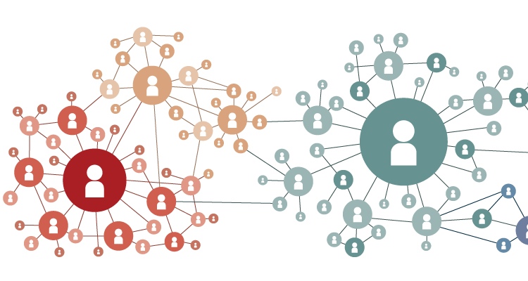
3. Lightweight Tuning
PyGim Tuner predicts the best-performing PaF strategy without manual programmer intervention
Hardware profiler generate a group of performance measurements
Performance predictor predict the execution of potential PaF strategy
PaF selector apply the best-performing PaF strategy
PyGim Tuner
PIM-Enabled Memory
PIM Core
PIM Core
Hardware Profiler
PaF Generator
DRAM Bank
DRAM Bank
Performance Predictor
Tunes
Real PIM System
Host->PIM
PIM Kernel
PIM->Host
Host Kernel
Best-performing
PaF Strategy
PaF Selector
Real-world Graph
Notes:
Graph’s characteristics (i.e., non-zero patterns)
PIM system’s characteristics (i.e., compute capabilities, available memory bandwidth…)

Slide 31
PyGim Overview
An efficient and easy-to-use GNN library for real PIM systems
PyGim incorporates 4 key components:
Cooperative Acceleration (CoA)
Parallelism Fusion (PaF)
Lightweight Tuning
Handy Programming Interface

Slide 32
4. Handy Programming Interface
PyGim integrates a handy Python API (currently integrated with PyTorch)
1
2
3
4
5
6
7
8
9
10
11
12
13
14
15
16
17
18
19
20
21
22
23
24
25
import torch, pygim as gyn
class GCNConv(torch.nn.Module):
def __init__(self, hidden_size):
self.linear = torch.nn.Linear(feature_size, features_size)
def forward(self, graph_pim, in_dense):
# Execute memory-intensive operator in PIM devices
dense_parts = col_split(in_dense)
out_dense = gyn.pim_run_aggr(graph_pim, dense_parts)
# Execute compute-intensive operator in Host (e.g., CPU/GPU)
out = self.linear(out_dense)
return out
gyn.pim_init_devices(num_pim_devices) # Initialize PIM devices
data = load_dataset() # Load graph
# Tune the PaF strategy
graph_parts, config = gyn.tune(data.graph, feature_size, device_info)
graph_pim = gyn.load_graph_pim(graph_parts) # Partition graph to PIM
# Create GNN model
model = torch.nn.Sequential([Linear(in_channels, feature_size),
GCNConv(feature_size),
GCNConv(feature_size),
GCNConv(feature_size),
Linear(feature_size, out_channels)])
model.forward(graph_pim, data.features) # GCN inference
import … pygim as gyn
# Execute memory-intensive kernel in real PIM devices
out_dense = gyn.pim_run_aggr(graph_pim, dense_parts)
# Tune the PaF strategy
graph_pim= gyn.tune(data.graph, feature_size, device_info)
# Create GNN model model=torch.nn.Sequential([Linear(in_channels,feature_size),
GCNConv(feature_size),
GCNConv(feature_size),
GCNConv(feature_size),
Linear(feature_size, out_channels)])

Slide 33
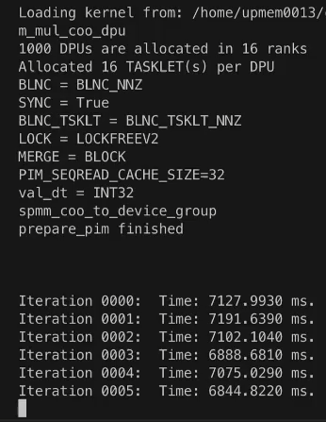

Deploy Your GNNs Effortlessly with PyGim and Enjoy the PIM Benefits!
1
2
3
4
5
6
7
8
9
10
11
12
13
14
15
16
17
18
19
20
21
22
23
24
25
import torch, pygim as gyn
class GCNConv(torch.nn.Module):
def __init__(self, hidden_size):
self.linear = torch.nn.Linear(feature_size, features_size)
def forward(self, graph_pim, in_dense):
# Execute memory-intensive operator in PIM devices
dense_parts = col_split(in_dense)
out_dense = gyn.pim_run_aggr(graph_pim, dense_parts)
# Execute compute-intensive operator in Host (e.g., CPU/GPU)
out = self.linear(out_dense)
return out
gyn.pim_init_devices(num_pim_devices) # Initialize PIM devices
data = load_dataset() # Load graph
# Tune the PaF strategy
graph_parts, config = gyn.tune(data.graph, feature_size, device_info)
graph_pim = gyn.load_graph_pim(graph_parts) # Partition graph to PIM
# Create GNN model
model = torch.nn.Sequential([Linear(in_channels, feature_size),
GCNConv(feature_size),
GCNConv(feature_size),
GCNConv(feature_size),
Linear(feature_size, out_channels)])
model.forward(graph_pim, data.features) # GCN inference
import … pygim as gyn
# Execute memory-intensive kernel in real PIM devices
out_dense = gyn.pim_run_aggr(graph_pim, dense_parts)
Computation is performed inside real PIM devices!
# Tune the PaF strategy
graph_pim= gyn.tune(data.graph, feature_size, device_info)
# Create GNN model model=torch.nn.Sequential([Linear(in_channels,feature_size),
GCNConv(feature_size),
GCNConv(feature_size),
GCNConv(feature_size),
Linear(feature_size, out_channels)])
fast-forwarded
Memory
small cores
UPMEM PIM

Slide 34
Talk Outline
Background & Motivation
PyGim Design
Evaluation

Slide 35
Evaluation Methodology
UPMEM PIM server: 16 PIM DIMMs with 1992 PIM Cores (24 threads per core) in total
GNN models: GCN, GIN, SAGE
Datasets: OGBN-Proteins, Reddit, AmazonProducts
Comparison points:
PyTorch running on host CPU
SparseP [Sigmetrics’22] (2×) running SpMM as multiple SpMV kernels on PIM cores
GraNDe [IEEE Trans. Comput.’23]: optimizes GNN aggregation on near-rank PIM systems
Host CPU (2-socket Intel Xeon)
Bus
128 GB Main Memory
PIM-Enabled Memory
PIM-Enabled Memory
Host Cores
124 GB PIM-Enabled Memory
PIM-Enabled Memory
PIM-Enabled Memory
Bus
PIM Core
PIM Core
PIM Core
PIM Core
Shared Cache
DRAM Bank
DRAM Bank
DRAM Bank
DRAM Bank
UPMEM PIM System

Slide 36
Performance Evaluation in GNN Inference
ogbn-proteins
reddit
amazonProducts

Slide 37
Performance Evaluation in GNN Inference
PyGim significantly outperforms PyTorch (CPU) and prior PIM-based schemes by 3.1× and 4.4× respectively
ogbn-proteins
reddit
amazonProducts

Slide 38
Energy Efficiency Evaluation in GNN Inference
PyGim improves energy efficiency by 2.7× and 3.3× compared to PyTorch (CPU) and prior PIM-based schemes respectively
ogbn-proteins
reddit
amazonProducts

Slide 39
Characteristics of CPU, PIM and GPU Systems
System | INT32 Peak Performance | FP32 Peak Performance | Total Bandwidth | Technology Node
CPU Xeon 4215 | 0.64 TOPS | 1.28 TFLOPS | 23.1 GB/s | 14nm
UPMEM PIM | 0.12 TOPS | 0.025 TFLOPS | 1390 GB/s | at least 20nm
GPU GTX 1080 Ti | 13.25 TOPS | 13.25 TFLOPS | 359.9 GB/s | 16nm
GPU RTX 2080 Ti | 16.94 TOPS | 16.94 TFLOPS | 558.1 GB/s | 12nm
GPU RTX 3090 | 17.79 TOPS | 35.58 TFLOPS | 936.2 GB/s | 8nm
Across last GPU generations:
memory bandwidth has tripled (~3×)
(last two generations) compute throughput has been doubled (~2×)

Slide 40
Core Utilization in GNN Aggregation
Dataset & data type/ Software library | Reddit INT32 | Reddit FP32
Intel MKL (CPU Intel Xeon 4215) | 0.63% | 0.22%
CUDA (GPU GTX 1080 Ti) | 0.62% | 0.62%
CUDA (GPU RTX 2080 Ti) | 0.68% | 0.67%
CUDA (GPU RTX 3090) | 1.56% | 0.78%
PyGim (UPMEM PIM) | 13.86% | 9.13%
Core utilization in GNN aggregation remains similarly low across GPU generations
PyGim running on a real PIM system achieves
significantly higher core utilization(11.6x on average) than the PyTorch on GPUs
Notes:
(at least a 5× increase)

Slide 41
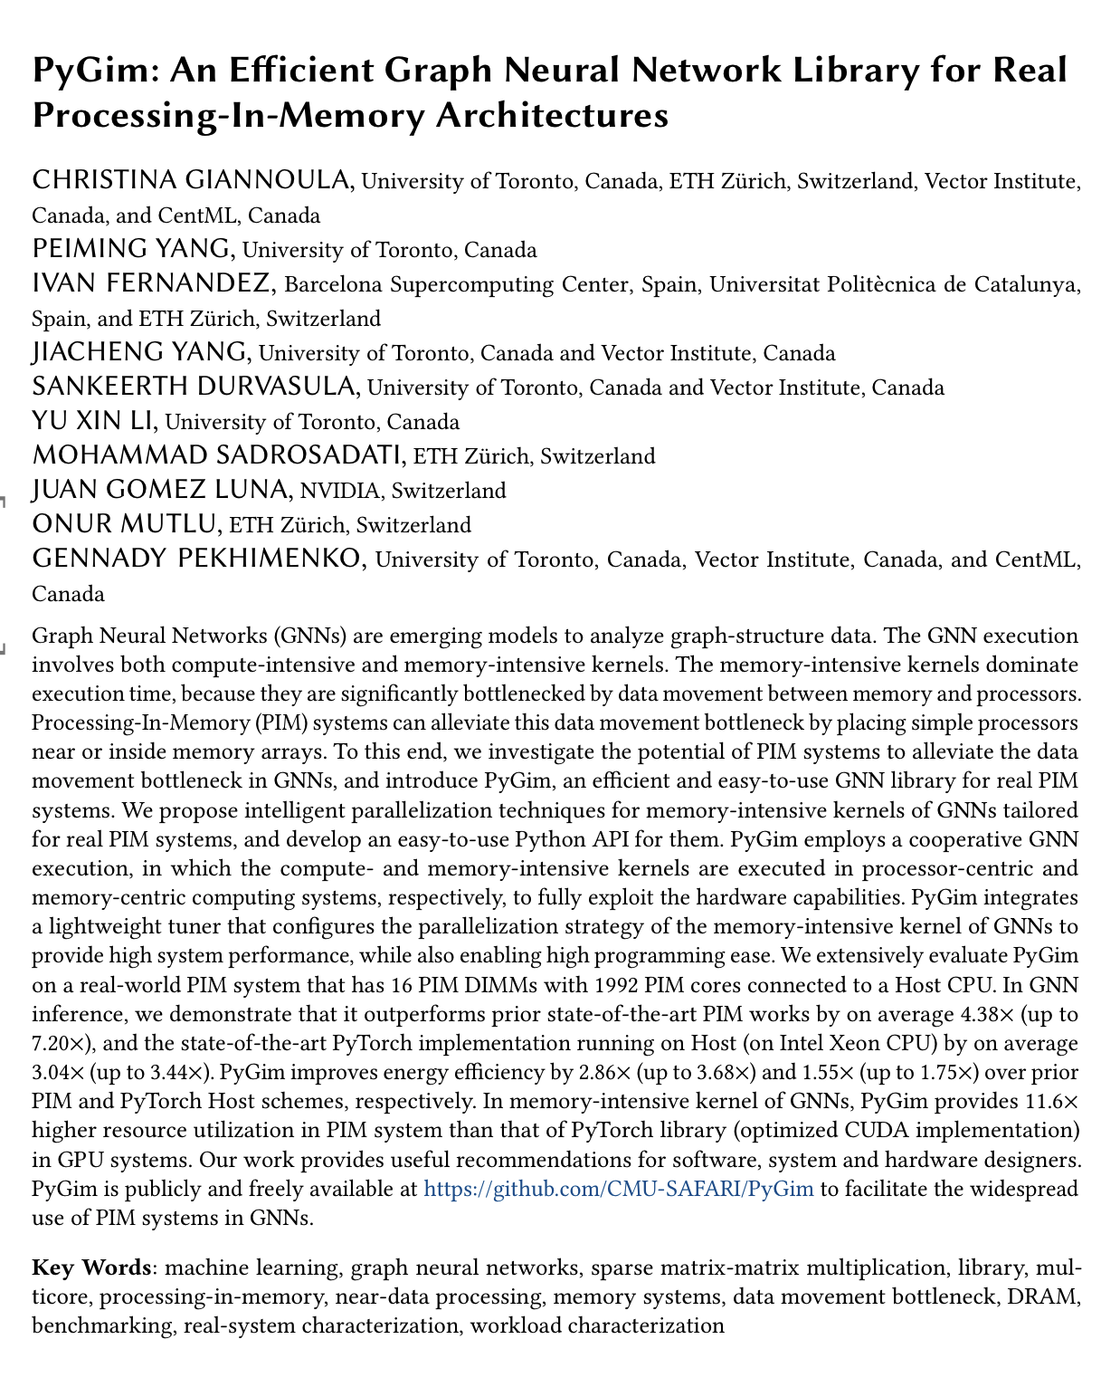
More in the Paper
Analysis within a PIM core
Analysis within a PIM cluster
Analysis across PIM clusters
PyGim tuning efficiency
Scalability analysis
Analysis on different data types
Analysis on different compression formats
Performance evaluation in GNN training
Recommendations
https://arxiv.org/pdf/2402.16731

Slide 42


Conclusion
We present PyGim, a handy ML library that significantly improves performance, energy efficiency and cost effectiveness in GNNs through real PIM devices
PyGim
Key Ideas & Benefits:
balances computation and data transfer costs via configurable parallelization strategies for diverse real-world graphs
automatically tunes the best-fit strategy without programmer intervention
Key Results:
performance and energy efficiency by 3.7× and 2.3× over SOTA schemes
core utilization on PIM system by 11.6× over PyTorch on GPUs

Slide 43
PyGim: An Efficient Graph Neural Network Library for Real Processing-In-Memory Architectures
Christina Giannoula, Peiming Yang, Ivan Fernandez, Jiacheng Yang, Sankeerth Durvasula, Yu Xin Li, Mohammad Sadrosadati, Juan Gomez Luna, Onur Mutlu, Gennady Pekhimenko

