Slide 1





SparseP
Towards Efficient Sparse Matrix Vector Multiplication
on Real Processing-In-Memory Architectures
Christina Giannoula
Ivan Fernandez, Juan Gomez-Luna,
Nectarios Koziris, Georgios Goumas, Onur Mutlu

Slide 2
Our Work
Efficient Algorithmic Designs
The first open-source Sparse Matrix Vector Multiplication (SpMV) software package, SparseP, for real Processing-In-Memory (PIM) systems
Extensive Characterization
The first comprehensive analysis of SpMV on the first real commercial PIM architecture
SparseP is Open-Source
SparseP: https://github.com/CMU-SAFARI/SparseP
Recommendations for Architects and Programmers
Full Paper: https://arxiv.org/pdf/2201.05072.pdf

Slide 3
Sparse Matrix Vector Multiplication
Sparse Matrix Vector Multiplication (SpMV):
Widely-used kernel in graph processing, machine learning, scientific computing …
A highly memory-bound kernel
Roofline Model
Peak Compute Performance
Performance
Peak Memory Bandwidth
SpMV
Operational Intensity

Slide 4
Real Processing-In-Memory Systems
Real Near-Bank Processing-In-Memory (PIM) Systems:
High levels of parallelism
Low memory access latency
Large aggregate memory bandwidth
Host CPU
Main Memory
PIM-Enabled Memory
PIM-Enabled Memory
PIM-Enabled Memory
Bus
DRAM Bank
DRAM Bank
DRAM Bank
DRAM Bank
PIM-Enabled Memory
PIM-Enabled Memory
PIM-Enabled Memory
PIM Core
PIM Core
PIM Core
PIM Core
PIM-Enabled Memory
Bus
DRAM Bank
DRAM Bank
DRAM Bank
DRAM Bank

Slide 5
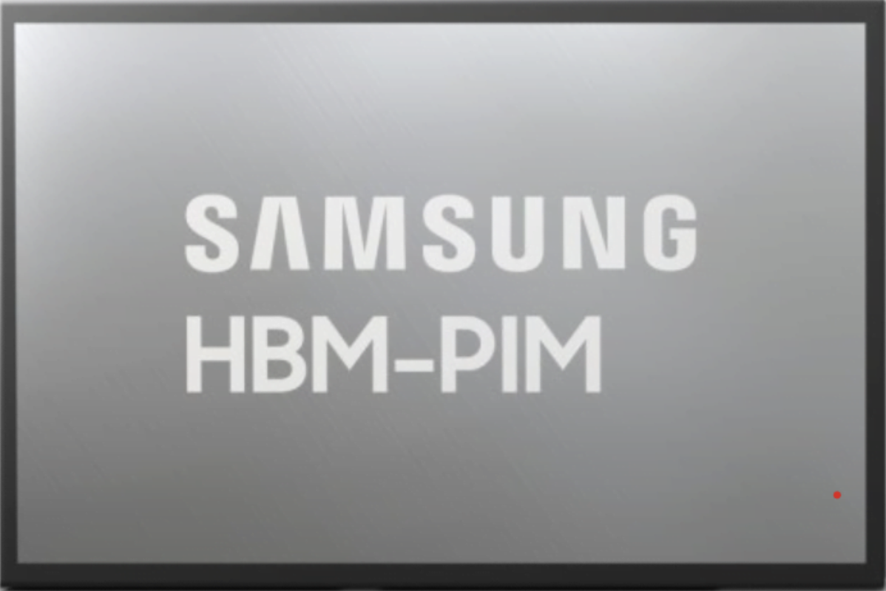
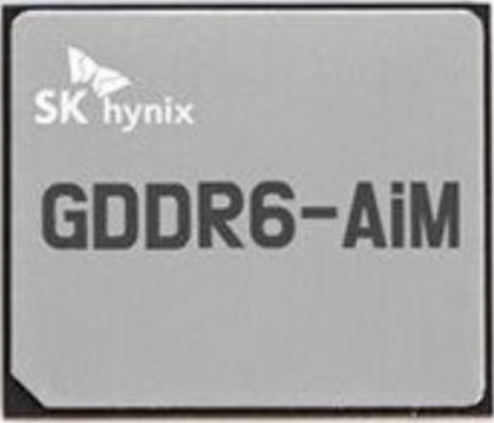
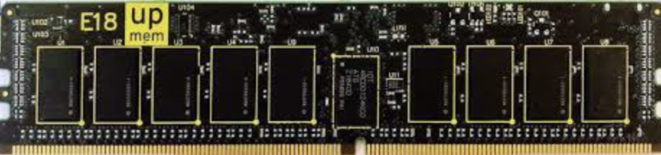
Real Processing-In-Memory Systems
Real Near-Bank Processing-In-Memory (PIM) Systems:
High levels of parallelism
Low memory access latency
Large aggregate memory bandwidth
Host CPU
Main Memory
PIM-Enabled Memory
Lee+, [ISSCC 2022]
Kwon+, [ISSCC 2021]
PIM-Enabled Memory
PIM-Enabled Memory
Bus
DRAM Bank
DRAM Bank
DRAM Bank
DRAM Bank
https://www.upmem.com
PIM-Enabled Memory
PIM-Enabled Memory
PIM-Enabled Memory
PIM Core
PIM Core
PIM Core
PIM Core
PIM-Enabled Memory
Bus
DRAM Bank
DRAM Bank
DRAM Bank
DRAM Bank

Slide 6

SparseP: SpMV Library for Real PIMs
Our Contributions:
Design efficient SpMV kernels for current and future PIM systems
25 SpMV kernels
4 compressed matrix formats (CSR, COO, BCSR, BCOO)
6 data types
4 data partitioning techniques
Various load balancing schemes among PIM cores/threads
3 synchronization approaches
Provide a comprehensive analysis of SpMV on the first commercially-available real PIM system
26 sparse matrices
Comparisons to state-of-the-art CPU and GPU systems
Recommendations for software, system and hardware designers

Slide 7
Outline
SpMV Kernels for Real PIM Systems
Key Takeaways from Our Study
Conclusion

Slide 8
SpMV Execution on a PIM System
1
2
3
4
Load the
input vector
Execute the kernel
Retrieve the
partial results
Merge the
partial results
PIM-Enabled Memory
Host CPU
Main Memory
PIM Core
PIM Core
PIM Core
DRAM Bank
DRAM Bank
bus
DRAM Bank
DRAM Bank
DRAM Bank
bus
+

Slide 9
Data Partitioning Techniques
SparseP supports two types of data partitioning techniques:
1D Partitioning
2D Partitioning
Core 1
Core 1
Core 2
Core 2
=
*
=
4x input vector
1x output vector
*
2x output vector
Core 3
2x input vector
Core 4
Core 3
Core 4
perform the complete
SpMV computation
only on PIM cores
trade-off
computation vs
data transfer costs

Slide 10
1D Partitioning Technique
Load-Balancing Approaches:
CSR, COO:
Balance Rows
Balance NNZs *
BCSR, BCOO:
Balance Blocks ^
Balance NNZs ^
* row-granularity for CSR
^ block-row-granularity for BCSR

Slide 11
1D Partitioning Technique
Load-Balancing of #NNZs:
CSR (row-granularity), COO
CSR
COO
row-
granularity
nnz-
granularity
Core 1
Core 1
Core 2
Core 2
Core 3
Core 3
row-order
nnz-order
rowptr
0
1
3
5
7
7
8
8
9
rowind
0
1
1
2
2
3
3
5
7
colind
0
2
5
3
5
3
6
4
4
colind
0
2
5
3
5
3
6
4
4
values
2
1
8
3
6
9
3
4
7
values
2
1
8
3
6
9
3
4
7

Slide 12
1D Partitioning Technique
Load-Balancing of #NNZs:
CSR (row-granularity), COO
BCSR (block-row-granularity), BCOO
ΒCSR
ΒCOO
block-row-
granularity
block-
granularity
Core 1
Core 1
Core 2
Core 2
Core 3
Core 3
block-row-order
block-order
rowptr
0
1
3
5
7
7
8
8
9
rowind
0
1
1
2
2
3
3
5
7
colind
0
2
5
3
5
3
6
4
4
colind
0
2
5
3
5
3
6
4
4
values
2
1
8
3
6
9
3
4
7
values
2
1
8
3
6
9
3
4
7

Slide 13
2D Partitioning Technique
Equally-Sized Tiles
Equally-Wide Tiles
Variable-Sized Tiles
input vector
input vector
input vector
2x
2x
2x
4x
4x
4x
4x
3x
5x
Core 1
Core 3
Core 3
Core 1
Core 1
Core 3
+
+
+
Core 4
Core 2
Core 2
Core 4
Core 2
Core 4
output vector
output vector
output vector
High NNZ imbalance
across PIM cores
High NNZ balance across PIM cores of the same vertical partition
High NNZ balance
across all PIM cores

Slide 14
Load-Balance across Threads
Multithreaded PIM Cores:
1D Partitioning
2D Partitioning
Core 1
Multithreaded
PIM Core
Core 1
Core 2
Core 2
Core 3
DRAM
Bank
Core 3
Core 4
Core 4
Balance #Rows
Balance #Rows
Thread 1
Thread 1
Thread 2
Thread 2
Various load-balance schemes across threads

Slide 15
Load-Balance across Threads
Multithreaded PIM Cores:
1D Partitioning
2D Partitioning
Core 1
Multithreaded
PIM Core
Core 1
Core 2
Core 2
Core 3
DRAM
Bank
Core 3
Core 4
Core 4
Balance #NNZs
Balance #NNZs
(e.g., COO format)
Thread 1
Thread 1
Thread 2
Thread 2
Various load-balance schemes across threads

Slide 16

Load-Balance across Threads
Multithreaded PIM Cores:
1D Partitioning
2D Partitioning
Core 1
Multithreaded
PIM Core
Core 1
Core 2
Core 2
Core 3
DRAM
Bank
Core 3
Core 4
Core 4
Balance #NNZs
Balance #NNZs
(e.g., COO format)
Thread 1
Thread 1
Thread 2
Thread 2
Various load-balance schemes across threads
Various synchronization approaches among threads

Slide 17
Synchronization Approaches
Multithreaded
PIM Core
Multithreaded PIM Core:
DRAM Bank
Coarse-Grained (lb-cg)
Fine-Grained (lb-fg)
Thread 1
Thread 1
Thread 2
=
Thread 2
=
output vector
output vector
Thread 3
Thread 3
Lock-Free (lf)
partial results
Thread 1
+
=
+
=
Thread 2
Thread 1
output vector
Thread 3

Slide 18
SparseP Software Package
25 SpMV kernels for PIM Systems →
https://github.com/CMU-SAFARI/SparseP
Partitioning | Matrix Format | Load-Balancing
9x 1D Kernels | CSR | rows, nnzs *
 | COO▵ | rows, nnzs *, nnzs
 | BCSR | blocks ^, nnzs ^
 | BCOO▵ | blocks, nnzs
4x 2D Equally-Sized Tiles | CSR | --
 | COO▵ | --
 | BCSR | --
 | BCOO▵ | --
6x 2D Equally-Wide Tiles | CSR | nnzs *
 | COO▵ | nnzs
 | BCSR | blocks ^, nnzs ^
 | BCOO▵ | blocks, nnzs
6x 2D Variable-Sized Tiles | CSR | nnzs *
 | COO▵ | nnzs
 | BCSR | blocks ^, nnzs ^
 | BCOO▵ | blocks, nnz
Load-balance
across PIM cores/threads:
* row-granularity (CSR)
^ block-row-granularity (BCSR)
Synchronization
among threads of a PIM core:
▵ lb-cg, lb-fb, lf (COO, BCOO)
Data Types:
8-bit integer
16-bit integer
32-bit integer
64-bit integer
32-bit float
64-bit float

Slide 19
Outline
SpMV Kernels for Real PIM Systems
Key Takeaways from Our Study
Conclusion

Slide 20
UPMEM-based PIM System
20 UPMEM PIM DIMMs with 2560 PIM cores in total
Each multithreaded PIM core supports 24 threads
Host CPU
(2-socket,
Intel Xeon)
128 GB Main Memory
PIM-Enabled Memory
PIM-Enabled Memory
PIM-Enabled Memory
Bus
DRAM Bank
DRAM Bank
DRAM Bank
DRAM Bank
160 GB PIM-Enabled Memory
PIM-Enabled Memory
PIM-Enabled Memory
PIM Core
PIM Core
PIM Core
PIM Core
PIM-Enabled Memory
Bus
DRAM Bank
DRAM Bank
DRAM Bank
DRAM Bank
DISPATCH
24 KB
Instr. Mem.
64
bits
64 MB
DRAM
Bank
24x
threads
14-stage
Pipeline
FETCH
DMA Engine
ALU
64 KB
Data Mem.
MERGE

Slide 21
Sparse Matrix Data Set
26 sparse matrices*:
Diverse sparsity patterns
Variability on irregular patterns
Variability on block patterns
Regular Matrix
Scale-Free Matrix
* Suite Sparse Matrix Collection: https://sparse.tamu.edu/

Slide 22
Kernel Execution on One PIM Core
1
2
3
4
Load the
input vector
Execute the kernel
Retrieve the
partial results
Merge the
partial results
PIM-Enabled Memory
Host CPU
Main Memory
PIM Core
PIM Core
PIM Core
DRAM Bank
DRAM Bank
bus
DRAM Bank
DRAM Bank
DRAM Bank
bus
+

Slide 23
Lock-Based Synchronization
16 threads, COO, 32-bit integer
UPMEM DRAM bank
Multithreaded
PIM Core
64
bits
DRAM
Bank
DMA Engine
Fine-grained locking (lb-fg)
does not improve performance over coarse-grained locking (lb-cg)
Fine-Grained Locking: memory accesses to the local DRAM bank are serialized in the DMA engine of the UPEM PIM hardware.

Slide 24
Lock-Based Synchronization
16 threads, COO, 32-bit integer
UPMEM DRAM bank
Fine-grained locking approaches cannot improve performance over coarse-grained locking, when the PIM hardware does not support concurrent accesses to the local DRAM bank.
Key Takeaway 1
Multithreaded
PIM Core
64
bits
DRAM
Bank
DMA Engine
Provide low-cost synchronization support and hardware support to enable concurrent memory accesses to the local DRAM bank, and integrate multiple DRAM banks per PIM core to increase execution parallelism.
Recommendation 1

Slide 25
Load-Balance within a PIM Core
16 threads, 32-bit integer
Load-balancing #NNZs
performs best in most matrices
Load-balancing #NNZ typically provides high computation balance across threads of a compute-limited PIM core

Slide 26
Load-Balance within a PIM Core
16 threads, 32-bit integer
Load-balancing #NNZs
causes high row imbalance
Load-balancing #NNZs: one single thread performs a much higher #memory accesses and #synchronization operations than the rest

Slide 27
Load-Balance within a PIM Core
16 threads, 32-bit integer
High operation imbalance in computation, synchronization, or memory instructions executed by multiple threads of a PIM core can cause high performance overhead.
Key Takeaway 2
Design algorithms that provide high load balance across threads of PIM core in terms of computations, synchronization points and memory accesses.
Recommendation 2

Slide 28
Scalability within a PIM Core
32-bit integer
Scalability increases up to 16 threads

Slide 29
Kernel Execution on Multiple PIM Cores
1
2
3
4
Load the
input vector
Execute the kernel
Retrieve the
partial results
Merge the
partial results
PIM-Enabled Memory
Host CPU
Main Memory
PIM Core
PIM Core
PIM Core
DRAM Bank
DRAM Bank
bus
DRAM Bank
DRAM Bank
DRAM Bank
bus
+

Slide 30
Comparison of Compressed Formats
2048 PIM Cores, 32-bit integer
1D
6.86x
Scale-free: COO, BCOO →
10.26x CSR, BCSR
13.66x
CSR
(row-granularity)
COO
Core 1
Core 1
Core 2
Core 2
In scale-free matrices, COO + BCOO provide higher non-zero element balance across PIM cores than CSR + BCSR, respectively.

Slide 31
Comparison of Compressed Formats
2048 PIM Cores, 32-bit integer
2D Equally-Sized Tiles
Core 1
Core 3
Scale-free:
COO, BCOO →
1.39x CSR, BCSR
1.23x
Core 2
Core 4
1.55x
Thread 1
Thread 1
Thread 2
Thread 2
CSR
(row-granularity)
COO
In scale-free matrices, COO + BCOO provide higher non-zero element balance across threads than CSR + BCSR, respectively.

Slide 32
Comparison of Compressed Formats
2048 PIM Cores, 32-bit integer
COO, BCOO → 32.38x CSR, BCSR
44x
46x
42x
40x
22x
24x
20x
21x
COO + BCOO formats provide higher non-zero element balance across PIM cores + threads than CSR + BCSR, respectively.

Slide 33
Comparison of Compressed Formats
2048 PIM Cores, 32-bit integer
The compressed matrix format used to store the input matrix determines the data partitioning across DRAM banks of PIM-enabled memory. As a result, it affects the load-balance across PIM cores (and threads of a PIM core) with corresponding performance implications.
Key Takeaway 3
Design compressed data structures that can be effectively partitioned across DRAM banks, with the goal of providing high computation balance across PIM cores (and threads of a PIM core).
Recommendation 3

Slide 34
End-to-End Performance
1
2
3
4
Load the
input vector
Execute the kernel
Retrieve the
partial results
Merge the
partial results
PIM-Enabled Memory
Host CPU
Main Memory
PIM Core
PIM Core
PIM Core
DRAM Bank
DRAM Bank
bus
DRAM Bank
DRAM Bank
DRAM Bank
bus
+

Slide 35
Scalability
The scalability is limited by the load time
COO format, 32-bit integer
1D
2D
Equally-Sized
2D
Equally-Wide
2D
Variable-Sized
#PIM Cores
#PIM Cores
#PIM Cores
#PIM Cores
1D: #bytes to load the input vector grows linearly to #PIM cores

Slide 36
Scalability
COO format, 32-bit integer
2D
Equally-Sized
2D
Equally-Wide
2D
Variable-Sized
The 1D-partitioned kernels are severely bottlenecked by the high data transfer costs to broadcast the whole input vector into DRAM banks of all PIM cores, through the narrow off-chip memory bus.
Key Takeaway 4
1D
Optimize the broadcast collective collective in data transfers to PIM-enabled memory to efficiently copy the input data into DRAM banks in the PIM system.
Recommendation 4
#PIM Cores
#PIM Cores
#PIM Cores
#PIM Cores

Slide 37
Scalability
The scalability is limited by the kernel time
COO format, 32-bit integer
1D
2D
Equally-Sized
2D
Equally-Wide
2D
Variable-Sized
#PIM Cores
#PIM Cores
#PIM Cores
#PIM Cores
2D Equally-Sized: kernel time is limited by only
a few PIM cores assigned to the 2D tiles with the largest #NNZs

Slide 38
Scalability
The scalability is limited by the retrieve time
COO format, 32-bit integer
1D
2D
Equally-Sized
2D
Equally-Wide
2D
Variable-Sized
> 88% of data is zeros
#PIM Cores
#PIM Cores
#PIM Cores
#PIM Cores
2D Equally-Wide + 2D Variable-Sized:
high amount of zero padding to gather the output vector →
parallel transfers supported at rank granularity = 64 PIM cores

Slide 39
Scalability
COO format, 32-bit integer
2D
Equally-Sized
2D
Equally-Wide
2D
Variable-Sized
The 2D equally-wide and variable-sized kernels need fine-grained parallel data transfers at DRAM bank granularity (zero padding) to be supported by the PIM system to achieve high performance.
Key Takeaway 5
1D
88.6%
88.0%
Optimize the gather collective operation at DRAM bank granularity in data transfers from PIM-enabled memory to efficiently retrieve the output results to the host CPU.
Recommendation 5
#PIM Cores
#PIM Cores
#PIM Cores
#PIM Cores

Slide 40
Comparison of Sparse Matrices
COO format, 32-bit integer
hugetric-00202
ldoor
Best-performing = 64 PIM cores
Best-performing = 128 PIM cores
1D: #PIM cores that provides the best performance
depends on the sparsity pattern of the input matrix

Slide 41
Comparison of Sparse Matrices
2048 PIM cores, COO format, 32-bit integer
Best-performing = 16 vertical part.
Best-performing = 8 vertical part.
2D: #vertical partitions that provides the best performance
depends on the sparsity pattern of the input matrix

Slide 42
Comparison of PIM Systems
COO format, 32-bit integer
PIM System A
hugetric-00202
PIM System B
hugetric-00202
Best-performing = 8 vertical part.
Best-performing = 16 vertical part.
System | PIM Cores | PIM Band. | Host CPU | Bus Band.
PIM A | 2048 @350 MHz | 1.43 TB/s | Intel Xeon Silver 4110 @2.1 GHz | 23.1 GB/s
PIM B | 2048 @425 MHz | 1.78 TB/s | Intel Xeon Silver 4215 @2.5 GHz | 21.8 GB/s

Slide 43
Comparison of PIM Systems
COO format, 32-bit integer
PIM System A
hugetric-00202
PIM System B
hugetric-00202
Best-performing = 8 vertical part.
Best-performing = 16 vertical part.
2D: #vertical partitions that provides the best performance
depends on the underlying hardware characteristics

Slide 44
Various Matrices and PIM Systems
COO format, 32-bit integer
There is no one-size-fits-all parallelization approach for SpMV, since the performance of each scheme depends on the characteristics of the input matrix and the underlying PIM hardware.
Key Takeaway 6
hugetric-00202
ldoor
`PIM System A
`PIM System B
Design adaptive algorithm that tune their configuration to the particular patterns of each input given and the characteristics of the PIM hardware.
Recommendation 6
#Vertical Partitions
#Vertical Partitions

Slide 45
1D vs 2D
Up to 2528 PIM Cores, 32-bit float
>1100 Idle Cores
>2200 Idle Cores
1.31x
1.45x
regular
scale-free
Best-performing SpMV execution:
trades off computation with lower data transfer costs

Slide 46
1D vs 2D
2528 PIM Cores, 32-bit float
Expensive data transfers to/from PIM-enabled memory performed via the narrow memory bus impose significant performance overhead to end-to-end SpMV execution. Thus, it is hard to fully exploit all available PIM cores of the system.
Key Takeaway 7
1329 Cores
253 Cores
1.31x
1.45x
Design high-speed communication channels and optimized libraries in data transfers to/from PIM-enabled memory, provide hardware support to effectively overlap computation with data transfers in the PIM system, and/or integrate PIM-enabled memory as the main memory of the system.
Recommendation 7
regular
scale-free

Slide 47
SpMV Execution on Various Systems
GPU System
CPU System
2
Execute the kernel
1
Execute the kernel
Load the
input vector
GPU Cores
Retrieve
the final vector
1
3
Host CPU
Main Memory
bus
DRAM Bank
DRAM Bank
Main Memory
GPU Global Memory
Host CPU
bus
DRAM Bank
DRAM Bank
DRAM Bank
DRAM Bank
SMX2
SMX2
Real PIM
System
1
2
3
4
Load the
input vector
Execute
the kernel
Retrieve the
partial results
Merge the
partial results
PIM-Enabled Memory
Main Memory
PIM Core
PIM Core
PIM Core
Host CPU
DRAM Bank
DRAM Bank
DRAM Bank
DRAM Bank
DRAM Bank
+
bus
bus

Slide 48
CPU/GPU Comparisons
System | Cores | Peak Performance | Bandwidth | TDP
CPU | Intel Xeon Silver 4110 | 660 GFlops | 23.1 GB/s | 2x85 W
GPU | NVIDIA Tesla V100 | 14.13 TFlops | 897 GB/s | 300 W
PIM | UPMEM 1st Gen. | 4.66 GFlops | 1.77 TB/s | 379 W
Processor-
Centric
Memory-Centric

Slide 49
CPU/GPU Comparisons
Kernel-Only (COO, 32-bit float):
CPU = 0.51% of Peak Perf.
GPU = 0.21% of Peak Perf.
PIM (1D) = 50.7% of Peak Perf.
System | Cores | Peak Performance | Bandwidth | TDP
CPU | Intel Xeon Silver 4110 | 660 GFlops | 23.1 GB/s | 2x85 W
GPU | NVIDIA Tesla V100 | 14.13 TFlops | 897 GB/s | 300 W
PIM | UPMEM 1st Gen. | 4.66 GFlops | 1.77 TB/s | 379 W
Processor-
Centric
Memory-Centric

Slide 50
CPU/GPU Comparisons
Kernel-Only (COO, 32-bit float):
CPU = 0.51% of Peak Perf.
GPU = 0.21% of Peak Perf.
PIM (1D) = 50.7% of Peak Perf.
End-to-End (COO, 32-bit float):
CPU = 4.08 GFlop/s
GPU = 1.92 GFlop/s
PIM (1D) = 0.11 GFlop/s
System | Cores | Peak Performance | Bandwidth | TDP
CPU | Intel Xeon Silver 4110 | 660 GFlops | 23.1 GB/s | 2x85 W
GPU | NVIDIA Tesla V100 | 14.13 TFlops | 897 GB/s | 300 W
PIM | UPMEM 1st Gen. | 4.66 GFlops | 1.77 TB/s | 379 W
Processor-
Centric
Memory-Centric

Slide 51
CPU/GPU Comparisons
Kernel-Energy (COO, 32-bit float):
CPU = 0.247 J
GPU = 0.051 J
PIM (1D) = 0.179 J
PIM: 1.38x higher energy efficiency over CPU
System | Cores | Peak Performance | Bandwidth | TDP
CPU | Intel Xeon Silver 4110 | 660 GFlops | 23.1 GB/s | 2x85 W
GPU | NVIDIA Tesla V100 | 14.13 TFlops | 897 GB/s | 300 W
PIM | UPMEM 1st Gen. | 4.66 GFlops | 1.77 TB/s | 379 W
Processor-
Centric
Memory-Centric

Slide 52
CPU/GPU Comparisons
Kernel-Energy (COO, 32-bit float):
CPU = 0.247 J
GPU = 0.051 J
PIM (1D) = 0.179 J
System | Cores | Peak Performance | Bandwidth | TDP
CPU | Intel Xeon Silver 4110 | 660 GFlops | 23.1 GB/s | 2x85 W
GPU | NVIDIA Tesla V100 | 14.13 TFlops | 897 GB/s | 300 W
PIM | UPMEM 1st Gen. | 4.66 GFlops | 1.77 TB/s | 379 W
Many more results in the full paper: https://arxiv.org/pdf/2201.05072.pdf
Processor-
Centric
Memory-Centric

Slide 53
Outline
SpMV Kernels for Real PIM Systems
Key Takeaways from Our Study
Conclusion

Slide 54
Conclusion
SpMV is a fundamental linear algebra kernel for important applications (HPC, machine learning, graph analytics… )
SpMV is a highly memory-bound kernel in processor-centric systems (e.g., CPU and GPU systems)
Real near-bank PIM systems can tackle the data movement bottleneck (high parallelism, large aggregate memory bandwidth)
Key Contributions:
SparseP : first open-source SpMV library for real PIM systems
Comprehensive characterization and analysis of SPMV on the first real PIM system
Recommendations to improve multiple aspects of future PIM hardware and software
SparseP: https://github.com/CMU-SAFARI/SparseP
Full Paper: https://arxiv.org/pdf/2201.05072.pdf
Our Work

Slide 55
SparseP
Towards Efficient Sparse Matrix Vector Multiplication
on Real Processing-In-Memory Architectures
Christina Giannoula
Ivan Fernandez, Juan Gomez-Luna,
Nectarios Koziris, Georgios Goumas, Onur Mutlu

