Slide 1
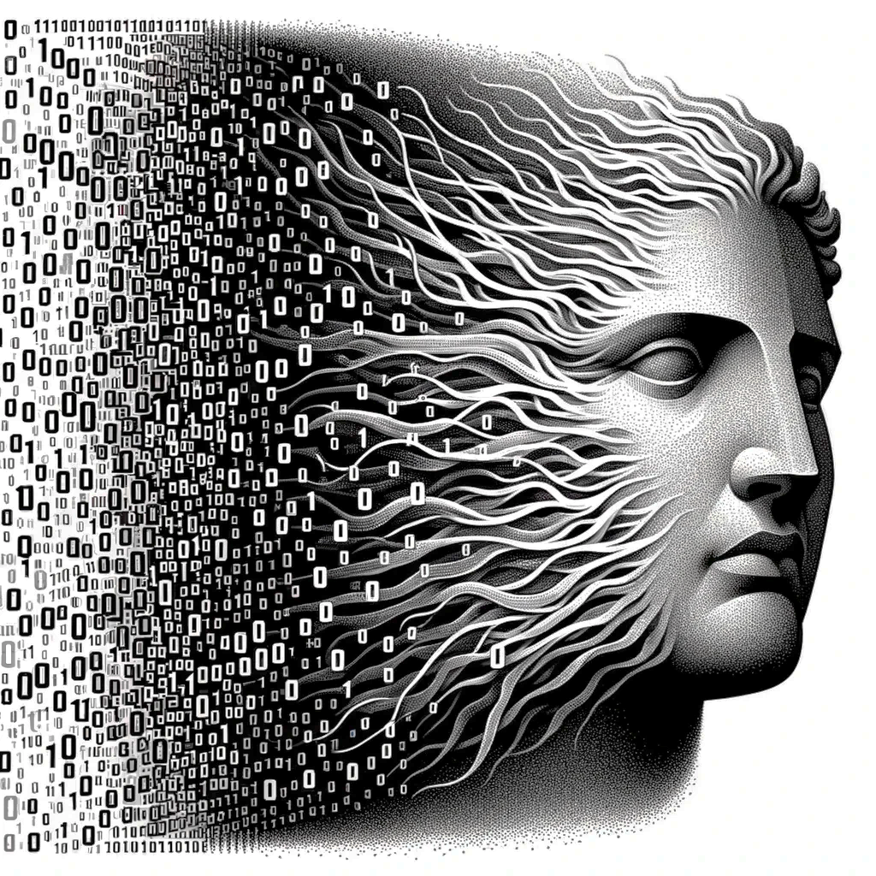





Atalanta: A Bit is Worth a “Thousand” Tensor Values
Alberto Delmas Lascorz, Mostafa Mahmoud, Ali Hadi Zadeh, Miloš Nikolić, Kareem Ibrahim, Christina Giannoula,
Ameer Abdelhadi, Andreas Moshovos
2024
Notes:
- Hi I am Christina and I will briefly introduce our work
- Atalanta. [CLICK]

Slide 2
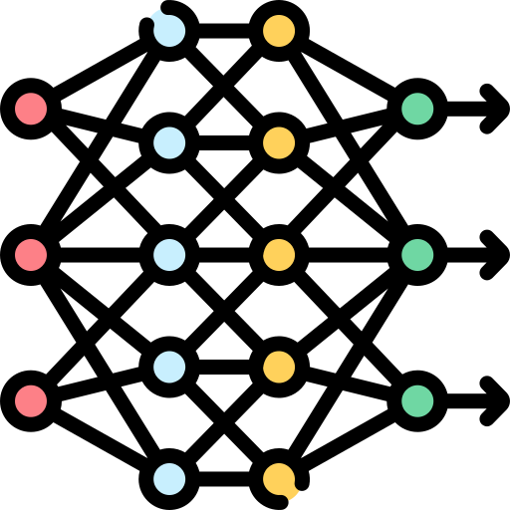

Growing Memory Footprint of Deep Learning Models
Cores
bottleneck
Off-Chip
Memory
Data
1 0 0 1 0 1 0 1 1 1 0 0
0 1 1 0 0 0 1 0 1 0 0 1
1 1 0 0 1 0 0 1 1 0 0 0
1 0 0 1 1 0 1 0 1 0 0 1
GPU
E.g., Llama2: 7B Params, 26GB Mem
Key Limitation:
Expensive Tensor Data Accesses from Off-Chip Memory
Notes:
- Nowadays,the memory footprint of state-of-the-art deep learning (DL) models has been rapidly increasing.
- As a result, the energy efficiency and execution performance of DL models is primarily limited by accesses to tensor data that resides in off-die memory modules. [CLICK]

Slide 3
Atalanta: Overview
Cores
Off-Chip
Memory
Data
1 0 0 1 0 1 0 1 1 0 1 1 0 0
GPU
E.g., Llama2: 7B Params, 26GB Mem
Atalanta:
A Near-Optimal Compression Engine for Deep Learning Models
Notes:
- To tackle this key limitation we propose Atalanta.
- a near-optimal, practical, hardware/software compression engine that significantly reduces the amount of data transferred between off-chip memory and processors. [CLICK]

Slide 4
Atalanta: Brief Overview
Frequent values need less than 1 bit
Arithmetic Coding [Langdon, 1984]
Cores
< 1 bit
Off-Chip Memory
Data
1 0 0 1 0 1 0 1 1 1 0 0
0 1 1 0 0 0 1 0 1 0 0 1
1 1 0 0 1 0 0 1 1 0 0 0
1 0 0 1 1 0 1 0 1 0 0 1
Notes:
- Atalanta is inspired by Arithmetic Coding and our software compression strategy can encode frequent repeated data values using less than one bit. [CLICK]

Slide 5
Atalanta: Brief Overview
Frequent values need less than 1 bit
Arithmetic Coding [Langdon, 1984]
Low Hardware Costs
Cores
Compr. Unit
Compr. Unit
Compr. Unit
< 50 bytes
Off-Chip Memory
Data
1 0 0 1 0 1 0 1 1 1 0 0
0 1 1 0 0 0 1 0 1 0 0 1
1 1 0 0 1 0 0 1 1 0 0 0
1 0 0 1 1 0 1 0 1 0 0 1
Notes:
- Our proposed compression units located just before the off-die memory controller,
have low power and area costs, each of them needs less than 50 bytes. [CLICK]

Slide 6



Atalanta: Brief Overview
Frequent values need less than 1 bit
Arithmetic Coding [Langdon, 1984]
Low Hardware Costs
Programmer Transparent
Lossless
Inference + Training (forward pass)
Cores
Compr. Unit
Compr. Unit
Compr. Unit
Off-Chip Memory
Transformers
Vision
Image
Classification
Notes:
- Atalanta requres no modifications to Deep Learning Models
- is loseless in terms of accuracy
- and can be used for both inference and the forward pass of training. [CLICK]

Slide 7
Atalanta: Brief Overview
Frequent values need less than 1 bit
Arithmetic Coding [Langdon, 1984]
Low Hardware Costs
Programmer Transparent
Lossless
Inference + Training (forward pass)
High Compression Rate
Cores
Compr. Unit
Compr. Unit
Compr. Unit
Weights: 60% on average
Activations: 48% on average
Off-Chip Memory
Transformers
Vision
Image
Classification
Notes:
- Across a wide range of Deep Learning models including GPT2 and Llama2 models
- Atalanta reduces data footprint of weights to 60%, and activations to 48% on average. [CLICK]

Slide 8
Atalanta: Brief Overview
Frequent values need less than 1 bit
Arithmetic Coding [Langdon, 1984]
Low Hardware Costs
Programmer Transparent
Lossless
Inference + Training (forward pass)
High Compression Rate
High Energy Efficiency
Cores
Compr. Unit
Compr. Unit
Compr. Unit
Off-Chip Memory
Transformers
Vision
Image
Classification
Notes:
- Atalanta provides high energy efficiency. [CLICK]

Slide 9
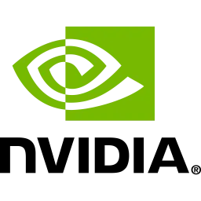
Atalanta: Brief Overview
Frequent values need less than 1 bit
Arithmetic Coding [Langdon, 1984]
Low Hardware Costs
Programmer Transparent
Lossless
Inference + Training (forward pass)
High Compression Rate
High Energy Efficiency
Seamlessly Integrated with AI Accelerators
Tensor Cores
Compr. Unit
Compr. Unit
Compr. Unit
Performance: 1.44x
Energy Efficiency: 1.37x
Off-Chip Memory
Transformers
Vision
Image
Classification
Notes:
- Finally, Atalanta can be easily integrated with DL accelerators at low cost.
- When integrated with a Tensorcore-based accelerator, Atalanta significantly improves performance and energy efficiency. [CLICK]

Slide 10
Atalanta: A Bit is Worth a “Thousand” Tensor Values
Alberto Delmas Lascorz, Mostafa Mahmoud, Ali Hadi Zadeh, Miloš Nikolić, Kareem Ibrahim, Christina Giannoula,
Ameer Abdelhadi, Andreas Moshovos
2024
Notes:
- Please attend our talk at ASPLOS 2024. Thank you.

