Slide 1




NATSA A Near-Data Processing Accelerator for Time Series Analysis
Ivan Fernandez, Ricardo Quislant, Christina Giannoula,
Mohammed Alser, Juan Gomez-Luna, Eladio Gutierrez,
Oscar Plata, Onur Mutlu
International Conference on Computer Design, ICCD 2020
Monday October 19, 11:50 am ET
Session 1A – Novel Architectures

Slide 2
Executive Summary
Problem: time series analysis is bottlenecked by data movement in conventional hardware platforms
Goal: enable high-performance and energy-efficient time series analysis for a wide range of applications
Contributions: first near-data processing accelerator for time series analysis based on matrix profile algo.
NATSA Evaluations:
NATSA provides up to 14.2x higher performance and consumes up to 27.2x less energy than a DDR4 platform with 8 OoO cores
NATSA outperforms an HBM-NDP platform with 64 in-order cores by 6.3x while consuming 10.2x less energy

Slide 3
Talk Outline
Motivation
NATSA Design
NATSA Evaluation
Conclusions

Slide 4
Talk Outline
Motivation
NATSA Design
NATSA Evaluation
Conclusions

Slide 5
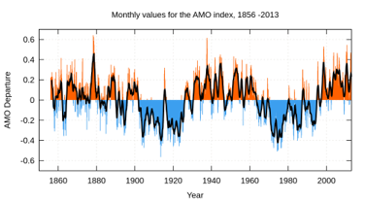
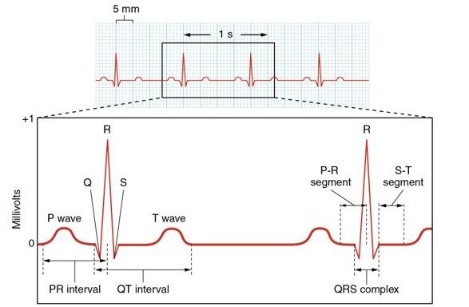
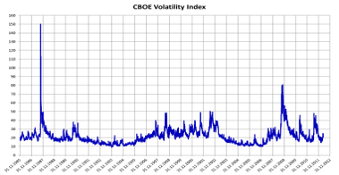
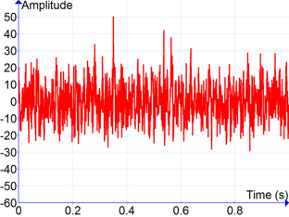
Time Series Analysis
Time series analysis has many applications
Climate change [1]
Medicine [2]
Economics [3]
Signal processing [4]
[1] M. Saker et al. “Exploring the relationship between climate change and rice yield in Bangladesh: An analysis of time series data”. Agr. Sys, 2012
[2] CK Peng et al. “Quantification of scaling exponents and crossover phenomena in nonstationary heartbeat time series”. Chaos, 1995
[3] Clive Granger and Paul Newbold. “Forecasting economic time series”, Academic Press, 2014
[4] O. Rioul and M. Vetterly. “Wavelets and signal processing”. IEEE signal processing magazine, 1991

Slide 6
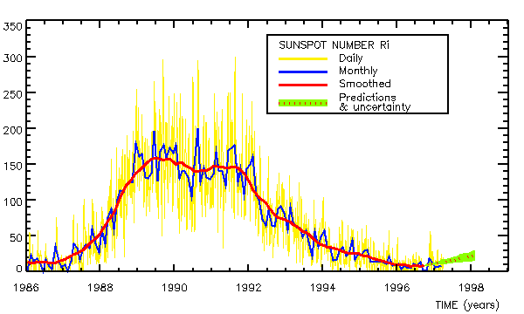
Time Series Analysis
Time series analysis has many applications
… and more [6]!
Astronomy [5]
[5] Vio, R., et al. "Time series analysis in astronomy-an application to quasar variability studies." The Astrophysical Journal, 1992
[6] Shumway, R. and D. Stoffer. “Time series analysis and its applications: with R examples”. Springer, 2017

Slide 7
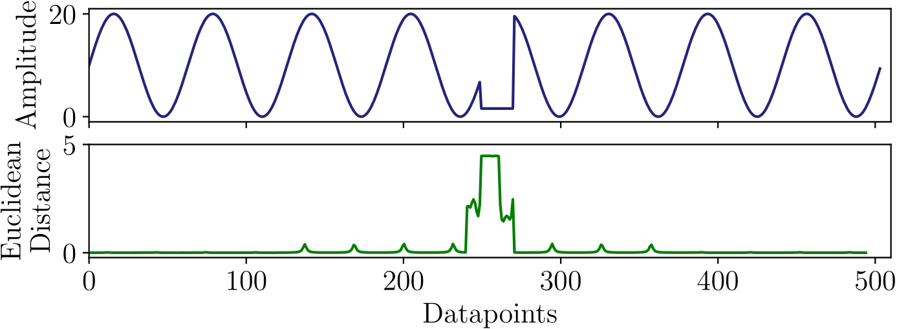
Motifs and Discords
Given a sliced time series into subsequences
motif discovery focuses on finding similarities
discord discovery focuses on finding anomalies
Naive example of anomaly detection:

Slide 8
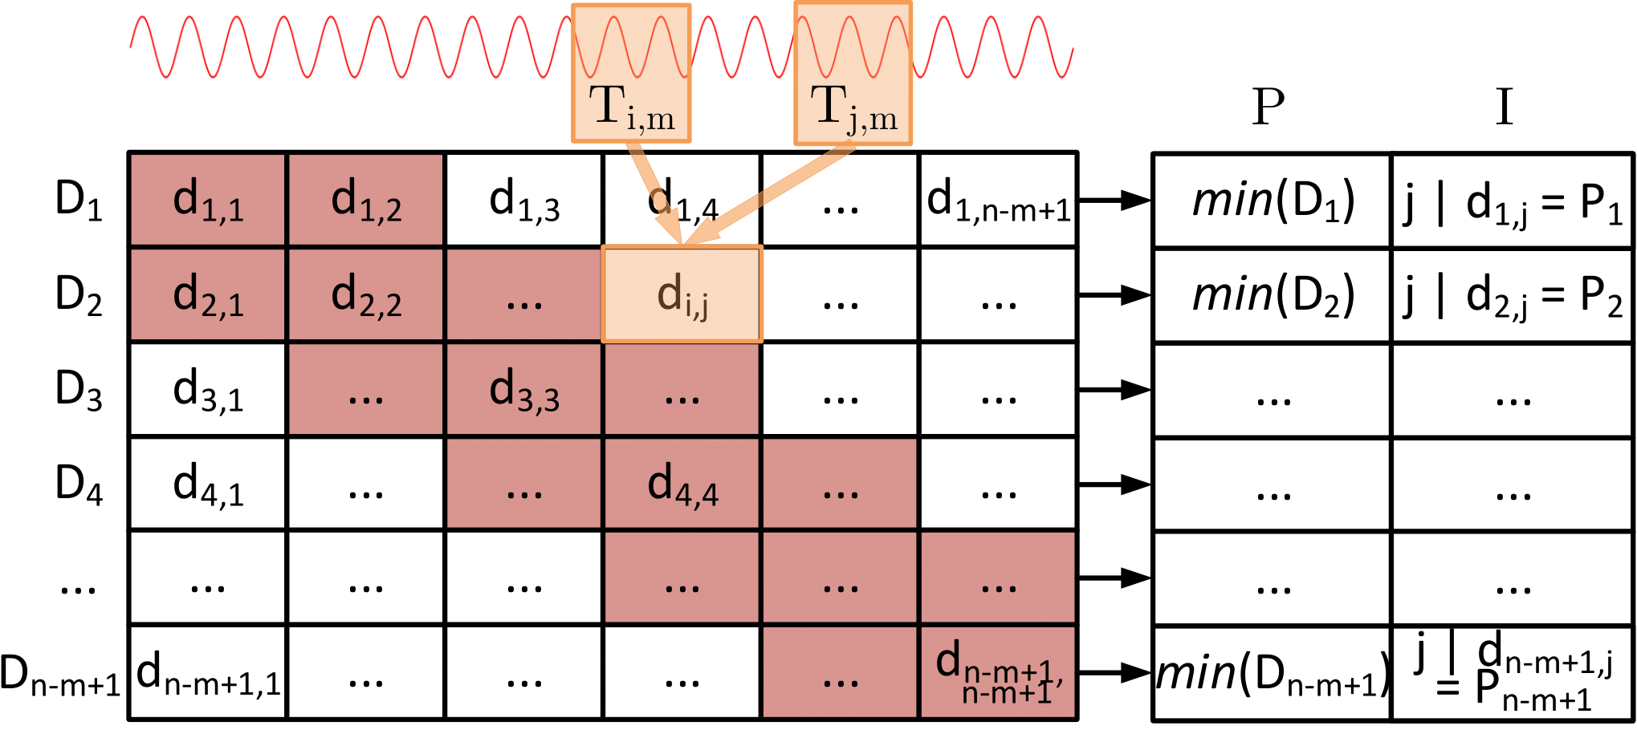
Matrix Profile
Matrix profile: an algorithm (and an open source tool), intended for motif and discord discovery
Easy to use: only subsequence length is needed

Slide 9
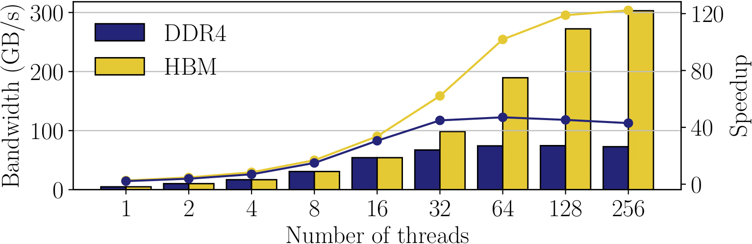
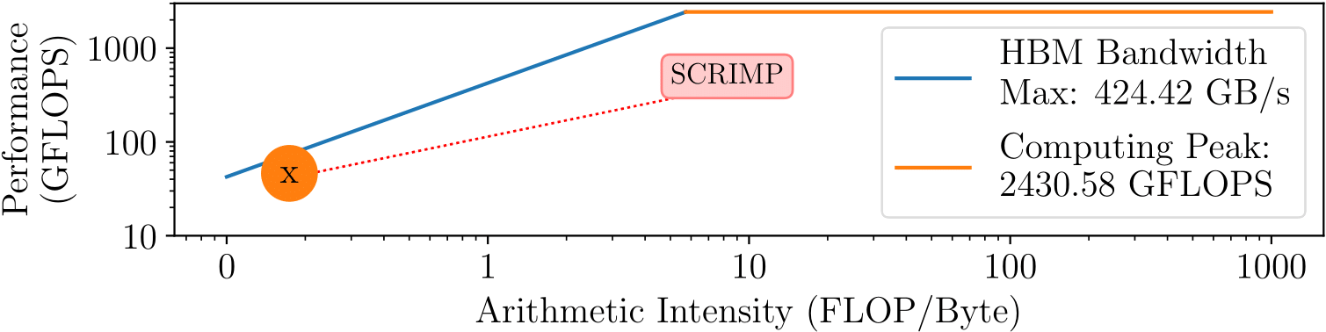
SCRIMP
SCRIMP: state-of-the-art CPU matrix profile implementation (also GPU and CPU-GPU available)
We characterize SCRIMP using an Intel Xeon Phi KNL

Slide 10
SCRIMP
SCRIMP: state-of-the-art CPU matrix profile implementation (also GPU and CPU-GPU available)
We characterize SCRIMP using an Intel Xeon Phi KNL
SCRIMP is heavily bottlenecked
by data movement

Slide 11
Goal
Our goal:
Enabling high-performance and energy-efficient time series analysis for a wide range of applications
by minimizing the overheads of data movement
To this end, we propose NATSA,
the first Near-data processing Accelerator for Time Series Analysis that exploits 3D-stacked HBM memories and specialized processing logic

Slide 12
Talk Outline
Motivation
NATSA Design
NATSA Evaluation
Conclusions

Slide 13
NATSA Overview
NATSA is designed to
Fully exploit the memory bandwidth of HBM
Employ the required amount of computing resources to provide a balanced solution
NATSA consists of multiple processing units (PUs)
Each PU includes energy-efficient floating-point units and bitwise operators
PUs are designed to compute batches of diagonals of the distance matrix following a vectorized approach

Slide 14
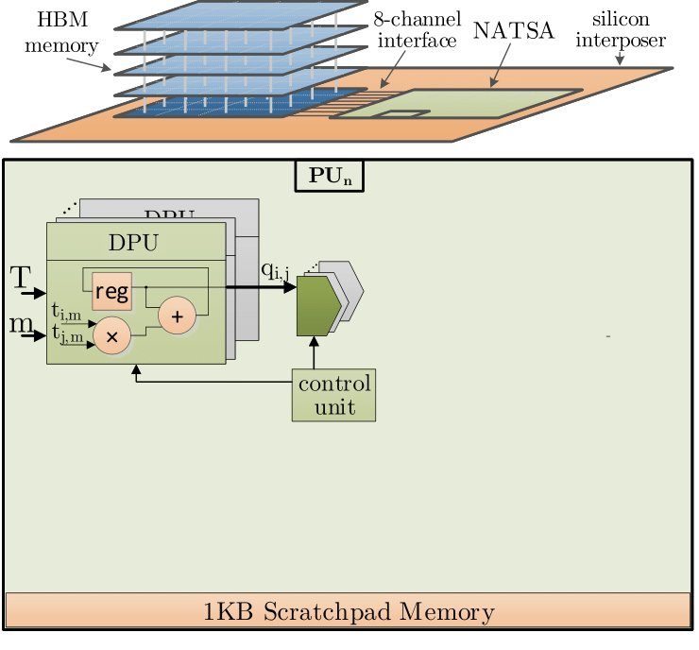
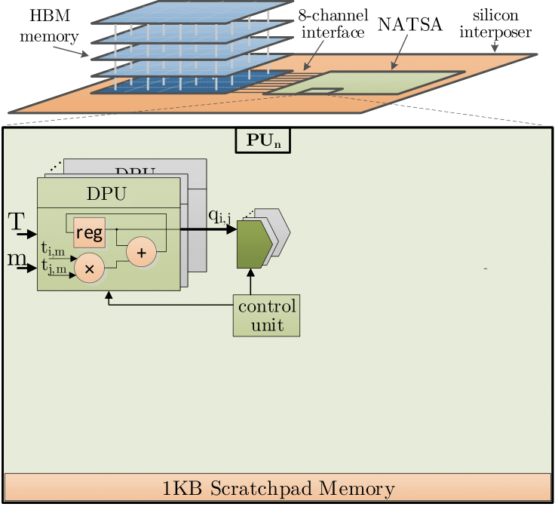
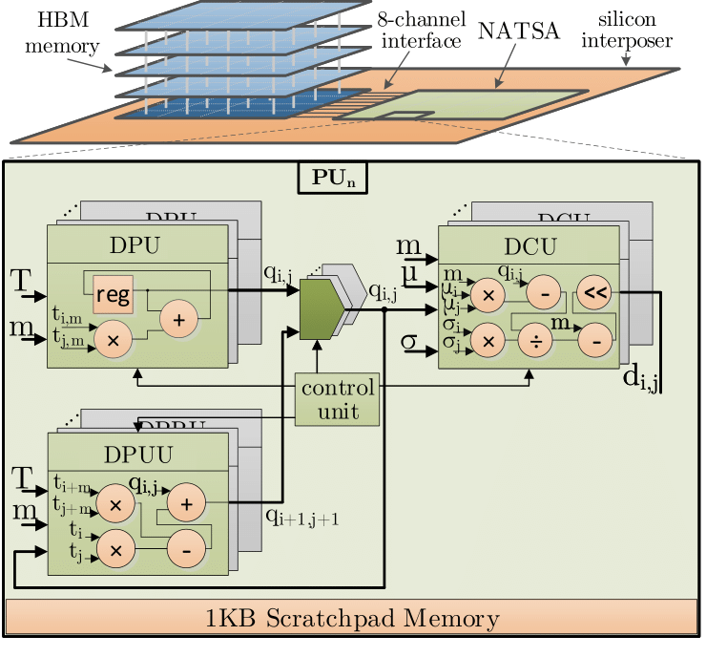
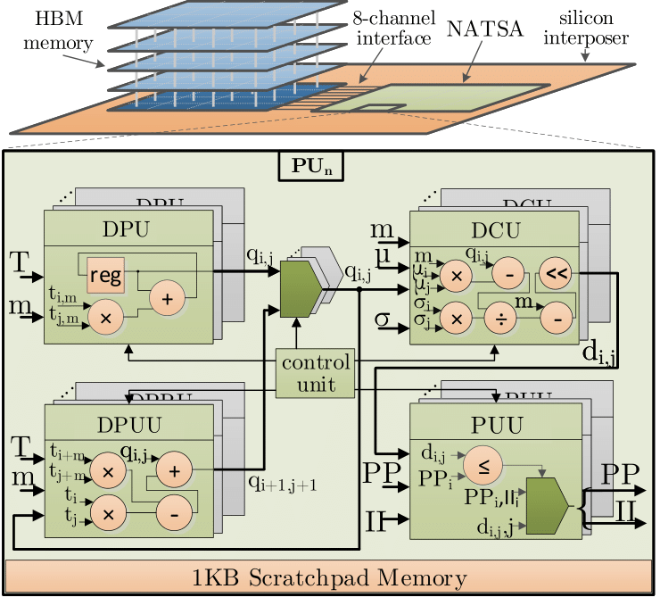
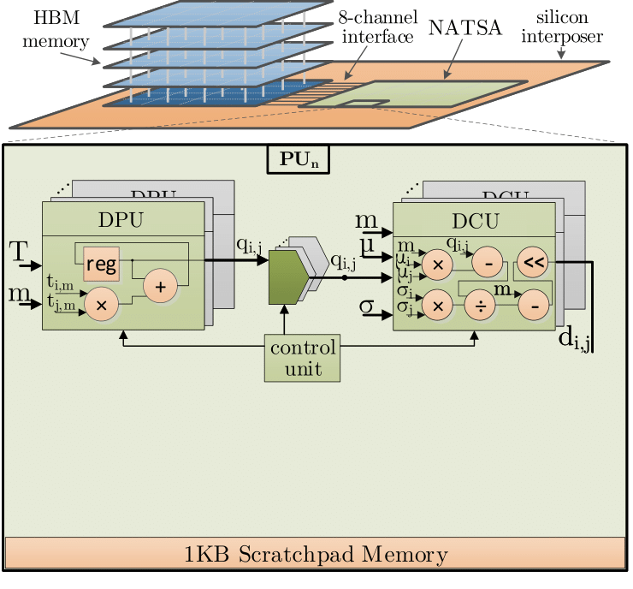

NATSA Integration
NATSA PUs consist of four hardware components:
Dot Product Unit
Distance Compute Unit
Dot Product Update Unit
Profile Update Unit

Slide 15
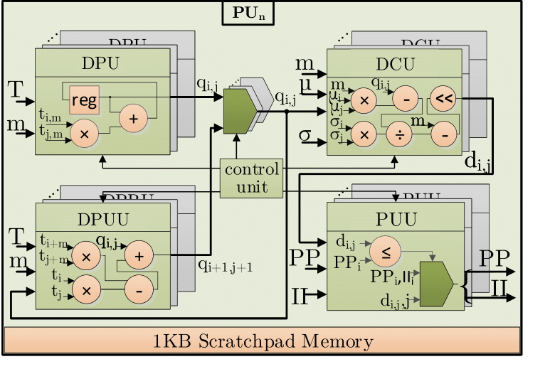
NATSA PU Execution Flow
The execution flow through the hardware components of a PU includes the following steps:
1) Dot product
computation
of the first
element of
the diagonal
3) First profile update
4) Dot product update
5) Second and successive Euclidean distance
computations
6) Second and successive profile updates

Slide 16
NATSA PU Execution Flow
The execution flow through the hardware components of a PU includes the following steps:
2) Euclidean
distance
computation
of the first
element of
the diagonal
3) First profile update
4) Dot product update
5) Second and successive Euclidean distance
computations
6) Second and successive profile updates

Slide 17
NATSA PU Execution Flow
The execution flow through the hardware components of a PU includes the following steps:
3) First profile
update
3)
4) Dot product update
5) Second and successive Euclidean distance
computations
6) Second and successive profile updates

Slide 18
NATSA PU Execution Flow
The execution flow through the hardware components of a PU includes the following steps:
4) Dot product
update
3)
4)
5) Second and successive Euclidean distance
computations
6) Second and successive profile updates

Slide 19
NATSA PU Execution Flow
The execution flow through the hardware components of a PU includes the following steps:
5) Second and
successive
Euclidean
distance
computations
3)
4)
5)
6) Second and successive profile updates

Slide 20
NATSA PU Execution Flow
The execution flow through the hardware components of a PU includes the following steps:
6) Second and
successive
profile
updates

Slide 21
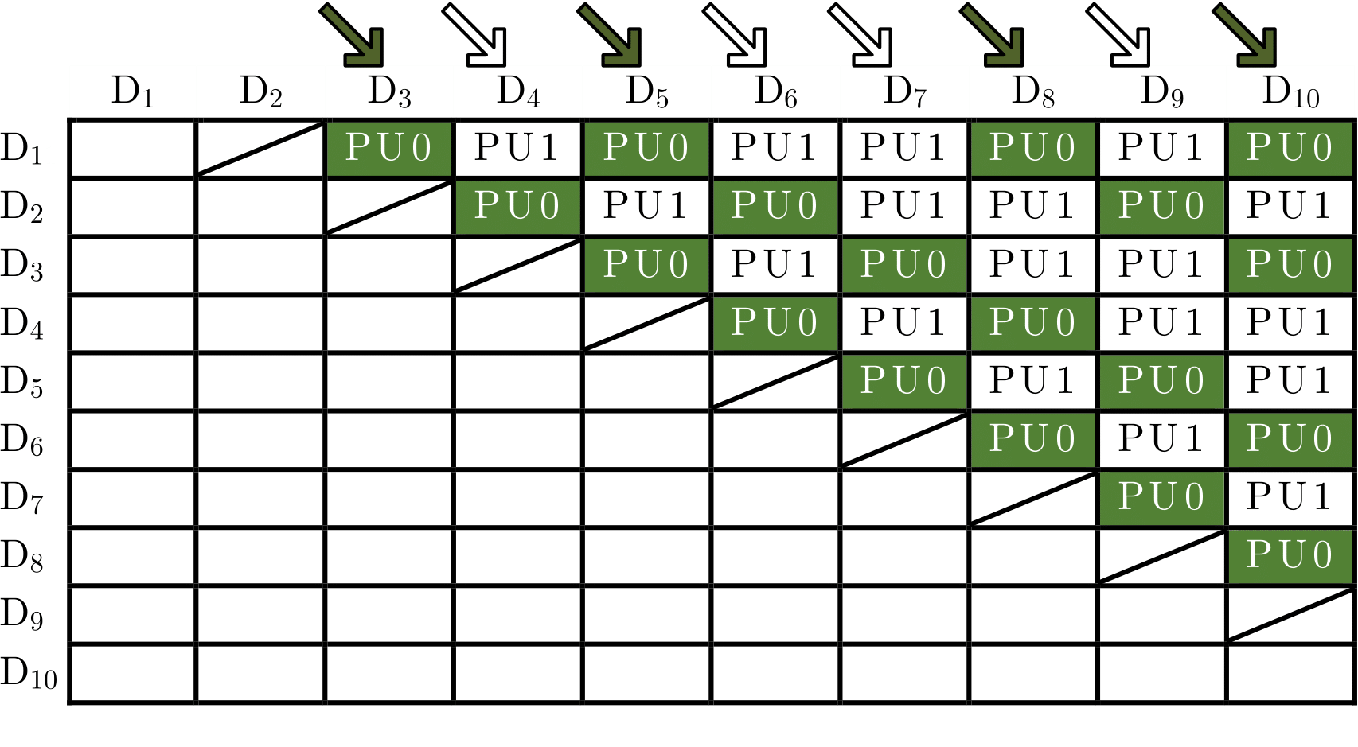
Workload Scheduling Scheme
We ensure load balancing among PUs using a static partition scheduling
We assign pairs of diagonals to each PU that sum the same number of cells to compute

Slide 22
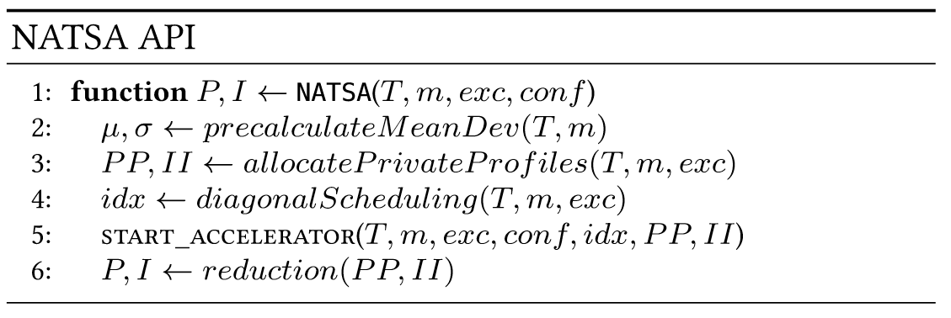
Programming Interface
The user is responsible for 1) allocating the time series and 2) providing the subsequence length
NATSA will provide the user the computed profile and profile index vectors as a result

Slide 23
Talk Outline
Motivation
NATSA Design
NATSA Evaluation
Conclusions

Slide 24
Simulation Environment
We use an in-house integration of ZSim and Ramulator to simulate general-purpose hardware platforms
We use McPAT to obtain area and power for the general-purpose hardware platforms
We use the integration of Aladdin and gem5 to obtain performance, power and area of NATSA
We obtain the memory side power consumption using Micron Power Calculator

Slide 25
Hardware Platforms
We define several representative simulated hardware platforms for the evaluation:
Hardware Platform | Cores / PUs | Caches (L1 / L2 / L3) | Memory
DDR4-OoO | 8 OoO @ 3.75 GHz | 32KB / 256KB / 8MB | 16 GB DDR4-2400
DDR4-inOrder | 64 in-order @ 2.5 GHz | 32KB / - / - | 16 GB DDR4-2400
HBM-OoO | 8 OoO @ 3.75 GHz | 32KB / 256KB / 8MB | 4 GB HBM2
HBM-inOrder | 64 in-order @ 2.5 GHz | 32KB / - / - | 4 GB HBM2
NATSA | 48 PUs @ 1 GHz | 48KB (Scratchpad) | 4 GB HBM2
We also evaluate NATSA against real hardware platforms (Intel Xeon Phi KNL, NVIDIA Tesla K40c and NVIDIA GTX 1050)

Slide 26
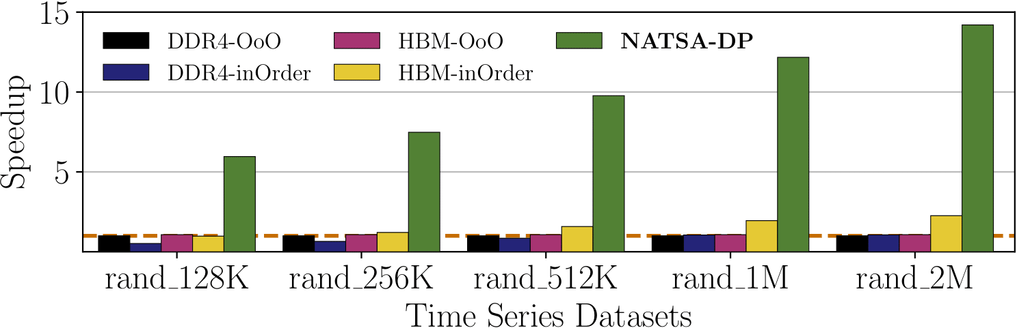
Performance of NATSA
We compare the performance of NATSA with respect to the general-purpose hardware platforms

Slide 27
Performance of NATSA
We compare the performance of NATSA with respect to the general-purpose hardware platforms
NATSA outperforms the baseline (DDR4-OoO) by up to 14.2x
(9.9x on average)

Slide 28
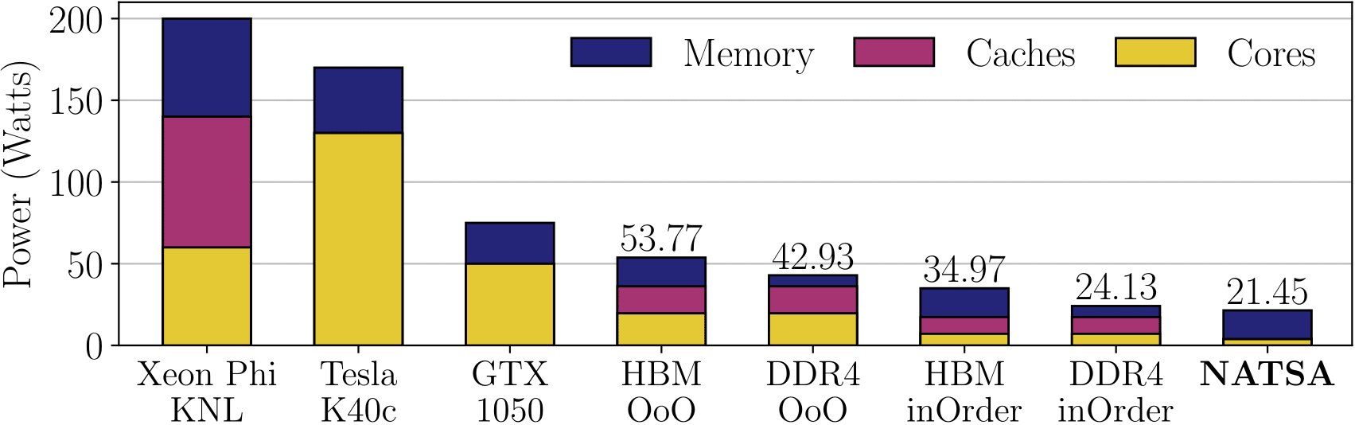
Power Consumption
We compare the power consumption of NATSA with respect to simulated and real hardware platforms

Slide 29
Power Consumption
We compare the power consumption of NATSA with respect to simulated and real hardware platforms
NATSA has the lowest power consumption
Most of NATSA’s power is consumed by memory

Slide 30
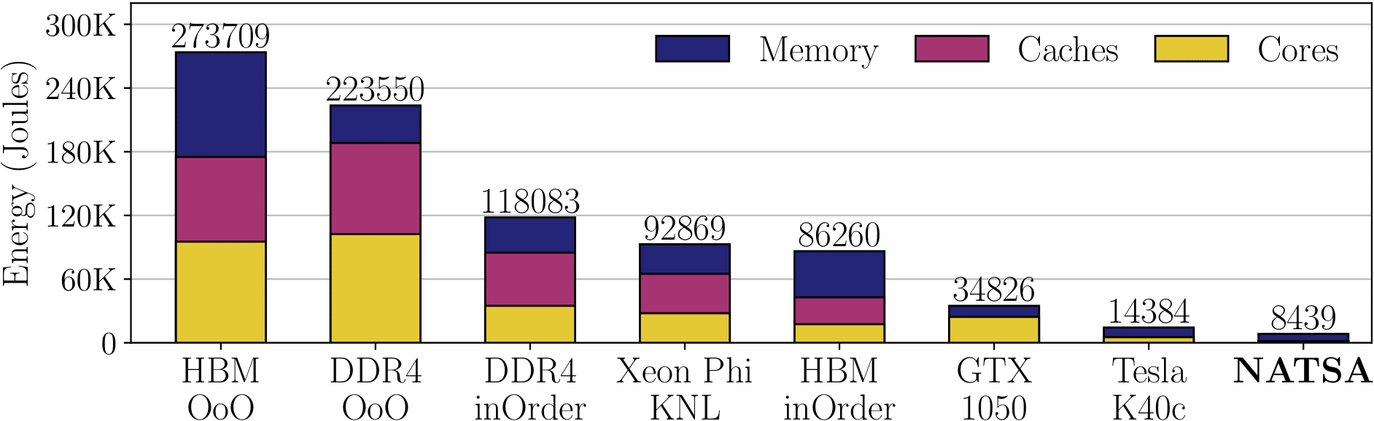
Energy Consumption
We compare the energy consumption of NATSA with respect to simulated and real hardware platforms

Slide 31
Energy Consumption
We compare the energy consumption of NATSA with respect to simulated and real hardware platforms
NATSA reduces energy consumption
by up to 27.2x over DDR4-OoO
by up to 10.2x over HBM-inOrder
by up to 1.7x over an NVIDIA K40c

Slide 32
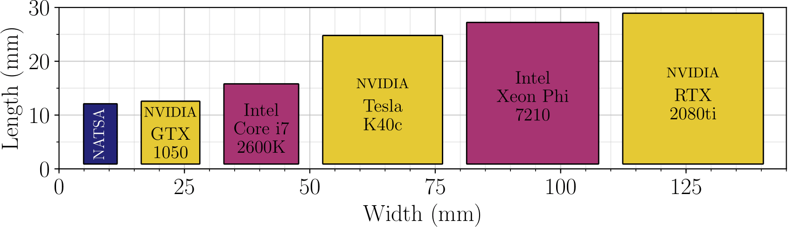
Area
We compare the area of NATSA with respect to simulated and real hardware platforms

Slide 33
Area
We compare the area of NATSA with respect to simulated and real hardware platforms
NATSA (even at 45nm technology node) requires the least area

Slide 34
Talk Outline
Motivation
NATSA Design
NATSA Evaluation
Conclusions

Slide 35
Executive Summary
Problem: time series analysis is bottlenecked by data movement in conventional hardware platforms
Goal: enable high-performance and energy-efficient time series analysis for a wide range of applications
Contributions: first near-data processing accelerator for time series analysis based on matrix profile algo.
NATSA Evaluations:
NATSA provides up to 14.2x higher performance and consumes up to 27.2x less energy than a DDR4 platform with 8 OoO cores
NATSA outperforms an HBM-NDP platform with 64 in-order cores by 6.3x while consuming 10.2x less energy

Slide 36
NATSA A Near-Data Processing Accelerator for Time Series Analysis
Ivan Fernandez, Ricardo Quislant, Christina Giannoula,
Mohammed Alser, Juan Gomez-Luna, Eladio Gutierrez,
Oscar Plata, Onur Mutlu
International Conference on Computer Design, ICCD 2020
Monday October 19, 11:50 am ET
Session 1A – Novel Architectures

