Slide 1






PAPI: Exploiting Dynamic Parallelism in Large Language Model Decoding with a Processing-In-Memory-Enabled Computing System
Yintao He Haiyu Mao Christina Giannoula
Mohammad Sadrosadati Juan Gómez-Luna Huawei Li
Xiaowei Li Ying Wang Onur Mutlu
ASPLOS 2025
Notes:
Hi everyone, I am Yintao. Today I am going to discuss our work “PAPI: Exploiting Dynamic Parallelism in Large Language Model Decoding with a Processing-In-Memory-Enabled Computing System”
[CLICK]

Slide 2

Executive Summary
Observation: Large Language Model (LLM) decoding kernels have different and dynamically changing computation and memory bandwidth demands at runtime
Problem: Existing heterogeneous LLM systems have two shortcomings:
Static scheduling that fails to dynamically cater to changing kernel demands
Support only one type of Processing-In-Memory (PIM) device with a certain computation throughput and memory bandwidth capability
Goal: Design a heterogeneous system that caters to different and dynamically changing computation and memory demands in LLM decoding
Key Idea: Enable online dynamic task scheduling on a heterogeneous architecture via online identification of LLM decoding kernel properties
Key techniques: A new computing system called PAPI:
Dynamic LLM kernel scheduling to the most suitable hardware units at runtime
Hybrid PIM units to meet the diverse LLM kernel demands
Key Results: PAPI outperforms a state-of-the-art PIM-enabled LLM computing system and a pure PIM system by 1.8X and 11.1X, respectively
Notes:
First, I will start with the executive summary
[CLICK] In this work, we observe that …
[CLICK] However, the existing designs have two shortcomings: …
[CLICK] To solve these problems,

Slide 3
Outline
1
Background
2
Observations & Motivation
3
PAPI’s Overview
4
PAPI’s Implementation
5
Evaluation
6
Conclusion
Notes:
First I provide the short background
[NEXT]

Slide 4
LLM Inference
An example:
Sam did his PhD
at
the
University
of
LLM
LLM
LLM
LLM
LLM
at
the
University
of
Toronto
Prefilling
Decoding
(Encodes contextual information from the input in parallel)
(Generates output tokens in serial or parallel)
Notes:
[CLICK] Here is a case of LLM inference process.
[CLICK] It consists of two stages. prefilling stage and decoding stage. LLM use prefilling stage to encodes information from the input in parallel. Like the figure shows, sam did this phd are four input tokens, and LLM process them to get an output token at.
[CLICK] Next, LLM use decoding to generate output tokens in serial or parallel. To be specific, LLM inputs the last output token to generate the next output token.
[CLICK] And we will repeat the same cycle again and again until all output tokens have been generated. This LLM inference process includes two stage.
[CLICK] Let’s see what’s the details in LLM.
[NEXT]

Slide 5
LLM Structure
QKV generation
Decoder 1
Multi-head attention
LLM
Decoder 2
Projection
…
Decoder N
Feed forward
networks
Attention kernels
Encoded from input tokens
Different data across requests
Fully-connected (FC) kernels
Pretrained by LLM training
Used for token generation
Notes:
A LLM has multiple decoders. And each decoder has multiple layers.
These layers are two types of kernels. The yellow one is attention kernels. Its data is encoded from input tokens, and has different data across different requests.
The pink layers are fully-connected kernels. They are pretrained by LLM training, and used for token generation across different request.

Slide 6
LLM Inference
An example:
Sam did his PhD
at
the
University
of
LLM
LLM
LLM
LLM
LLM
at
the
University
of
Toronto
Prefilling
Decoding
(Encodes contextual information from the input in parallel)
(Generates output tokens in serial or parallel)
Notes:
We just mentioned that decoding can be in serial or in parallel, so what is serial decoding?

Slide 7
Serial Decoding
Request A
LLM
LLM
LLM
LLM
Low hardware utilization
Low throughput
Notes:
[CLICK] Here is a case. As you see, an LLM model generates tokens in request A one-by-one. [CLICK]
[CLICK] Therefore, serial processing leads to low hardware utilization and low throughput of LLM inference.
[NEXT]

Slide 8
Parallel Decoding
Decode tokens of one request in parallel
Decode different requests in parallel
Request A
Requests A & B
LLM
LLM
LLM
LLM
Token-Level Parallelism
(TLP)
Request-Level Parallelism
(RLP)
Higher hardware utilization
Higher throughput
Do TLP and RLP benefit all kernels in LLM decoding?
Notes:
To overcome these issues, people proposed parallel decoding.
[CLICK] To be more specific, parallel decoding can decode tokens of one request in parallel. Just like the figure shows, we generate two tokens from request A in parallel,
We name it as token-level parallelism.
[CLICK] What’s more, we can decode different requests in parallel. In this case, the yellow one and green one show the tokens from request A and B, and they can be generated in parallel.
[CLICK] It call request-level parallelism.
[CLICK] Parallel decoding can achieve higher hardware utilization and higher throughput.
[CLICK] Then there is a question, Do TLP and RLP benefit all kernels in LLM decoding? To answer this question, let’s characterize LLM kernels

Slide 9
Outline
1
Background
2
Observations & Motivation
3
PAPI’s Overview
4
PAPI’s Implementation
5
Evaluation
6
Conclusion
Notes:
to find our observations and motivations.

Slide 10
Key Observations
LLM kernels have different computation and memory bandwidth demands across different RLP & TLP levels
1
2
Memory-bound kernels exhibit different
computation demands depending on kernel type
LLM kernels have dynamically changing
RLP and TLP levels
3
Notes:
I summarize first our key observations. 123.
Let’s move to detail of each observation .

Slide 11
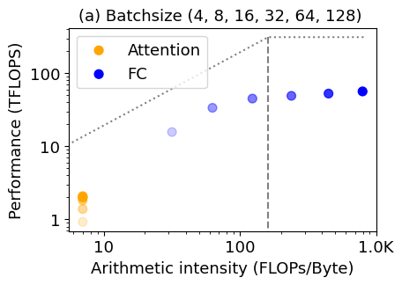
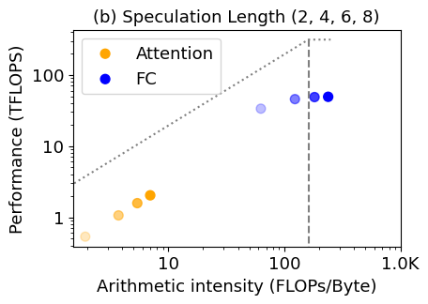
1. Different Computation and Memory Bandwidth Demands due to RLP/TLP
Roofline model of LLM kernels with six RLP and four TLP configurations on an NVIDIA A100 GPU system:
RLP (4, 8, 16, 32, 64, 128)
TLP (2, 4, 6, 8)
Memory
Bound
Compute
Bound
Memory
Bound
Compute
Bound
LLM kernels have different computation and memory bandwidth demands across different RLP & TLP levels
Notes:
[CLICK] First, we analyzed the roofline model of LLM kernels with six RLP and four TLP configurations on a GPU system.
[CLICK] The yellow points are attention kernels, and the blue ones are FC kernels.
[CLICK] From the results, we can see that with different RLP, some attention and FC kernels are memory-bound,
[CLICK] while others are compute-bound. we have this similar observation for TLP as well
[CLICK] Based on this, we make the first observation: LLM kernels have different computation and memory bandwidth demands across different RLP & TLP configurations.

Slide 12
Why Different Computation & Memory Demands in Parallel Decoding?
FC kernels benefit from RLP & TLP
FC
Compute-Bound
Attention kernels benefit from TLP
TLP is usually much smaller than RLP
Attention #1
Attention #2
Memory-Bound
Notes:
So why they have different demands? When we use parallel decoding, FC kernels can process all the tokens at the same time. Therefore, FC kernels benefits from both RLP and TLP. And FC kernels can be compute-bound with a large RLP and TLP.
However, attention kernels can only process tokens from different request in serial. It is because different requests have different data in attention kernels.
[CLICK] so attention kernels can only benefits from Token-Level-Parallelism, which is usually smaller than Request-Level-Parallelism. Therefore, attention kernels are always memory-bound.

Slide 13
2. Different Computation and Memory Bandwidth Demands due to Kernel Type
RLP (4, 8, 16, 32, 64, 128)
TLP (2, 4, 6, 8)
> 30 FLOPs/Byte
> 60 FLOPs/Byte
< 10 FLOPs/Byte
< 10 FLOPs/Byte
Memory
Bound
Compute
Bound
Memory
Bound
Compute
Bound
Memory-bound kernels exhibit different
computation demands depending on kernel type
Notes:
[CLICK] Furthermore, let’s focus on just the memory-bound kernels for a moment. [CLICK] You can see that the attention kernels have very low arithmetic intensity. They are even lower than ten FLOPs per Byte.
[CLICK] while the memory-bound FC kernels are much higher arithmetic intensity. Also the same with different TLP levels. [CLICK] This leads us to the second Observation: memory-bound kernels exhibit different computation demands depending on kernel type.

Slide 14
3. Dynamically Changing RLP and TLP Levels
Parallelism levels (RLP & TLP) vary dynamically in real-world scenarios
E.g., request-level parallelism (RLP) decreases at runtime when using static batching
Decoding Cycles of Requests in One Batch
Number of Requests
in a Batch
Notes:
[CLICK] Moreover, We find that parallelism levels (RLP & TLP) vary dynamically in real-world scenarios.
[CLICK] For example, Request-level parallelism levels (RLP) decrease at runtime when using static batching.
[CLICK] We analyzed the decoding cycles of requests in one batch. As this figure shows, with the decoding cycles increases, the number of requests that processed in parallel are decreased. Therefore, the RLP decrease at runtime.

Slide 15
In the Paper: Analysis of Dynamic Parallelism Levels
Initial RLP:
Service level objective
Memory capacity limits
Dynamic batching
Runtime RLP:
Static batching
Mixed continuous batching
TLP:
Speculative decoding
LLM kernels have dynamically changing
RLP and TLP levels
Notes:
In the paper, we have shown that not only RLP but also TLP are changing dynamically.
And there are a lot of reasons.
based on these, we find LLM kernels have dynamically changing RLP and TLP levels
[NEXT]

Slide 16
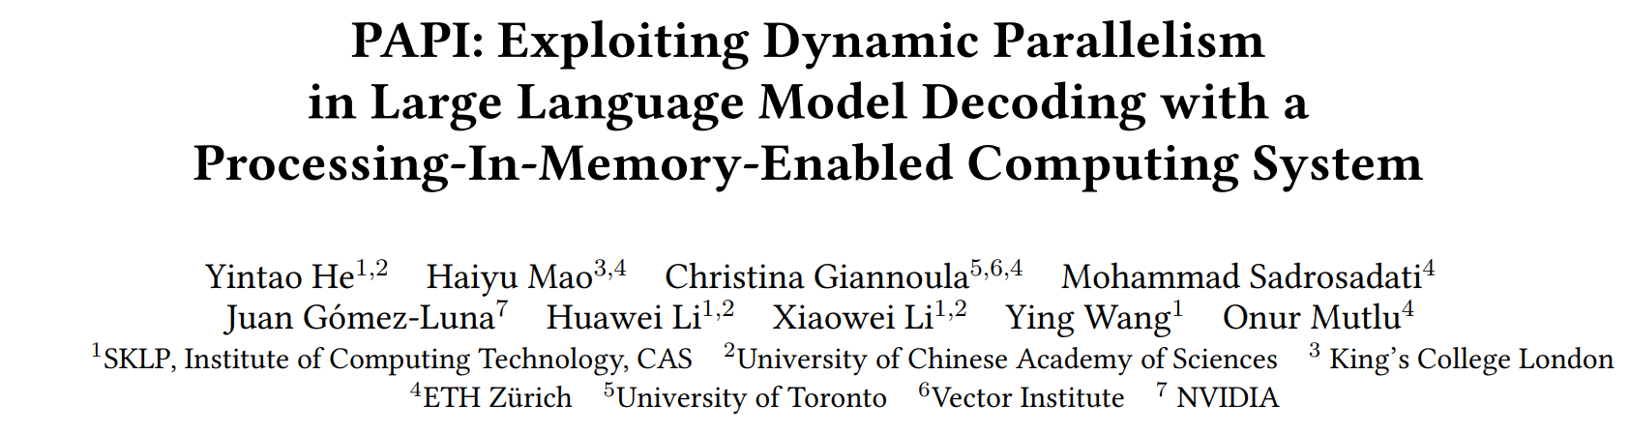

In the Paper: Analysis of Dynamic Parallelism Levels
https://arxiv.org/pdf/2502.15470
Notes:
Please find all these things in our paper

Slide 17
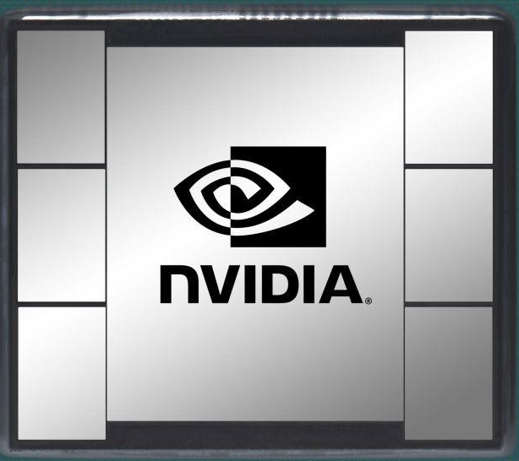
State-of-the-Art in LLM Inference
A PIM-enabled LLM computing system:
Memory-centric computing device
(e.g., HBM-PIM)
Computation-centric accelerator
(e.g., GPU)
PIM-Enabled
Memory
Map
Map
Attention kernels
FC kernels
Notes:
We look into a state-of-the-art approach. This approach employs a heterogeneous architecture with
[CLICK] a memory-centric computing device,
[CLICK] And a computation-centric accelerator like GPU, to support memory-bound and compute-bound LLM kernels. [CLICK] In this approach, attention kernels are usually mapped onto memory-centric computing device
[CLICK] and FC kernels are mapped onto computation-centric accelerator.

Slide 18
Major Shortcomings
Static scheduling leads to sub-optimal performance
across different parallelism levels
1
2
Prior approaches support only one type of PIM device with
a certain computation and memory bandwidth capability
Notes:
We find there are two shortcomings in the state-of-the-art approach.

Slide 19
Shortcoming 1: Static Scheduling (I)
State-of-the-art typically uses static scheduling:
Memory-centric computing device
Computation-centric accelerator
PIM-Enabled
Memory
Attention kernels
FC kernels
Notes:
[CLICK] First, The state of the art approach typically take a static scheduling.
[CLICK] It typically maps all attention kernels to memory-centric devices.
[CLICK] And it statically maps the FC kernels to computation-centric devices.

Slide 20
Shortcoming 1: Static Scheduling (II)
Static scheduling works well for memory-bound attention kernels
Static scheduling fails for FC kernels that switch between being compute-bound or memory-bound
RLP (4, 8, 16, 32, 64, 128)
TLP (2, 4, 6, 8)
Memory
Bound
Compute
Bound
Memory
Bound
Compute
Bound
Static scheduling leads to sub-optimal performance
across different parallelism levels
Notes:
[CLICK] That’s ok since all attention kernels are memory-bound as we have shown before.
[CLICK] However, Static scheduling fails for FC kernels with dynamic memory and compute demands.
It is because based on our observation, FC kernels can be memory-bound or compute-bound under different and dynamically-changed parallelism levels.

Slide 21
Shortcoming 2: One-Size-Fits-All Approach
Prior works leverage
only one type of PIM device with
a fixed computation and memory bandwidth
Memory-bound FC kernels and attention kernels have varying computation
and memory bandwidth demands
Prior approaches support only one type of PIM device
with a certain computation and memory bandwidth capability
Notes:
[CLICK] Second, Prior works leverage only one type of PIM device with a certain computation and memory bandwidth
[CLICK] but Memory-bound FC kernels and attention kernels have varying computation and memory bandwidth demands
[CLICK] Prior approaches support only one type of PIM device with a certain computation and memory bandwidth capability. It’s not good and hard to meet the diverse demands of kernels.

Slide 22
Our Goal
Design a heterogeneous system that caters to
varying parallelism levels in real-world LLM inference
with different and dynamically changing
computation and memory demands
Notes:
[CLICK] Based on our analysis and insights, our goal is …

Slide 23
Outline
1
Background
2
Observations & Motivation
3
PAPI’s Overview
4
PAPI’s Implementation
5
Evaluation
6
Conclusion
Notes:
Next, let’s go to papi’s overview.

Slide 24
PAPI’s Key Idea
Enable online dynamic task scheduling in a heterogeneous PIM-enabled architecture via online identification of kernel properties in LLM decoding

Slide 25
PAPI’s Key Components
A new PIM-enabled computing system design
Hybrid PIM units
to cater to different parallelism levels of FC and attention kernels
Dynamic LLM kernel scheduling
to cater to dynamically changing parallelism levels
Notes:
[CLICK] To this end, we design a new …

Slide 26
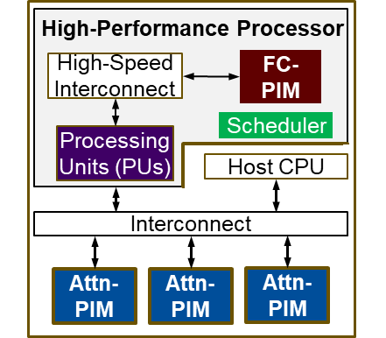
PAPI’s Architecture
Handles memory-bound or compute-bound FC kernels
Execution of FC kernels
Dynamic scheduling
Handles memory-bound attention kernels
Notes:
[CLICK] here is PAPI’s architecture overview.
In PAPI system, we have a high-performance processor to handle memory-bound or compute-bound FC kernels,
And Attn-PIM devices handle memory-bound kernels
And also a host CPU

Slide 27
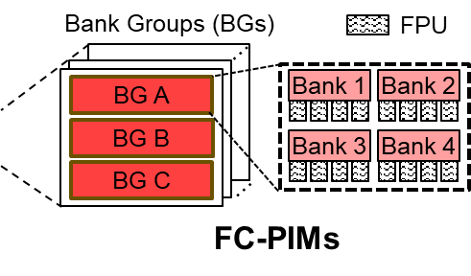
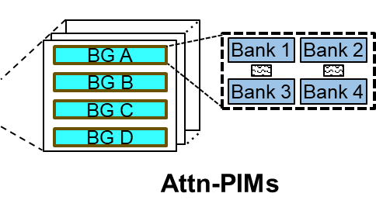
PAPI’s Architecture
Hybrid PIM units handle memory-bound FC & attention kernels with different computational and memory demands
Notes:
And you can see there are FC-PIM and Attn-PIM devices in PAPI architecture.
The Hybrid PIM units handle memory-bound FC & attention kernels with different computational and memory demands

Slide 28
Outline
1
Background
2
Observations & Motivation
3
PAPI’s Overview
4
PAPI’s Implementation
5
Evaluation
6
Conclusion
Notes:
Next, I will describe how to implement our work.
[NEXT]

Slide 29
High-Performance Processor
High-Performance Processor
FC-
PIM
When FC kernels are compute-bound:
Assign FC kernels to PUs
High-Speed Interconnect
FC-
PIM
Scheduler
Scheduler
Processing
Units (PUs)
Scheduler
Processing
Units (PUs)
Host CPU
Interconnect
When FC kernels are memory-bound:
Assign FC kernels to FC-PIM
Attn-PIM Devices
Attn-
PIM
Attn-
PIM
Attn-
PIM
Notes:
let’s see the High-performance processor in PAPI architecture first.
[CLICK] It includes a scheduler and two kinds of computing units: computation-centric processing units and memory-centric FC-PIM.
[CLICK] When FC kernels are compute-bound, the scheduler assigns the FC kernels to processing units,
[CLICK] and when FC kernels memory-bound, assigns the FC kernels to FC-PIM device.

Slide 30
Hybrid PIM Units (I)
High-Performance Processor
FC-
PIM
High-Speed Interconnect
FC-
PIM
FC-PIM device placed in
the High-Performance Processor
Scheduler
Processing
Units (PUs)
Host CPU
Interconnect
Attn-PIM devices store KV cache; separated from
the High-Performance Processor
Attn-
PIM
Attn-
PIM
Attn-
PIM
Attn-
PIM
Attn-
PIM
Attn-
PIM
Notes:
And in PAPI architecture, we have FC-PIM and Attention-PIM.
[CLICK] It is placed in high-performance processor.
[CLICK] And Attn-PIM is for attention kernels. It is disaggregated from the high-performance processor. So that we can add more Attn-PIM devices that can provide more memory bandwidth and capacity in a flexible manner.
Let’s go into the details on the two PIM units.

Slide 31
Hybrid PIM Units (II)
Floating-Point Processing Units (FPU)
Bank Groups (BGs)
BG A
Bank 1
Bank 2
Higher Computation Capability
to cater to FC kernels
BG B
Bank 3
Bank 4
BG C
FC-PIM
More FPUs per Bank
…
BG A
Bank 1
Bank 2
Higher Memory Capacity
to cater to attention kernels
BG A
BG B
BG B
Bank 3
Bank 4
BG C
BG C
BG D
BG D
…
Attn-PIMs
More Bank Groups per Stack
More Attn-PIM Devices
Notes:
[CLICK] In each bank in FC-PIM, we integrates four floating-point processing units by leveraging the high data reuse level in FC kernels.
[CLICK] Therefore, FC-PIM units offer high computation capabilities to cater to the FC kernels.
[CLICK]Compared to FC-PIM, Attention-PIM integrates more bank groups in one stack,
[CLICK] so that it can provide larger memory bandwidth and capacity for the attention kernels.

Slide 32
PAPI Runtime Scheduler
Offline: identify memory-boundedness threshold
① Monitor Parallelism Levels
RLP & TLP
② Arithmetic Intensity Predictor
Estimate arithmetic intensity of FC kernels
Compare with memory-boundedness threshold
③ Schedule the FC Kernels
Map FC kernels to either FC-PIM or PUs
Notes:
Now we have two kinds of computing units to execute FC kernels, FC-PIM and processing-units. Then how to do the runtime FC kernel scheduling? We will first offline identify a memory-boundedness threshold. To test FC kernels execution time with different parallelism levels, and find under what condition kernel has better performance on FC-PIM rather than PUs. Then we execute the runtime scheduling.
There will be three stopes.
[CLICK] First, the scheduler is always monitoring the parallelism levels, TLP and RLP.
[CLICK] Once the parallelism levels are changed, an arithmetic intensity predictor works, estimate the arithmetic intensity of FC kernels, and then compare with memory-boundedness threshold
[CLICK] Finally, we schedule the FC kernels to map them to FC-PIM or PUs

Slide 33
Outline
1
Background
2
Observations & Motivation
3
PAPI’s Overview
4
PAPI’s Implementation
5
Evaluation
6
Conclusion
Notes:
Next, Let’s look at our evaluation

Slide 34
Evaluation Methodology
Performance and Energy Analysis:
Simulation using AttAcc [ASPLOS’24] and Ramulator 2 [IEEE CAL’23]
Baselines:
AttAcc [ASPLOS’24]
GPU+HBM-PIM (NVIDIA A100 GPU + Samsung’s HBM-PIM)
PIM-only (PIM devices in AttAcc)
Workloads: Three transformer-based LLMs
LLaMA-65B, GPT-3 66B, GPT-3 175B
Datasets: Dolly
Creative-writing tasks
General-QA tasks
Notes:
We evaluate PAPI’s performance and energy using a simulator provided by AttAcc, which is based on Ramulator2.
And we compare PAPI with 3 baselines. a state-of-the-art PIM-enabled LLM computing system AttAcc, a GPU with HBM-PIM computing system, and a PIM-only design.
We evaluate three popular transformer-based LLMs with two different tasks in Dolly datasets.

Slide 35
Performance Analysis
AttAcc
GPU+HBM-PIM
PIM-only
PAPI
LLAMA-65B
GPT-3 66B
GPT-3 175B
TLP=1
TLP=2
TLP=4
TLP=1
TLP=2
TLP=4
TLP=1
TLP=2
TLP=4
4 16 64
4 16 64
4 16 64
4 16 64
4 16 64
4 16 64
4 16 64
4 16 64
4 16 64
Initial RLP
PAPI improves performance by 1.8X, 1.9X, and 11.1X
compared to AttAcc, GPU+HBM-PIM, and PIM-only, respectively
Notes:
Here are the results of performance.
[CLICK] On average, PAPI provides 1.8 times, 1.9 times, and 11.1 times compared to the baselines.
[NEXT] our speedup over PIM-only is because of two reasons: hybrid PIM units and also heterogenous system with computation-centric processing units.

Slide 36
Energy Analysis
AttAcc
GPU+HBM-PIM
PIM-only
PAPI
LLAMA-65B
GPT-3 66B
GPT-3 175B
Spe=1
Spe=2
Spe=4
Spe=1
Spe=2
Spe=4
Spe=1
Spe=2
Spe=4
4 16 64
4 16 64
4 16 64
4 16 64
4 16 64
4 16 64
4 16 64
4 16 64
4 16 64
Initial RLP
Batch size
PAPI improves energy efficiency by 3.4X, 3.4X, and 1.2X
compared to AttAcc, GPU+HBM-PIM, and PIM-only, respectively
Notes:
Here are the energy efficiency results.
[CLICK] On average, PAPI improves energy efficiency by 3.4 times, 3.4 times, and 1.2 times compared to the baselines.
It is because the heterogenous baselines, AttAcc and GPU+HBM-PIM execute the FC kernels on energy-hungry A100 GPUs, while PAPI offloads parts of these kernels to FC-PIM devices

Slide 37
More in the Paper
Details on PAPI’s implementation
PAPI’s heterogeneous architecture
PAPI’s runtime scheduler
System integration
Data partitioning across PIM devices (both Attn-PIM & FC-PIM)
Detailed evaluation results
PAPI’s speedup across different RLP & TLP levels
Ablation study for PAPI’s speedup
Area/power analysis
Notes:
We invite you to check our paper for more details on
[CLICK] PAPI’s implementation, such as ..
[NEXT] And xxx

Slide 38
More in the Paper
https://arxiv.org/pdf/2502.15470
Notes:
[NEXT]

Slide 39
Outline
1
Background
2
Observations & Motivation
3
PAPI’s Overview
4
PAPI’s Implementation
5
Evaluation
6
Conclusion
Notes:
To conclude our work

Slide 40



Conclusion
LLM kernels have different computation and memory bandwidth demands across different RLP & TLP levels
Key Findings
Memory-bound kernels exhibit different computation demands depending on kernel type
LLM kernels have dynamically changing RLP and TLP levels
Notes:
We have three key findings.

Slide 41
Conclusion
PAPI
A new PIM-enabled heterogeneous system design
that caters to varying demands of LLM kernels
by scheduling them dynamically to computation-centric processing units and hybrid PIM units
Key Contribution
PAPI largely improves both performance and energy efficiency over best prior LLM decoding system
1.8× speedup
3.4× energy efficiency increase
Key Results

Slide 42
PAPI: Exploiting Dynamic Parallelism in Large Language Model Decoding with a Processing-In-Memory-Enabled Computing System
Yintao He Haiyu Mao Christina Giannoula
Mohammad Sadrosadati Juan Gómez-Luna Huawei Li
Xiaowei Li Ying Wang Onur Mutlu
ASPLOS 2025
Notes:
Here are all for today. Thank you. Happy to take any questions.

Slide 43
Backup Slides
Interconnections in PAPI
Identify memory-boundedness threshold
Energy breakdown & power analysis
Estimated arithmetic intensity
Execution time breakdown in LLM decoding
The process of dynamic scheduling
Notes:
We invite you to check our paper for more details on
[CLICK] PAPI’s architecture design,
[CLICK] our runtime scheduler.
[CLICK] Sensitivity to Parallelization Levels
[CLICK] Speedup of FC-PIM
[CLICK] and PAPI’s Execution Time Breakdown
[NEXT]

Slide 44
Interconnections in PAPI
High-Performance Processor
FC-PIM units & PUs:
High-speed interconnect
FC-
PIM
High-Speed Interconnect
FC-
PIM
FC kernels with large weight parameters’ transfers from FC-PIM to PUs
Scheduler
Processing
Units (PUs)
Scheduler
Processing
Units (PUs)
Host CPU
Interconnect
Attn-PIM Devices
Attn-PIM & high-performance processor: a standard interconnect like PCIe
Attn-
PIM
Attn-
PIM
Attn-
PIM
Attention kernel involves
small data transfers (Byte-level Q vector)
Notes:
in PAPI architecture, There are two types of PIM units, FC-PIM and Attention-PIM.
[CLICK] FC-PIM is design for storing and processing FC kernels. It is placed in high-performance processor.
[CLICK] And Attn-PIM is for attention kernels. It is disaggregated from the high-performance processor. So that we enables adding a large number of Attn-PIM devices that can house large memory footprints in a flexible manner.
[CLICK] The hybrid PIM units cater to memory-intensive kernels with different computational demands and memory footprints

Slide 45
Identify memory-boundedness threshold
We evaluate when FC kernels becomes memory-bound by testing different configurations
① Run FC kernels
With different TLP and RLP levels
On PUs and FC-PIM unit, respectively
② Measure arithmetic intensity and execution time for each case
③ Figure out threshold
Under what conditions FC-PIM unit faster than PUs
Notes:
in PAPI architecture, There are two types of PIM units, FC-PIM and Attention-PIM.
[CLICK] FC-PIM is design for storing and processing FC kernels. It is placed in high-performance processor.
[CLICK] And Attn-PIM is for attention kernels. It is disaggregated from the high-performance processor. So that we enables adding a large number of Attn-PIM devices that can house large memory footprints in a flexible manner.
[CLICK] The hybrid PIM units cater to memory-intensive kernels with different computational demands and memory footprints

Slide 46
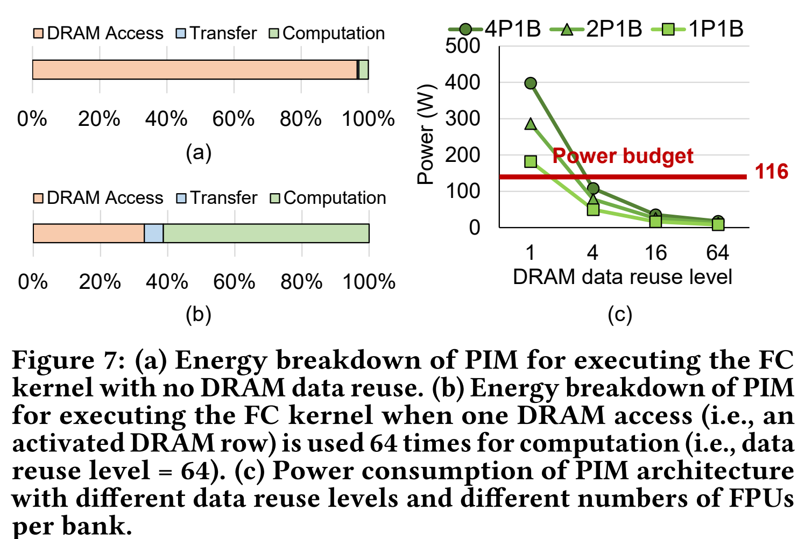
Energy Breakdown & Power Analysis
DRAM access costs the most energy consumption when executing the FC kernels
Leveraging data reuse can reduce the number of DRAM access
Notes:
in PAPI architecture, There are two types of PIM units, FC-PIM and Attention-PIM.
[CLICK] FC-PIM is design for storing and processing FC kernels. It is placed in high-performance processor.
[CLICK] And Attn-PIM is for attention kernels. It is disaggregated from the high-performance processor. So that we enables adding a large number of Attn-PIM devices that can house large memory footprints in a flexible manner.
[CLICK] The hybrid PIM units cater to memory-intensive kernels with different computational demands and memory footprints

Slide 47
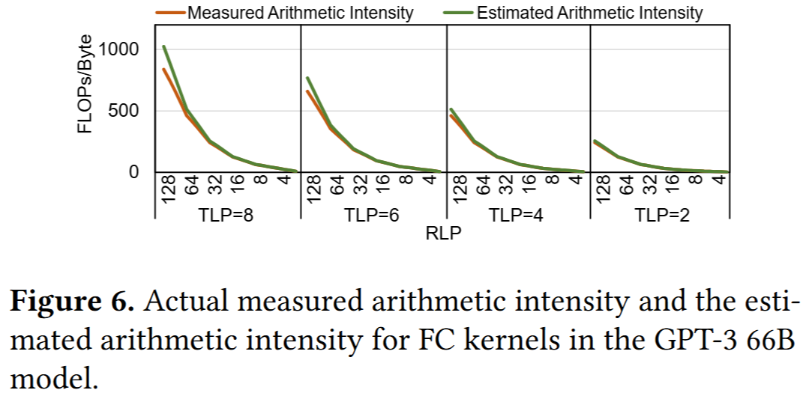
Estimated Arithmetic Intensity
Arithmetic Intensity ≈ RLP×TLP
Notes:
in PAPI architecture, There are two types of PIM units, FC-PIM and Attention-PIM.
[CLICK] FC-PIM is design for storing and processing FC kernels. It is placed in high-performance processor.
[CLICK] And Attn-PIM is for attention kernels. It is disaggregated from the high-performance processor. So that we enables adding a large number of Attn-PIM devices that can house large memory footprints in a flexible manner.
[CLICK] The hybrid PIM units cater to memory-intensive kernels with different computational demands and memory footprints

Slide 48
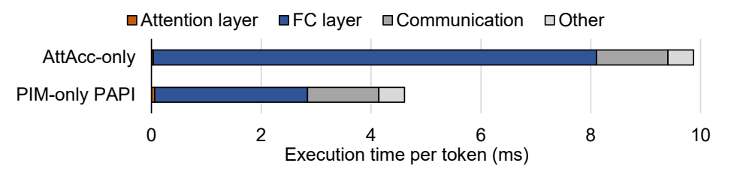
Execution Time Breakdown in LLM Decoding
LLM decoding in pure PIM system:
Attention kernels: 0.3~1% of the execution time
FC kernels dominate the total execution time
Similar within the PIM-enabled heterogeneous LLM systems
The execution time breakdown per token in the decoding stage
Of LLaMA-65B model (Initial RLP = 4, TLP=4)
It is valuable to speedup FC kernels
Notes:
in PAPI architecture, There are two types of PIM units, FC-PIM and Attention-PIM.
[CLICK] FC-PIM is design for storing and processing FC kernels. It is placed in high-performance processor.
[CLICK] And Attn-PIM is for attention kernels. It is disaggregated from the high-performance processor. So that we enables adding a large number of Attn-PIM devices that can house large memory footprints in a flexible manner.
[CLICK] The hybrid PIM units cater to memory-intensive kernels with different computational demands and memory footprints

Slide 49
The Process of Dynamic Scheduling
Assume the memory-boundedness threshold α=3 in this case
Output tokens of requests
Today
is
sunny
<eos>
It
is
a
good
work
<eos>
Have
a
nice
day
.
<eos>
How
are
you
?
<eos>
Here
is
a
cute
dog
,
look
!
<eos>
RLP | 5 | 5 | 5 | 4 | 2 | 1 | 1 | 1 | 0
TLP | 1 | 1 | 1 | 1 | 1 | 1 | 1 | 1 | 1
Estimated value | 5 | 5 | 5 | 4 | 2 | 1 | 1 | 1 | 0
Reschedule |  |  |  |  |  |  |  |  | 
RESULT | - | - | - | PU | PIM | PIM | - | - | PIM
Notes:
[CLICK] Here is a process of dynamic scheduling
[CLICK] Let’s assume that a FC kernel becomes memory bound when their arithmetic intensity is smaller than 4
[CLICK] At the beginning, the LLM decoding generates three tokens and we are monitoring the RLP and TLP. Since the parallelism levels did not change,
[CLICK] the arithmetic intensity does not change.
[CLICK] and we don’t reschedule the FC kernels and have no mapping results.
[CLICK] After the output tokens in the fourth cycles are generated, we find there is an end-of-sentence (EOS) token in the first request, which means the request is finished. At this time, the RLP becomes from five to four. The arithmetic intensity becomes 4. And we execute the reschedule. and the mapping result is PU.
[CLICK] Similar to the fourth cycle, we reschedule at the fifth cycle and find the mapping result becomes PIM this time. Since the arithmetic intensity is smaller than 4.
[CLICK] The runtime scheduling will continue until all the requests are finished to execute.

