Slide 1




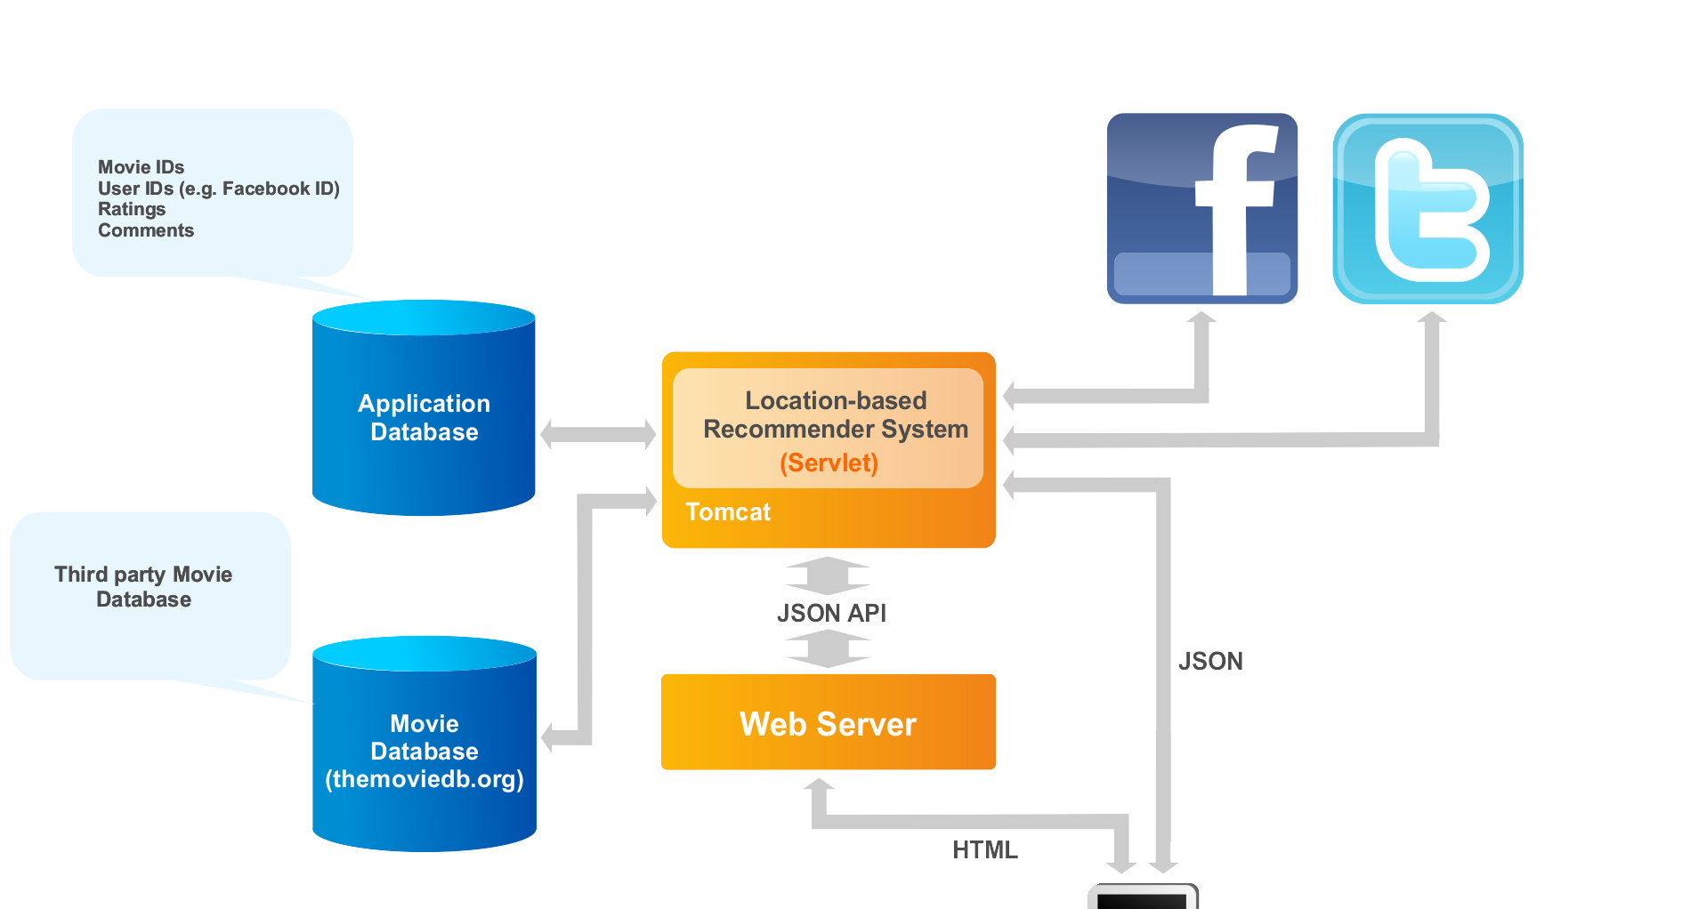
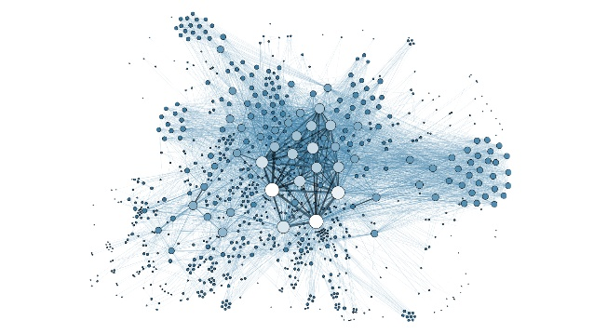


SMASH: Co-Designing Software Compression
and Hardware-Accelerated Indexing
for Efficient Sparse Matrix Operations
Konstantinos Kanellopoulos Nandita Vijaykumar Christina Giannoula
Roknoddin Azizi Skanda Koppula Nika Mansouri Ghiasi
Taha Shahroodi Juan Gomez Luna Onur Mutlu
1: Summary
2: Sparse Matrix Operations and Compression Formats
Many important workloads heavily involve Sparse Matrix Operations
Sparse Matrix Operations are widespread today
Compressed Sparse Row
Indexing overhead
Extremely sparse matrices require compression to
avoid storage and computational overheads
Recommender Systems
Graph Analytics
Neural Networks
Shortcomings of existing compression formats
expensive discovery of the positions of non-zero elements or
narrow applicability
MATRIX
CSR
SMASH: hardware/software cooperative mechanism for
efficient sparse matrix storage and computation
Software: Efficient compression scheme using
a Hierarchy of Bitmaps
Hardware: Hardware unit interprets the Bitmap Hierarchy
and accelerates indexing
5
0
0
0
row_ptr
0
1
3
4
5
Α =
0
0
3
4
col_ind
0
2
3
1
3
Limitations of Existing Compression Formats
0
8
0
0
values
3
8
3
1
General formats optimize for storage
Expensive discovery of the positions of non-zero elements
0
0
0
3
5
4
Performance improvement: 38% and 44% for SpMV and SpMM
over the widely used CSR format
SMASH is highly efficient, low-cost and widely applicable
Many instructions needed to discover
the position of a non-zero element
2
Specialized formats assume
specific matrix structures
and patterns (e.g., diagonals)
Narrow
applicability
Requires multiple data-dependent
memory accesses
3: SMASH
4: Software Compression Scheme
Hardware/Software cooperative mechanism: Explain SMASH
Enables highly-efficient sparse matrix compression and computation
General across a diverse set of sparse matrices and sparse matrix operations
Bitmap
Hierarchy of Bitmaps
Software
Hardware
Encodes the presence/absence of a non-zero element
in a block of the original matrix with a single bit
MATRIX
Compression Ratio 2:1
Efficient compression using a Hierarchy of Bitmaps
Unit that scans bitmaps to accelerate indexing
MATRIX
BITMAP
NZ
Z
Z
Z
Compression Ratio 4:1
1
1
Bitmap 2
Z
Z
Z
Z
NZ
ZEROS
ZEROS
ZEROS
1
0
0
0
Might contain high number of zero bits
Z
Z
Z
Z
1
0
0
1
Bitmap 1
ZEROS
ZEROS
ZEROS
ZEROS
0
0
0
0
Z
Z
NZ
NZ
ZEROS
ZEROS
ZEROS
ZEROS
0
0
0
0
1
0
0
0
0
0
0
0
0
0
0
0
0
0
1
1
Bitmap 0
SMASH
ISA
ZEROS
ZEROS
NZ
NZ
0
0
1
1
NZ
NZ
NZ
NON-ZERO VALUES ARRAY
5: Hardware Acceleration Unit
6: Cross-Layer Interface
7: Use Case: SpMV
Bitmap Management Unit (BMU)
Need for a cross-layer interface that enables software to control the BMU
Communicate the parameters needed to calculate the index
Query the BMU to retrieve the index of the next non-zero element
SMASH ISA
BMU
STREAM THROUGH
THE NON-ZERO BLOCKS
SMASH ISA
MATINFO
NZA
VECTOR
SRAM BUFFER 2
BMAPINFO
0
1
0
0
1
0
NZ
NZ
NZ
SRAM BUFFER 1
BITMAP
BUFFERS
RDBMAP
0
1
0
1
0
0
NZ
NZ
NZ
SRAM BUFFER 0
PBMAP
ROW
INDEX
NZ
NZ
NZ
CPU
Group 2
RDIND
0
1
0
1
0
0
NZ
NZ
NZ
SCAN
NON ZERO INDEX
Group 3
COLUMN
INDEX
Hardware Logic
UPDATE
Matrix Parameters
READ
Enables SMASH to flexibly accelerate a diverse range of operations on any sparse matrix
INDEX THE VECTOR
USING THE BMU
Matrix Parameters
Bitmap Parameters
Bitmap Parameters
8: Evaluation
Methodology
Performance Improvement using SMASH
Number of Executed Instructions
Simulator: ZSim Simulator
Workloads:
Sparse Matrix Kernels
SpMV & SpMM from TACO
Graph Applications
PageRank & Betweenness Centrality
from Ligra
Input dataset:
15 diverse sparse matrices & 4 graphs
from the Sparse Suite Collection [4]
Sparsity ranges from 0.01% to 8.79%
SMASH provides significant performance improvements over state-of-the-art formats
SMASH significantly reduces
the number of executed instructions
Sparsity sweep for SpMV
Hardware Overhead
Other Results in the Paper
SMASH configuration
Support for 4 matrices in the BMU
256 bytes / SRAM buffer
140 bytes for registers & counters
Compression ratio sensitivity analysis
Distribution of non-zero elements
Detailed results for SpMM
Conversion from CSR to SMASH overhead
Software-only approaches
0.076% area overhead over an Intel Xeon CPU
Scan for full paper
SMASH provides speedups regardless
of the sparsity of the matrix
SMASH incurs negligible area overhead

