Slide 1


SMASH
Co-Designing Software Compression
and Hardware-Accelerated Indexing
for Efficient Sparse Matrix Operations
Konstantinos Kanellopoulos, Nandita Vijaykumar, Christina Giannoula,
Roknoddin Azizi, Skanda Koppula, Nika Mansouri Ghiasi,
Taha Shahroodi, Juan Gomez Luna, Onur Mutlu
Notes:
Thanks a lot for the introduction.
SMASH Co-designing Software Compression and Hardware-Accelerated Indexing for Efficient Sparse Matrix Operations.
This paper is a collaboration between SAFARI members from ETH Zurich and Carnegie Mellon University.

Slide 2
Executive Summary
Many important workloads heavily make use of sparse matrices
Matrices are extremely sparse
Compression is essential to avoid storage/computational overheads
Shortcomings of existing compression formats
Expensive discovery of the positions of non-zero elements or
Narrow applicability
SMASH: hardware/software cooperative mechanism for efficient
sparse matrix storage and computation
Software: Efficient compression scheme using
a hierarchy of bitmaps
Hardware: Hardware unit interprets the bitmap hierarchy
and accelerates indexing
Performance improvement: 38% and 44% for SpMV and SpMM
over the widely used CSR format
SMASH is highly efficient, low-cost and widely applicable
Notes:
Let’s dive into the executive summary of our work.
Many important workloads heavily involve Sparse Matrix Operations
In these workloads the input matrices are really sparse. Compression is needed to avoid the shortcomings of storage and computation on zero elements.
Existing compression formats suffer from the following shortcomings:
1)
2)
In this work, we introduce SMASH. A hardware software cooperative mechanism that enables efficient sparse matrix compression and computation.
The key idea is to codesign software and hardware in a way to enable hardware to recognize and exploit the sparsity in data.
SMASH comprises of 2 key components.
On the software side
2) On the hardware side
….
It offers significant performance improvements of 38% and 44% on average for SpMV and SpMM.

Slide 3
Presentation Outline
1. Sparse Matrix Basics
2. Compression Formats & Shortcomings
3. SMASH
4. Evaluation
5. Conclusion
Notes:
Here is the Outline of my talk.
I am going to start by giving some background on Sparse Matrix Operations.
Then I will present our proposed mechanism and its key components.
After that, I am going to demonstrate our evaluation results and finally conclude.

Slide 4
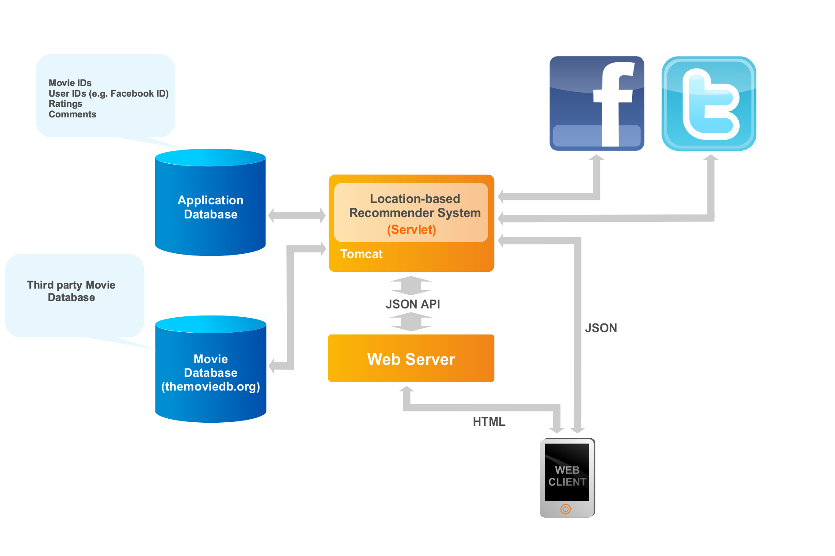
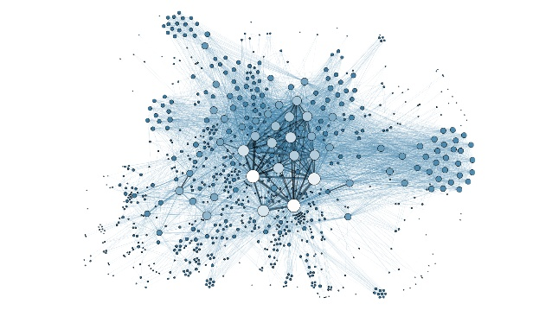

Sparse Matrix Operations are Widespread Today
Recommender Systems
Graph Analytics
Neural Networks
PageRank
Breadth First Search
Betweenness
Centrality
Sparse DNNs
Graph Neural Networks
Collaborative Filtering
Notes:
Sparse Matrix Operations are widespread today.
They are critical components of domains like Recommender Systems, Graph Analytics AS WELL AS Neural Networks

Slide 5


Real World Matrices Have High Sparsity
0.0003%
non-zero elements
2.31%
non-zero elements
Sparse matrix compression
is essential to enable
efficient storage and computation
Notes:
The matrices used in these workloads are extremele sparse.
For example, Facebook’s and Youtube’s social connectivity graphs have an extremely small amount of non-zero elements.
We conclude, Sparse matrix compression is an essential tool to enable efficient storage and computation

Slide 6
Presentation Outline
1. Sparse Matrix Basics
2. Compression Formats & Shortcomings
3. SMASH
4. Evaluation
5. Conclusion
Notes:
We will now discuss existing compression formats and their shortcomings.

Slide 7
Limitations of Existing Compression Formats
1
Expensive discovery of the positions
of non-zero elements
General formats optimize for storage
Notes:
Existing compression formats have the following shortcomings.
First, general compression formats optimize for storage and suffer from expensive discovery of the positions of non-zero elements.
Let’s dive into this class of compression formats.
Second, some specialized formats assume specific matrix structures and patterns like Diagonals. These formats are not general enough and offer narrow applicability.

Slide 8
Widely Used Format: Compressed Sparse Row
Used in multiple libraries & frameworks:
Intel MKL, TACO, Ligra, Polymer
Stores only the non-zero elements
of the sparse matrix
Provides high compression ratio
Notes:
The most widely used compression format is called Compressed Sparse Row. It is used in multiple frameworks and libraries.
CSR Stores only the non-zero elements of the sparse matrix and
that is the reason why it provides high compression ratios.

Slide 9
Basics of CSR: Indexing Overhead
MATRIX
CSR
5
0
0
0
row_ptr
0
1
3
4
5
0
0
3
4
Α =
col_ind
0
2
3
1
3
0
8
0
0
0
0
0
3
values
5
3
4
8
3
Multiple instructions are needed to discover
the position of a non-zero element
Requires multiple
data-dependent memory accesses
Notes:
Let me explain how it works and where the indexing overhead is coming from.
The CSR format uses 3 arrays to compress the sparse matrix.
The row_ptr which holds info about the number of non-zero elements/row.
The col_ind which holds column index of a non-zero element
And the values array contains the actual non-zero values of the sparse matrix
Finding out the position of this specific element requires accessing both the row_ptr array and the col_ind array to retrieve the value 3.
This process is called indexing.

Slide 10
Indexing Overhead in Sparse Kernels
Sparse Matrix Vector Multiplication (SpMV)
Indexing for every non-zero element of the sparse matrix to multiply
with the corresponding element of the vector.
Sparse Matrix Matrix Multiplication (SpMM)
Index matching for every inner product between the 2 sparse matrices.
Indexing is expensive
for major sparse matrix kernels
Notes:
Let me show you the importance of indexing in two major sparse matrix kernels.
First, SpMV needs to perform Indexing for every non-zero element of the sparse matrix to multiply
with the corresponding element of the vector.
Second, SpMM requires index matching for every inner product between the 2 sparse matrices.
Index matching is the process of matching the indices of the row and column of the 2 matrices that need to be multiplied.
As we see, Indexing can be expensive for major sparse matrix kernels

Slide 11
Performing Indexing with Zero Cost
Reducing the cost of indexing
can accelerate sparse matrix operations
Notes:
To better understand the indexing bottleneck we conducted experiments where we perform indexing with zero Cost
The processor does not execute instructions or memory accesses related to indexing.
In this figure we demonstrate the performance achieved by the ZERO-COST INDEXING scheme compared against the default CSR implementation.
We evaluated 3 workloads, Sparse Matrix Sparse Matrix Addition, SpMV and SpMM. The results are average across a set of 15 matrices.
As we observe, for all the workloads the IDEAL CSR scheme results in performance improvements, especially in SpMM where the indexing is really intensive.
It turns out, that reducing the cost of indexing can accelerate sparse matrix operations

Slide 12
Limitations of Existing Compression Formats
1
Expensive discovery of the positions
of non-zero elements
General formats optimize for storage
2
Specialized formats assume
specific matrix structures
and patterns (e.g., diagonals)
Narrow
applicability
Notes:
Coming back to the compression formats,
, some specialized formats assume specific matrix structures and patterns like Diagonals. These formats are not general enough and offer narrow applicability.

Slide 13
Our Goal
Design a sparse matrix compression mechanism that:
Minimizes the indexing overheads
Can be used across a wide range of
sparse matrices and sparse matrix operations
Enables high compression ratio
Notes:
Our goal is to design a sparse matrix compression mechanism that:
[CLICK]
1)
[CLICK]
2)
[CLICK]
3)

Slide 14
Presentation Outline
1. Sparse Matrix Basics
2. Compression Formats & Shortcomings
3. SMASH
Software Compression Scheme
Hardware Acceleration Unit
Cross-layer Interface
4. Evaluation
5. Conclusion
Notes:
To this end, we propose SMASH.

Slide 15
SMASH: Key Idea
Hardware/Software cooperative mechanism:
Enables highly-efficient sparse matrix compression and computation
General across a diverse set of sparse matrices and sparse matrix operations
Software
Hardware
Efficient compression using a Hierarchy of Bitmaps
Unit that scans bitmaps to accelerate indexing
SMASH ISA
Notes:
To address the limitations of existing compression mechanisms we propose SMASH.
SMASH is a hardware/software cooperative mechanism that enables:
1)
And is
2)
On the software side, SMASH, efficiently compresses sparse matrices using a hierarchy of bitmaps.
On the hardware side, it employs hardware unit that scans the bitmap hierarchy and quickly determine the positions of non-zero elements.
Software manipulates the functionality of the hardware unit using a set of primitives called the SMASH ISA.

Slide 16
Presentation Outline
1. Sparse Matrix Basics
2. Compression Formats & Shortcomings
3. SMASH
Software Compression Scheme
Hardware Acceleration Unit
Cross-layer Interface
4. Evaluation
5. Conclusion
Notes:
Lets dive into the software compression scheme.

Slide 17
SMASH: Software Compression Scheme
Software
Efficient compression using a Hierarchy of Bitmaps
Encodes the positions of non-zero elements
using bits to maintain low storage overhead
Notes:
The Software Compression Scheme Introduced in SMASH
Encodes the positions of non-zero elements using bits to maintain low storage overheads.

Slide 18
SMASH: Software Compression Scheme
BITMAP:
Encodes if a block of the matrix contains
any non-zero element
MATRIX
BITMAP
ZEROS
ZEROS
1
0
0
0
Might contain high number of zero bits
NZ
ZEROS
1
0
0
0
0
1
0
0
ZEROS
NZ
ZEROS
ZEROS
0
1
0
0
0
0
0
0
0
0
0
0
ZEROS
ZEROS
ZEROS
ZEROS
0
0
1
1
0
0
1
1
ZEROS
ZEROS
NZ
NZ
Idea: Apply the same encoding recursively
to compress more effectively
Notes:
The core data structure behind our compression scheme is a bitmap.
The bitmap data structure is used to encode the presence/absence of non-zero elements in regions of the original sparse matrix.
I am going to show you an example of a bitmap compressing a sparse matrix.
On the left we divide the sparse matrix into blocks.
Blocks map one-to-one with bits of the bitmaps.
The first block of the matrix is a non-zero block. This means that it contains at least one non-zero element.
The first bit of the bitmap is set to 1 in this case.
The next few blocks of the matrix are zero-blocks. This means, that they contain only zero elements.
As we observe, depending on the block size, the bitmap hierarchy might contain a high number of zero bits.
One simple idea, is to apply the same encoding recursively to compress more effectively.

Slide 19
Hierarchy of Bitmaps
Compression Ratio 2:1
Z
Zero Region
MATRIX
NZ
Non-Zero Region
1
1
Bitmap 2
NZ
Z
Z
Z
Z
Z
Z
Z
Compression Ratio 4:1
Z
Z
Z
Z
1
0
0
1
Bitmap 1
Z
Z
NZ
NZ
1
0
0
0
0
0
0
0
0
0
0
0
0
0
1
1
Bitmap 0
NZ
NZ
NZ
NON-ZERO VALUES ARRAY
Storage
Efficient
Fast
Indexing
Hardware
Friendly
Notes:
We demonstrate a simplified example of an hierarchy of bitmaps.
The original matrix contains 4 non-zero blocks.
We store these 4 blocks contiguously in memory using a data structure called NON-ZERO VALUES ARRAY.
Based on the positions of the non-zero blocks we create Bitmap-0.
Set bits represent non-zero blocks and encode their respective positions in the sparse matrix.
We recursively build the higher levels of the bitmap hierarchy. Bitmap-1 encodes a 4-bit block of Bitmap-0 and Bitmap-2 encodes a 2-bit block of Bitmap-1.
As we see the compression ratio across the levels of the bitmap hierarchy can be different. This provides an opportunity to compress matrices with different sparsity characteristics.
One advantage of the Hierarchy of Bitmaps is that it does not keep in memory the bitmap and matrix blocks that contain zero elements or bits.
As we see in this example, Bitmap 0 has 2 blocks that contain only zero bits. These blocks are not kept in memory .
Determining the positions of the non-zero elements of the matrix, requires traversing the bitmap hierarchy in a depth first search manner. You can find more details about the index calculation in the paper.
As I mentioned before, one advantage of the hierarchy of bitmaps, is that it does not store in memory the zero blocks of the sparse matrix and the bitmaps.
Due to that,
Storage efficient compression scheme that enables fast indexing (we don’t need to scanthe zero blocks)
Scanning the bitmaps requires bitwise operations which make the Hierarchy of Bitmaps amenable to hardware acceleration.

Slide 20
Presentation Outline
1. Sparse Matrix Basics
2. Compression Formats & Shortcomings
3. SMASH
Software Compression Scheme
Hardware Acceleration Unit
Cross-layer Interface
4. Evaluation
5. Conclusion
Notes:
I am now going to present the hardware acceleration unit of SMASH

Slide 21
SMASH: Hardware Acceleration Unit
Hardware
Unit that scans bitmaps to accelerate indexing
Interprets the Bitmap Hierarchy used in software
Buffers the Bitmap Hierarchy
and scans it using bitwise operations
Notes:
SMASH employs a hardware unit that scans the Bitmap Hierarchy to perform indexing and quickly determine the positions of non-zero elements.
1) Interprets…
2) Buffers and scans it using bitwise operations

Slide 22
Bitmap Management Unit (BMU)
SMASH ISA
SRAM BUFFER 2
BITMAP
BUFFERS
SRAM BUFFER 1
CPU
SRAM BUFFER 0
SCAN
Group 3
NON ZERO INDEX
Group 2
Hardware Logic
UPDATE
READ
Matrix Parameters
BMU
Bitmap Parameters
Notes:
The hardware unit used in SMASH Is called Bitmap Management Unit.
THE CPU QUIERIES THE BMU TO determine the positions of the non-zero elements.
THE BMU consists of 4 key components.
SRAM BUFFERS HOLDING THE BITMAPS
PROGRAMMABLE REGISTERS THAT HOLD PARAMETERS OF THE MATRIX AND THE BITMAP HIERARCHY
REGISTERS THAT HOLD THE ROW AND COLUMN INDEX OF THE CURRENT NON-ZERO BLOCK
AND THE HARDWARE LOGIC THAT SCANS THE BUFFERS, READS THE PARAMETEERS AND UPDATES THE ROW AND COLUMN INDICES.
TO ENABLE INDEXING MULTIPLE MATRICES, THE BMU CONTAINS MULTIPLE GROUPS OF THESE COMPONENTS.

Slide 23
Presentation Outline
1. Sparse Matrix Basics
2. Compression Formats & Shortcomings
3. SMASH
Software Compression Scheme
Hardware Acceleration Unit
Cross-Layer Interface
4. Evaluation
5. Conclusion

Slide 24
SMASH: Cross-Layer Interface
Need for a cross-layer interface that enables software to control the BMU
Communicate the parameters needed to calculate the index
Query the BMU to retrieve the index of the next non-zero element
SMASH ISA
MATINFO
BMAPINFO
RDBMAP
PBMAP
RDIND
Enables SMASH to flexibly accelerate
a diverse range of operations
on any sparse matrix

Slide 25
Presentation Outline
1. Sparse Matrix Basics
2. Compression Formats & Shortcomings
3. SMASH
Software Compression Scheme
Hardware Acceleration Unit
Cross-Layer Interface
4. Evaluation
5. Conclusion

Slide 26
Methodology
Simulator: ZSim Simulator [1]
Workloads:
Sparse Matrix Kernels
SpMV & SpMM from TACO [2]
Graph Applications
PageRank & Betweenness Centrality from Ligra [3]
Input datasets:
15 diverse sparse matrices & 4 graphs
from the Sparse Suite Collection [4]
[1] Sanchez et al. “ZSim: Fast and Accurate Microarchitectural Simulation of Thousand-Core Systems” ISCA‘13
[2] Kjolstad et al. “ taco: A Tool to Generate Tensor Algebra Kernels“ ASE’17
[3] Shun et al. “Ligra: A Lightweight Graph Processing Framework for Shared Memory” PPoPP’13
[4] Davis et al. “The University of Florida Sparse Matrix Collection” TOMS’11

Slide 27
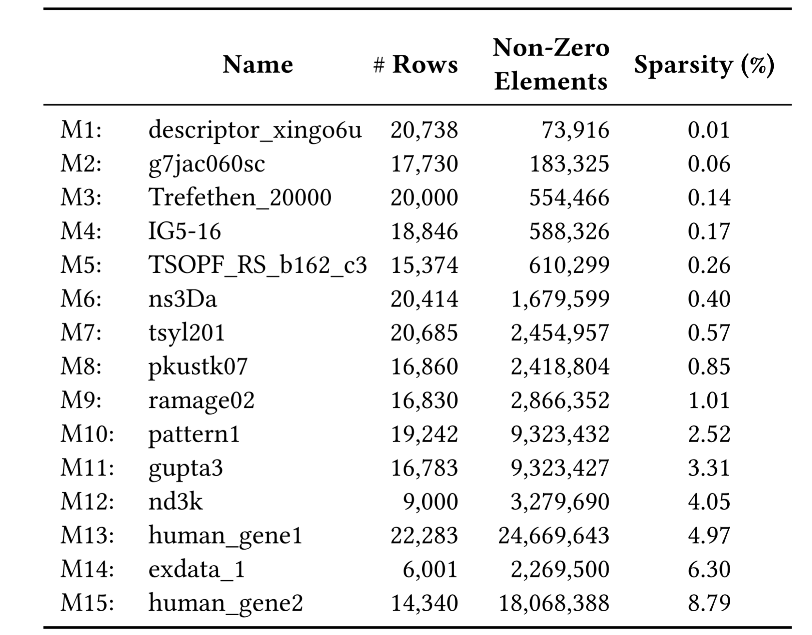
Evaluated Sparse Matrices
Notes:
In our evaluation we examined 15 matrices with sparsity ranging from 0.01% to 8.79%

Slide 28
Performance Improvement Using SMASH
SMASH provides significant performance improvements over state-of-the-art formats
Notes:
In this figure we demonstrate the speedup of SMASH and TACO-BCSR over TACO-CSR In the x axis we see 4 different workloads.
SpMV,SpMM, PageRank and BC.
As we observe, SMASH provides significant performance improvements over state-of-the-art format, up to 44%.

Slide 29
Number of Executed Instructions
SMASH significantly reduces
the number of executed instructions
Notes:
In this figure we demonstrate the number of executed instructions of SMASH and TACO-BCSR over TACO-CSR.
As we observe, SMASH results in significant reduction in the number of executed instructions.

Slide 30
Sparsity Sweep for SpMV
SMASH provides speedups regardless
of the sparsity of the matrix
Notes:
In this experiment we sweeped through matrices with ascending order based on their sparsity.
As we observe in this case, for this set of 15 matrices, SMASH provides speedups regardless of the density of the matrix.

Slide 31
Hardware Area Overhead
SMASH configuration
Support for 4 matrices in the BMU
256 bytes / SRAM buffer
140 bytes for registers & counters
0.076% area overhead over an Intel Xeon CPU
SMASH incurs negligible area overhead
Notes:
We also calculated the hardware area overhead of SMASH.
In our SMASH Configuration, we…
1)
2)
3)
SMASH incurs 0.076% area overhead over an Intel Xeon CPU, which is negligible.

Slide 32
Other Results in the Paper
Compression ratio sensitivity analysis
Distribution of non-zero elements
Detailed results for SpMM
Conversion from CSR to SMASH overhead
Software-only approaches executed
in a real machine
Notes:
You can find other results in our paper like:
1)
2)
..
..
..

Slide 33
Presentation Outline
1. Sparse Matrix Basics
2. Compression Formats & Shortcomings
3. SMASH
Software Compression Scheme
Hardware Acceleration Unit
Cross-layer Interface
4. Evaluation
5. Conclusion
Notes:
I will now conclude my talk.

Slide 34
Summary & Conclusion
Many important workloads heavily make use of sparse matrices
Matrices are extremely sparse
Compression is essential to avoid storage/computational overheads
Shortcomings of existing compression formats
Expensive discovery of the positions of non-zero elements or
Narrow applicability
SMASH: hardware/software cooperative mechanism for efficient
sparse matrix storage and computation
Software: Efficient compression scheme using
a hierarchy of bitmaps
Hardware: Hardware unit interprets the bitmap hierarchy
and accelerates indexing
Performance improvement: 38% and 44% for SpMV and SpMM
over the widely used CSR format
SMASH is highly efficient, low-cost and widely applicable
Notes:
Let’s dive into the executive summary of our work.
Many important workloads heavily involve Sparse Matrix Operations
In these workloads the input matrices are really sparse. Compression is needed to avoid the shortcomings of storage and computation on zero elements.
Existing compression formats suffer from the following shortcomings:
1)
2)
In this work, we introduce SMASH. A hardware software cooperative mechanism that enables efficient sparse matrix compression and computation.
The key idea is to codesign software and hardware in a way to enable hardware to recognize and exploit the sparsity in data.
SMASH comprises of 2 key components.
On the software side
2) On the hardware side
….
It offers significant performance improvements of 38% and 44% on average for SpMV and SpMM.

Slide 35
SMASH
Co-Designing Software Compression
and Hardware-Accelerated Indexing
for Efficient Sparse Matrix Operations
Konstantinos Kanellopoulos, Nandita Vijaykumar, Christina Giannoula,
Roknoddin Azizi, Skanda Koppula, Nika Mansouri Ghiasi,
Taha Shahroodi, Juan Gomez Luna, Onur Mutlu
Notes:
Thanks for attending my talk and happy to hear your questions.

Slide 36
Compression Ratio
SMALL BITMAPS VS ZERO COMPUTATION
MATRIX
MATRIX
1
A
B
Bitmap-0
1
A
B
Bitmap-0
Six 0’s
Two 0’s
NZA
NZA
A
B
A
B
Notes:
There are two major factors that impact the effectivenesss of our hierarchical bitmap compression scheme.
The first one is the compression ratio which affects computation and storage of zero elements.
This slide demostraes the impact of choosing different compression ratios for Bitmap-0
In the first case, the compression ratio is 8:1.In this case SMASH requires 2 bits to encode the whole matrix.
In the second case, the compression ratio is 4:1.In this case SMASH requires 4 bits to encode the whole matrix.
In the first case, we store a block with 6 zero elements and in the second case a block with 2 zero elemnts.
Compression ratio forms a trade off between smaller bitmaps that can be efficiently scanned and morezero elements in the NZA.

Slide 37
Sparse Matrix Matrix Multiplication with CSR
MATRIX A
MATRIX B
col_ind
row_ind
Α
Β
C
D
0
1
2
0
1
3
E
F
Α
Β
C
D
E
F
INDEX MATCHING
FOR EVERY INNER PRODUCT
Notes:
Sparse Matrix Matrix Multiplication CSR-based implementation requires even more indexing.
INDEX MATCHING FOR EVERY INNER PRODUCT.

Slide 38
CSR-based SpMV
CSR-based SpMV
VECTOR
row_ptr
0
1
3
4
5
0
1
2
col_ind
0
2
3
1
3
3
4
5
INDIRECT ACCESS TO LOAD THE VECTOR
Notes:
Sparse Matrix Vector Multiplication is a really important application used in both Graph Analytics and Sparse Neural Networks.
The CSR-based SpMV requires streaming through the row_ptr to discover the number of non-zero elements per row.
For each row we need to find the column index of each non-zero element.
The column index is required to perform the multiplication with the corresponding element of the vector. This procedure is called indexing.

Slide 39
Use Case: SpMV
STREAM THROUGH
THE NON-ZERO BLOCKS
BMU
NZA
VECTOR
0
1
0
0
1
0
NZ
NZ
NZ
0
1
0
1
0
0
NZ
NZ
NZ
ROW
INDEX
NZ
NZ
NZ
0
1
0
1
0
0
NZ
NZ
NZ
COLUMN
INDEX
Matrix Parameters
Bitmap Parameters
INDEX THE VECTOR
USING THE BMU
Notes:
In SPMV we need to iterate over each of the non-zero blocks in the NZA.
THE CPU requests the row and column index of each non-zero block from the BMU to index the input vector and the output vector.

Slide 40
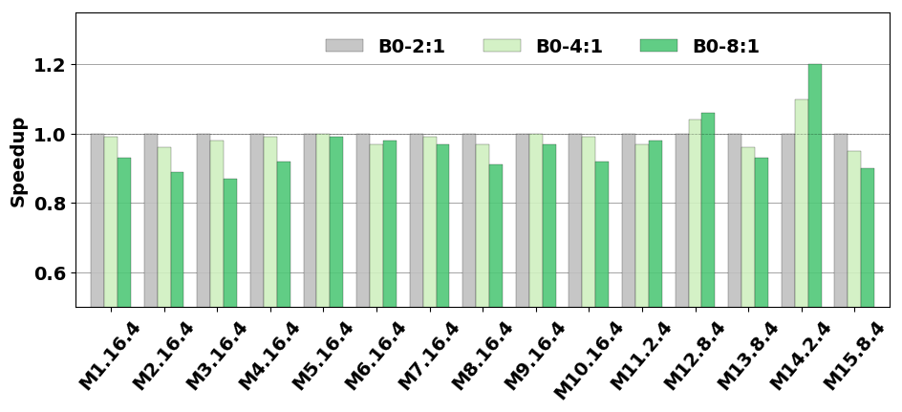
Effect of Compression Ratio

Slide 41
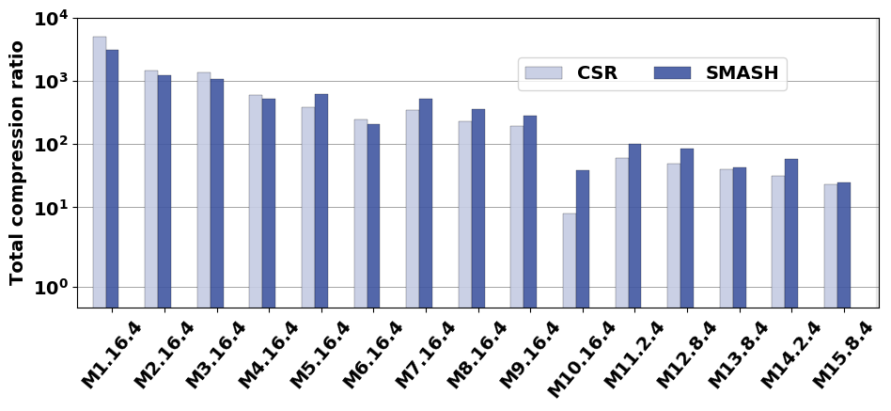
Storage Efficiency
CSR compresses
more efficiently
SMASH > CSR

Slide 42
Distribution of non-zero elements

Slide 43
Storage Efficiency
SMASH enables highly-efficient storage of sparse matrices
Notes:
We compared the storage efficiency of SMASH against CSR. SMASH is able to compress efficiently most of the matrices in our dataset.

