Slide 1


Session V-A: Domain Specific Accelerators (Tuesday 1:30PM)
SMASH
Co-designing Software Compression
and Hardware-Accelerated Indexing
for Efficient Sparse Matrix Operations
Konstantinos Kanellopoulos, Nandita Vijaykumar, Christina Giannoula,
Roknoddin Azizi, Skanda Koppula, Nika Mansouri Ghiasi,
Taha Shahroodi, Juan Gomez Luna, Onur Mutlu
Notes:
Hi, my name is Konstantinos and I am from ETH Zurich.
I will present a brief overview of our paper that appears at MICRO 2019, entitled
SMASH Co-designing Software Compression and Hardware-Accelerated Indexing for Efficient Sparse Matrix Operations

Slide 2
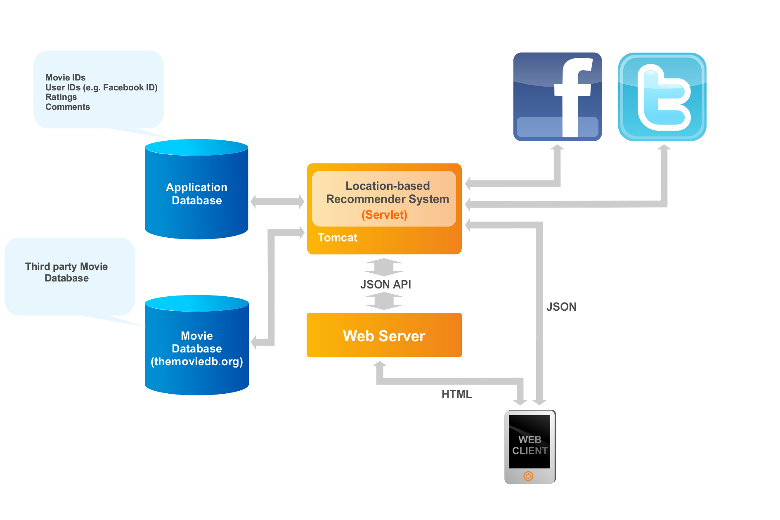

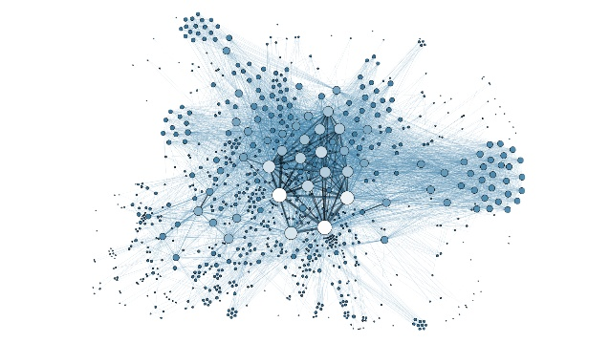
Sparse Matrix Operations are Widespread Today
Recommender Systems
Graph Analytics
Neural Networks
PageRank
Breadth-First Search
Betweenness
Centrality
Graph Neural Networks
Sparse Deep
Neural Networks
Collaborative Filtering
Sparse matrix compression
is essential to enable
efficient storage and computation
1
Notes:
Sparse matrix operations are nowadays becoming critical components of modern workloads
The matrices used in these applications are really sparse and sparse matrix compression is essential to enable efficient storage and computation.

Slide 3
Limitations of Existing Compression Formats
1
Expensive discovery of the positions
of non-zero elements
General formats optimize for storage
2
Specialized formats assume
specific matrix structures
and patterns (e.g., diagonals)
Narrow
applicability
2
Notes:
Existing compression formats have the following shortcomings.
First, general compression formats optimize for storage and suffer from expensive discovery of the positions of non-zero elements.
Second, some specialized formats assume specific matrix structures and patterns like Diagonals. These formats are not general enough and offer narrow applicability.

Slide 4
SMASH
Hardware/Software cooperative mechanism:
Enables highly-efficient sparse matrix compression and computation
General across a diverse set of sparse matrices and sparse matrix operations
Software
Hardware
Efficient compression using a Hierarchy of Bitmaps
Unit that scans bitmaps to accelerate indexing
SMASH ISA
3
Notes:
To address the limitations of existing compression mechanisms we propose SMASH.
SMASH is a hardware/software cooperative mechanism that enables:
1)
And is
2)
On the software side, SMASH, efficiently compresses sparse matrices using a hierarchy of bitmaps.
On the hardware side, it employs hardware unit that scans the bitmap hierarchy and quickly determine the positions of non-zero elements.
Software manipulates the functionality of the hardware unit using a set of primitives called the SMASH ISA.

Slide 5
Key Results
SMASH
38% and 44% speedup
for SpMV and SpMM
Hardware Overhead
0.076% area overhead over an
Intel Xeon CPU
4
Notes:
SMASH provides performance improvements for various sparse matrix kernels.
SMASH also incurs negligible hardware area overhead compared to a modern CPU.

Slide 6
Session V-A: Domain Specific Accelerators (Tuesday 1:30PM)
SMASH
Co-designing Software Compression
and Hardware-Accelerated Indexing
for Efficient Sparse Matrix Operations
Konstantinos Kanellopoulos, Nandita Vijaykumar, Christina Giannoula,
Roknoddin Azizi, Skanda Koppula, Nika Mansouri Ghiasi,
Taha Shahroodi, Juan Gomez Luna, Onur Mutlu
Notes:
Please attend my talk on Tuesday at 1.30 pm if you would like to learn more or ask questions. Thank you.

