Slide 1


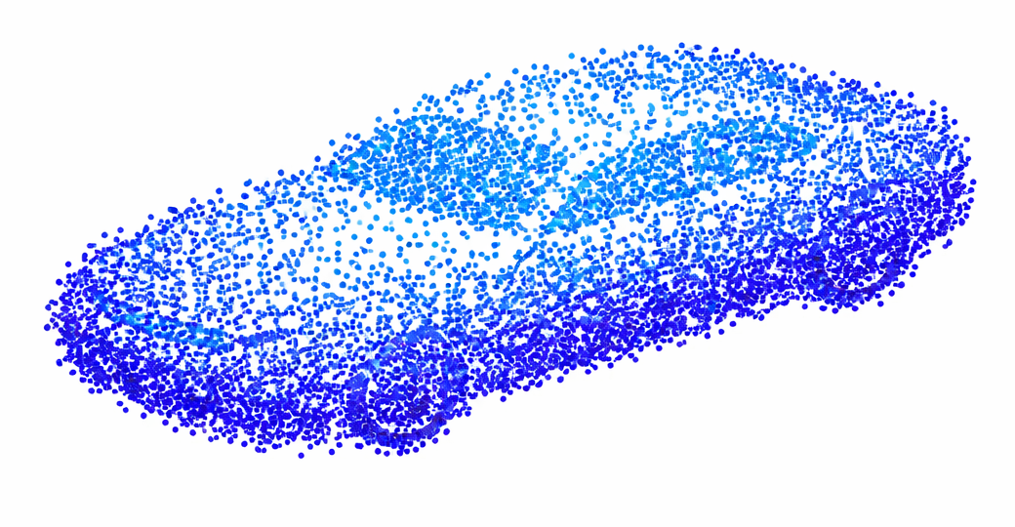
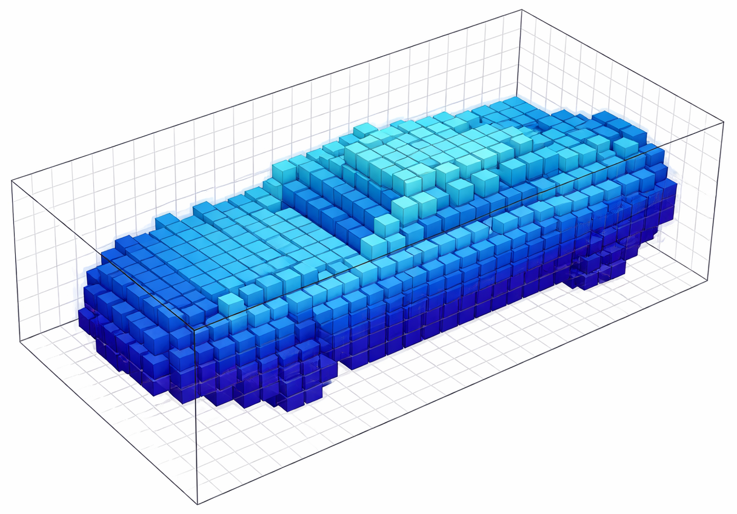






Spira: Exploiting Voxel Data Structural Properties for Efficient Sparse Convolution in Point Cloud Networks
Dionysios Adamopoulos ^{1,2} Anastasia Poulopoulou ² Georgios Goumas ² Christina Giannoula ¹
¹ Max Planck Institute for Software Systems ² National Technical University of Athens
GitHub
Paper
1. Summary
2. Background on Voxel Data
3. Background on Sparse Convolution
Sparse Convolution (SpC) is a key operator in point cloud networks used in autonomous driving, robotics, and AR/VR.
SpC operates on voxel data that have inherent structural properties; however, existing works do not exploit them.
Spira is the first SpC engine that intelligently leverages structural properties of voxel data, unlocking significant performance gains.
Spira improves inference performance by 1.68x on average across six GPU architectures.
3D grid-aligned cubes
(voxels)
Sparse Convolution (SpC) preserves the sparsity pattern of the input in the output.
SpC computes the output features in 2 steps:
1. Mapping Step: Creates the mappings between the input, weight offsets and output
non-zero voxels and stores them in a Kernel Map
transformed
Weight Offset
+
=
offs(W₀) offs(W₁) offs(W₂) …
offs(W₀)
Q₄
P?
found!
Q₀
3D Point Clouds
1. Mapping
=
Weight Offset
+
(Generated) Queries
offs(W₀)
Q₄
P₃
stored
Q₁
invalid entry
(no mapping)
Voxelized Point Cloud
(voxel data)
P₃
offs(W₀)
Q₄
Search
Mappings
Q₂
guides
Q₃
non-zero voxel at (x, y, z) location
2. Feature computation
x
W₀
=
P₀
P₁
P₂
P₃
P₄
…
Q₄
…
Kernel Map
valid entry
(mapping found)
F_{P}: Features
F_{Q}: Features
P: Sorted Input Coord.
Mappings
2. Feature Computation Step: There are two different execution dataflows to process the kernel map and produce the output features:
Q₀
Q₀
Q₁
P₀
Q₁
Q₀
Q₁
zero voxel at (x, y, z)
location
P₁
W₀
W₁
W₂
Q₂
Q₂
Q₂
P₂
W₃
W₄
W₅
Q₃
P₃
Q₃
Q₃
Feature
(A) Output-Stationary: performs better when the kernel map has large #valid entries
(B) Weight-Stationary: performs better when the kernel map has small #valid entries
Q₄
Q₄
W₆
W₇
W₈
Q₄
highly sparse
(usually less than 1%)
P₅
P₆
P₄
W: Weights
Q₅
Q₆
voxel data
P: Input Non-Zero Coord.
Q: Output Non-Zero Coord.
4. Motivation: Voxel Data Properties
5. Spira Design
We identify three important properties on real-world
voxel data:
Voxel coordinates are integer-valued.
Voxel coordinates are spatially constrained due to technological sensor limits.
Neighboring voxel coordinates
of the same object surface are likely to exist in small
offset displacements.
One-Shot Z-Delta Search in Mapping
We leverage the
Key Observation I: Consecutive weight offsets in the z-axis produce consecutive queries.
Key Observation II: Consecutive queries can only be found in consecutive elements in the sorted input coordinate array.
Spira executes the first query via a binary search and resolves the remaining consecutive queries via a localized linear search.
Packed-Native Mapping Step
We leverage the
Key Observation III: Voxel coordinates require less bits in the x-, y-, z- axis.
Spira packs all coordinates into a single integer number.
We pack only once at the network start; perform mapping steps as packed-native.
Adaptive Hybrid Dataflow Execution
We leverage the
Key Observation IV: Kernel map columns of weight offsets that are associated with smaller offset displacements have larger #valid entries.
Different weight offsets in kernel map can be processed with either output- or weight-stationary dataflow execution.
The configuration is tunable, allowing a best-fit execution.
Network-Wide Mapping
Key Observation V: Mapping steps have no true dependencies neither with feature computation steps nor between them.
Spira executes all mapping steps concurrently at network start and significantly improves GPU SM utilization.
Integer Property
Integer Property
Integer Property
+
Bounded Property
Neighboring Property
Bounded Property
Neighboring Property
SpC layer 1
Prior Works
SpC layer 2
Mapping
Feature Computation
Batch
Normalization
ReLU
Activation
Mapping
Feature Computation
Batch
Normalization
small offset: same
object surface
Output Coordinate
Consecutive Weight Offsets
Generated Consecutive Queries
Prior Works
Kernel Map
…
Q₄
(50,4,6)
offs(W₀) = (0,0,-1)
(50,4,5) = P?
three coordinates
sequential execution of mapping steps
large offset: no same
object surface
+
offs(W₁) = (0,0,0)
(50,4,6) = P?
X
Y
Z
output-stationary exec.
weight-stationary exec.
offs(W₂) = (0,0,1)
(50,4,7) = P?
32 bits
32 bits
32 bits
#valid entries $↑$
#valid entries $↓$
Spira
identical x, y values +
consecutive z values
Binary
search
Spira
Mapping
Feature Computation
Batch
Normalization
ReLU
Activation
Feature Computation
Batch
Normalization
performance gain
Linear
search
one packed coordinate
memory footprint and
computation cost gain
Mapping
P₀
P₁
P₂
P₃
P₄
P₅
P₆
X | Y | Z
concurrent execution of mapping steps
Existing SpC engines [e.g., TorchSparse++’23, Minuet’24]
do not leverage voxel data properties
P₀
P₁
P₂
P₃
P₄
…
(50,2,3)
(50,3,9)
(50,4,1)
(50,4,5)
(50,4,6)
(50,4,7)
(50,5,3)
32 bits
tunable configuration
P: Sorted Input Coord.
Consecutive elements in the
sorted input coordinates
6. Methodology
7. Evaluation
3x Point Cloud Networks: ResNet, Large ResNet, UNet
3x Point Cloud Datasets: Waymo, SemanticKITTI, ScanNet
6x GPUs:
- A100, H100: datacenter
- Quadro RTX 5000: workstation
- GTX 1060, RTX 3090: consumer
- Jetson Orin AGX: edge GPU platform
Comparison Points
- TorchSparse++ [Tang et al., MICRO’23]
- Minuet [Yang et al., EuroSys’24]
Averaged inference performance across 3 networks and 3 datasets
Performance benefits of Spira’s key ideas in UNet
Officially artifact evaluated as available, functional and reproducible.
datacenter
workstation
consumer
edge GPU platform
Speedup
Spira significantly outperforms existing works by 1.68× averaged across six GPUs
Largest performance gain comes from Spira’s Z-Delta search algorithm (1.18× over TorchSparse++)

